Slide 1

Reticulate RStudio and your R code with Python!
TIFFANY TIMBERS, PH.D.

Slide 2
Outline
Choosing the "best" software tool or language for the job
Set-up {reticulate} after installing miniconda
How to use the Python repl in RStudio
How to create, edit and run Python scripts in RStudio
Weaving Python into R Markdown

Slide 3
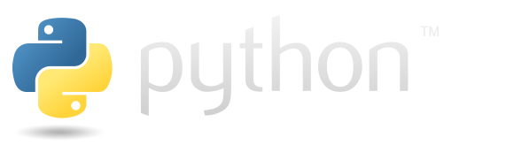


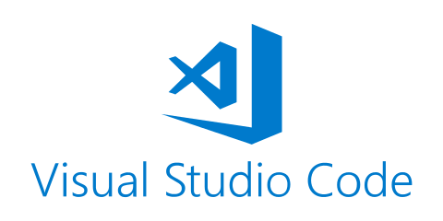


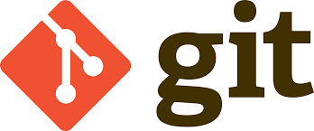
The data science software stack
Type of tools needed:
Programming language
Code editor
Version control software
Examples:

Slide 4
Choosing the "best" tool for the job
As long as the tools allow you to meet the following criteria for your analysis,
they will be suitable for data science:
Reproducible and auditable
Accurate
Collaborative
Parker, H. (2017), Opinionated Analysis Development. PeerJ, doi: 10.7287/peerj.preprints.3210v1

Slide 5
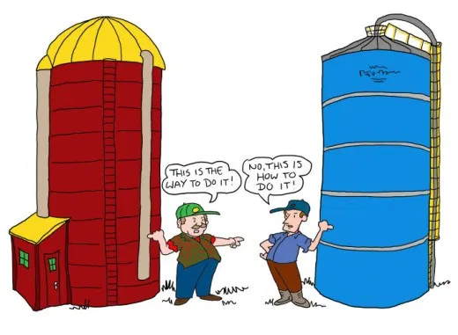
Choosing the "best" tool for the job
Source: http://thecontextofthings.com/2015/11/11/work-and-certain-skills-belonging-to-a-few-people/
Avoid the language wars... silos are worse than not choosing the "perfect" tool.

Slide 6

Choosing the "best" tool for the job
Source: https://chatsworthconsulting.com/2015/01/29/why-it-is-imperative-to-break-down-silos-now-and-five-ways-to-do-it/
Sharing of tools and workflows connect silos and leads to collaboration and success

