Slide 1
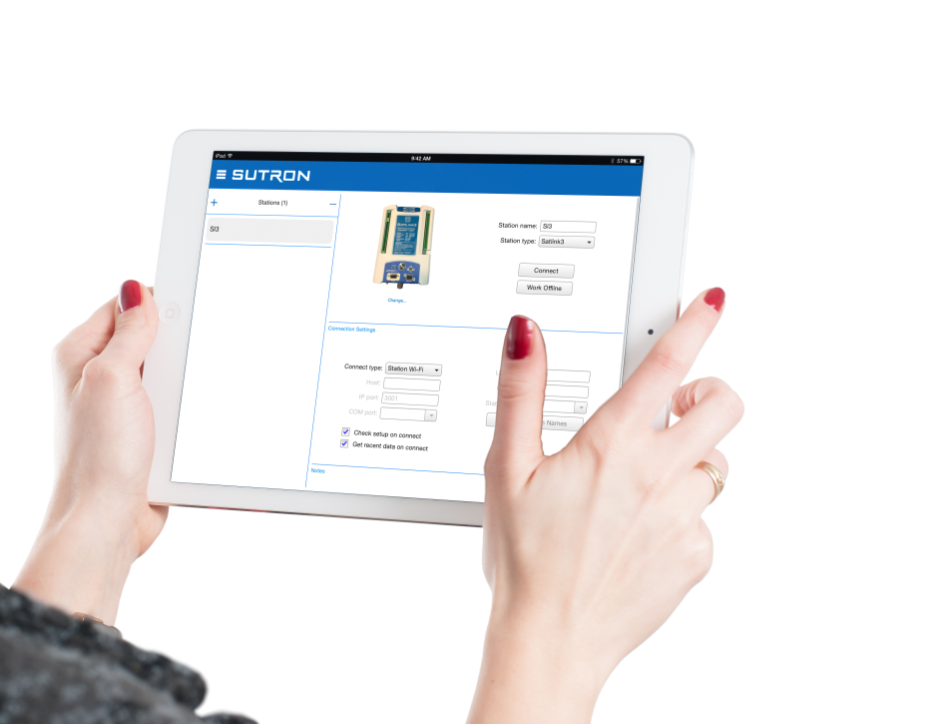
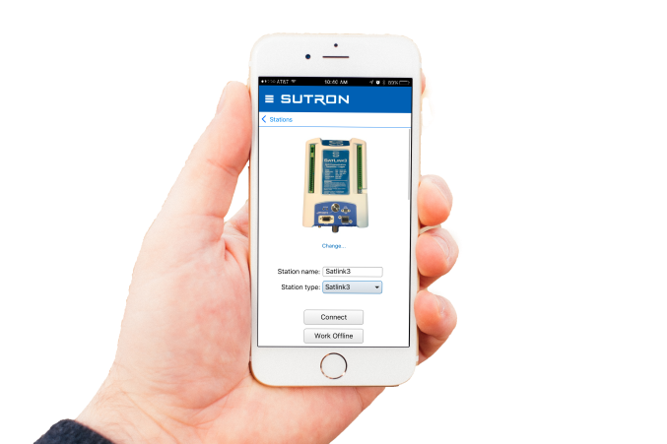
LinkComm v3 – “Common Communicator”
LinkComm can connect to SatLink 3 via WiFi to view live readings, view logged readings, view diagnostics/status, calibrate, and setup.

Slide 2
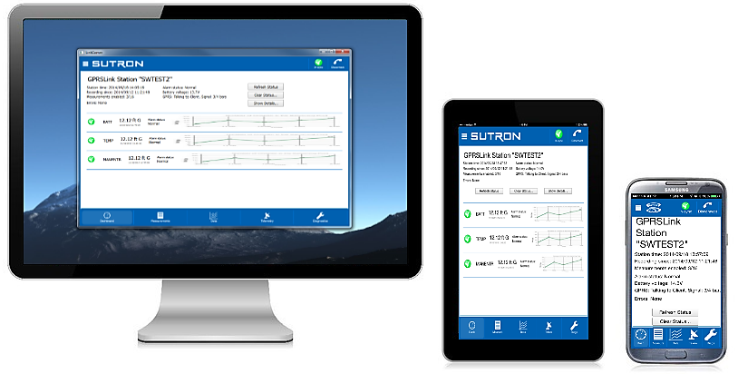
LinkComm v3 – “Common Communicator”
Multi-logger
SatLink3, Xlink, Xpert, 8310
Multi-platform
Windows, Mac, iOS, Android
Serial & TCP/IP
WiFi
Redirector
Multi-screen
Desktop, tablet, phone
Touch enabled
Enhanced experience
Graphing, pics, animations
High performance
Single source

Slide 3
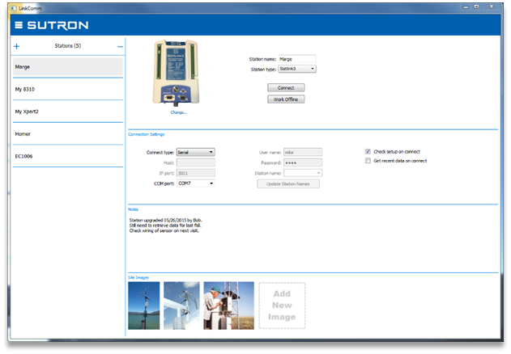
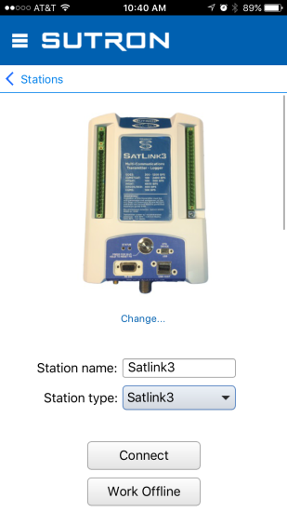
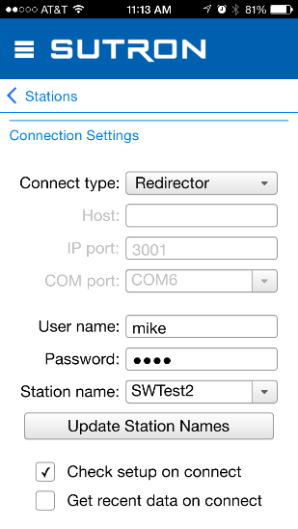
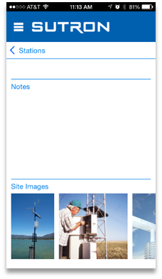
LinkComm v3 – Station Management
First screen you see
Remembers station definitions
Automatic saves
Station type
Connection Settings
Serial Port (incl. USB serial)
Station WiFi
Redirector
TCP/IP
Enhanced setup data
Site notes
Site pictures
Browse for pics, or use device camera
Scroll to see more (vertical)

Slide 4
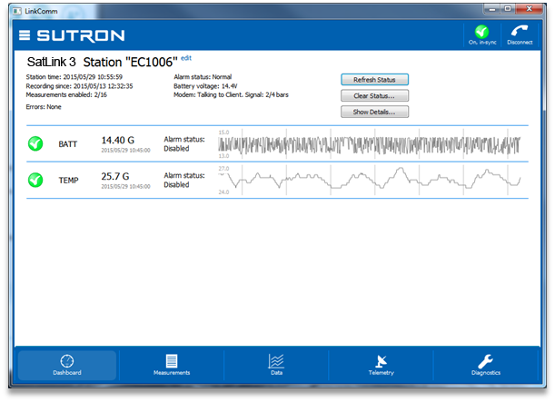



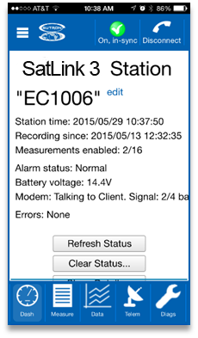
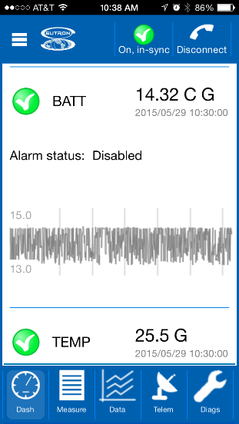
LinkComm v3 – Dashboard Tab
First screen after “Connect”
View station’s current state
Current status
Current measurement values
Graphs of recent values (1 week)
Sync button in header
Setup in sync and recording ON
Setup has changed
Recording is OFF
Connect button in header
Buttons to “Refresh Status”, “Clear Data”, and “Show Details”

Slide 5
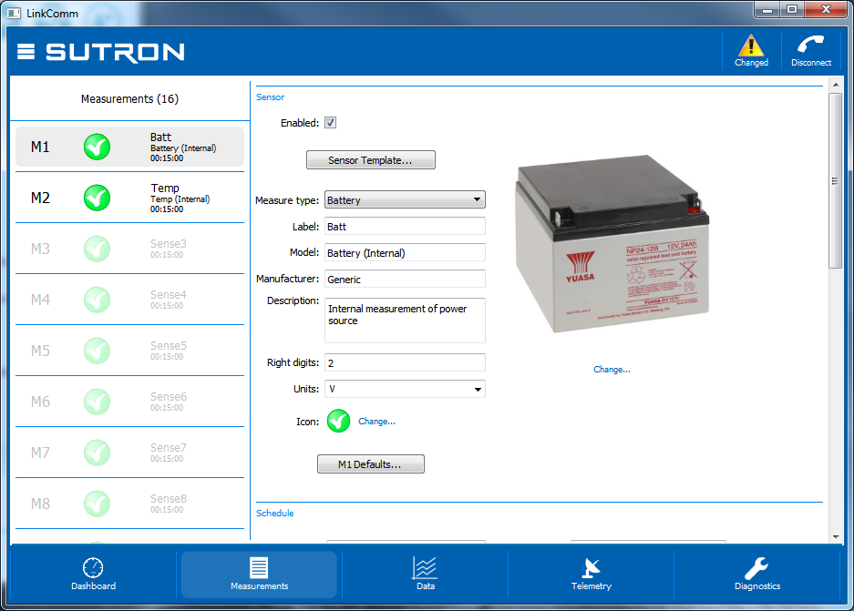
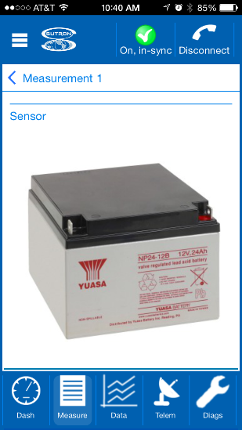
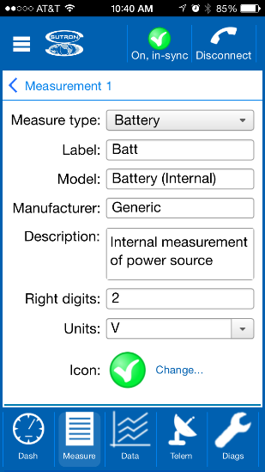
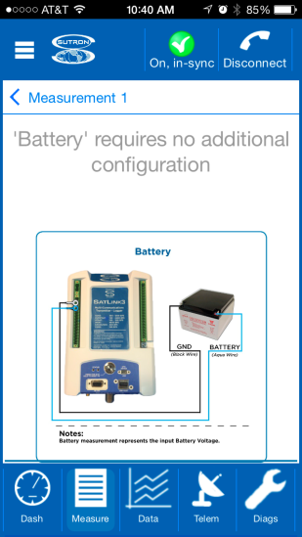
LinkComm v3 – Measurements Tab
First screen after “Work Offline”
Define configuration and meta data for each measurement
Select measurement in left pane
Sensor templates
Default configuration
Sensor image
Wiring diagram
Custom sensor image
Custom wiring diagram
Send setup after making changes!

Slide 6
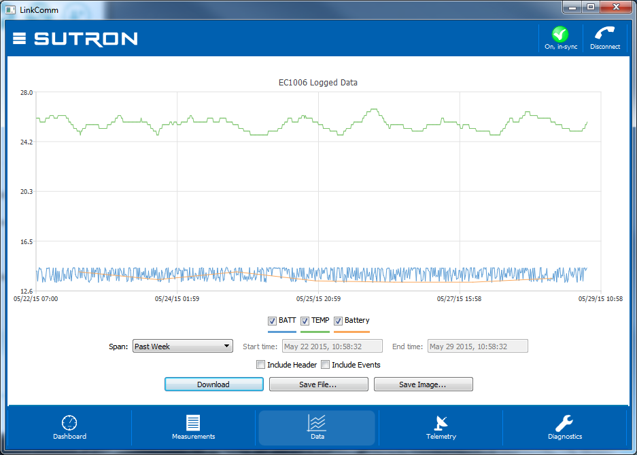
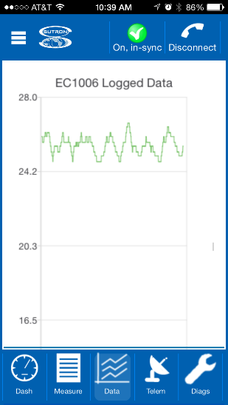
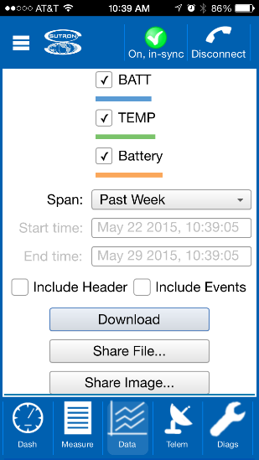
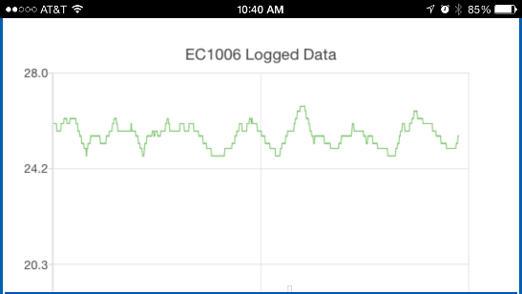
LinkComm v3 – Data Tab
Zoom-in by click-and drag
Zoom-out by double-tap/click
Check to show/hide data sets
Right-click (or touch) graph for menu options to
Select/deselect all series
Show points
Shows recent data by default
Save download to file
Save graph to file
Share to DropBox

Slide 7
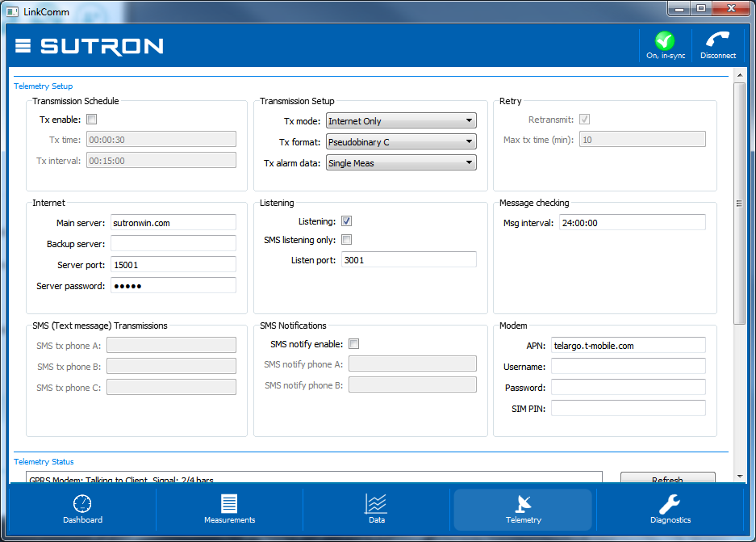
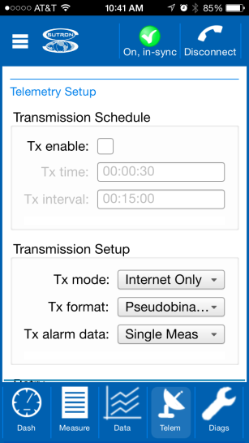
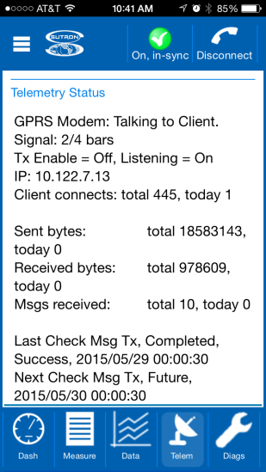
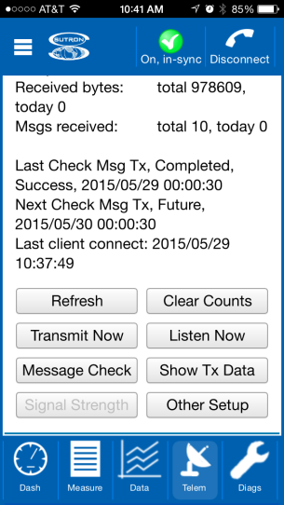
LinkComm v3 – Telemetry Tab
Telemetry Configuration
Transmission schedule and setup
Internet, Listening, SMS
Modem settings, etc.
Telemetry status
Test operations
Tx Now
Message Check
Show Tx Data
Other Setup
WiFi Settings
Modbus Settings

Slide 8
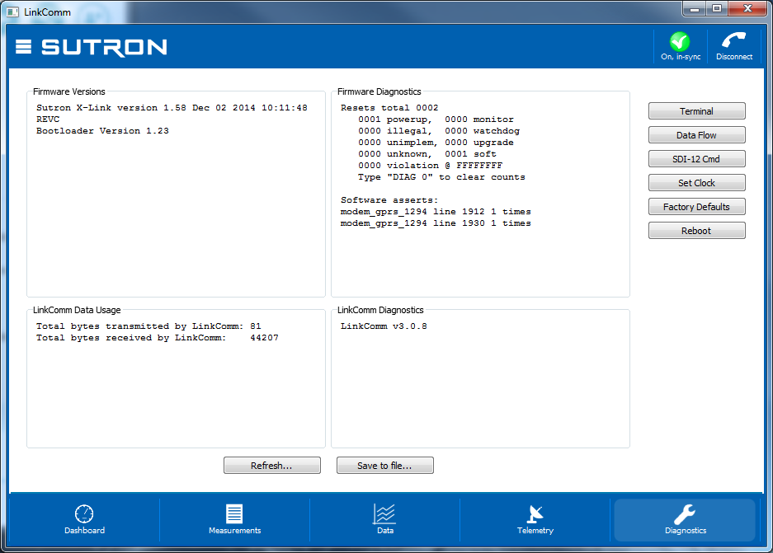
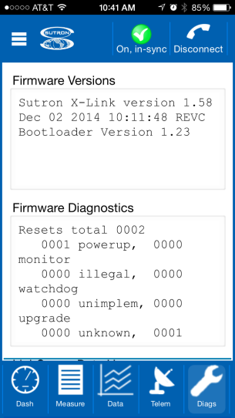
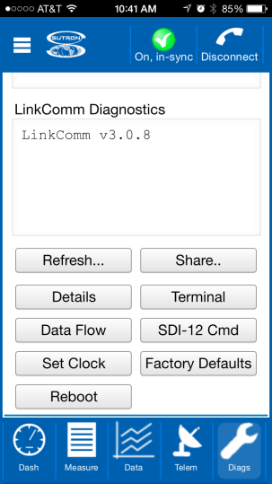
LinkComm v3 – Diagnostics Tab
Firmware Versions
Firmware Diagnostics
Recent asserts and exceptions
LinkComm data usage
LinkComm version
Options to
Save file to share with customer service
Terminal dialog (send commands)
Data Flow dialog (view data in hex)
SDI-12 dialog to send SDI-12 commands to sensors attached to station
Set Clock, Factory Defaults, Reboot

