Slide 1
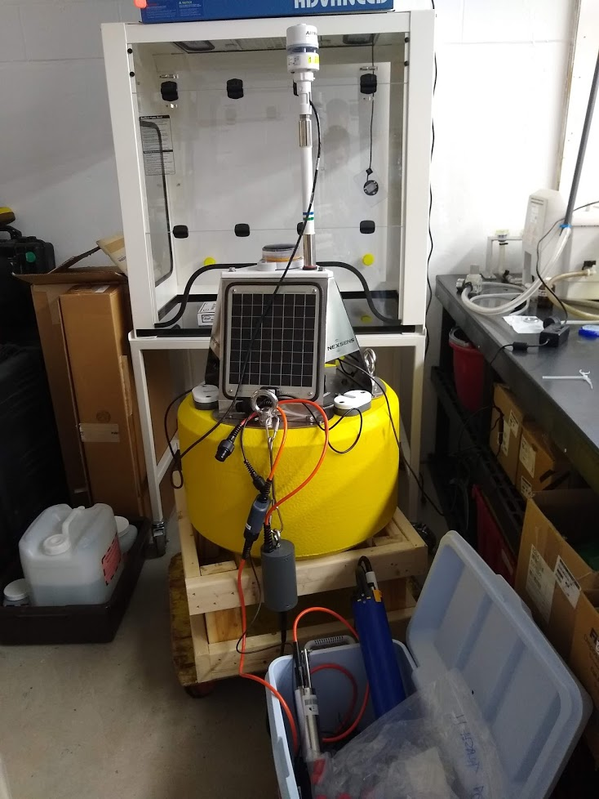
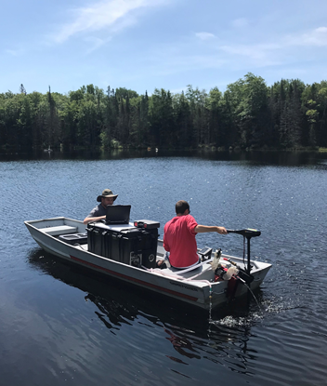
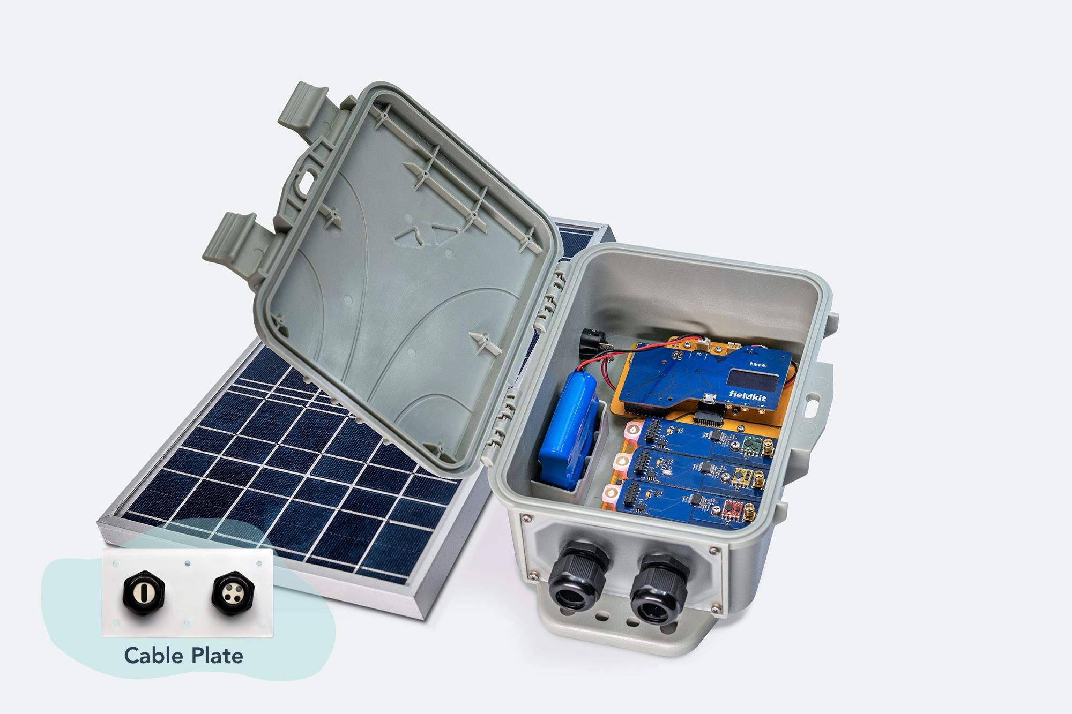
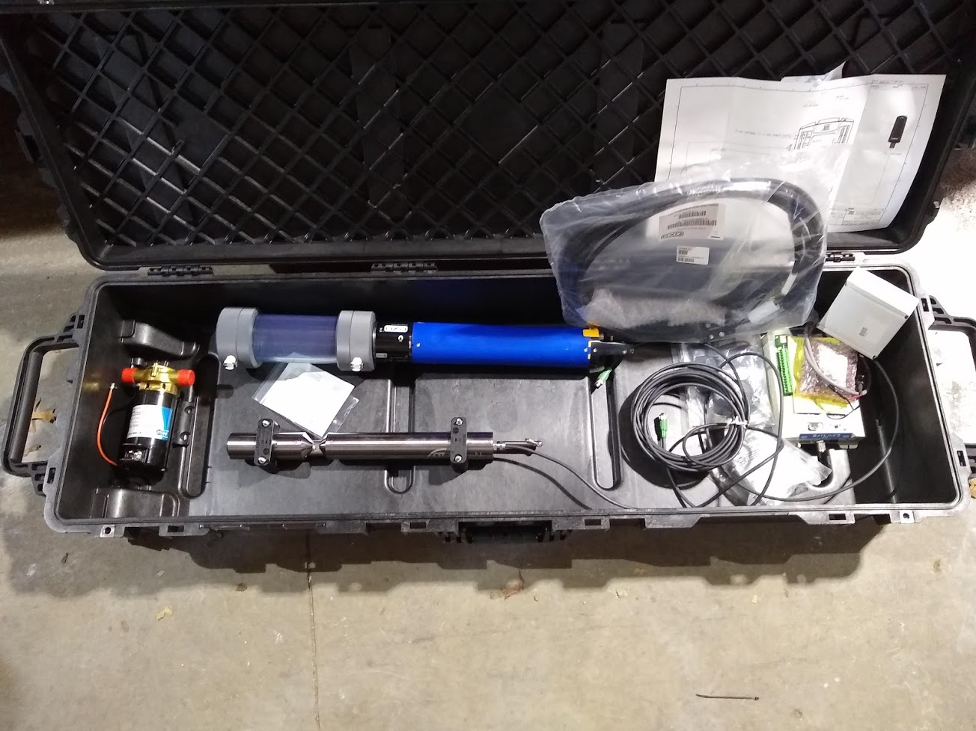
USEPA HABs Research
Work in progress!
Two ponds
Shubael Pond and Hamblin Pond
Data
DO, pH, Temp, Turbidity, Chlorophyll, Phycocyanin, Toxins …
HABS over time
Two buoys to collect every ~15 minutes
HABS across space
On-board flow through system
Sampling May(ish) through November
Two Buoys
FLAMe (https://flame.wisc.edu/)

