Slide 1
NLA_ChlaAnalysis20130820.r L:\Public\SSWR NEXUS-Concept\NPRatioManuscript\NLA_ChlaAnalysis20130820.r

Slide 2
princomp(v2012[,c('lnNTL','lnPTL'),cor=F)

Slide 3
1. We have decided to use the 2 factor PCA (TN and TP without NPratio). The reason for this is that based on the linear algebra this has all the information we need. The first PCA component will give information on the levels of nutrients and the second will give information on their ratio. In the first factor both variable load either positive or both load negative. For the second factor one loads positive and the other negative. Since we are using log transformed data lnTN/lnTP = lnTN-lnTP. So the signs are correct.
2. Using the correlation or the covariance matrix does not affect the result. The rsq and rmse are identical. Therefore we should use the covariance matrix because it involves less manipulation of the data and will therefore be easier to explain. Also, both TN and TP are of similar magnitude so it is appropriate to use the covariance matrix.
3. We will build the model with the 2012 data and test it with the 2007 data. The plots look better and the rsq is little higher this way.

Slide 4
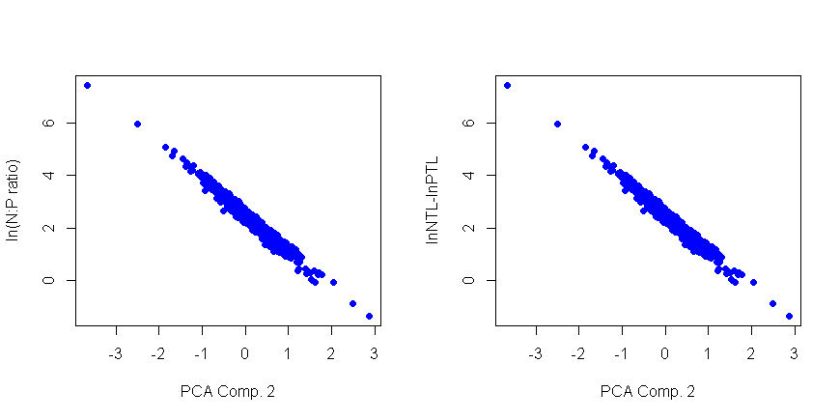
PCA2 is essentially the NPratio. Note the signs are opposite for the loadings of lnNTL and lnPTL
So this is essentially lnNTL-lnPTL or log(NPR)
Note: PCA2 inversely related to NPR-high loading on PCA2=low NPR

Slide 5
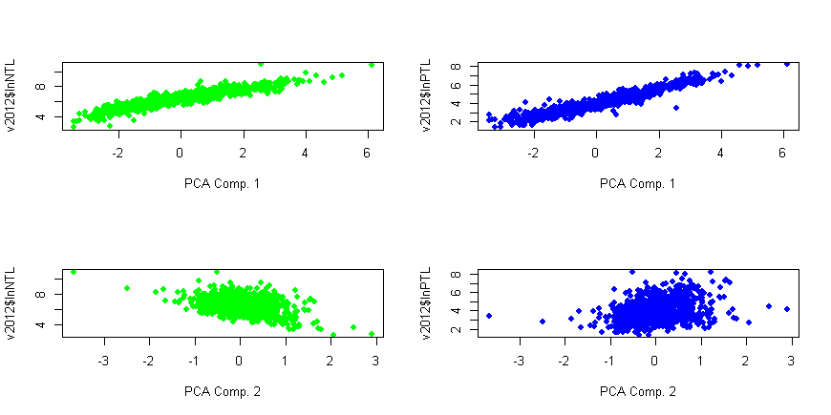
PCA1 explains 88% of the variation and is clearly associated with nutrient levels
PCA2 only explains 12% and is the NPR.
General positive relationship between PTL and PCA2 indicates that NPR decreases (PCA2 increases) with increasing PTL (as expected)
General negative relationship between NTL and PCA2 indicates that NPR increases (PCA2 decreases) with increasing NTL (as expected)

Slide 6
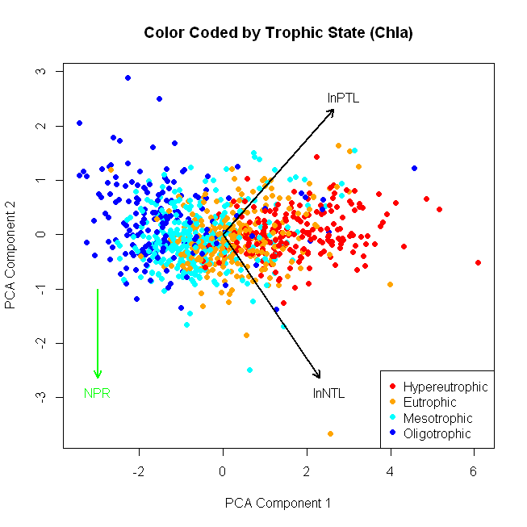

Slide 7
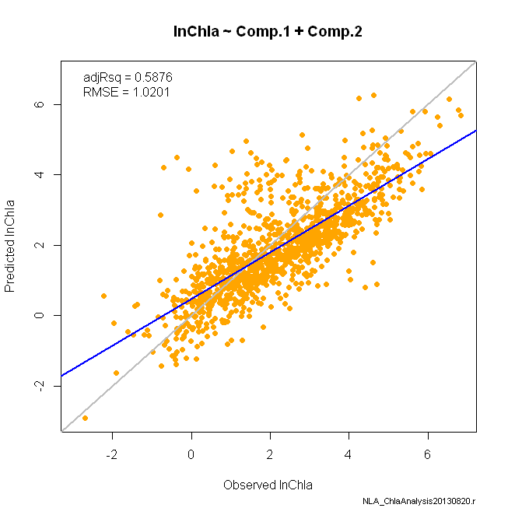

Slide 8
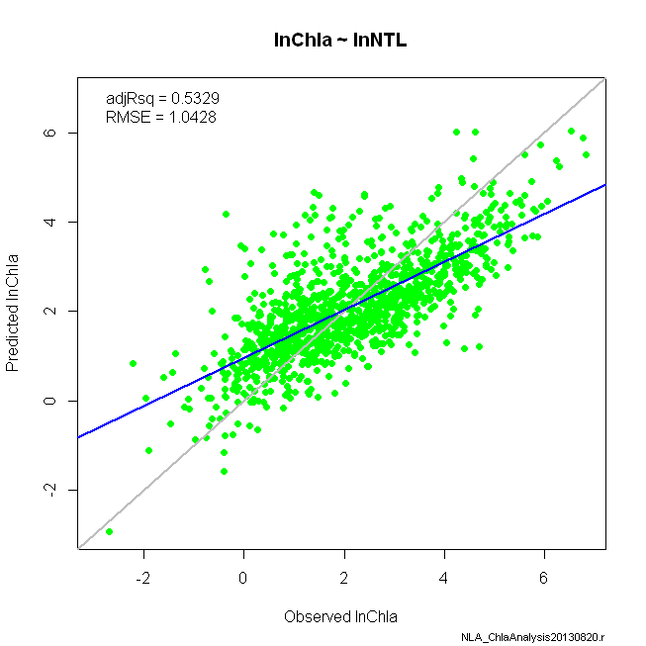

Slide 9
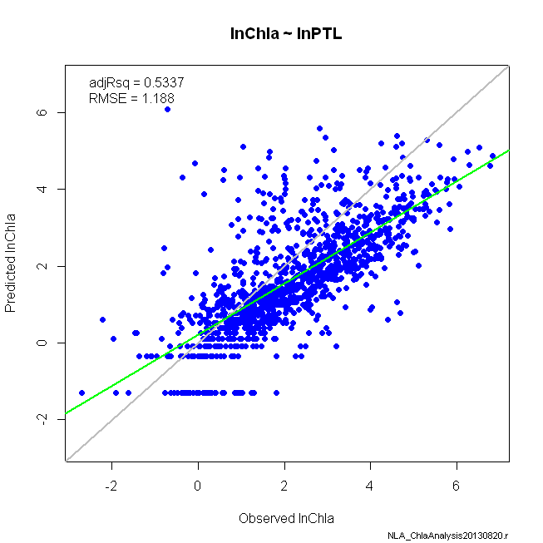

Slide 10
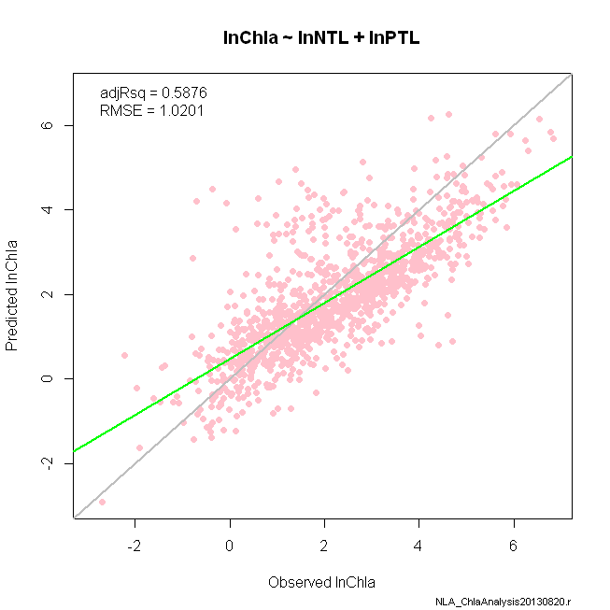

Slide 11
