Slide 1
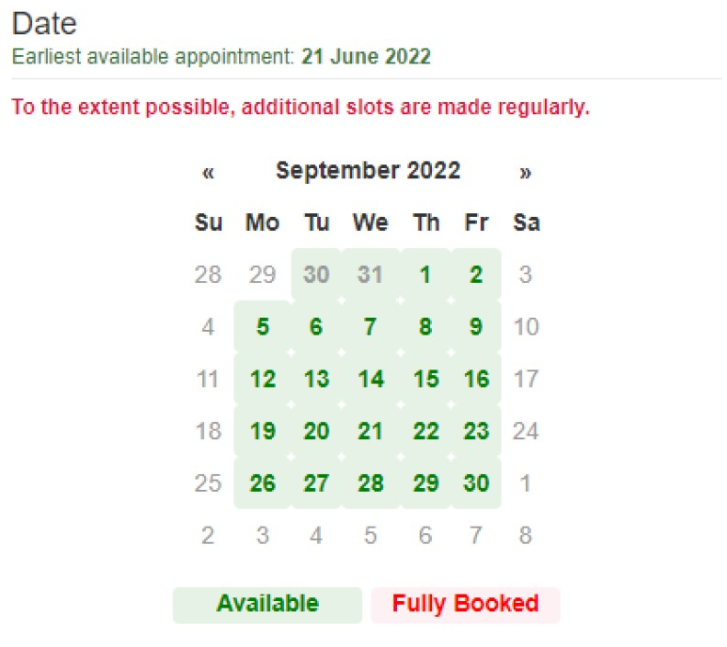
DIVISION
SECTION
FULL NAME
MIS CONTROL
Wifi disconnection
For Windows Update
Note:
Please give your user password to IS personnel only.

Slide 2
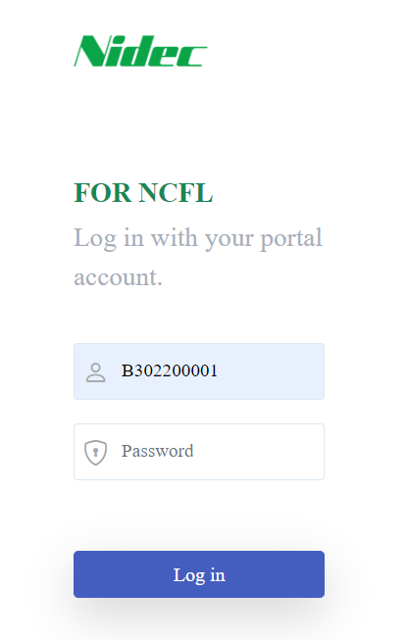

FULL NAME
DIVISION
SECTION
MIS CONTROL
Note:
Please give your user password to IS personnel only.

