Slide 1
Online Coffee Shop
Developed By : Jayesh Ahir

Slide 2
Project Contains
Project Specification
Introduction
SDLC –Spiral Module
Software Requirements
Tools & Technologies
How To Download
How To Run Project
Limitations
Bibliography
Future Enhancements

Slide 3
Project Specifications
Project Title :Online Coffee Shop System Front End Tools : Asp.net , MVC, C#, CSS, Java Script Back End Tool : SQL Server Operating System : Microsoft windows 10 Web Server : IIS Web Browser : chrome Editor : Visual studio Hardware : 64-bit processor, 1.70 GHz, 4.00 GB RAM

Slide 4
Three Panel Architacture
User Panel
Admin Panel
Main Panel

Slide 5
System Development Strategy
As per the requirement of the project, We have choose
the Spiral as a strategy of developing the project, because
in Spiral-SDLC model starts with a small set of requirement
and goes through each development phase for those set of
requirements, so the appropriate strategy is spiral model.

Slide 6
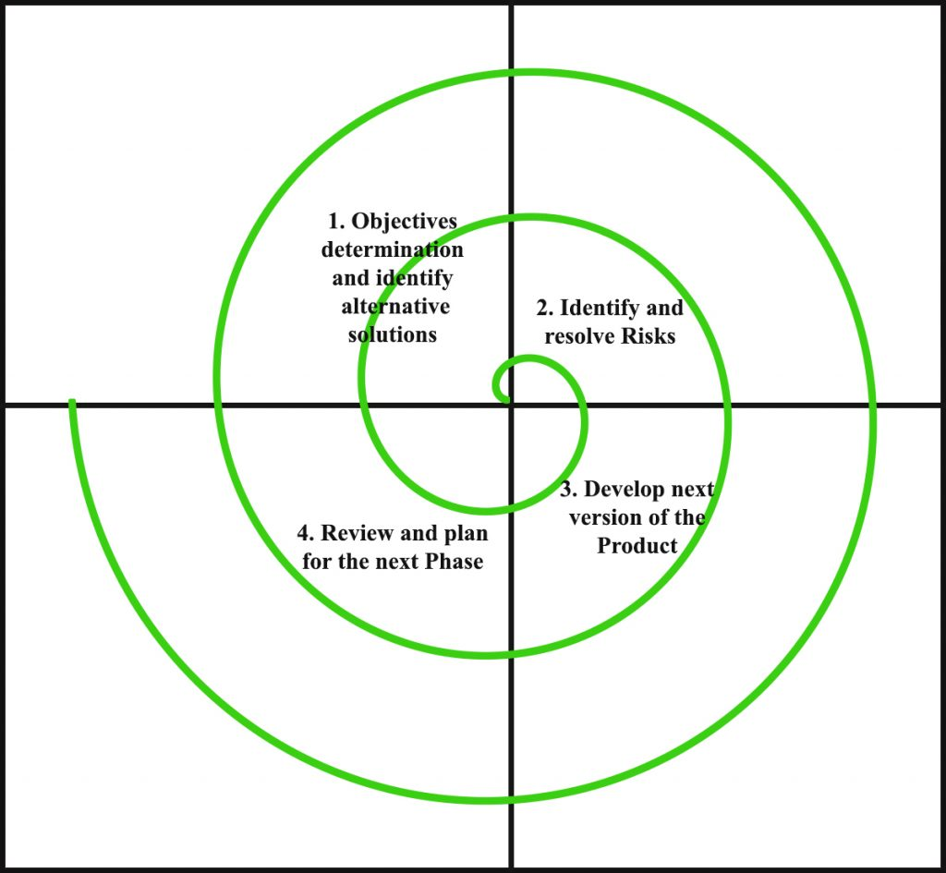
Spiral Module

Slide 7
Data Flow Diagram
A data-flow diagram (DFD) is a graphical representation of the "flow" of data through an information system. DFDs can also be used for the visualization of data processing (structured design).
On a DFD, data items flow from an external data source or an internal data store to an internal data store or an external data sink, via an internal process.

Slide 8
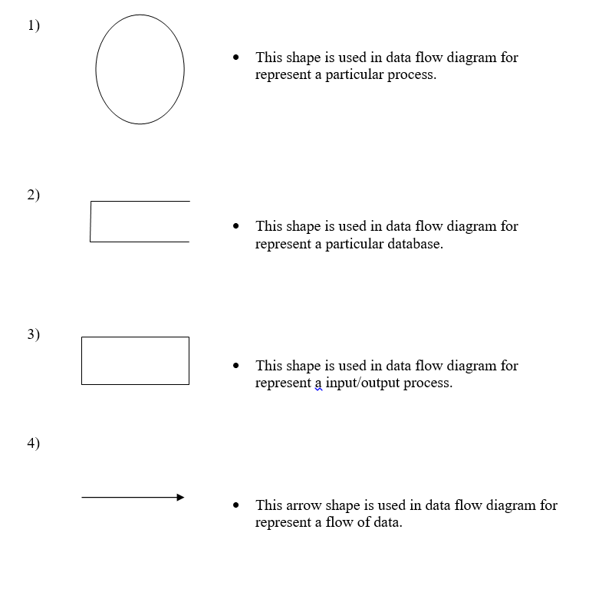

Slide 9
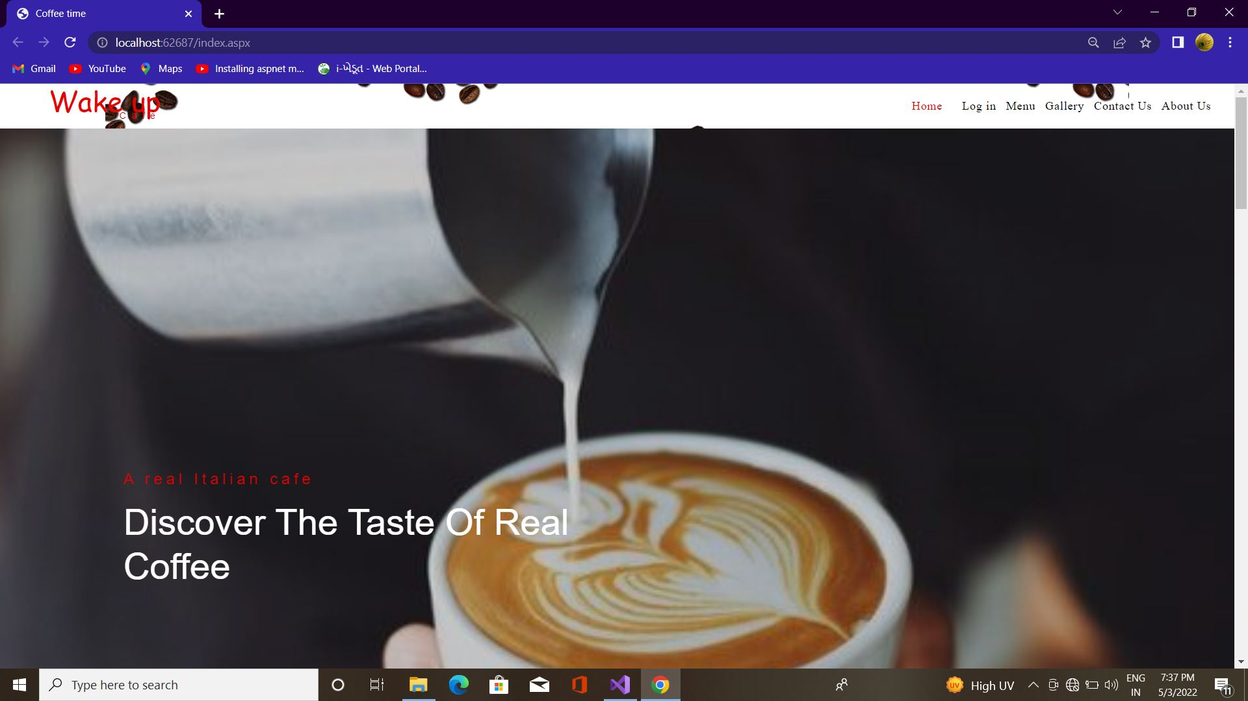
User : Home :

Slide 10
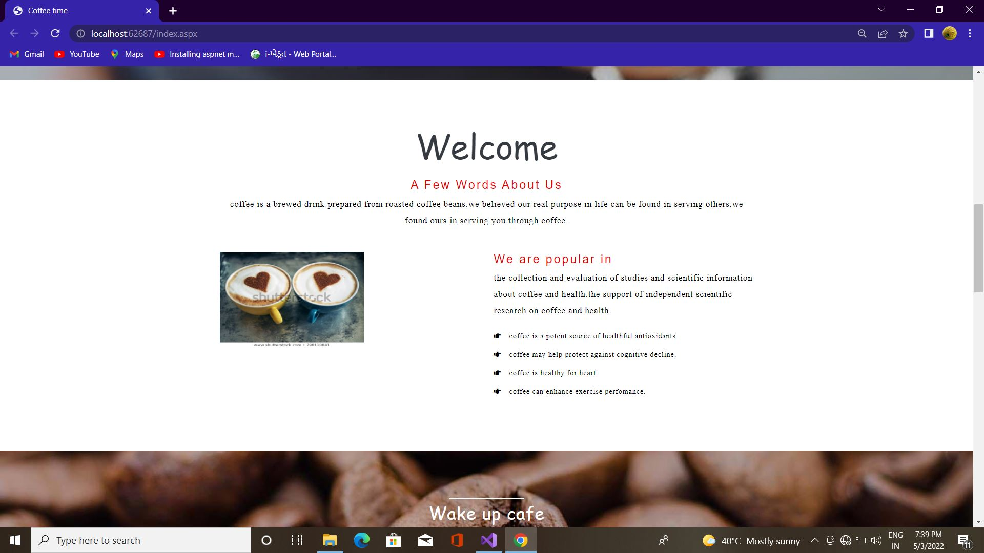
User : Welcome :

Slide 11
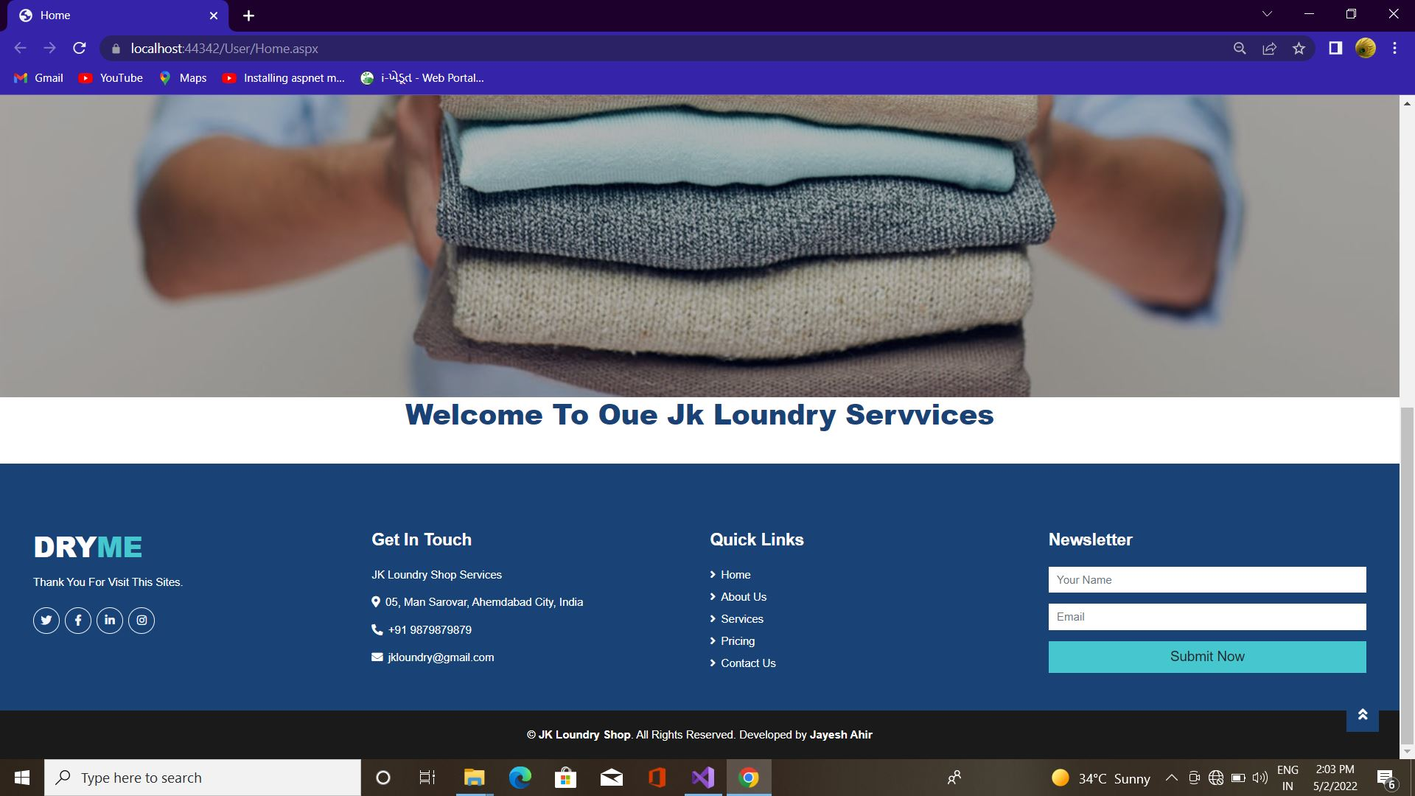
User : footer :

Slide 12
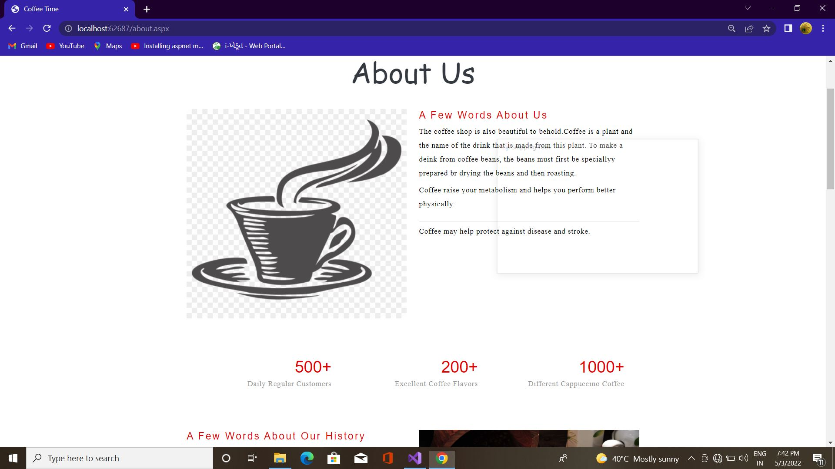
About

Slide 13
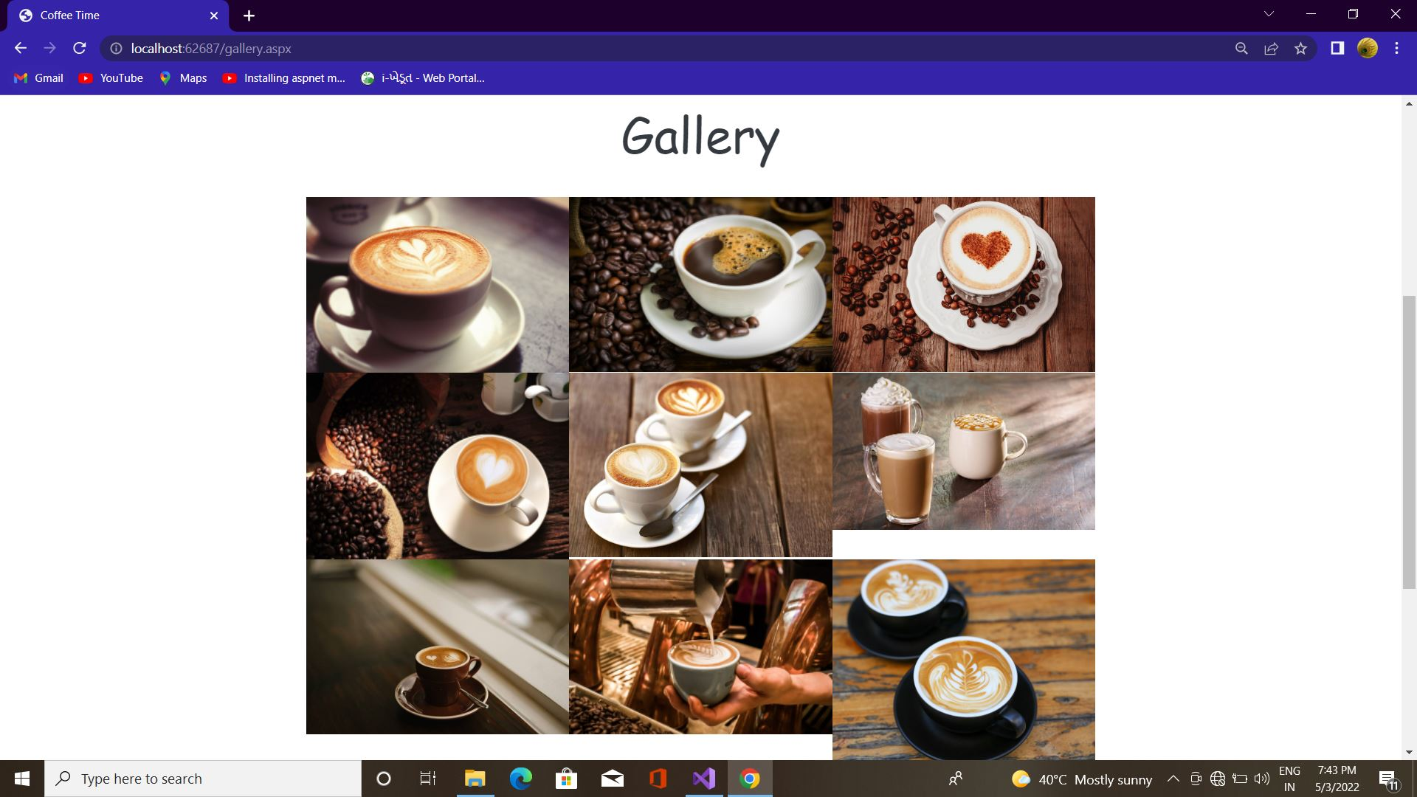
Gallery :

Slide 14
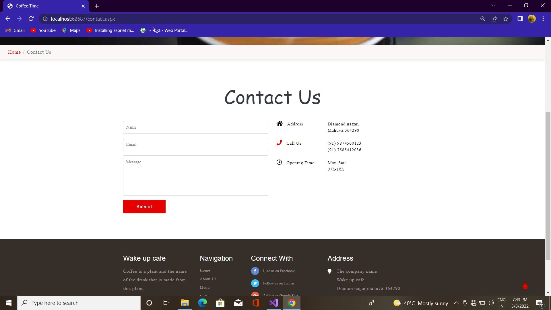
Contact :

Slide 15
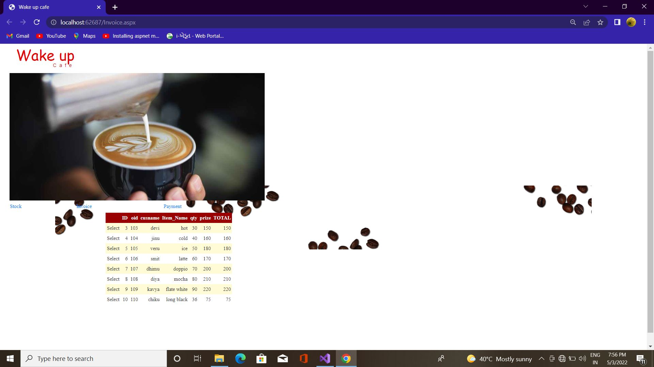
Invoice

Slide 16
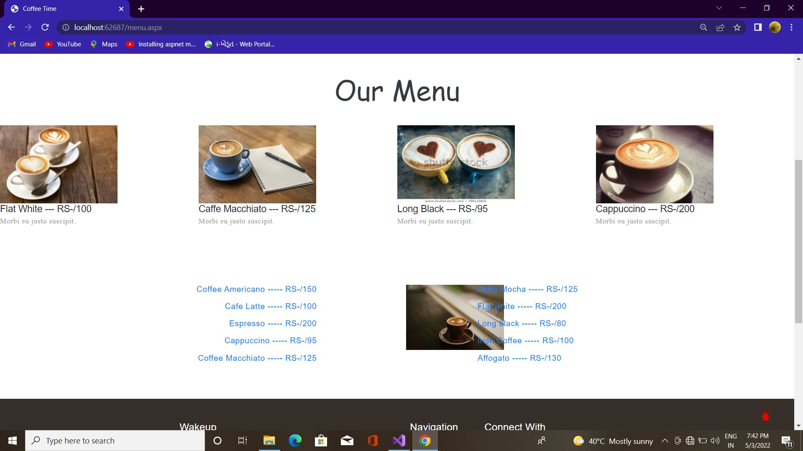
Menu

Slide 17
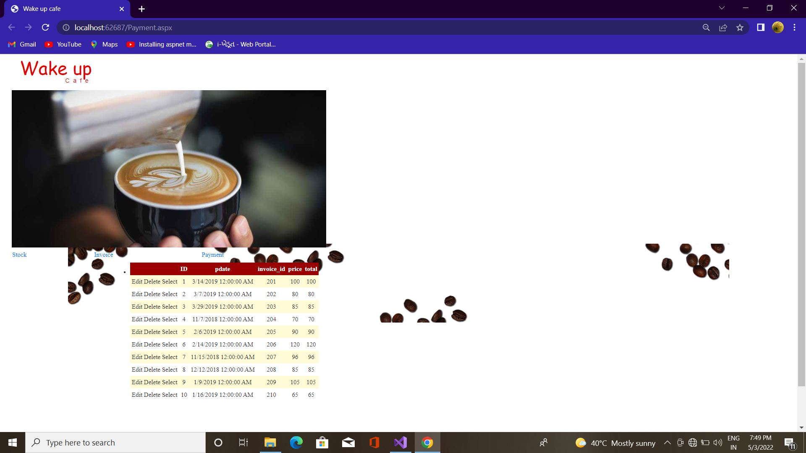
payment

Slide 18
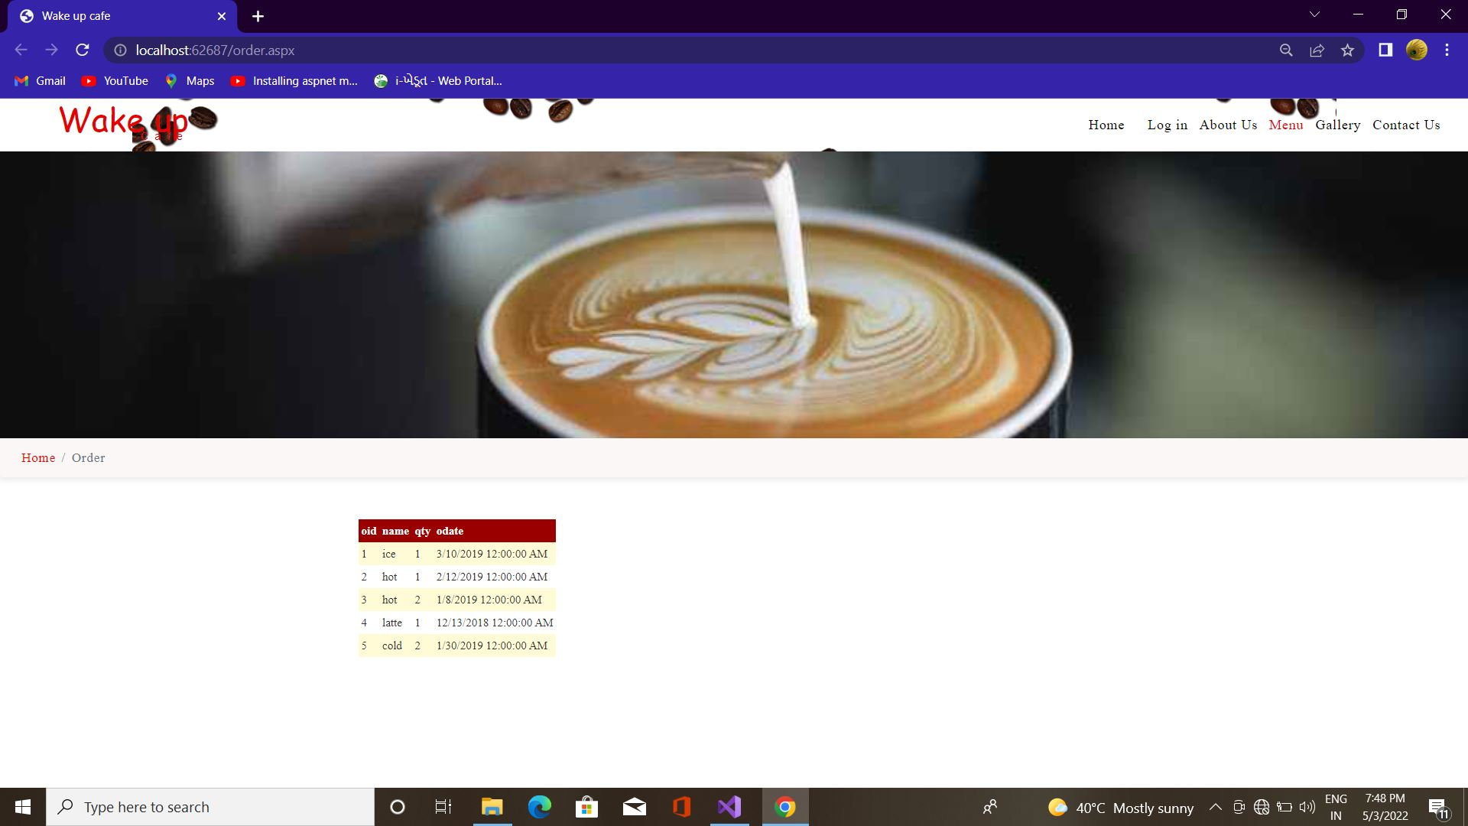
Order

Slide 19
Testing and Implementation
Grey Box Testing
Grey Box testing is testing technique performed with limited information about the internal functionality of the system. Grey Box testers have access to the detailed design documents along with information about requirements.
Grey Box tests are generated based on the state-based models, UML Diagrams or architecture diagrams of the target system.
Black Box
White Box
Gray Box

Slide 20
Thank You..!

