Slide 1
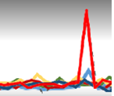
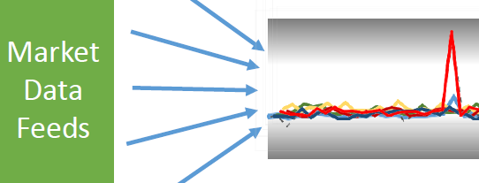
ULL Architectures for Electronic Trading
Course Objectives
Develop advanced skills in architecting electronic trading (ET) and market data applications for ultra low latency (ULL), for competitive advantage, and for positive ROI.
Ted Hruzd, Sr. Infrastructure Architect
Wall Street IT since 1983
ULL (Ultra Low Latency) Architect at Citigroup, Deutsche Bank, JP Morgan
Utilized ML Neural Networks (NN) for Latency predictions
Rutgers Grad – BA 1978; MCRP 1982 + few MBA courses
NYU – Certificates in C++ & Internet Technologies 1994-97
Rutgers Adjunct Instructor – Machine Learning/AI (2017 -> )
NYU Adjunct Instructor – teach ULL Architectures for Electronic Trading (ET)
Comments by Ted Hruzd here are their own personal view and not that of Ted’s current or past employers

Slide 2
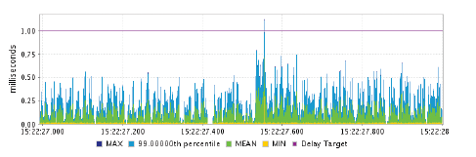
Intro
Thanks to all enrolled (reached max of 20) – ULL – ET
Career goal
ULL-ET opportunities in 2017
Course goals include – competitive advantages & ROI
Thanks to NYU
My career and teaching in brief
Your goals
White board – ET skills

Slide 3
What you will get out of this course
You'll Walk Away with
A strong understanding of relevant ultra-low latency technologies, including hardware acceleration, FPGAs, application design, kernel tuning, real-time analytics, servers, networks
The ability to architect electronic trading applications per business requirements, including conducting ROI analysis for new infrastructures
Knowledge of how to leverage machine learning for electronic trading
Ideal for
Strategic infrastructure / application architects, engineers, product / project managers
System administrators, developers, production support, and QA analysts with intermediate skills in Linux, servers, networks, bash, FIX, and market data protocols
Questions
Your course goals?
Skill Set: Infr or App Arch; FPGA’s; Dev, Prod, UAT, Mgt, networks, servers, Linux, Python, R, Big Data, wireshark …….

Slide 4
Session 1 – Tue May 30 - ULL components: CoLo, FPFA, servers, OS, networks, software & middleware, mkt data
Q: Why are ULL market data architectures increasing in importance?
A: Advances in ML have improved accuracy of RT alpha seeking strategies which now have decreasing windows as opportunities, often in micro seconds today
Q: How can trading firms take advantage of this?
A: Optimize their infrastructure end-end, starting with market data ingestion, ending with order placements, with deterministic latencies.
Q: What can they do regarding market data?
A: Implement at least partial FPGA infrastructures. FPGA's improved their ability for deep pipelining & parallel processing. They run at line speed; hence they are fast with deterministic latencies.
Q: How can a partial FPGA solution work?
A: Utilize FPGA card for market data FH normalization. FPGA's are best at Data transformations, key to FH. Also consider utilizing an FPGA based switch to transfer raw market data in 5 nano seconds to FPGA card for FH. Book builds and order flow processing may be non FPGA based as they are more complex in programming. Few vendors tout Tick-2-trade solutions in under 1 microsecond.

Slide 5
Session 1 – Tue May 30 - ULL components: CoLo, FPFA, servers, OS, networks, software & middleware, mkt data
Q: When can this architecture be most useful in the trading day?
A: At times of volume spikes, an optimized FPGA architecture will provide deterministic Tick-2-trade. Non optimized competitors may have market data latencies 100 or more times greater than their median latencies and miss many trade fills, and completely miss their alpha seeking recommendations. Most successful trading firms excel at generating revenues during volatile times
Q: Are these solutions expensive?
A: Not necessarily. For example, 48 port FPGA switched may be priced at $18k. Nevertheless all firms must conduct ROI analysis and projections before any infrastructure expenditures. Firms must not run blind with metrics. Successful firms know how their fill rates and revenues increase with decreases in order ack time latencies, with special thanks to high speed real time in memory Big Data analysis.

Slide 6
Session 1 – Tue May 30 - ULL components: CoLo, FPFA, servers, OS, networks, software & middleware, mkt data
Q: Why has the market for deterministic latencies been growing.
A: Very often peak trading revenue is maximized by trading applications that process with little or no jitter during most volatile market data spikes
Q: Any other reasons?
A: Alpha Seeking opportunities
Q: What do most successful traders analyze? A: All serious traders track their partners fill rates, successful trades, real time TCA, and very importantly - latencies. Those trading partners that Q and choke during market volume spikes or trading volume can be taken off trading lists for peak volume periods or taken off indefinitely for any periods. This should motivate more hedge funds, prop traders, market makers, agency brokers, sell side, dark pools, and exchanges to invest in partial or full FPGA based ET pending meticulous, accurate ROI projections.

Slide 7
Session 1 – Tue May 30 - ULL components: CoLo, FPFA, servers, OS, networks, software & middleware, mkt data
More Re: FH in FPGA:
Address (FIX problems with) - Memory bottlenecks, operating system overheads, poor parallelism, compiler limitations and slow networking stacks are among the many factors constraining performance and causing long tails in the processing latency distribution.
With FPGA’s : no switch, NIC card, CPU with networking stack to cross resulting in magnitudes faster processing during market bursts than what is achievable with traditional software-based solutions.

Slide 8
Session 1 – Tue May 30 - ULL components: CoLo, FPFA, servers, OS, networks, software & middleware, mkt data
Will present 3 diagrams with co-lo ULL architectures that generate orders destined for trading venues, utilizing Layer 1 switching + FPGA’s for market data & order flow with a target of sub 1 micro second Tick-2-Trade (T2T) latencies. Latencies will be deterministic, even at peak loads, as long as switch and FPGA’s process at line speed.
Metamako MetaMux switches feeding to Intel Cores or to another FPGA solution such as from Algo-Logic or NovaSparks
Algo Logic for 100% FPGA based market data – order flow solution just for CME
Solutions utilizing xCelor FPGA based appliances for market data FH normalization (parse off switch – immediate to FPGA card FH; Intel cores for order book builds
BTW – Order Book builds with Nova Sparks and Algo Logic (CME)

Slide 9
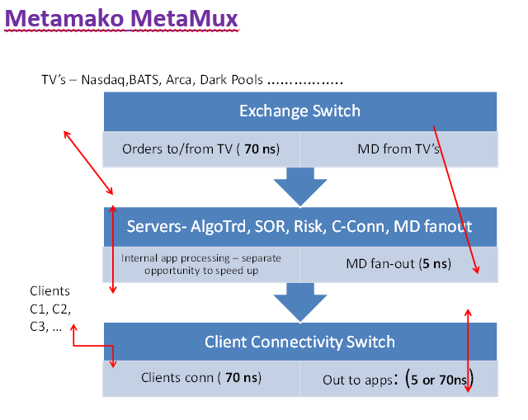
Session 1 – Tue May 30 - ULL components: CoLo, FPFA, servers, OS, networks, software & middleware, mkt data

Slide 10
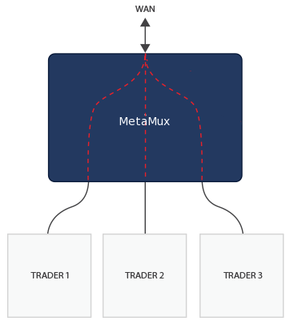
Session 1 – Tue May 30 - ULL components: CoLo, FPFA, servers, OS, networks, software & middleware, mkt data
Multiplexing Connections (Order entry)
Multiple connections can be funneled into a single connection in around 80 ns using MetaMux, assuming there is no congestion. Otherwise packets will be queued. Packet ordering is strictly FIFO (first-in first-out) with no starvation if a link is saturated.
In this trading example, multiple trading clients are multiplexed into a single link with around 80-100 ns latency. The downstream direction can be configured to use MetaMux's layer 1 matrix switching in order to deliver 5 ns in that direction (ex X-Bar). Therefore, the combined latency through the switch is a little over 85 ns compared to a few hundred nanoseconds in each direction for a conventional switch.
MetaMux can both tap and aggregate up to 16 bi-directional connections in a single device, with an overhead of only 4-5 ns, while simultaneously significantly improving the quality of the signals, providing a re-patching capability, providing network insights, and all at a lower cost than traditional passive optical taps.

Slide 11
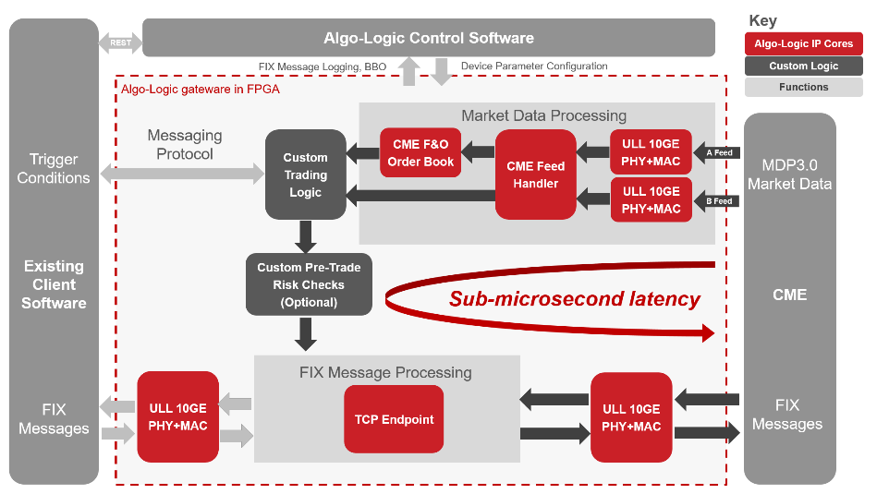
Session 1 – Tue May 30 - ULL components: CoLo, FPFA, servers, OS, networks, software & middleware, mkt data
Sub-microsecond wire-to-wire latencies are achieved by receiving CME MDP 3.0 tick data directly into FPGA on 10G link, detecting opportunities, placing trades as FIX messages encapsulated in TCP packets per ULL 10G TCP Endpoint.

Slide 12
Session 1 – Tue May 30 - ULL components: CoLo, FPFA, servers, OS, networks, software & middleware, mkt data
Pre-Built Modules:
ULL 10GE PHY+MAC:
Lowest round trip latency of 89.6ns
Cut through packet processing to avoid buffering delays
CME Feed Handler:
A/B faster feed arbitration resulting in earliest possible market data event detection
Filtering on subscribed multicast channels
MDP3.0 message processing and parsing
CME Futures & Options Order Book:
Book building for instruments that have real and implied orders
Reporting L2 snapshots with the best bid offer (BBO) information
Recovery based on CME Natural Refresh mechanism in the event of packet loss
10G TCP Endpoint:
100% FPGA accelerated full TCP termination (for FIX orders)
Lowest packet processing latency
Full TCP protocol support including fast retransmission
FIX Message Processing:
Session tracking
FIX message processing and parsing
Add Nova Sparks or xCelor multi FH’s for more complete mkt data solution integrated with order flow?

Slide 13
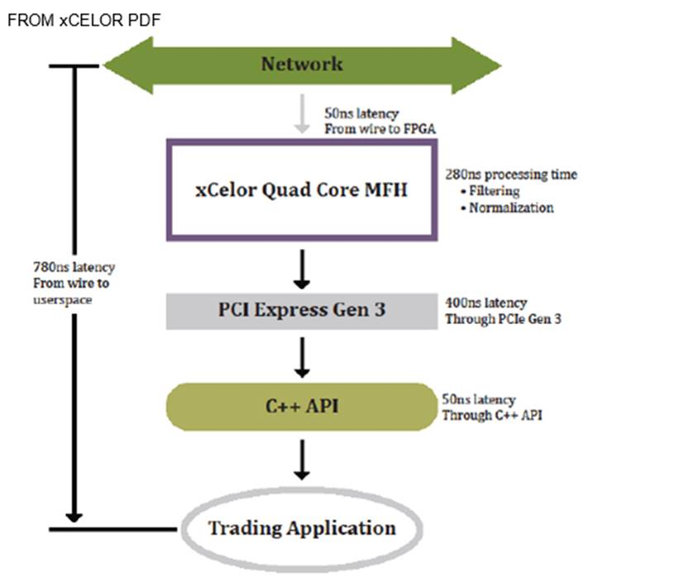
Session 1 – Tue May 30 - ULL components: CoLo, FPFA, servers, OS, networks, software & middleware, mkt data
** all in FPGA – mkt data feed -> FH with decode/filtering (Exchange–Network → MFH ) MFH includes 4 DMA on-chip engines for hashing /pipelining
switch reads the packet to prepare it for (b) feed handler normalization in FPGA.
xCelor - 48 port Layer 1 software programmable switch with deterministic 2-4 nSec latency from exchange to any port or any port to another port with zero jitter; aggregation is at 80 ns (like Metamako)

Slide 14
Session 1 – Tue May 30 - ULL components: CoLo, FPFA, servers, OS, networks, software & middleware, mkt data
FPGA filtered data sets for speed advantages (xCelor)
FH
xCelor’s Market Feed Handler (MFH) is a low-profile, PCIe card that delivers ultra-low latency to process market data from a myriad of exchanges.
L5 switch (few slides later …)
Integration with CIARA HFT SuperMicro OverClocked servers:
Uses xCelor FH PCIe adapters for Book Builds
Includes CME, NASDAQ, NYSE, BATS

Slide 15
Session 1 – Tue May 30 - ULL components: CoLo, FPFA, servers, OS, networks, software & middleware, mkt data
The xCelor XPM40G-MUX switch is most impressive. Out of the box it provides:
Approx. 2-4 ns Mkt Data fan-out via its L1 switch component (faster than Metamako’s 5 ns)
Instantaneous decodes of the feeds, filters over 12,000 symbols, normalizes the data --- for all major US feeds. In essence it is a FPFA feed handle that sends to order flow app (ex C++) over PCIe in 780 ns. Thus its Tick-to-Trade (T2T) is 780 ns – time of ingress from Exchanges to point were order flow app receives it. BTW the longest latency is the PCIe transmission of 400 ns.
xCelor Thin API (symbols, books, updates …)
5 SSD’s with each 1 up to 2 TB to store pcap data –with time stamps within 10 ns accuracy. The PCAP’s can be forwarded to Corvil for advanced network/transaction analytics, or it can be forward to a SolarFlare appliance that is completing with Corvil – not here yet all the way but with plans to get there and cheaper??

Slide 16
Session 1 – Tue May 30 - ULL components: CoLo, FPFA, servers, OS, networks, software & middleware, mkt data
In sum, the key advantage xCelor has over competitors are (1) FPGA feed handlers – all major US feeds + (2) SSD storage. The 780 ns T2T is faster than Metamako – AlgoLogic CME feed combo of approx. 900 ns, but not as fast as The ZL appliance ZL builds (Intel Core – FPGA cache coherency) that results in 400 ns T2T (validate!!)
xCelor may have industry lead in immediate and fastest FH normalization with their 330 ns timings. Other solutions (ex: Metamako) ingest the feed in 5 ns for market data fan-out or to connect with another device / app for feed normalization
SolarFlare XtremeScale NICs / LDAtech combo 120 ns T2T is a very niche solution
No decoding of mkt data; trader knows exact messages in packets to act on for FIX order. This is not true generic T2T
If msg is #15 of 30 then timing starts at receipt of #15 (may be 200ns+ already)
LDS LightSpeed TCP IP core has parallel TCP connections for order flow
xCelor new Layer 5 FPGA switches now ingest 1 feed on 1 port at Layer 5, parsing symbols, then distribute to “custom” (by symbol) trading sessions off other 31 ports.

Slide 17
Session 1 – Tue May 30 - ULL components: CoLo, FPFA, servers, OS, networks, software & middleware, mkt data
FIXNETICS
Zero Latency (ZL) FPGA + Intel cores appliance (core and FPGA on separate sockets)
Intel focus on parallelizing code more than doubling processing speeds now
ZL appliance target -- Broker (integrated with client); broker in control
The future – shared infrastructure
Protocol agnostic
Multiple asset classes
Combo of MetaMako MetaMux 48 port $18K multi layer switches complement ZL very well, servicing it with market data and FIX order flow in 5ns and 70ns respectively, and also in sending orders to venues in 70ns.

Slide 18
Session 1 – Tue May 30 - ULL components: CoLo, FPFA, servers, OS, networks, software & middleware, mkt data
Intel Core – Altera FPGA - Cache Coherency
Upon receiving process data in a core on 1 socket, a mirror of that data is directly transported to cache on another socket for an FPGA process in _____. No driver, bus, or PCIE are in play.

Slide 19
Session 1 – Tue May 30 - ULL components: CoLo, FPFA, servers, OS, networks, software & middleware, mkt data
Intel Cores + FPGA:
joint FPGA/Intel-core appliance (which one?) for deterministic latencies, Tick 2 Trades (T2T) consistently under 1 uSec; actually expect 400 ns?
quick software to hardware transport for
cache coherent CPU core -FPGA
significant factor in providing deterministic latencies, even with spikes in peak message processing. This overcomes other ULL solutions which encounter jitter during spikes.
What may be advantages of high speed cache coherency between Intel cores and FPGA’s for ET? Prospects for the lead player? How can this speed up End-2-Enf flow from mkt data → order flow → exchange and back?

Slide 20
Session 1 – Tue May 30 - ULL components: CoLo, FPFA, servers, OS, networks, software & middleware, mkt data
Key advantages of FPGA (reference -Ted’s A-Team Doc)
wire speed processing
deep pipelining
Superior parallelization (massive)
can act immediately on specific events (per Verilog @always clause)
Data transformation (ideal for feed handlers) -- contrast with GPU’s
deterministic latencies
accelerates algos of many ops on small data
re-program
create ‘cores’ in FPGA – Sweden Royal Inst of Tech
FPGAs have many registers + many tiny RAM blocks which can be useful for some pipelines.
If you can break down your algorithm into many tiny steps with a register at the end of each step, you can feed in a new data value on each clock tick. During each clock cycle, the whole algorithm is performed, but each part is done on a different "piece" of the input data. After the clock has ticked enough times to cover the number of register stages in your pipeline, the answer for the data which went in that many ticks ago comes out.

Slide 21
Session 1 – Tue May 30 - ULL components: CoLo, FPFA, servers, OS, networks, software & middleware, mkt data
FPGA’s – Verilog vs OpenCL programming. Present FPGA Module.
Verilog ‘module’ design subassembly with defined connections to other modules
Registers store state, function as variables
Vectors
Multiple counters with multiple clocks all process in parallel
Use ‘<=’ when adding to output Q. use with ‘sequential logic’ – will be done in parallel, then next sequence (<= is ‘non-blocking, order of assignments is irrelevant)
FPGA –
Module,
UCF,
Binary to FPGA
‘always’ clause executes whenever any entities change
Ex: always @(b or e)
Present some FPGA Verilog code;
then OpenCL code --- white board?

Slide 22
Session 1 – Tue May 30 - ULL components: CoLo, FPFA, servers, OS, networks, software & middleware, mkt data
More Re: FPGA’s
Cost effective / quickly address competitiveness (Re-program)
Intelligent circuitry design – advantage over GPU’s
Turnkey compilers may fall short
However – FiberBlaze hooks into multiple paths into NIC IP’s
Ideal for automated risk mgt
10 Gb message processing 300 ns (2013) Stratix V
Leading FPGA – 5 million gates
What are advantages of 5 million gates?

Slide 23
Session 1 – Tue May 30 - ULL components: CoLo, FPFA, servers, OS, networks, software & middleware, mkt data
Some Core points regarding FPGA’s (& GPU’s)
GPUs: excel @computationally intensive tasks; ex: floating-point arithmetic
FPGAs excel at simple data transformation. xCelor FPGAs speed up trade-related processes. FPGA’s allow parallelization. FPGA is able to operate on a physical electronic signal as it comes through a cable on a server. Theoretically, one can consume data as fast as it is delivered—at what is called link speed.
FPGAs are actually slower than CPUs, but capable of much more throughput. FPGA’s are programmed to perform many tasks in parallel. Many instructions are carried out in single clock cycle; this accounts for speed advantage. Discuss pipelining, parallel proc.
Previously, FPGAs were available on a network card inside a server. Now, FPGAs are being integrated into the latest network switches, which opens up new categories of applications from centralized feed handling (replacing traditional “ticker plants”) to risk management to preparing a real-time feed for transmission over microwave.
Market participants need to meet the challenge of how to achieve SEC compliance with the lowest latency penalty. The best way is the one that entails the least transformation of data. In this area, FPGAs represent a real step forward. The latest switches that feature FPGAs embedded within them can permit users to check data as it crosses a switch—with net-zero latency penalty: RT Monitoring / Alerts

Slide 24
Session 1 – Tue May 30 - ULL components: CoLo, FPFA, servers, OS, networks, software & middleware, mkt data
All modern servers contain multiple CPUs. They spin off a thread to handle concurrent execution. The lack of determinism inherent in this model can lead to the problem of race conditions. With FPGAs, one can program exact operating instructions, avoid such issues. If there is bug, you (owner), can fix it. You are not reliant on a provider. The caveat is that FPGAs must be programmed intelligently.
Programmers can write code in C or Java and a compiler like Impulse C will turn it into FPGA code. But programs like those lack the “brains” to orchestrate complex machinery. Verilog the better choice.
“Intelligent code” means putting thought into making the most of the capabilities of the FPGA chip. This requires a human being to carefully study what’s needed and what the chip can do, and marry the two in the most efficient way. The code generated from a higher-level Java/C compiler won’t do this at all; it will do what you tell it as simply as it can, using a small part of the chip but leaving much of the parallel FPGA capabilities to waste.
Procedural languages, are incapable of expressing full parallel possibilities of FPGA.
Ted – describe progression from multi cores → OpenMP + AVX-512 → KTH “cores” on FPGA’s …. No OS --- white board ….

Slide 25
Session 1 – Tue May 30 - ULL components: CoLo, FPFA, servers, OS, networks, software & middleware, mkt data
Switches with FPGA chips embedded within them are becoming available, FPGAs can add value in areas like microwave networks. Sending market data over microwave is limited by bandwidth and reliability
FPGA chip inside a switch can solve these problems, filtering down a full feed to only those symbols that are interesting at the remote market center, and adding in redundant updates to tackle the reliability problem.

Slide 26
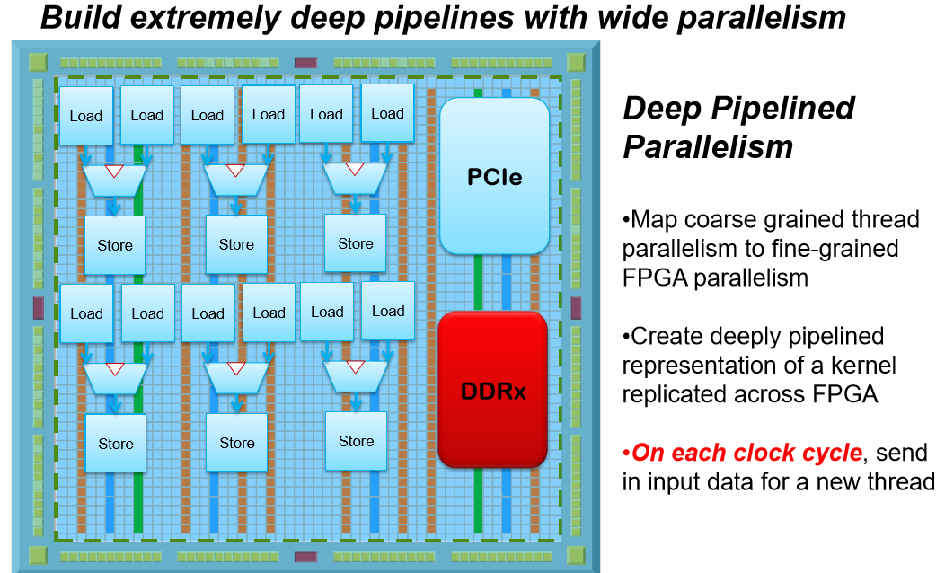
Session 1 – Tue May 30 - ULL components: CoLo, FPFA, servers, OS, networks, software & middleware, mkt data
Altera

Slide 27
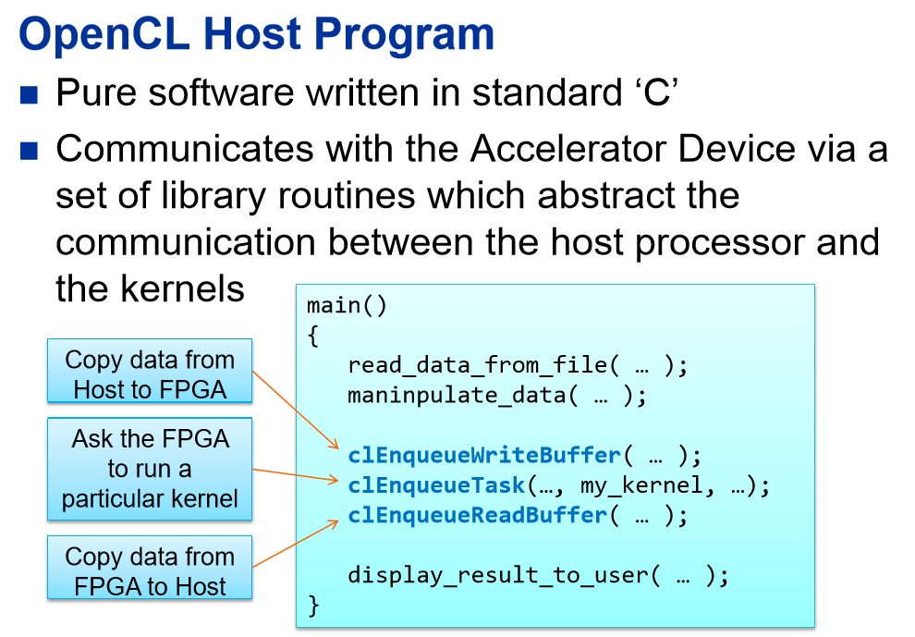
Session 1 – Tue May 30 - ULL components: CoLo, FPFA, servers, OS, networks, software & middleware, mkt data

Slide 28
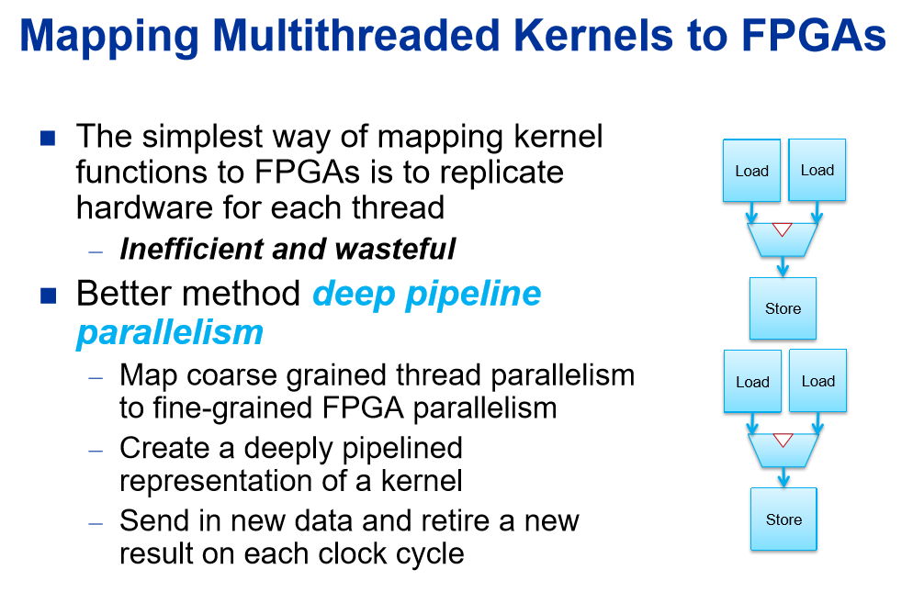
Session 1 – Tue May 30 - ULL components: CoLo, FPFA, servers, OS, networks, software & middleware, mkt data

Slide 29
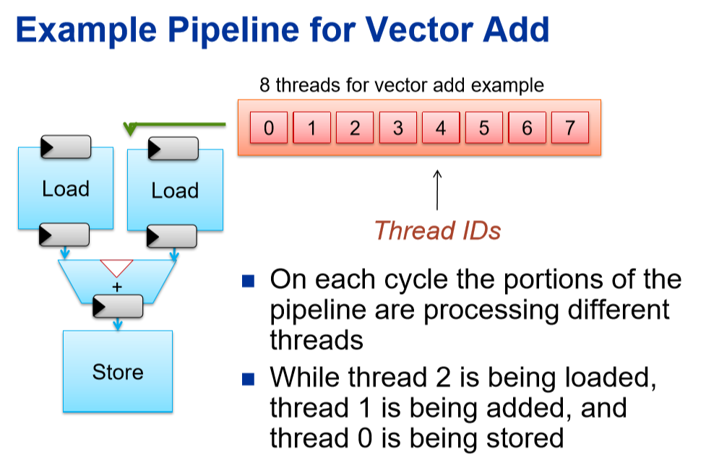
Session 1 – Tue May 30 - ULL components: CoLo, FPFA, servers, OS, networks, software & middleware, mkt data

Slide 30
Session 1 – Tue May 30 - ULL components: CoLo, FPFA, servers, OS, networks, software & middleware, mkt data
But in exchange protocol parsing is generally heavily parallelized and executed at line rate on FPGAs.
Book Builds – in FPGA or multi core servers?
Book building in CPU Vs FPGA: advantages and disadvantages in both
With today’s processors running at almost 5GHz [almost 20X the speed of FPGA] one could argue that book building in CPUs is prudent
One would have to find 20X parallelism in FPGA to beat the CPU.
This is difficult, but can lead to deterministic latencies – but overall longer mean latencies
xCelor use of CIARA SuperMicro overclocked servers for book builds (also + risk checks, order flow and creation, set up exchange routing) can be TUNED to mitigate latency spikes.
SF NIC’s in Colo → orders → Exchanges
There is absolutely no argument that CPU’s are a lot more flexible than FPGA based programming.
FPGAs have traditionally been faster but their clock speed has stagnated over the years, while CPUs have continued to scale with overclocked servers.
With the same argument one could argue that exchange protocol parsing and filtering can be done in CPUs.
BUT Exchange protocol parsing is generally heavily parallelized, executed at line rate on FPGAs.

Slide 31
Session 1 – Tue May 30 - ULL components: CoLo, FPFA, servers, OS, networks, software & middleware, mkt data
Why processing speed & ULL market data still matter; will for next several years at least
Why Meta-Speed is more important than pure speed (reference Corvil-Tabb Doc)
Meta-Speed Deep Dive (10 minutes)
Why Layer 1 switches
Layer 1 switch with integrated cores + FPGA for risk checks (FixNetics ZL – 40 risk checks)
Diagram -High speed Buy-Side real time analytics for seeking alpha (trade opportunities) & infrastructure analytics to route to proper exec broker.
Data – historical & RT market data, news analytics (intro to RavenPack or RP), twitter, and aggregated Coril session latency analytics via OLAP dimensions, machine learning – neural networks for routing to best exec broker for specific alpha opportunity
Exchange (Trading Venue) connectivity
Layer 2/3 aggregation in new switch appliances

Slide 32
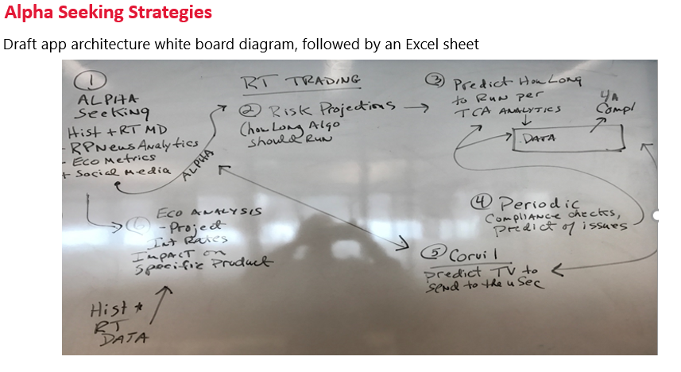
Session 1 – Tue May 30 - ULL components: CoLo, FPFA, servers, OS, networks, software & middleware, mkt data

Slide 33
Session 1 – Tue May 30 - ULL components: CoLo, FPFA, servers, OS, networks, software & middleware, mkt data
Some leading ULL vendors:
Metamako
Algo-Logic
Nova-Sparks, with Nova-Link product (to an order routing partner ex: Algo-Logic)
Corvil
Intel / Lenovo
SolarFlare
ExaBlaze
Enyx
xCelor
LightFleet
Role of Linux kernel tuning for ULL – use network-latency profile & common Linux best practices
Present some Linux configurations to critique (ex: no K bypass, same NIC for mkt data & order flow)
What electronic trading organizations will prosper in space of ULL ET now & in future? Which may very well fail, even disappear? Why is role of ROI critical? Difficulties of proper ROI analysis

Slide 34
Session 1 – Tue May 30 - ULL components: CoLo, FPFA, servers, OS, networks, software & middleware, mkt data
Will briefly present an alternative architecture utilizing a Single Tier network (Plexxi)
We will periodically revisit the co-lo ULL architectures throughout this course when we cover specific architecture components in depth (Algo Trading and/or SOR that feeds this architecture, use of FPGA, and Layer 1 switching)
Partial FPGA and non FPGA alternative architectures (maybe per ROI; TUNE to max!)

Slide 35
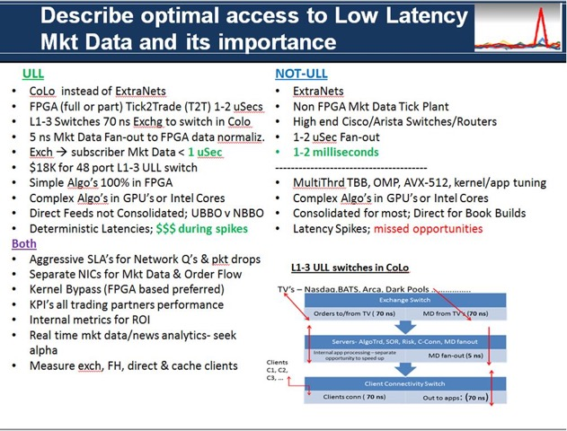
Session 1 – Tue May 30 - ULL components: CoLo, FPFA, servers, OS, networks, software & middleware, mkt data
Quick sum + other considerations for optimal architectures
(left)

Slide 36
Session 1 – Tue May 30 - ULL components: CoLo, FPFA, servers, OS, networks, software & middleware, mkt data
Hardware accelerated appliances for ULL and deterministic performance
Ted’s FPGA Hand-out: -- FPGA design & programming (I/O blocks + Logic blocks, OpenCL for creating “kernels” + synchronization for parallelism )
Q: Why performance tends to be very deterministic with FPGA’s & why deterministic performance (latencies) are critical for HFT and algo traders
Pitfalls of FPGA's
FPGA's vs GPU’s, Intel Phi (Intel Doc), and multi cores
Feeds in FPGA –architecture, performance, design, support
Switch crossbars or caches for fan out with TCP distribution

Slide 37
Session 1 – Tue May 30 - ULL components: CoLo, FPFA, servers, OS, networks, software & middleware, mkt data
HOMEWORK #1 – Ted will describe 1 or 2 ET applications, then ask for an architecture that can be Visio (or picture of white board drawing – to save time). Students will be required to justify their choice(s) in 1-2 pages max.
HOMEWORK #2 –reading assignments (2 weeks to complete) - Chap 4 & 5 – FPGA’s & GPU’s are priority as some info from that will be on a 20 minute quiz 6/13-book below
Architects of Electronic Trading, Stephanie Hammer, Wiley 2013
https://developers.redhat.com/blog/2015/02/11/low-latency-performance-tuning-rhel-7/
https://access.redhat.com/sites/default/files/attachments/201501-perf-brief-low-latency-tuning-rhel7-v1.1.pdf
OPTIONAL – listen to 1 hour Webinar -- was Dec 8, 2016 Panelist for an A-Team Webinar re: perspectives on strategic ULL market data architectures & how trading firms can realize ROI, seek alpha, expand market share, address risks and compliance.
access webinar recording here:http://bit.ly/2fXujEo.
(may add more reading assignments here …):
Get a head start and read parts Ted will specify in Ultimate Algorithmic Trading Systems ToolBox, George Pruitt, Wiley, 2016 ( 4 weeks to complete )
ADD link to Market Data White Paper (OPTIONAL) - https://homerunfitness.wordpress.com/2017/01/28/ultra-low-latency-ull-market-data-current-state-and-future/

Slide 38
Session 1 – Tue May 30 - EXTRA / APPENDIX
Next Slides ………

Slide 39
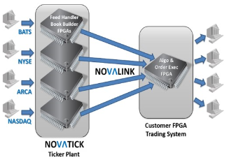
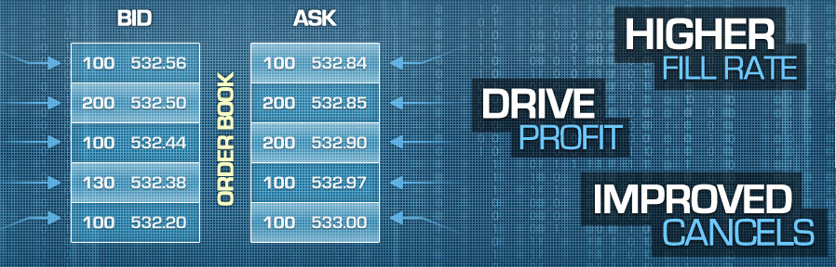
Session 1 – Tue May 30 - EXTRA / APPENDIX

Slide 40
Session 1 – Tue May 30 - EXTRA / APPENDIX
FPGA-centric architecture is augmented with tightly integrated Intel processors to support non-latency sensitive tasks such as exchange recovery functions. NovaSparks’ ticker plants have a common output format across markets. They are consumed with a single application programming interface (API), which allows banks and trading firms to deploy additional feed-handlers quickly and effortlessly.

Slide 41
Session 1 – Tue May 30 - EXTRA / APPENDIX
*** All Links – optional reading; mainly sharing points of relevant interest …
Read about Sweden Royal Inst of Tech creation of “cores” in FPGA …
https://www.nextplatform.com/2016/10/19/turning-openmp-programs-parallel-hardware/
June 8 – I will be a panelist at:
http://intelligenttradingtechnology.com/events/intelligent-trading-summit-its-new-york-city/agenda/
xCelor
http://xcelorgroup.com/
http://xcelorgroup.com/wp-content/uploads/2015/07/xCelor-and-Ciara-Partnership_FINAL.pdf
http://www.waterstechnology.com/connectivity-networks/latency/3365761/xcelor-ciara-ally-for-high-frequency-on-server-feed-handling-book-building
Nova Sparks
http://www.waterstechnology.com/inside-market-data/news/2474409/novasparks-cuts-book-building-latency-fpga-ticker-plant
For Nova Sparks, the 300-nanosecond reduction means that firms using 10 Gigabit Ethernet multicast distribution wire-to-wire will see latency fall from 1,100ns to 800ns. For those using the vendor's NovaLink service, which connects the NovaTick FPGA ticker plant to clients' own FPGA applications, latency will decline from 1,050 ns to 750 ns, and for those using PCIe direct memory access, latency will fall from 1,550 ns to 1,250 ns.
“300nanoseconds means different things to different customers. It depends on what kinds of strategies they're engaged in. For some, it will mean the difference between making money or not. For others, it will mean making money versus making more money," Baetz says. "Typically, our customers are improving their infrastructure on a constant basis─switches, servers, and telecoms─so it's important for us to ensure we are a part of that constant improvement.“

Slide 42
Session 1 – Tue May 30 - EXTRA / APPENDIX
Fixnetics - product is ‘Zero Latency’
One can add newly regulated risk checks per Flash Crash in an FPGA card. The FPGA will process concurrently with order processing risk checks in CPU cores. Utilizing Intel’s QPI CPU-FPGA transfer the CPU cores and FPFA will complete their tasks per order at the same time while utilizing cache coherency for speed up. Accessing then processing in L1 cache == 17 ns
Setting up order for routing = 150 ns
Total concurrent risk checks approx 150-200 ns, with writes in circular buffers

Slide 43
Session 1 – Tue May 30 - EXTRA / APPENDIX
FIBER BLAZE
Their core product suite includes XILINX based FPFA cards and FPGA based NIC’s, with total kernel bypass – even excluding users space. How? Via PCIe combined writes to FPFA based TCP or UDP stacks. This then is identical to another vendor – Enyx They have multiple FPGA IP nodes, including · building multi level market data books · data parser that includes all exchange protocols and FIX protocol · custom built Top line FPGA card with 2.5 million gates, 8 GB RAM, 10, 40, 100 GigE available *** Their C API is critical part of their solution and perhaps a key advantage over other competitors. Their FPGA IP nodes have multiple “hooks” or paths that are accessed per API call. This decreases needs to make FPGA card changes and increases ability of customers to create their own proprietary transactions, logic, applications, etc … Some customers utilize experienced FPGA programmers but a trend has emerged where customers make no or minor FPGA changes and rely more on vendor As other FPGA based competitors, they state that a full FPGA solution can result in 1 microsecond Tick2Trade times in CoLo’s. Some of their NIC’s excel in 3 ns accuracy time stamps for packet captures. These then can be input to Corvil appliances for up the OSI stack (FIX protocol, all market data protocols, analytics, LL middleware such as LBM, etc) They use RTL, not Verilog for most FPGA programming. They have 25 engineers, globally, are based in Netherlands Their customers include commercial and investment banks, hedge funds, prop traders, and also ultra low latency appliance vendors

Slide 44
Session 1 – Tue May 30 - EXTRA / APPENDIX
Comment by Dave Weisberger (who I worked wit at Citi, keep in touch ..)”BLAMING HFT instead of adopting aspects of modern technology is a losing proposition for trading firms. The key for traders is to MEASURE trading performance including the opportunity costs of being "too slow". At ViableMkts, we are happy to help firms understand this landscape...” to article → https://epta.fia.org/articles/flash-crashes-–-time-stop-knee-jerk-blaming-hft
My response to Dave: Dave - your last point is most significant - measure opportunity costs of being "too slow". In addition, firms should measure also how their fill rates and thus revenues increase whenever their speed of processing is fastest - such as tick-to-trade times. Such metrics are key to ROI projections for any infrastructure upgrades to decrease latencies and especially to attain deterministic latencies so volume spikes will not degrade algo trading. Exclusively my views ....

Slide 45
Session 1 – Tue May 30 - EXTRA / APPENDIX
https://www.nextplatform.com/2017/05/25/logistics-application-path-neural-networks/
https://www.nextplatform.com/2017/03/21/can-fpgas-beat-gpus-accelerating-next-generation-deep-learning/
http://corvil.com/lp/tabb-group-speed-ii-have-we-reached-a-tipping-point
http://corvil.com/content/lp/tabb-group-speed-ii-have-we-reached-a-tipping-point/speed-2-tipping-point-report.pdf
https://solarflare.com/solarcapture
Leveraging the industry-leading Solarflare software and hardware technology, with an open disaggregated solution that enables the use of third party analytics packages and industry-standard servers, SolarCapture can be used for a range of applications. These range from stand-alone packet capture systems through to sophisticated service assurance, business intelligence and custom application feeds for a range of security, regulatory and compliance needs.
https://solarflare.com/Media/Default/PDFs/Software/Solarflare_SolarCapture_Product_Brief.pdf

Slide 46
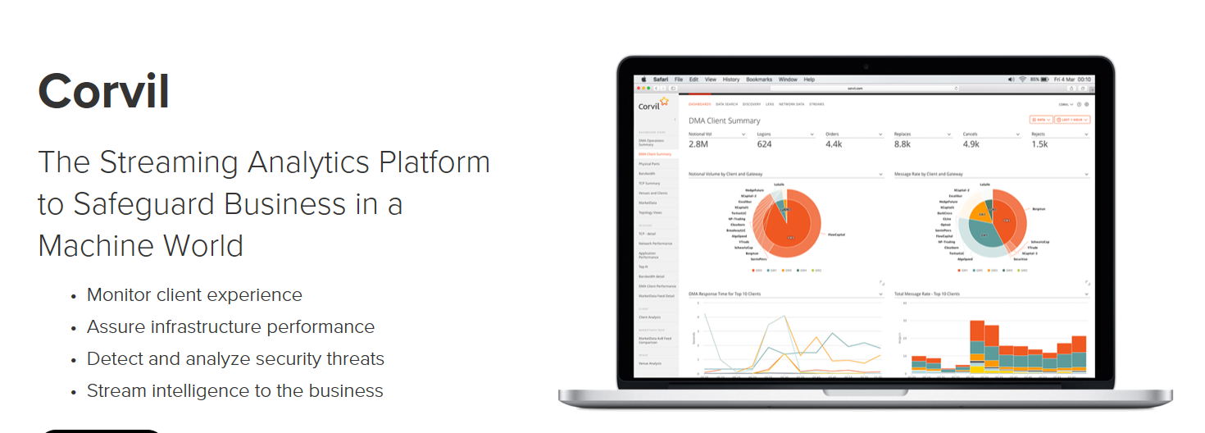
Session 1 – Tue May 30 - EXTRA / APPENDIX
http://corvil.com/solutions/electronic-trading

Slide 47
Session 1 – Tue May 30 - EXTRA / APPENDIX

Slide 48
Session 1 – Tue May 30 - EXTRA / APPENDIX

