Slide 1
End-to-End System of MBTI personality Recognition
Jhonatan Parada Torres, Dr. Guozhen An (Faculty Advisor)
Queensborough Community College, Department of Engineering Technology, City University of New York
April 30, 2026
Jhonatan Parada Torres, Dr. Guozhen An

Slide 2
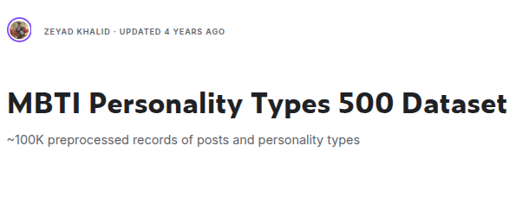
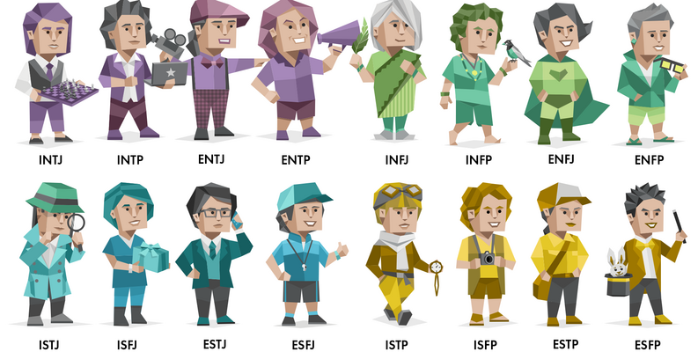
Coverage
Yi, Jiang, Tran, G´omez, Canning, Bloem & Barrett
Jhonatan Parada Torres, Dr. Merlinda Drini
Jhonatan Parada Torres, Dr. Guozhen An

Slide 3
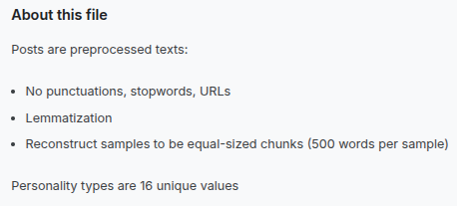
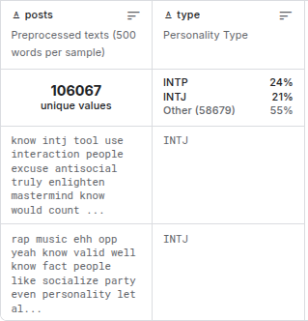
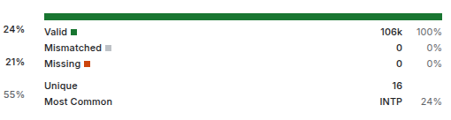
Data Coverage
Yi, Jiang, Tran, G´omez, Canning, Bloem & Barrett
Jhonatan Parada Torres, Dr. Merlinda Drini
Jhonatan Parada Torres, Dr. Guozhen An

Slide 4
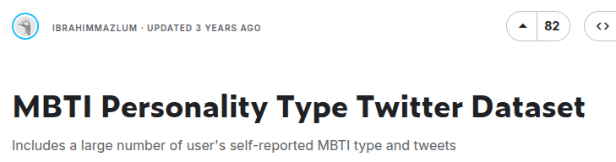
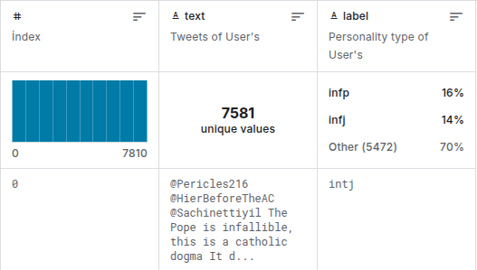
Coverage
Yi, Jiang, Tran, G´omez, Canning, Bloem & Barrett
Jhonatan Parada Torres, Dr. Merlinda Drini
Jhonatan Parada Torres, Dr. Guozhen An

Slide 5
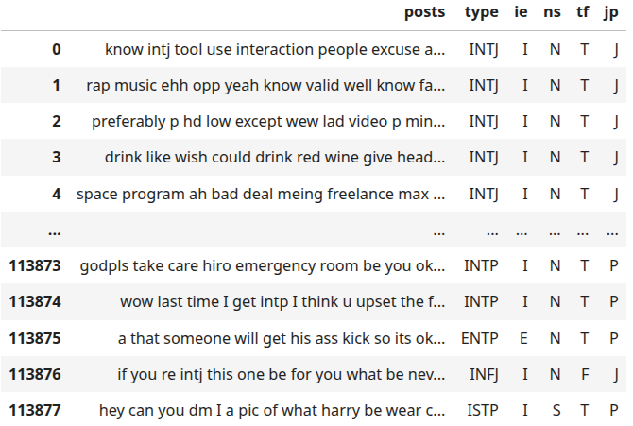
Methods
Yi, Jiang, Tran, G´omez, Canning, Bloem & Barrett
Jhonatan Parada Torres, Dr. Merlinda Drini
Jhonatan Parada Torres, Dr. Guozhen An

Slide 6
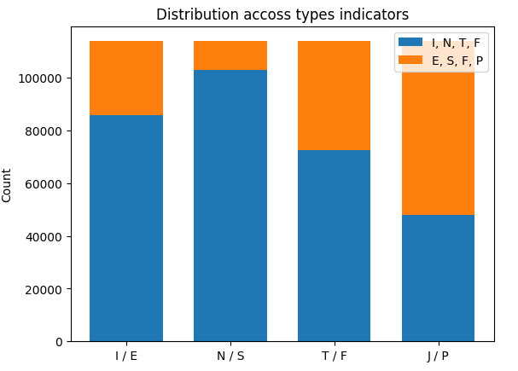
Methods
Yi, Jiang, Tran, G´omez, Canning, Bloem & Barrett
Jhonatan Parada Torres, Dr. Merlinda Drini
Jhonatan Parada Torres, Dr. Guozhen An

Slide 7
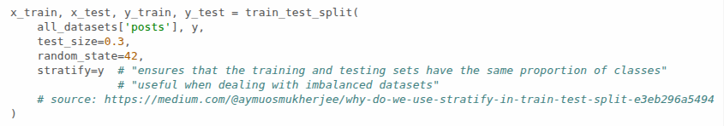
Methods
Yi, Jiang, Tran, G´omez, Canning, Bloem & Barrett
Jhonatan Parada Torres, Dr. Merlinda Drini
Jhonatan Parada Torres, Dr. Guozhen An

Slide 8
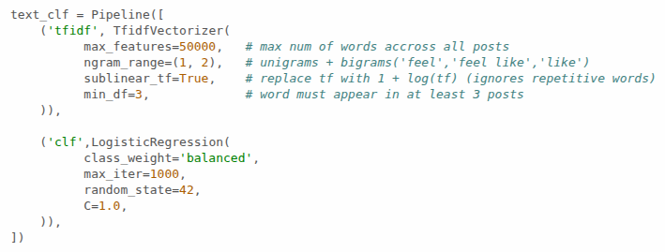
Methods
Yi, Jiang, Tran, G´omez, Canning, Bloem & Barrett
Jhonatan Parada Torres, Dr. Merlinda Drini
Jhonatan Parada Torres, Dr. Guozhen An

Slide 9
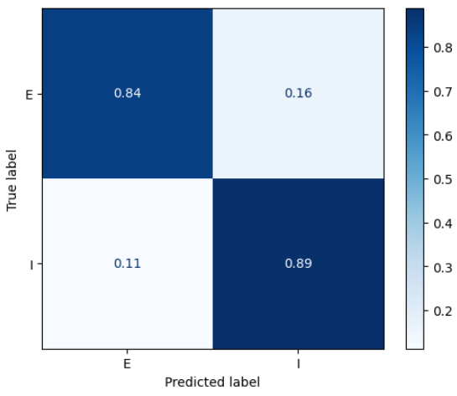
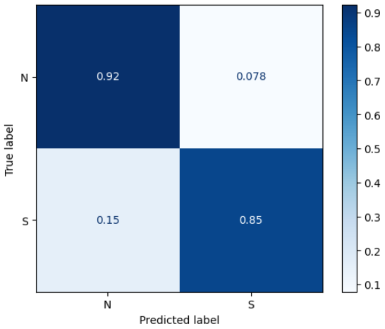
Results
Yi, Jiang, Tran, G´omez, Canning, Bloem & Barrett
Jhonatan Parada Torres, Dr. Merlinda Drini
Jhonatan Parada Torres, Dr. Guozhen An

Slide 10
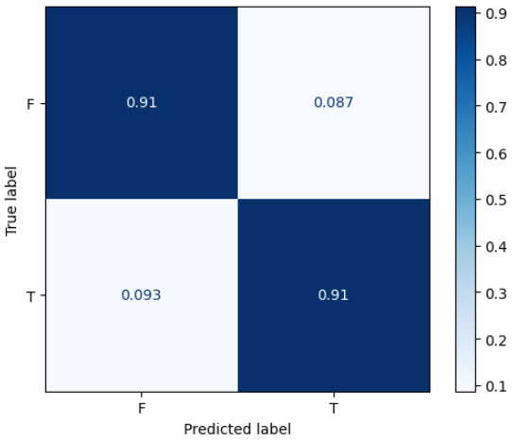
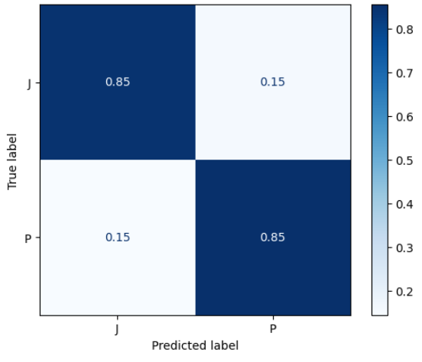
Results
Yi, Jiang, Tran, G´omez, Canning, Bloem & Barrett
Jhonatan Parada Torres, Dr. Merlinda Drini
Jhonatan Parada Torres, Dr. Guozhen An

Slide 11
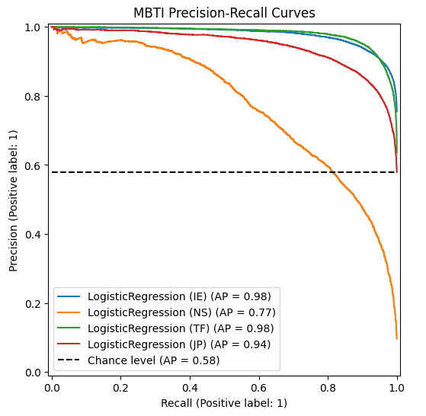
Results
Yi, Jiang, Tran, G´omez, Canning, Bloem & Barrett
Jhonatan Parada Torres, Dr. Merlinda Drini
Jhonatan Parada Torres, Dr. Guozhen An

Slide 12
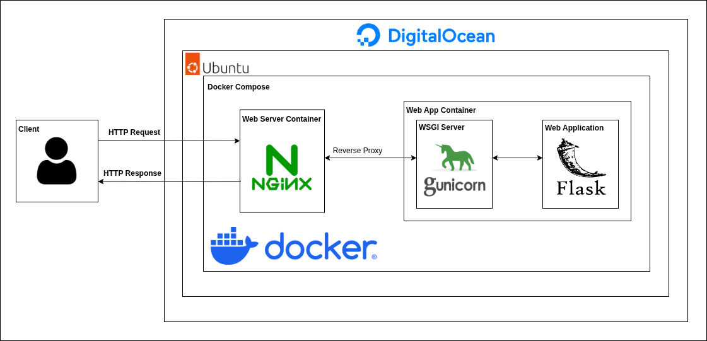
Results
Yi, Jiang, Tran, G´omez, Canning, Bloem & Barrett
Jhonatan Parada Torres, Dr. Merlinda Drini
Jhonatan Parada Torres, Dr. Guozhen An

Slide 13
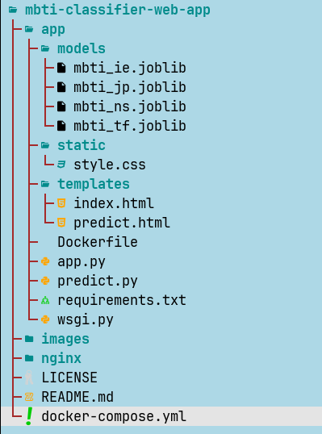
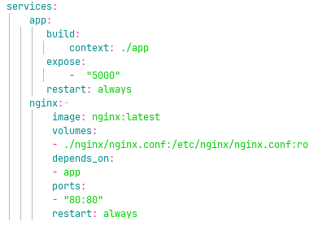
Results
Yi, Jiang, Tran, G´omez, Canning, Bloem & Barrett
Jhonatan Parada Torres, Dr. Merlinda Drini
Jhonatan Parada Torres, Dr. Guozhen An

Slide 14
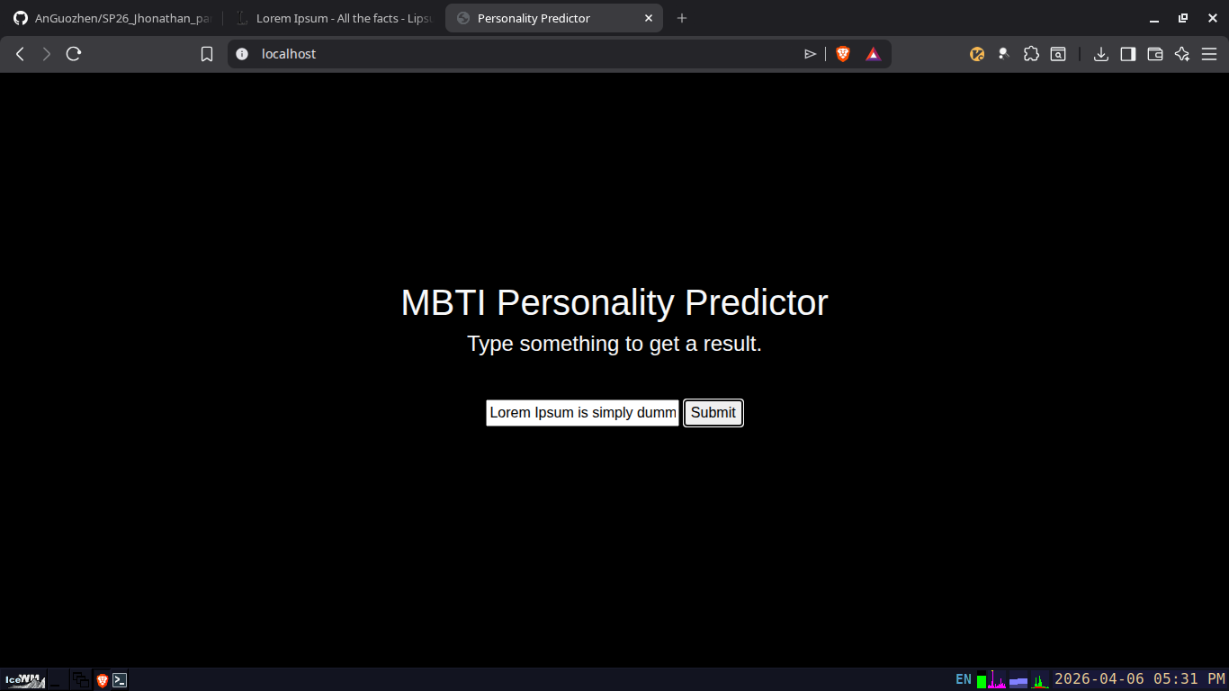
Results
Yi, Jiang, Tran, G´omez, Canning, Bloem & Barrett
Jhonatan Parada Torres, Dr. Merlinda Drini
Jhonatan Parada Torres, Dr. Guozhen An

Slide 15
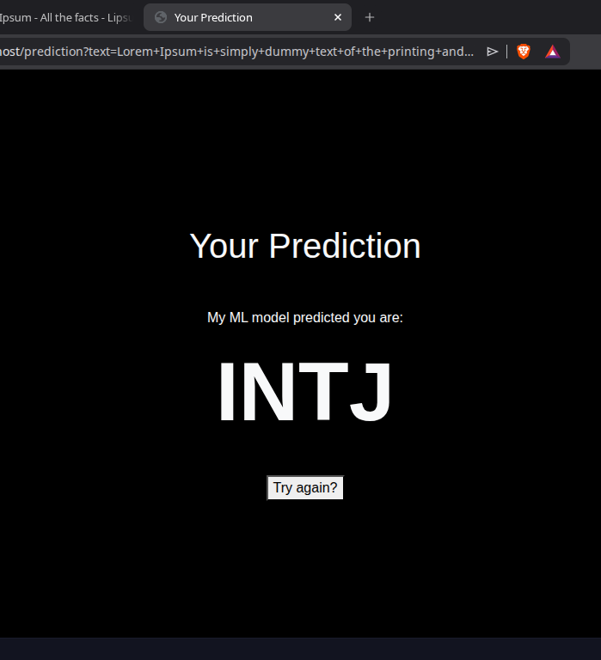
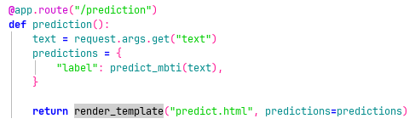
Results
Yi, Jiang, Tran, G´omez, Canning, Bloem & Barrett
Jhonatan Parada Torres, Dr. Merlinda Drini
Jhonatan Parada Torres, Dr. Guozhen An

Slide 16
Thank you for your interest, questions, and comments!
Yi, Jiang, Tran, G´omez, Canning, Bloem & Barrett
Jhonatan Parada Torres, Dr. Merlinda Drini
Jhonatan Parada Torres, Dr. Guozhen An

