Slide 1

Results on Sleep Health and Lifestyle Research
Patterns in the better sleep
Data Scientist: Jhonathan
© 2024 Udacity.

Slide 2
Agenda
Results of sleep health and lifestyle analysis
Data Description
Typical Amount of Physical Activity
Number of Daily Steps
Distribution of Heart Rates

Slide 3
Data Description
‘Age’ is an example of a continuous variable in the dataset.
‘Daily Steps’ is an example of an integer variable in the dataset.
‘BMI Category’ is an example of an ordinal categorical variable in the dataset.
‘Sleep Disorder’ is an example of a nominal categorical variable in the dataset.

Slide 4
Typical Amount (Minutes) of Physical Activity
MEAN | MEDIAN | MODE
59.17112299 | 60 | 60

Slide 5
Analysis of Daily Steps Taken
Mean | Median | Mode
6,816.84 | 7,000.00 | 8,000.00
MAX | MIN | RANGE
10,000.00 | 3,000.00 | 7,000.00
Sum of Squares | Variance | Standard Deviation
976,383,877.01 | 2,610,652.08 | 1,615.75
Q1 | Q2 | Q3
5,600.00 | 7,000.00 | 8,000.00

Slide 6
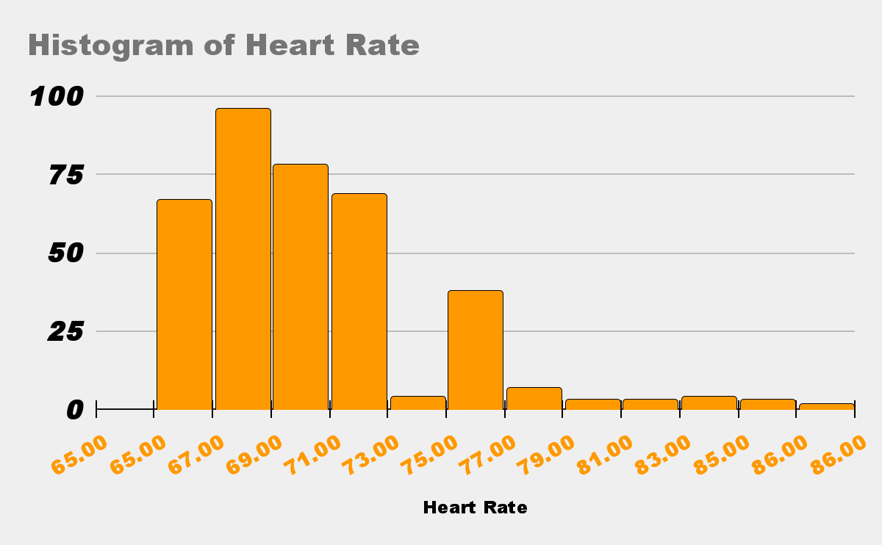
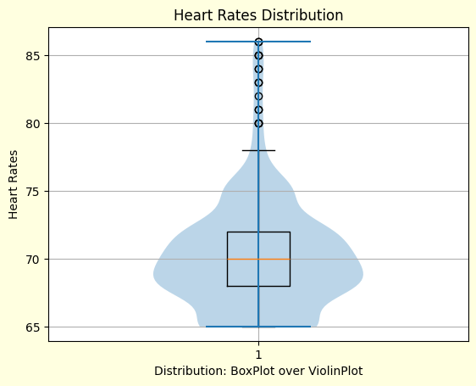
Distribution of Heart Rates
View of the Heart Rate Distribution

