Slide 1

Results on Sleep Health and Lifestyle Research
Patterns in the better sleep
Data Scientist: Jhonathan
© 2024 Udacity.

Slide 2
Agenda
Results of sleep health and lifestyle analysis
Data Description
Typical Amount of Physical Activity
Number of Daily Steps
Distribution of Heart Rates

Slide 3
Data Description
‘Age’ is an example of a continuous variable in the dataset.
‘Daily Steps’ is an example of an integer variable in the dataset.
‘BMI Category’ is an example of an ordinal categorical variable in the dataset.
‘Sleep Disorder’ is an example of a nominal categorical variable in the dataset.

Slide 4
Typical Amount (Minutes) of Physical Activity
MEAN | MEDIAN | MODE
59.17112299 | 60 | 60

Slide 5
Analysis of Daily Steps Taken
Mean | Median | Mode
6,816.84 | 7,000.00 | 8,000.00
MAX | MIN | RANGE
10,000.00 | 3,000.00 | 7,000.00
Sum of Squares | Variance | Standard Deviation
976,383,877.01 | 2,610,652.08 | 1,615.75
Q1 | Q2 | Q3
5,600.00 | 7,000.00 | 8,000.00

Slide 6
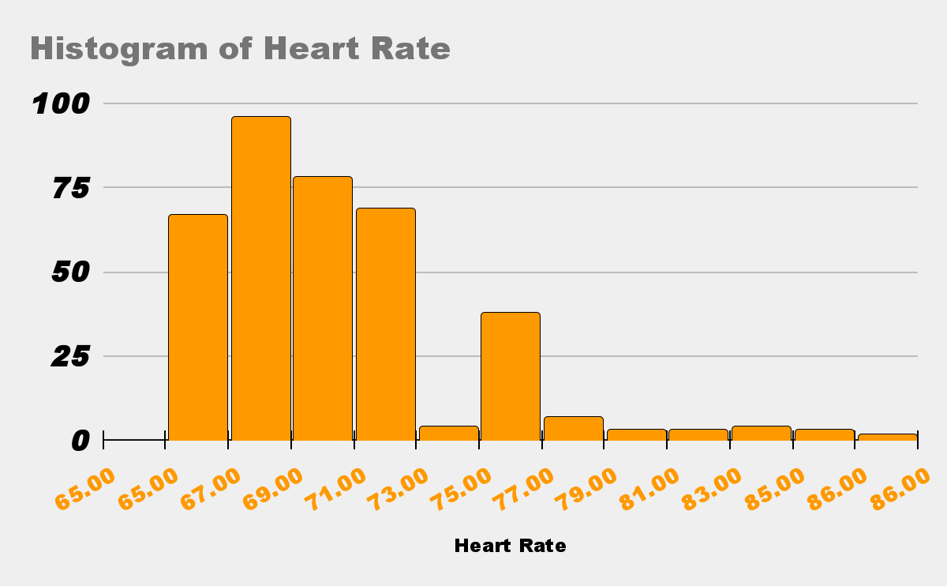
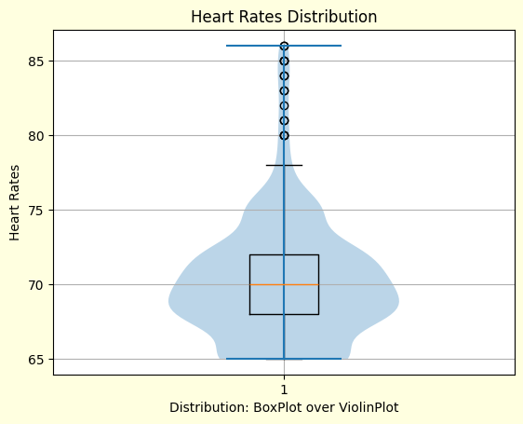
Distribution of Heart Rates
View of the Heart Rate Distribution
Heart Rate Mean:

Slide 7
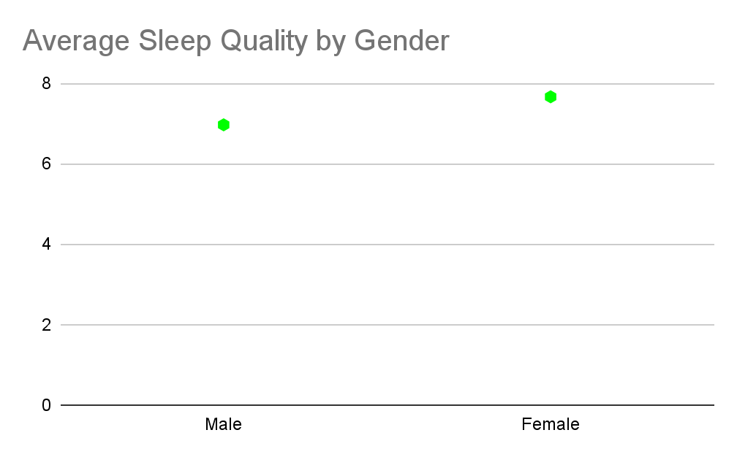
Difference between Man and Woman sleep
Woman, sleep better than man, in average.

Slide 8
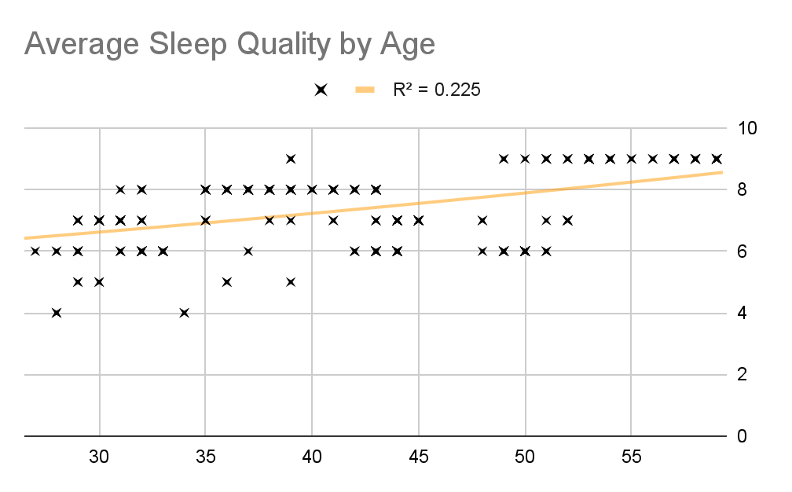
The older, the better
We can see some positive correlation between age and sleep quality

Slide 9
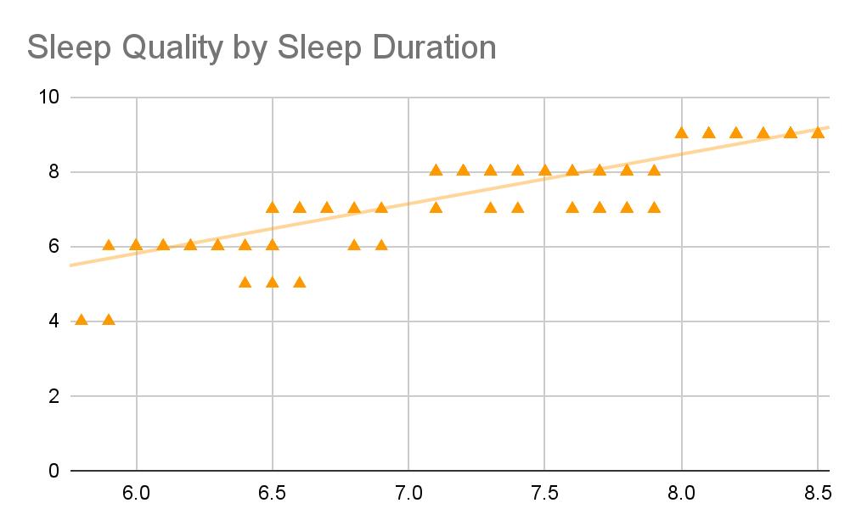
Sleep more, Sleep better
The obvious must be said?

Slide 10
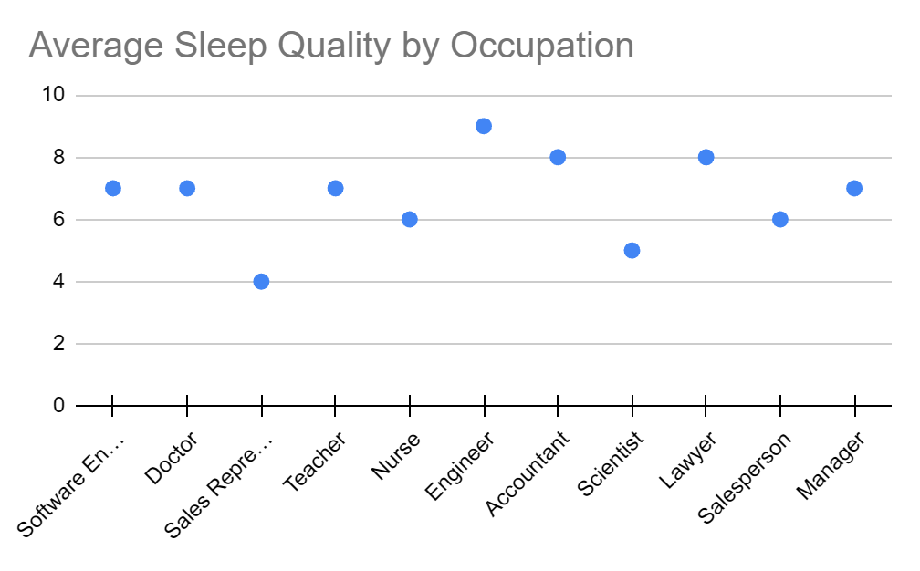
Mean of sleep quality by occupation

Slide 11
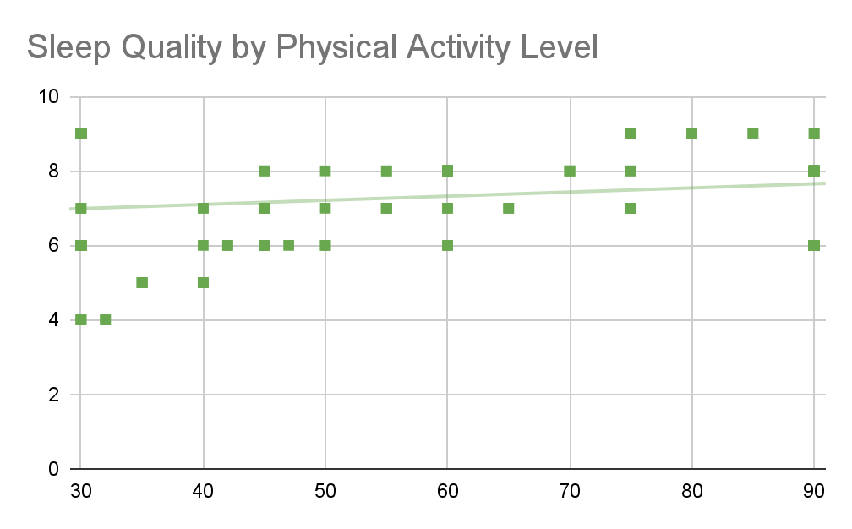
People who exercise tend to sleep better
We can a very weak positive correlation between physical activity level and sleep quality

Slide 12
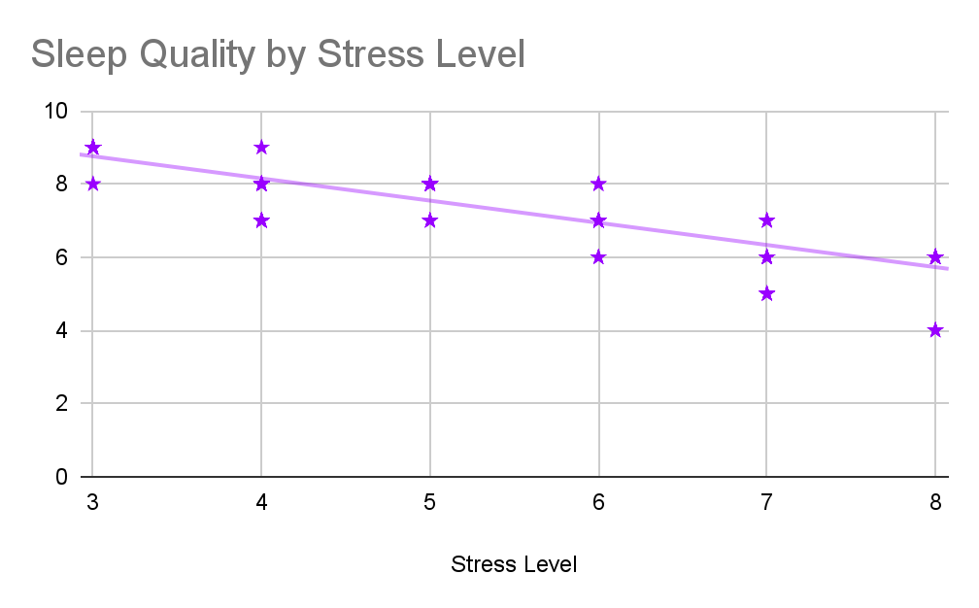
Calm down to get your rest
Stress tend to make your sleep quality worse

Slide 13
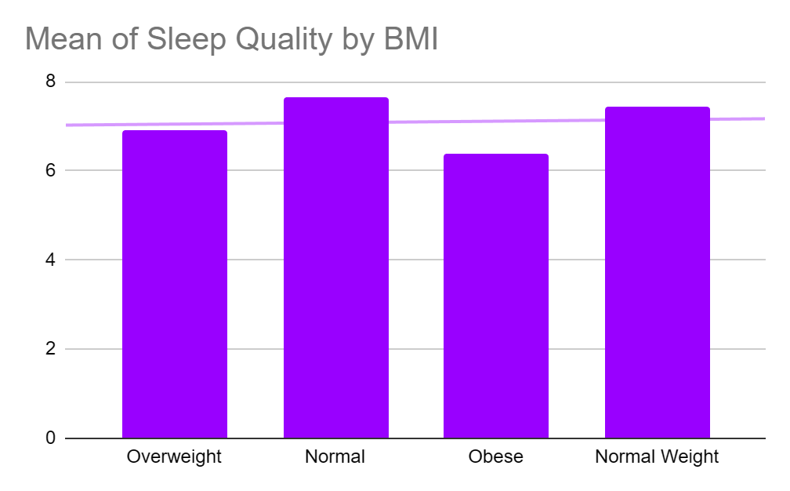
Average Sleep Quality by BMI

