Slide 1
Inheritance
The “is a” Relationship

Slide 2
Everything starts with a ‘base class’
We use the ‘abstract’ keyword to signify to the compiler that we are using a base class.
(original setup of a class)
public class Animal
{
public Animal(){ }
public int NumberOfLegs {get;set;}
//Other properties go down here
// |
// v
}
(adding the abstract keyword)
public abstract class Animal
{
public Animal(){ }
public int NumberOfLegs {get;set;}
//Other properties go down here
// |
// v
}
*abstract classes cannot be “Newed-up” (instantiated)*

Slide 3
Quick note:
-You can use inheritance w/o using the ‘abstract’ keyword.
-But not having a base class can overly complicate the ‘flow of your application’
-When we make a base class, the idea is to make an object which is the ‘starting point of all inheriting classes’

Slide 4
How to set up Inheritance
We use the ‘:’ after the class name.
(base class)
public abstract class Animal
{
public Animal(){ }
public int NumberOfLegs {get;set;}
//Other properties go down here
// |
// v
}
public class Cat : Animal
{
public Cat(){ //constructor code..}
1.ALL PROPERTIES AND METHODS FROM
2.THE ANIMAL CLASS ARE PASSED DOWN TO
THIS CAT CLASS.
3.So, this case Cat has inherited the property ‘int NumberOfLegs {get;set;}’
}
*So, a Cat “is a” Animal*

Slide 5
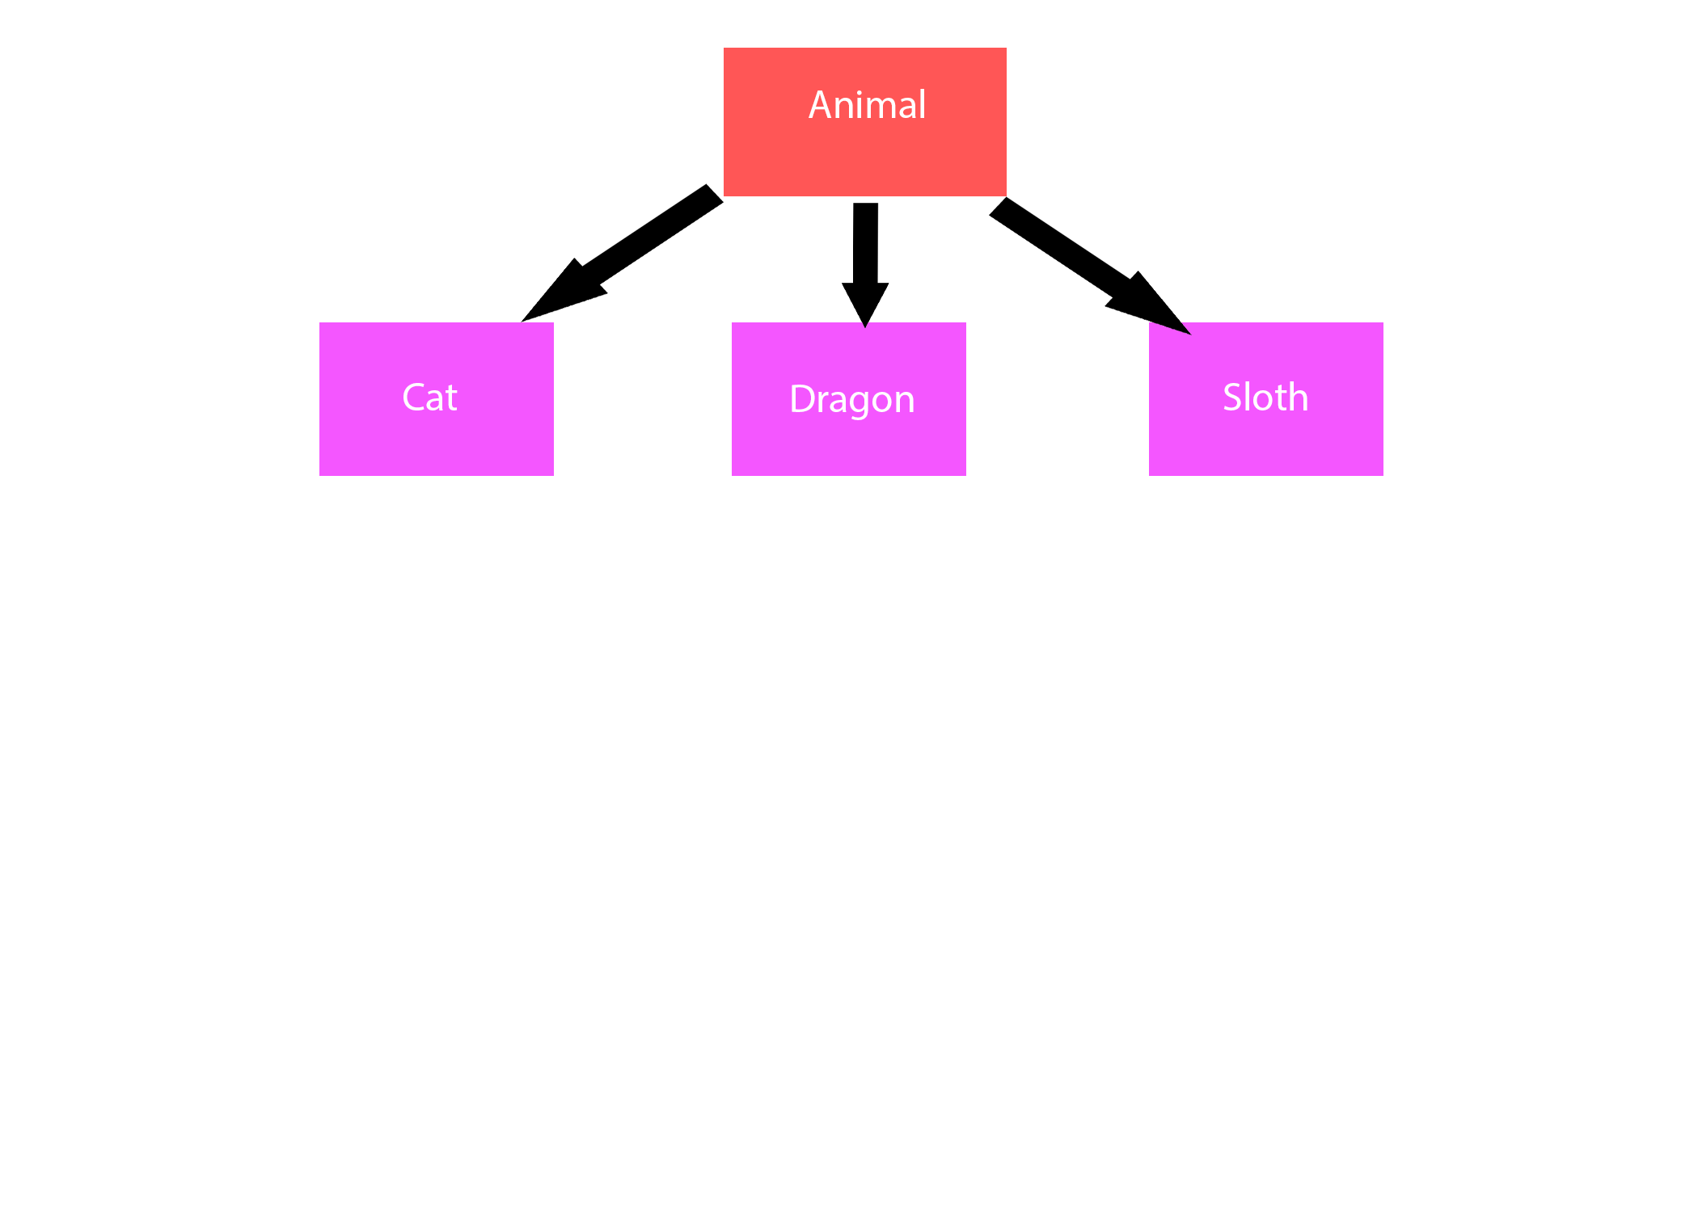
A visual representation of inheritance
- A Cat ‘is a’ Animal
-A Dragon ‘is a’ Animal
-A Sloth ‘is a’ Animal

Slide 6
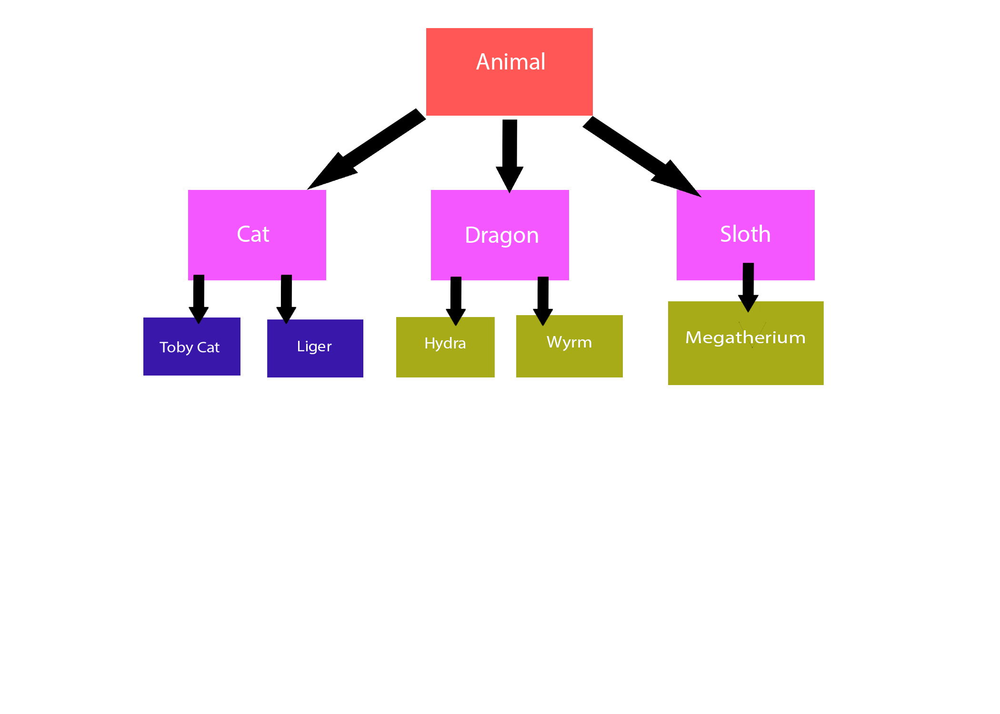
Lets go further down the inheritance chain:
-Now a Toby Cat ‘is a’ Cat
-a Liger ‘is a’ Cat
-a Hydra ‘is a’ Dragon
-a Wyrm ‘is a’ Dragon
-a Megatherium ‘is a’ Sloth
*So, you can inherit from other classes that inherit from cat!
*And each inheriting type can have its own parameters and methods.
*And all of these are of type ‘Animal’.

Slide 7
An Example:
Step:1
(original setup of a class)
public class Animal
{
public Animal(){ }
public int NumberOfLegs {get;set;}
//Other properties go down here
// |
// v
}
Step:2 (inherit from animal)
public class Cat : Animal
{
public Cat()
{
//constructor code..
}
public int NumberOfLegs {get;set;}
}
Step:3 (inherit from Cat)
public class TabbyCat : Cat
{
public TabbyCat()
{
//constructor code..
}
public int NumberOfLegs {get;set;}
public bool isTabby {get;set}
public void TabbyMethod(){}
}

Slide 8
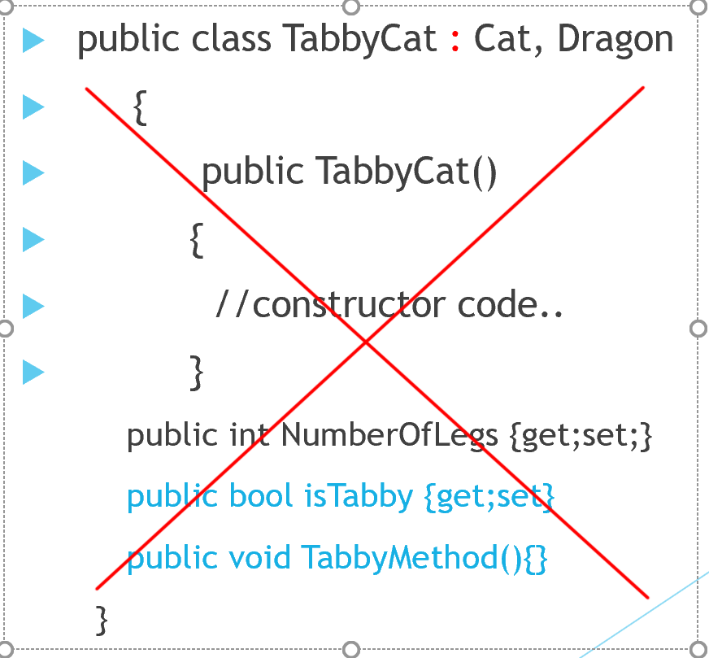
*We can only inherit from 1 class!
CANNOT INHERIT FROM BOTH CAT AND DRAGON
ONLY 1 OF THEM! (YOU WILL GET A COMPILER ERROR!
The right way:
public class TabbyCat : Cat
{
public TabbyCat()
{
//constructor code..
}
public int NumberOfLegs {get;set;}
public bool isTabby {get;set}
public void TabbyMethod(){}
}

Slide 9
Which is why:
1. Every thing ‘Trickles down’ from the base class/class(s) to derived classes.
2. So we only have vertical movement between classes.
3. Even though Cat inherits from Animal by no way or means can Cat have anything to do with the properties/methods of Dragon. Cat only has a relationship in the ‘vertical direction’.
4.But, with ‘Type inference’ the compiler can perform tasks that can pertain to anything that derives from the Animal class. So, if there is a method that takes in an Animal in its parameters any of these object(s) that derive from Animal can used.

Slide 10
The ‘virtual’ keyword:
We use the virtual keyword to Make any method(s) w/n the class re-writeable.
So,
public class Cat : Animal
{
//Method
public virtual void MakeSound()
{
Console.WriteLine(“Meow”);
}
}

Slide 11
The ‘override’ keyword:
We use the override keyword to write over any Inherited methods that are marked as virtual.
So,
public class TabbyCat : Cat
{
//Method that is being overridden
public override void MakeSound()
{
Console.WriteLine(“Purr!”);
//You can keep the base functionality from the base class if needed.
//this also calls the MakeSound method that lives on the Cat class
base.MakeSound();
}
}

Slide 12
Pros of Inheritance
1. Reduces having to repeat unnecessary code (and copying and pasting)
2. Very flexible and reserves type safety between each Inheriting type.
But……..

Slide 13
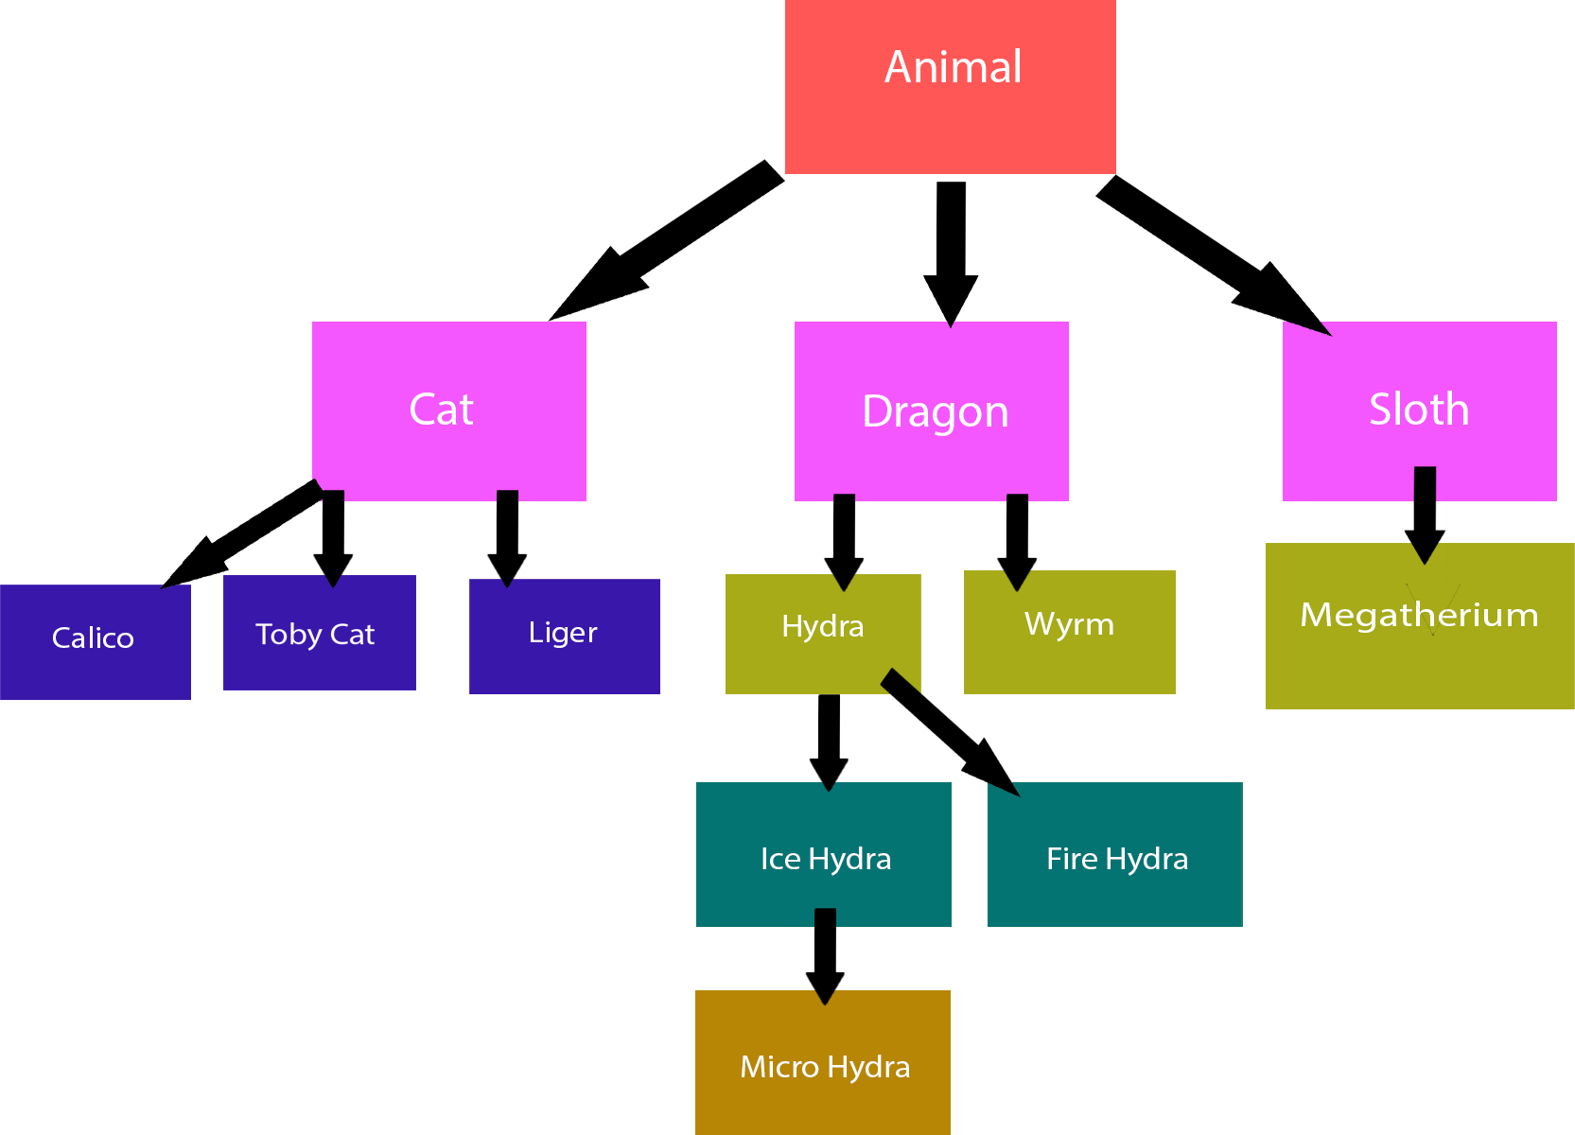
Cons of Inheritance: Code Bloat
We can have multiple inherited chains that can be quite nasty when it comes to code cleanliness.
This would become too hard to maintain. For example, the Hydra class has three concrete sub-classes and to use any of these I have to be explicit with which type I want to use. And what if I wanted a type of Ice Hydra that has a secret transformation that could give the Ice Hydra Fire Hydra moves? This cannot be obtained w/o making another Ice Hydra type with Fire Hydra properties. And even then, I would have to copy and past code b/c the rules of Inheritance states that we can only inherit from one class. This is just unstable code.
*But there is hope, Interfaces! –To be discussed later

