Slide 1
Language Embeddings w/ Ollama

Slide 2


Agenda
Language Embeddings
Ollama
Vector Database
Embedding Projections

Slide 3
Language Embeddings (app demo)
3

Slide 4
Ollama
3

Slide 5

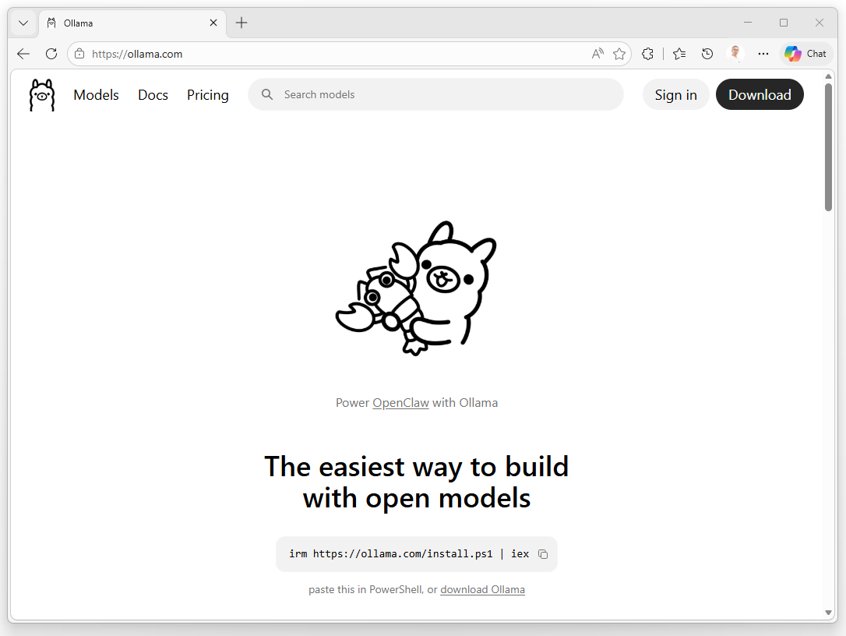
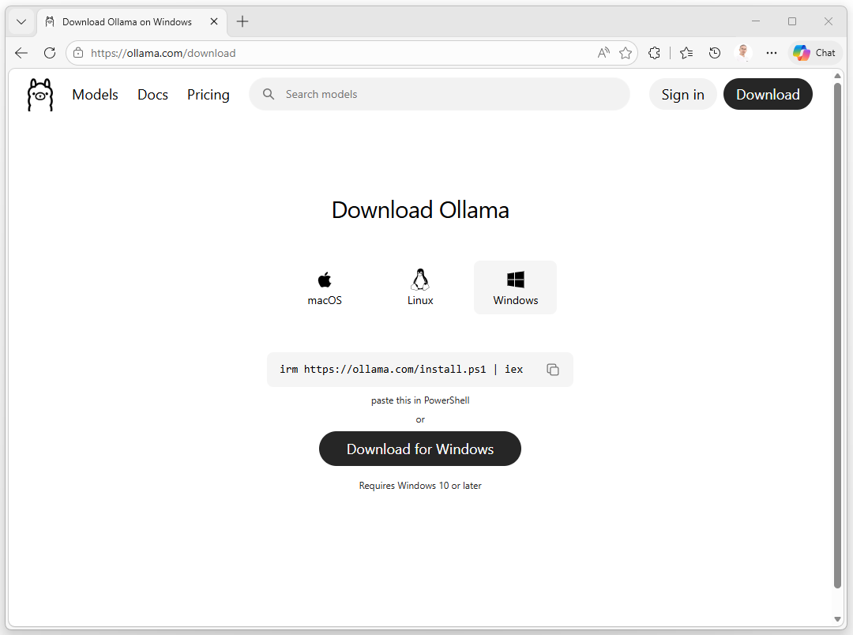
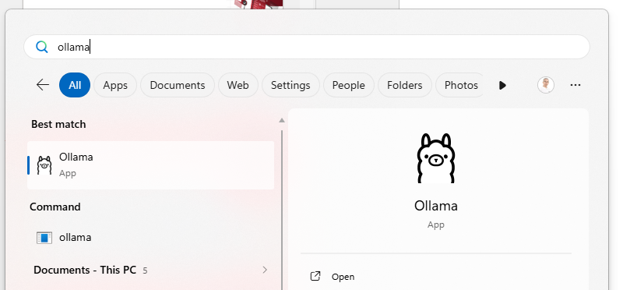
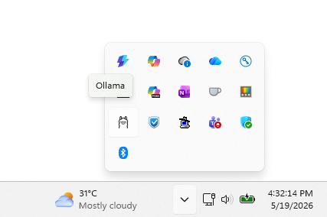
Installation

Slide 6
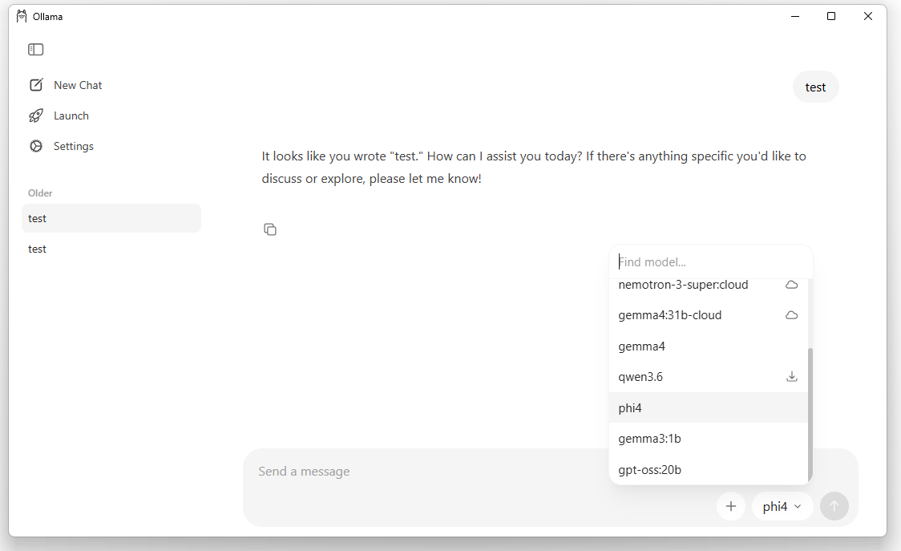
The application

Slide 7
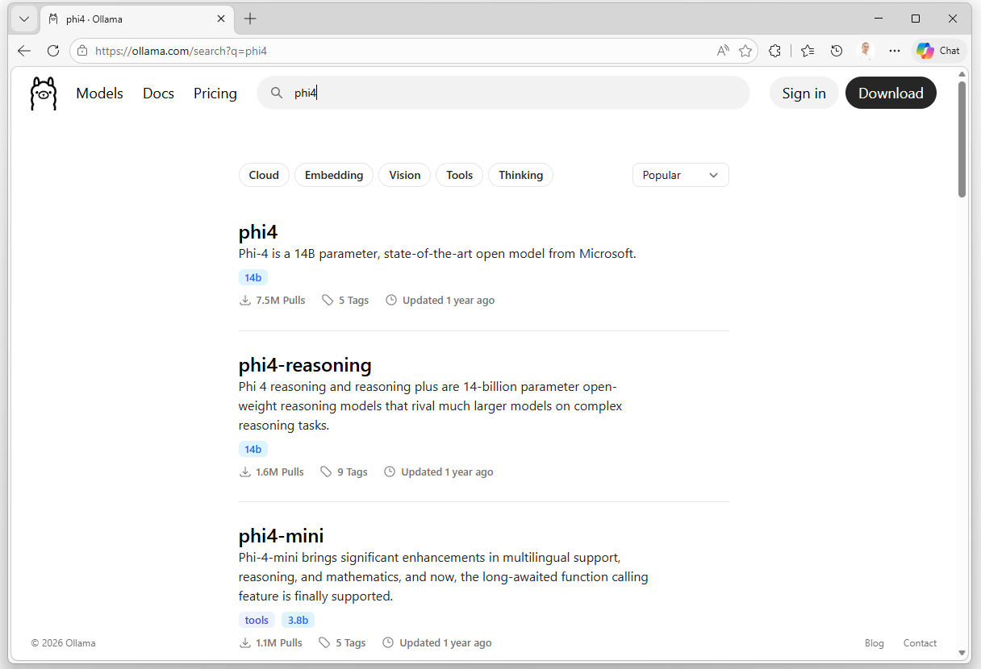
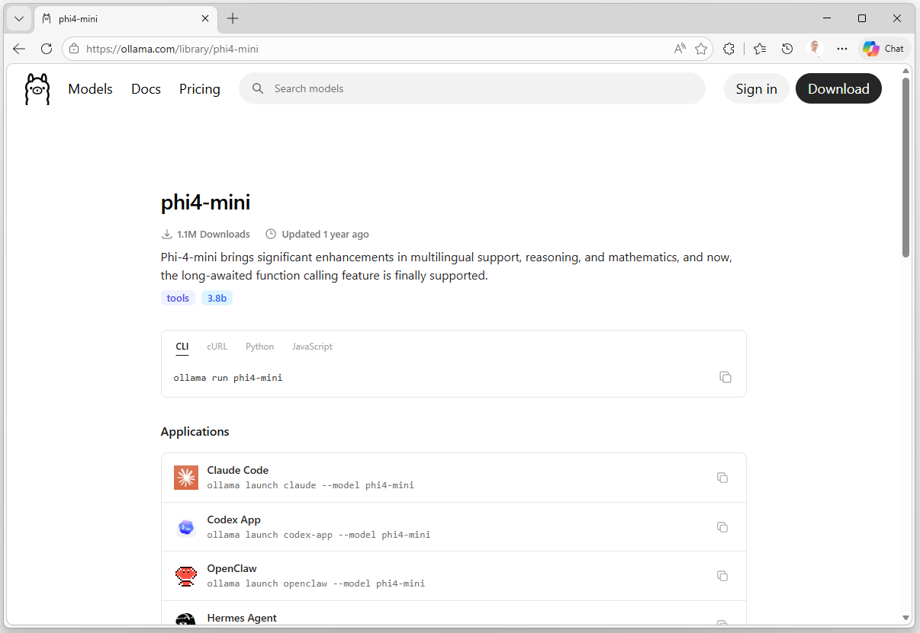
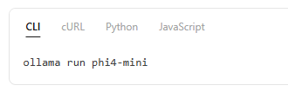
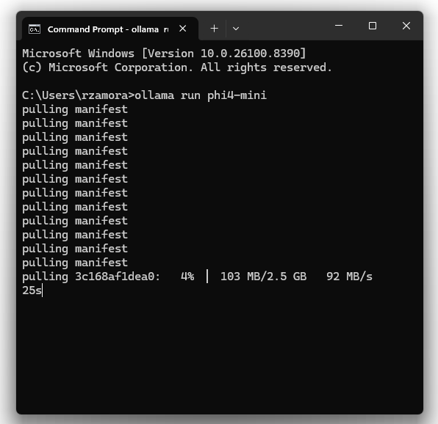
The Models

Slide 8
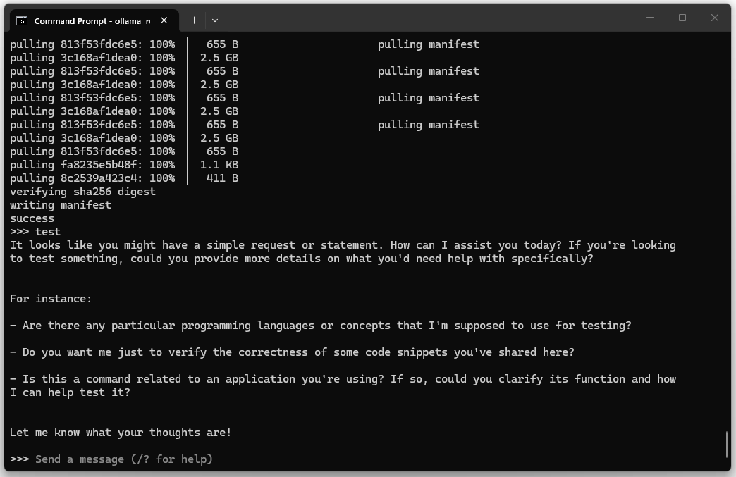
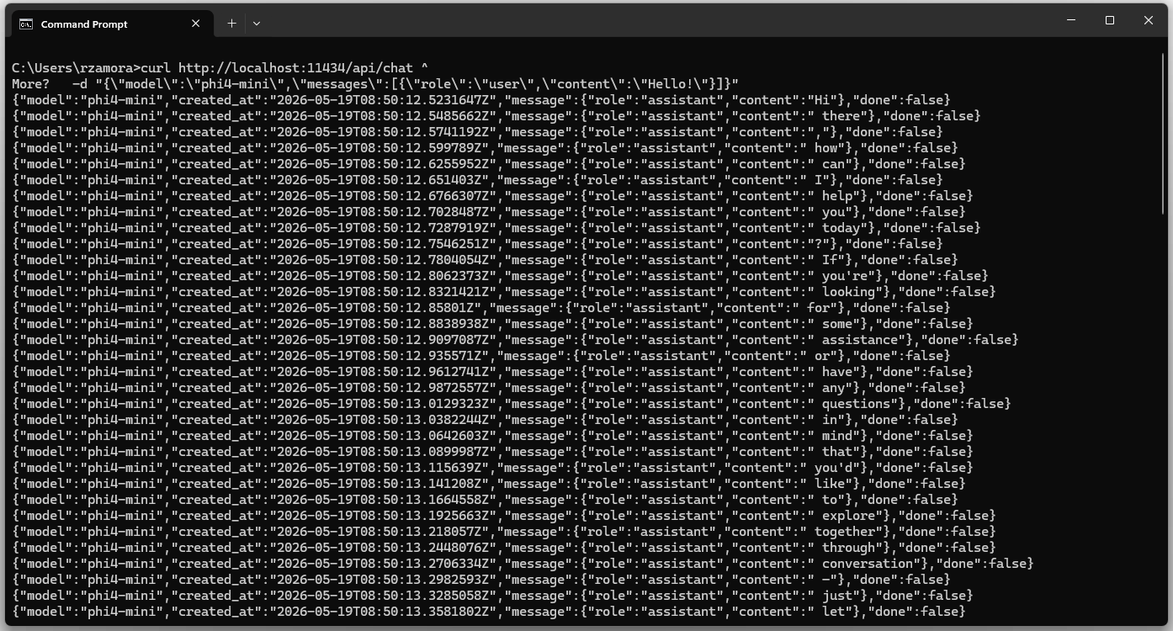
Running the Models
curl http://localhost:11434/api/chat ^
-d "{\"model\":\"phi4-mini\",
\"messages\":[{\"role\":\"user\",\"content\":\"Hello!\"}]}"

Slide 9
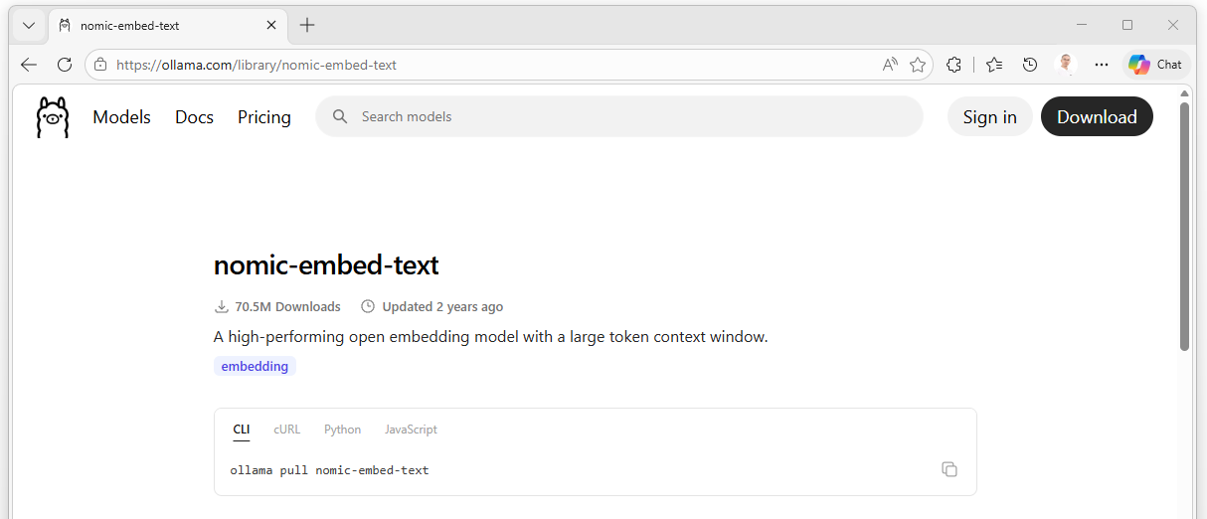
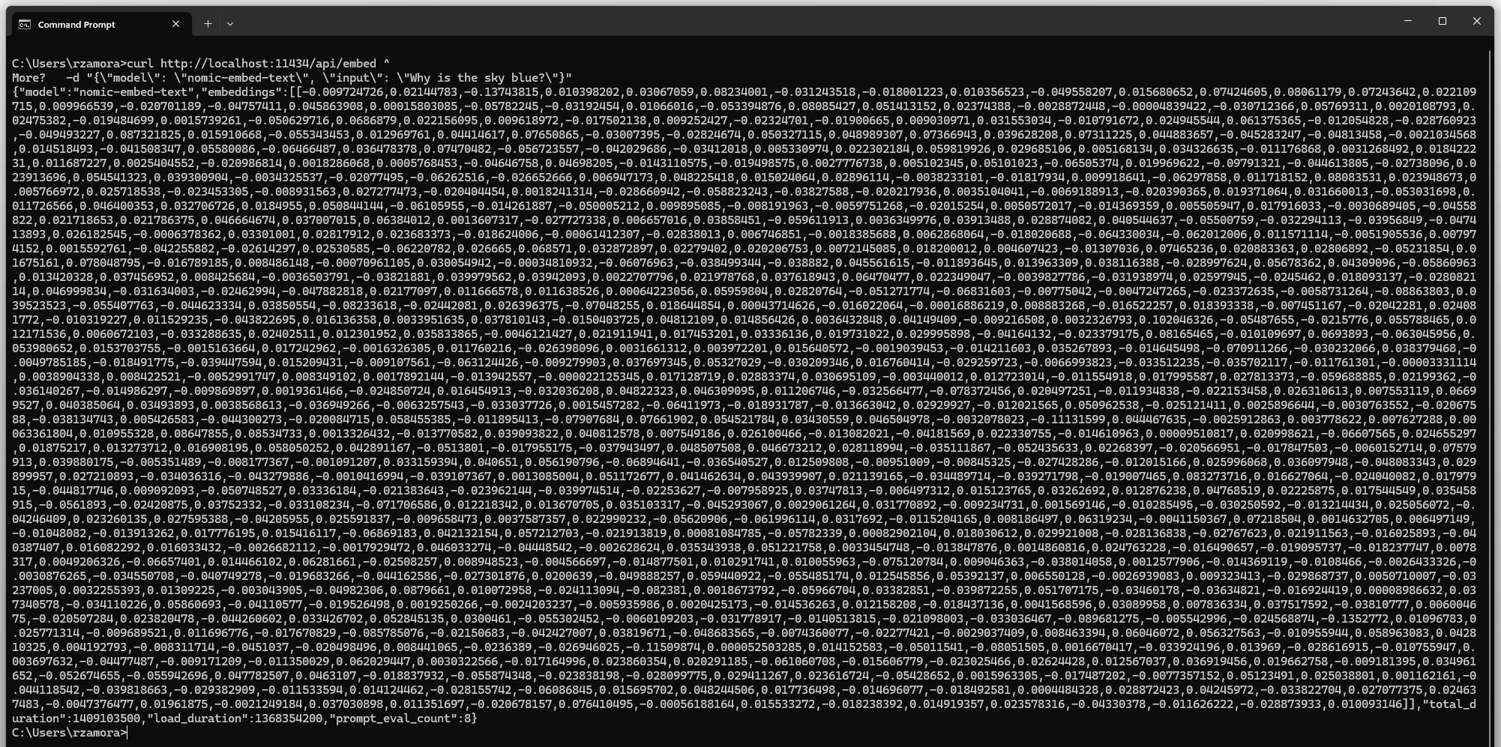
Running an Embedding Model
curl http://localhost:11434/api/embed ^
-d "{\"model\": \"nomic-embed-text\", \"input\": \"Why is the sky blue?\"}"

Slide 10
Vector Databases Postgres DB + pgvector (code demo)
3

Slide 11
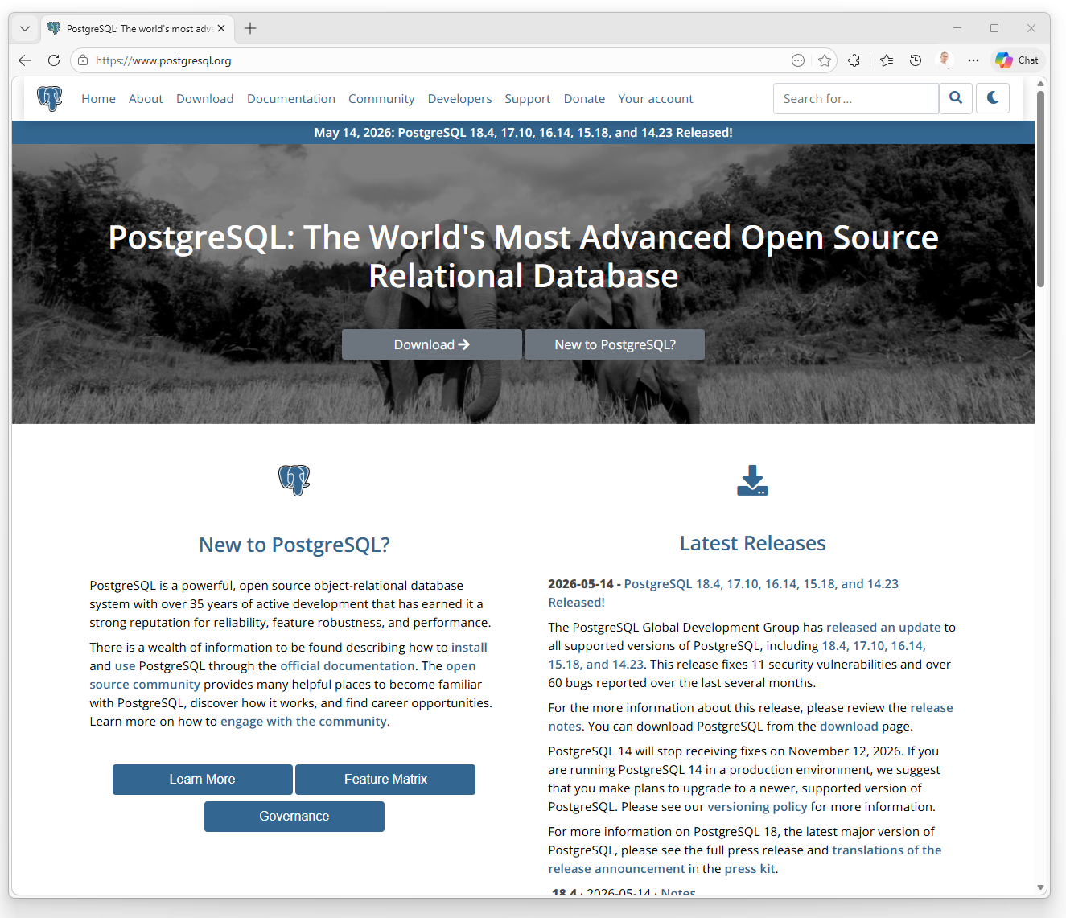
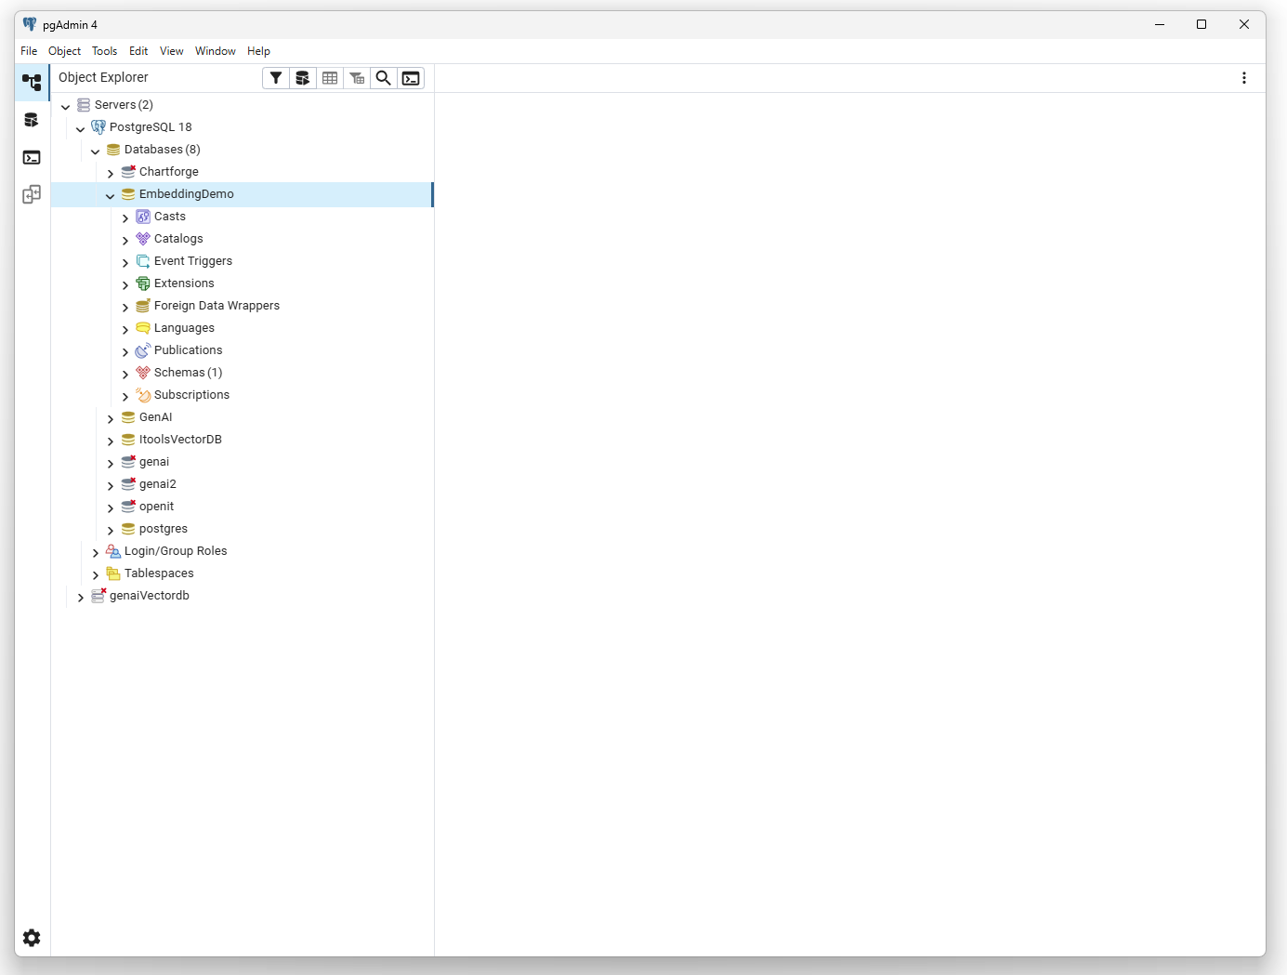
Install PostgreSQL and pgAdmin

Slide 12
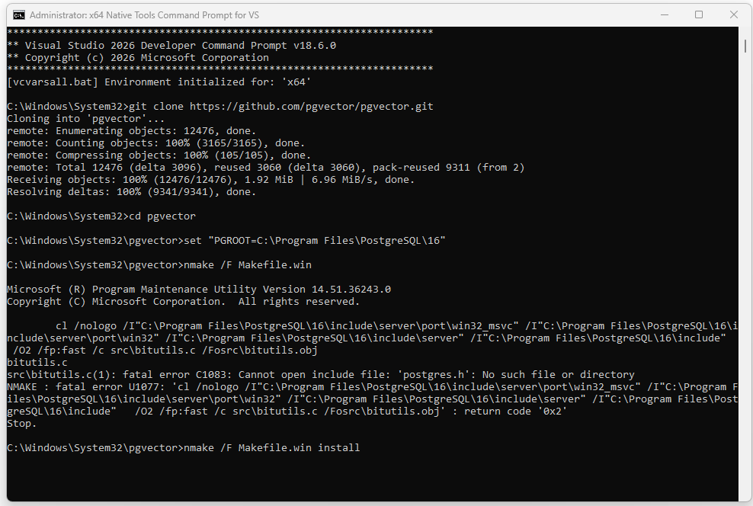
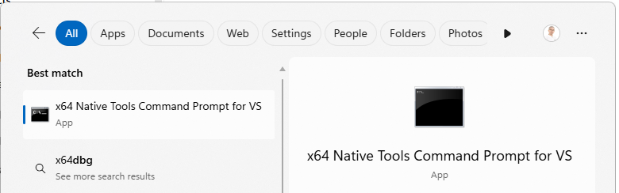
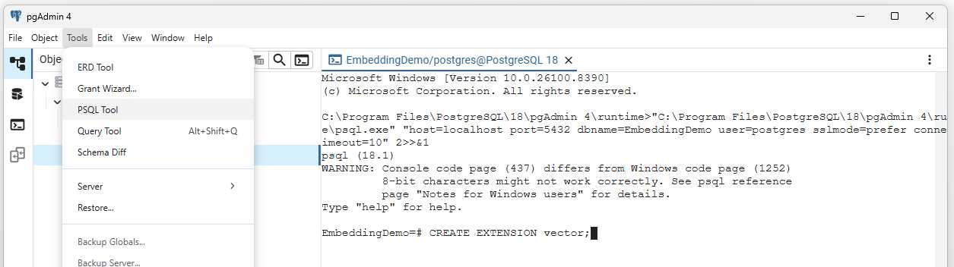
Install pgvector
1. Run as Admin x64 Native Tools Command Prompt for VS 2022
2. On the CLI
C:\> git clone https://github.com/pgvector/pgvector.git
C:\>cd pgvector
C:\>set "PGROOT=C:\Program Files\PostgreSQL\16« C:\>nmake /F Makefile.win
C:\>nmake /F Makefile.win install
3. On the PSQL Tool
CREATE EXTENSION vector;
\dx

Slide 13
Embedding Projections PCA, UMAP
3

Slide 14
Get In Touch With Us
getstarted@openit.com

Slide 15
Thank You.

