Slide 1

MICROSERVICES
By: Jhonny Villarroel

Slide 2

What are Microservices ?
Microservices is a way of designing software independently deployable services, automated deployment, intelligence in the endpoints, and decentralized control of languages and data.
Recovered from: (https://martinfowler.com/articles/microservices.html)

Slide 3
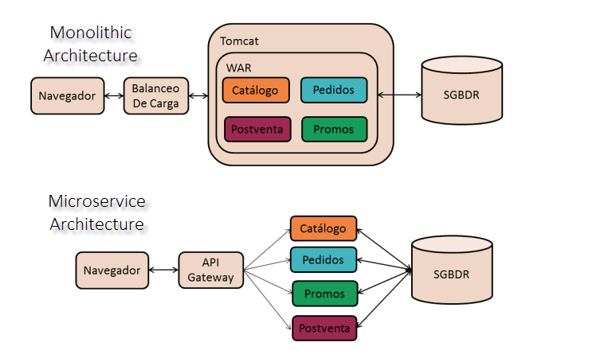
Microservices Vs Monolithic Architecture

Slide 4
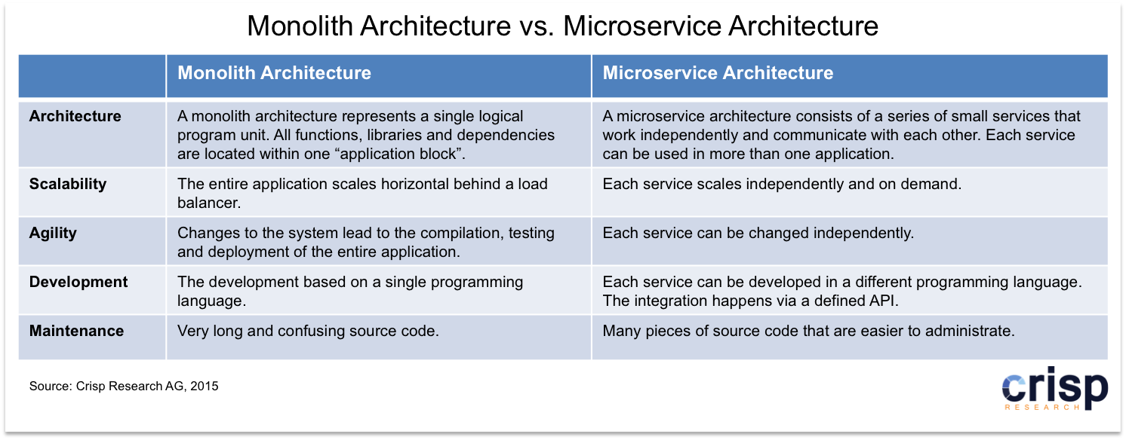
Microservices Vs Monolithic Architecture

Slide 5

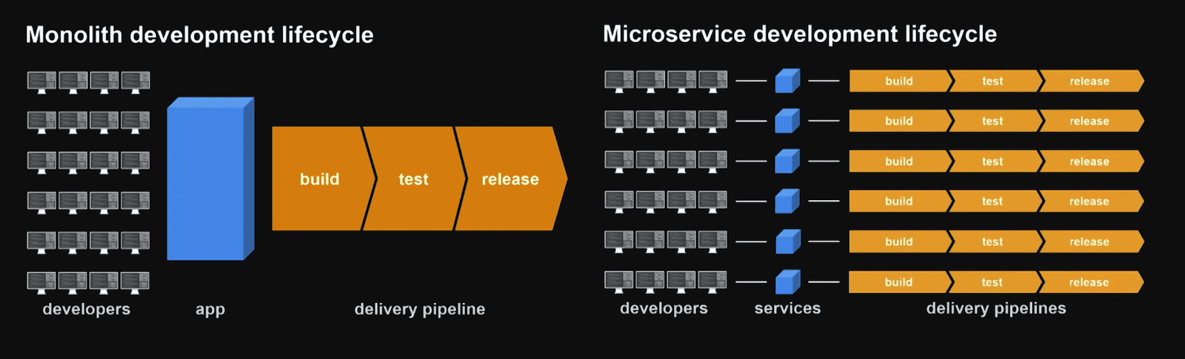
Continues Integration Advantages

Slide 6



Microservices Frameworks
There are good frameworks to implement microservices in java.
Netflix OSS
Spring Cloud
Eventuate

Slide 7
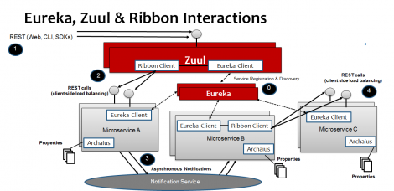
Spring Cloud
Spring Cloud provides tools for developers to quickly build some of the common patterns in distributed systems
(e.g. configuration management, service discovery/registry, circuit breakers, intelligent routing).

Slide 8
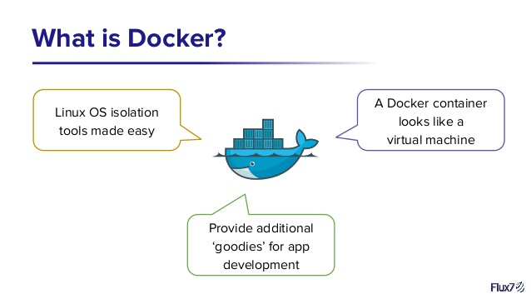
Scalable Infrastructure with Docker

Slide 9
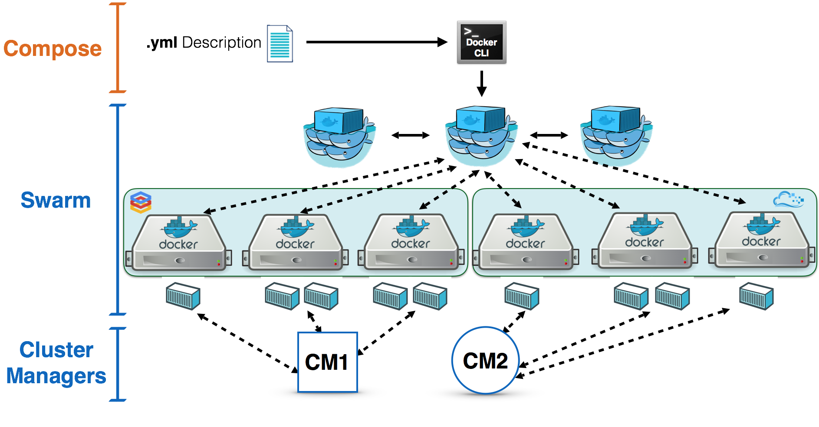
Scalable Infrastructure with Docker

Slide 10

DEMO

Slide 11

Form Builder

Slide 12
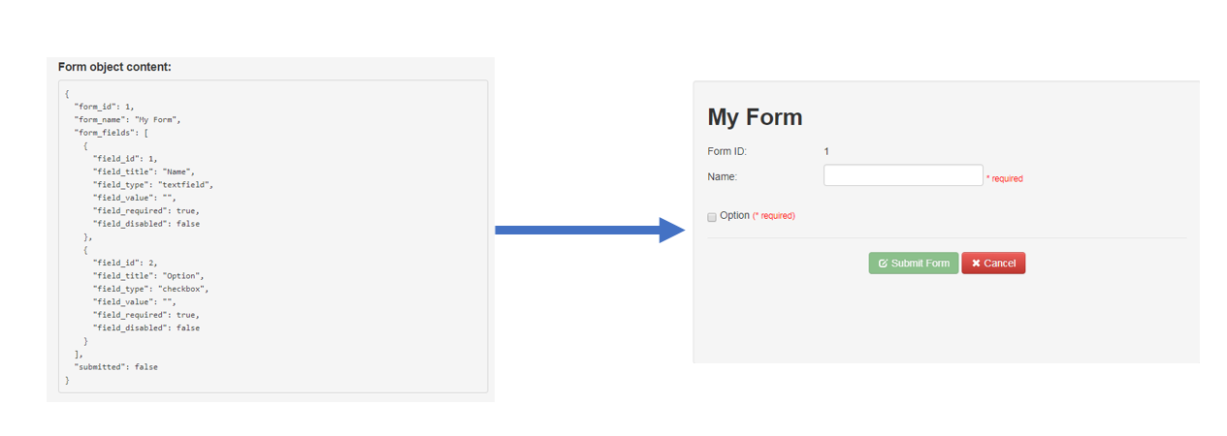
DEMO

Slide 13
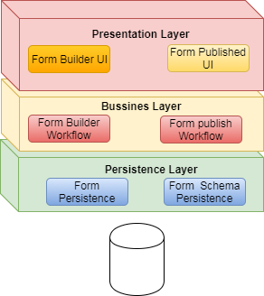
Form builder Monolithic Architecture

Slide 14
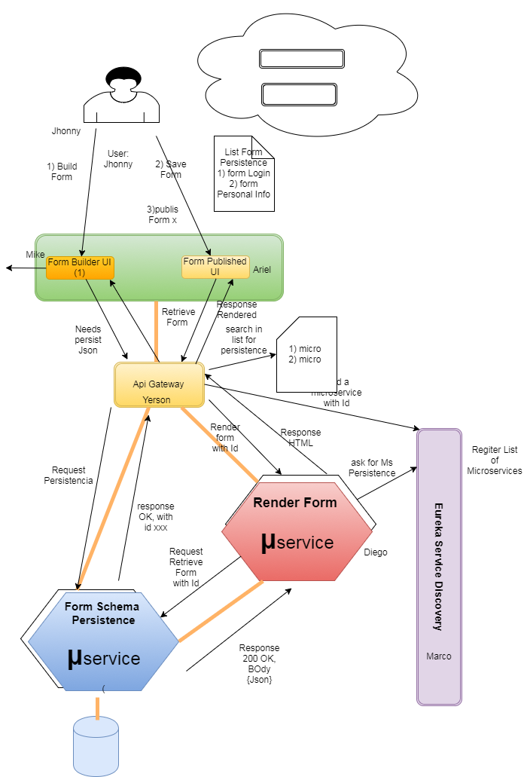
Form builder Microservice Architecture

