Slide 1
NFL-Player Evaluation
💲💲💲
💲💲💲
💲💲💲
💲💲
💲💲💲
💲💲
💲💲💲
💲💲💲
💲💲💲
💲💲💲
Jhonsen Djajamuliadi
Project #2 @ METIS Bootcamp

Slide 2

Why Evaluate NFL Players?
NFL multibillion-dollar industry
Team Manager’s Goal
Build a dream team,
but spend less $$$
Challenges in NFL analytics
Player’s performance depends on many factors
Subjective evaluation
Limited Methods ^{[1,2,3]}
Machine Learning
[1]https://en.wikipedia.org/wiki/Moneyball_(film)#/media/File:Moneyball_Poster.jpg
Kuzmits et al.(2008) 22:1721-1727; McGee et al. (2003) JSC 17:6-11; Park, P. (2017) Thesis

Slide 3
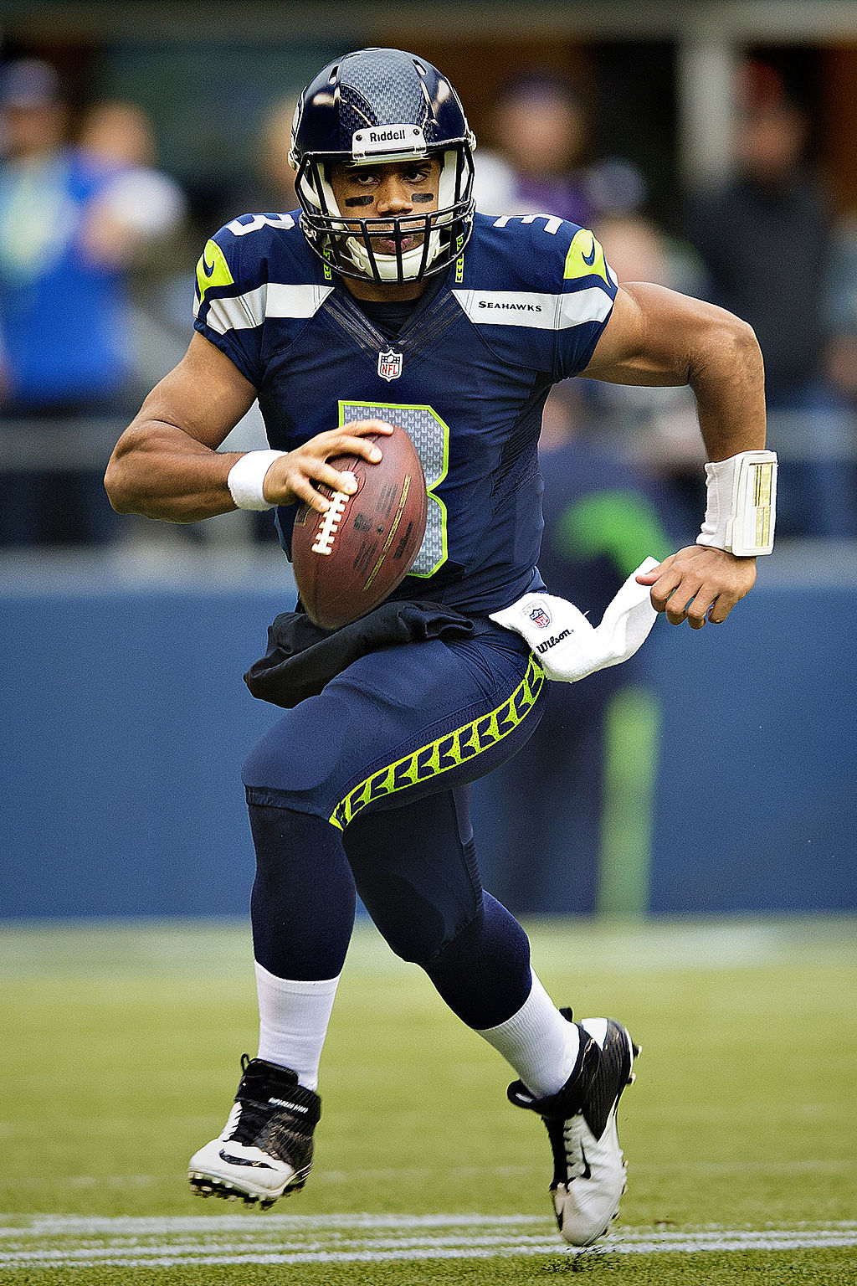
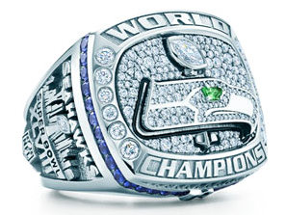
Project Goal & Methodology
Question:
Was Russell Wilson Underpaid?
What’s his value?
Initial Contract (<1 mil/yr)
$$$
1st
4th
2012
2014
XLIX
2016
2013
XLVIII
2015
https://en.wikipedia.org/wiki/Russell_Wilson

Slide 4

Web Scraping and Data-Wrangling
NFL Analytics is complex!
Sources:
Pro-football-reference – players stats
Spotrac – players salary
Variables
Target
Performance Metrics
NFL Combine results
Performance stats
Base Salary
Iterate over 15 year-span (2000-2014)
3 Positions:
Running Backs
Receivers
Quarterbacks
$$$
1st
4th
5th
(190 rows)
2012
2013
2014
2015
2016

Slide 5
Data Collection and -Wrangling
NFL Analytics is complex!
Sources:
Pro-football-reference – players stats
Spotrac – players salary
Variables
Target
Performance Metrics
NFL Combine results
Performance stats
Base Salary
Iterate over 15 year span (2000-2014)
3 Positions:
Running Backs
Receivers
Quarterbacks
$$$
1st
4th
(356 rows)
2012
2013
2014
2015
2016

Slide 6
Wrangling & Feature Engineering
Data structure
@
#
#,+
#,+
#,+
#,+
#,+
#,+
@ 1-Hot Encoding
# Transformations
Log1p
Box-cox
Yeo-Johnson
+ Engineering
USD inflation rate applied
Weighted average of Yards & Touchdowns
Dimension: (356 rows, 11 features)

Slide 7
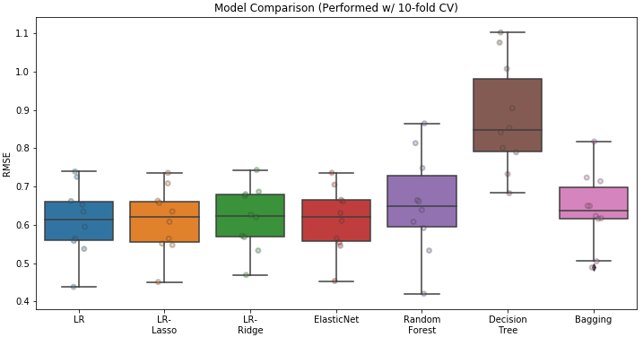
Best Model for Player Evaluation?
Linear regression methods show similar performance
*
*
*
Keep It Simple data-Scientist!
*λ: 0.03, 246, 0.07
Tree-based regressors (out-of-the-box) perform worse

Slide 8
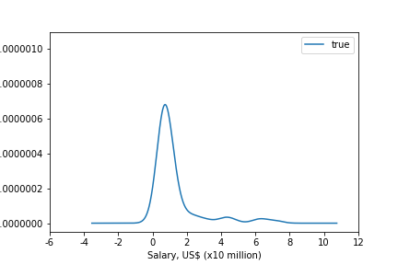
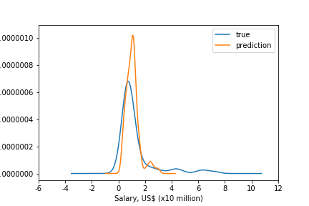
Model Performance of Simple LR
Distribution of Salaries in Test Set
Similar distributions and comparable lineshapes
Some discrepancies
Pretty good model!
Error ~USD 1.1 million (RMSE)
http://turnersnips.blogspot.com/2011/07/conclusion-of-conventions-of-videos-in.html

Slide 9
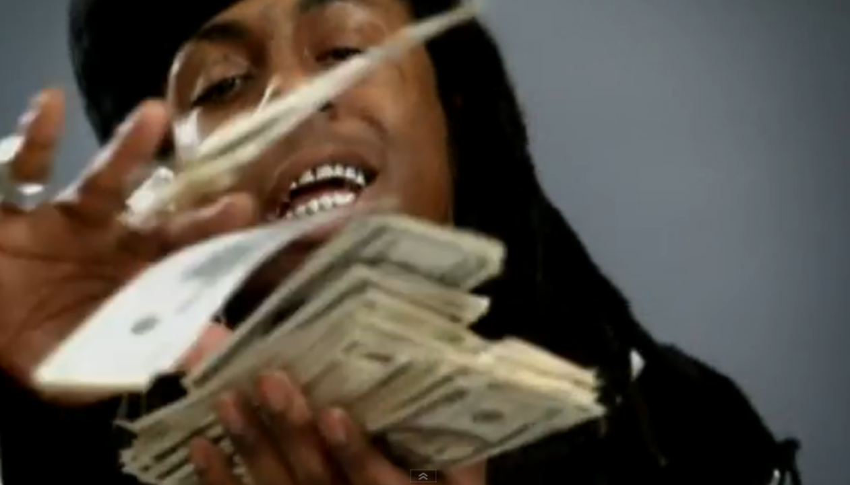
Model Performance of Simple LR
Distribution of Salaries in Test Set
Similar distributions and comparable lineshapes
Some discrepancies
Pretty good model!
Error ~USD 1.1 million (RMSE)

Slide 10
Model Improvement & Future Work
Obtain more data
NFL.com’s API to collect missing data, < year 2000
Explore other ways of feature engineering
Opportunity Factor : minutes played /game, injury in depth chart, etc.
Interaction terms : coach’s strategy ∝ offensive lines ∝ QB
Nurture vs Nature : motivation? neighborhood of origin?
Progress towards bigger breakthroughs in NFL analytics using ML

Slide 11
Answering the $10⁶ Question!
Question:
Was Russell Wilson underpaid?
Given his performance stats:
Our LR model:
$2.6 mil
Actual Salary:
< $1 mil
$$$
Answer:
YES!
https://en.wikipedia.org/wiki/Russell_Wilson

Slide 12
Thank You…
Fun Facts from EDA:
Roughly 60-70% players drop out within 5 years.
Quarterbacks make 2x as much $$$ than other positions
Tom Brady made < 0.5 mil USD/year in his first 5 years of NFL career

Slide 13
Appendix

Slide 14
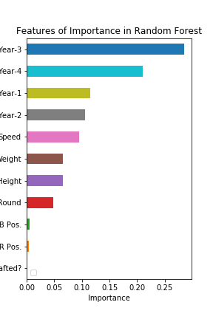
Features of Importance in RF Model
Players performance in Year-3 & Year-4 play a huge role in the model
Players don’t need to get drafted, to get paid!
Drafted?

Slide 15
Tree-Based Regressors

Slide 16
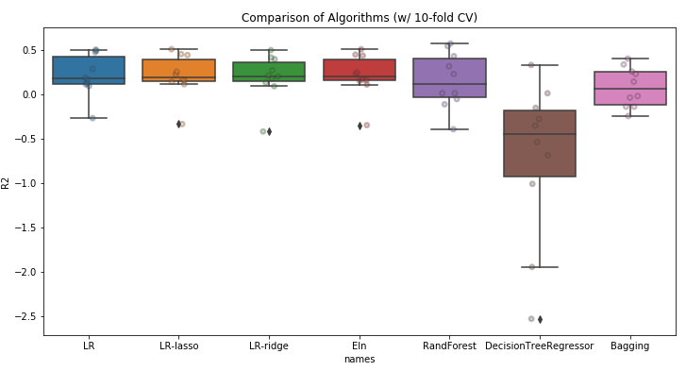
R² Values in Training Set (w/ 10-fold CV)
LR-methods perform better
Note:
Lambdas in Ridge, Lasso & ElasticNet were tuned, but tree-based hyperparameters were not tuned

Slide 17
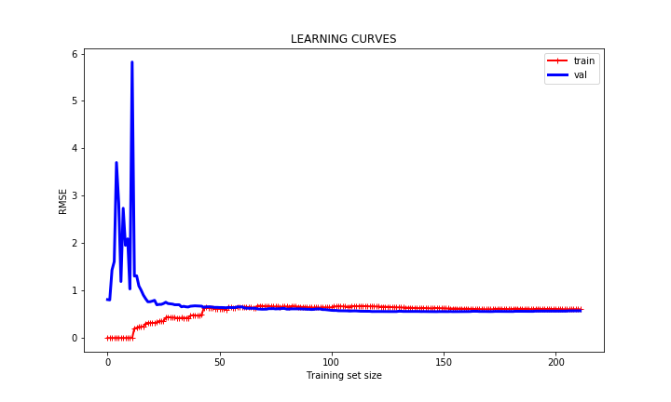
Do We Have Sufficient Training Set?
Training- and Validation errors achieve convergence

Slide 18
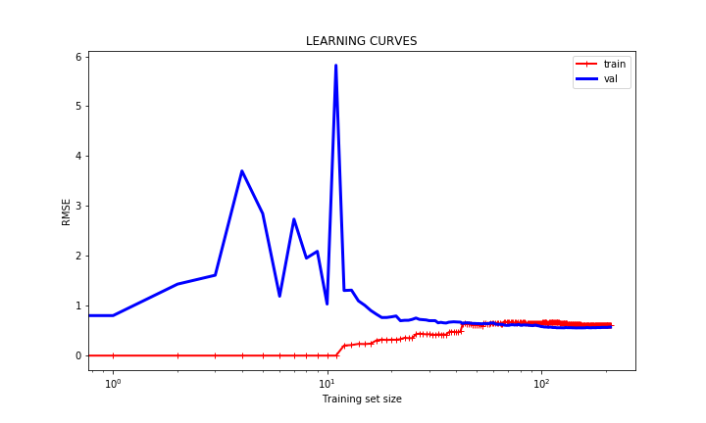
Do We Have Sufficient Training Set?
Training and Validation errors achieve convergence

Slide 19
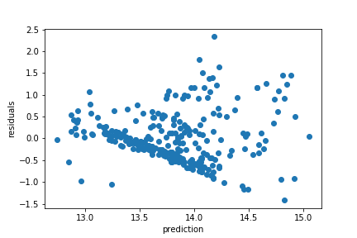

Predictions vs. Residuals
Something looks fishy here!
Target and/or variables require transformations

Slide 20
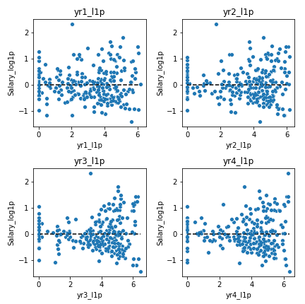

Residuals vs. Numerical Features
Training Set
A few variables still reflect odd-looking residuals, despite transformations

Slide 21
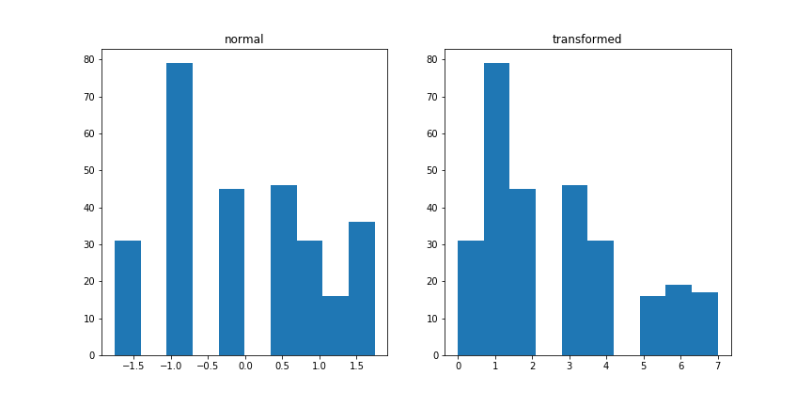
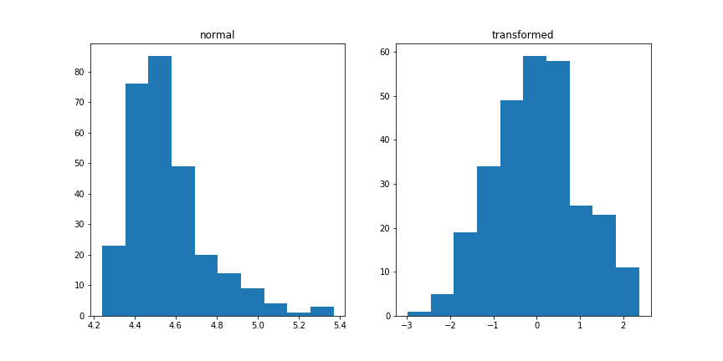
Histograms of Weight and Draft-Round
Box-cox transformation on dash
Yeo-Johnson transformation on draft-Round

Slide 22
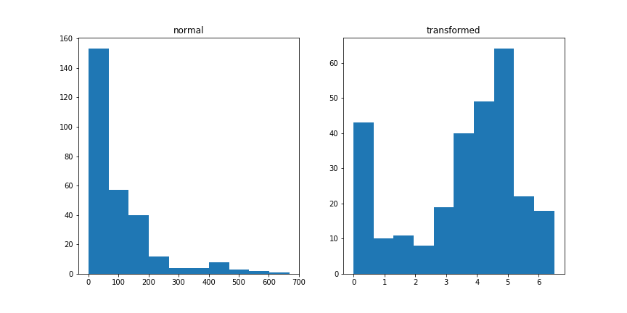
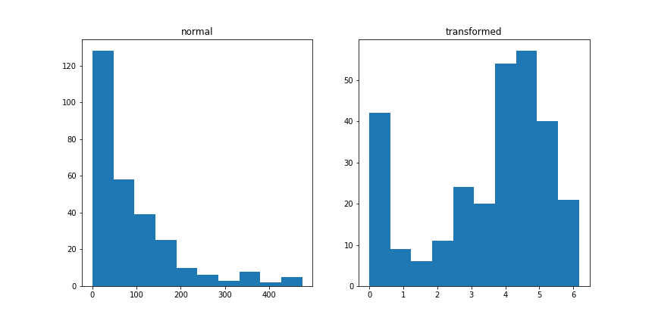
Histograms of Player Performance
Log1p transformations on year-1 & year-2

Slide 23
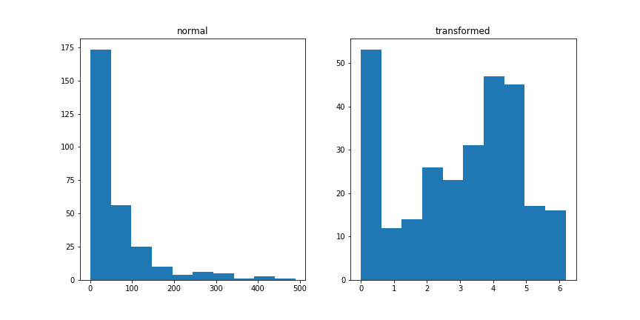
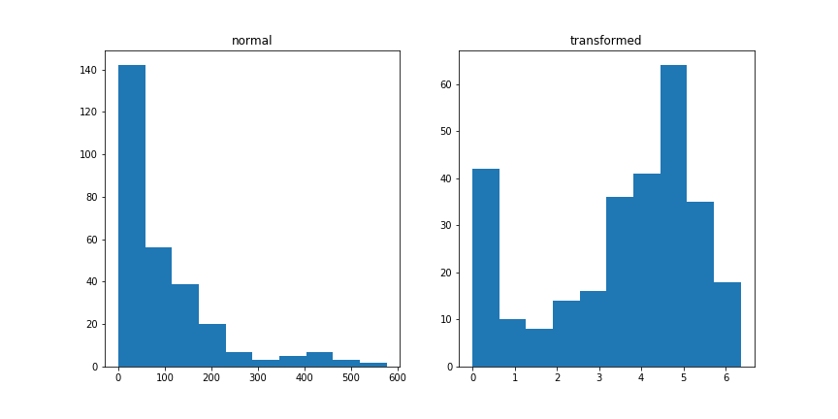
Histograms of Player Performance
Log1p transformations on year-3 & year-4

Slide 24
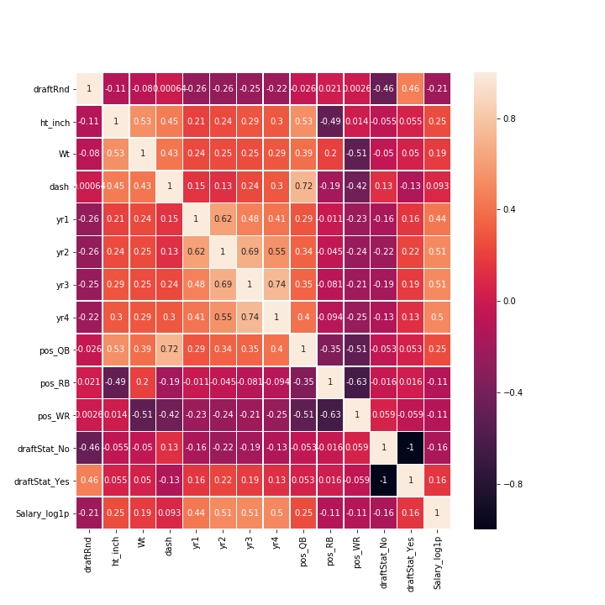
Correlations: Variables & Target
Player performance: Year-1 thru Year-4 show Pearson’s correlation of 0.4-0.5
Other variables: <0.25

Slide 25
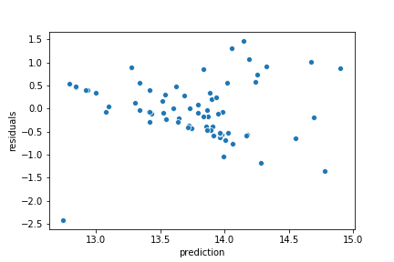
Predictions vs. Residuals
Test Set

Slide 26
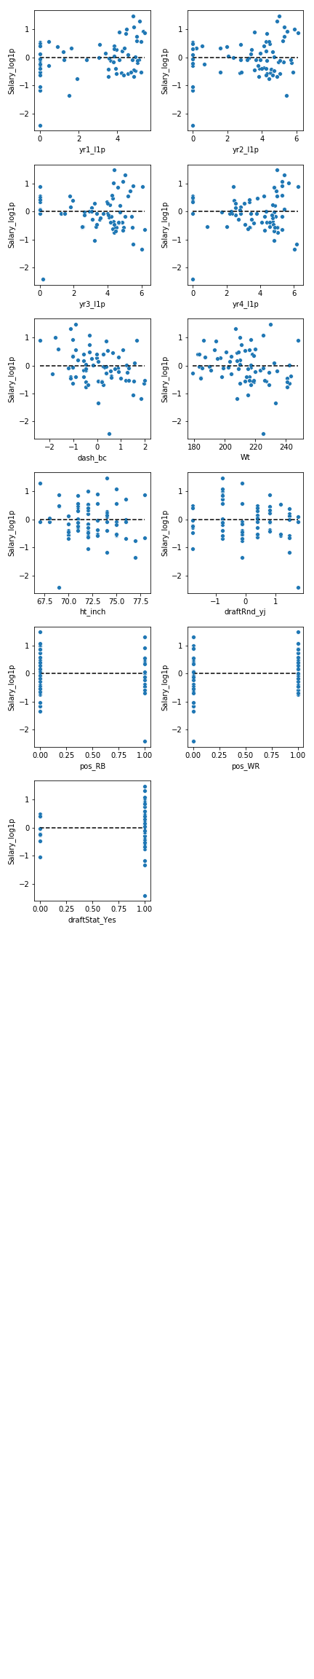
Residuals vs. Numerical Features
Test (hold-out) Set

