Slide 1
Android for beginners
http://jhoobergs.github.io/AndroidForBeginners/

Slide 2
Jesse Hoobergs
2e bachelor engineering science
Computer science and electrical engineering
Lead Android developer @ Quivr
http://jhoobergs.github.io/AndroidForBeginners/

Slide 3
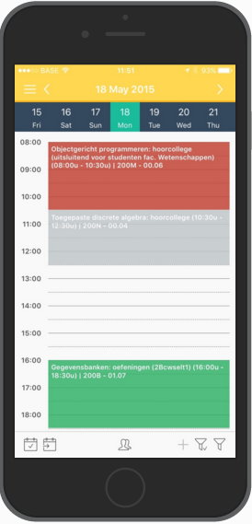
Quivr
App for students
Android, Ios, Windows Phone and Web
Schedule for KUL-students
Menu of the student-restaurants
Occupancy and opening hours of the library
More than 15000 daily users
http://jhoobergs.github.io/AndroidForBeginners/

Slide 4
Requirements
- Android Studio (http://developer.android.com/sdk/index.html)
- Android sdk’s
- Genymotion (https://www.genymotion.com/#!/store -> free version)
(- Android phone and usb cable)
http://jhoobergs.github.io/AndroidForBeginners/
Notes:
When installing android Studio, the latest sdk should be installed
Genymotion is a alternative emulator that works with virtualbox, it is much better and quicker than the emulator of android itself.

Slide 5
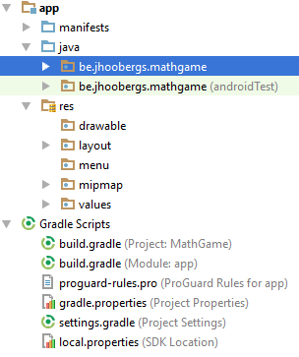
Structure of an Android project
http://jhoobergs.github.io/AndroidForBeginners/
Notes:
- I will explain all files in depth first.

Slide 6
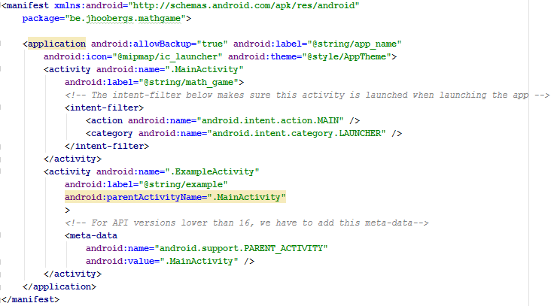
Manifest
http://jhoobergs.github.io/AndroidForBeginners/
manifests\AndroidManifest.xml
Notes:
Global config of the app.
Application with all activities
Launcher via intent-filter
ParentActivity

Slide 7
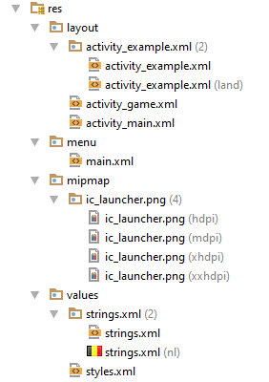
Resources
http://jhoobergs.github.io/AndroidForBeginners/
Notes:
All resources of the app (images, strings, layout …)
Drawable: All images used in the app. (png)
Layout: Contains all layoutfiles. Layoutfiles can have multiple variants, for example a different variant for portrait-modus and landscape-modus. Multiple options: For example a different layout for android 5 and android 4.
Menu: Contains the layoutfiles with all menu-items of the menu
Mipmap: New version of drawable that should only contain the icon of the app. Also different versions for different resolutions.
Values: This folder contains xml files that contain strings, styles, dimensions, colors

Slide 8
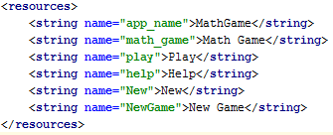
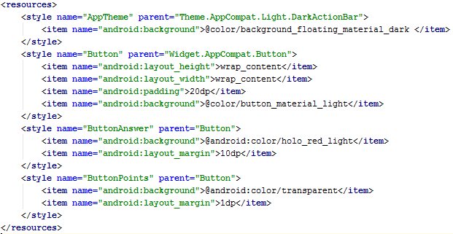
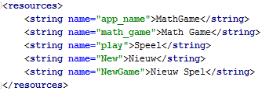
Values
Strings.xml
Styles.xml
Strings.xml (nl)
http://jhoobergs.github.io/AndroidForBeginners/
Notes:
Strings: Keys-value pair: Easy translation
Styles: Name and parent

Slide 9
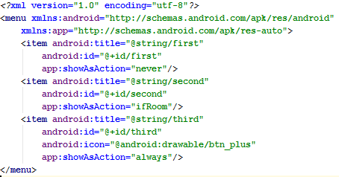
Menu
http://jhoobergs.github.io/AndroidForBeginners/
Notes:
Menuitems have a title, id, icon and showAsAction

Slide 10
Layout
Views:
layout_width en layout_height (required)
4 possible values:
wrap_content
match_parent
Fill_parent (from android 2.* it’s equal to match_parent) (DON’T USE)
Absolute value (in dp)
<View android:layout_width=“wrap_content" android:layout_height="wrap_content“/>
http://jhoobergs.github.io/AndroidForBeginners/
Notes:
Every view has a width and height
- “3“ possible values

Slide 11
View(holders)
LinearLayout
Has an orientation: Vertical or Horizontal (android:orientation)
Possibility to give view a width or height in percentages
RelativeLayout
Views are placed relative to each other.
Layout_above, layout_toRightOf
http://jhoobergs.github.io/AndroidForBeginners/
Notes:
Linear: It is like it is. You can specify the orientation.
Relatief: The views are placed relative to each other. The one above the other.
Layout_above: This view is placed above the specified layout

Slide 12
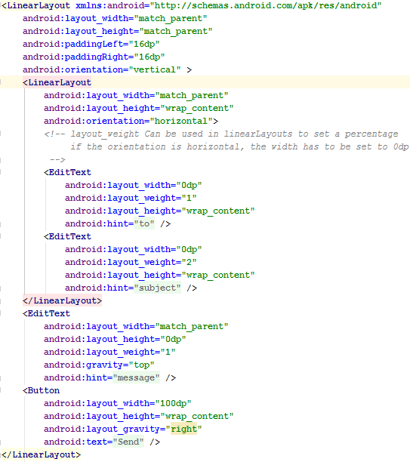
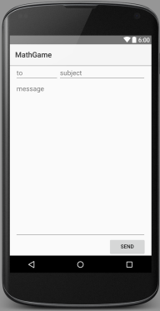
Res/layout/activity_example.xml
http://jhoobergs.github.io/AndroidForBeginners/
Notes:
Click on Text
LinearLayout

Slide 13
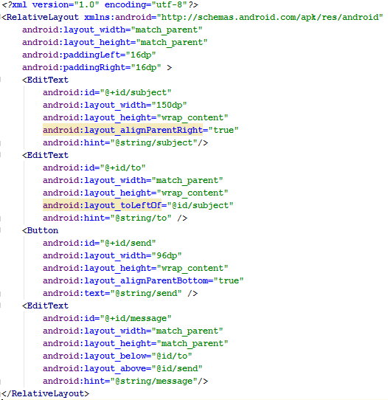
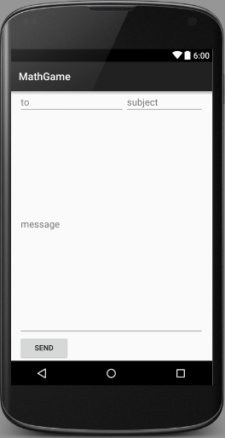
Res/layout/activity_example (land)
http://jhoobergs.github.io/AndroidForBeginners/
Notes:
-Relative layout

Slide 14
Activity
A page in an Android app
Java code that loads the layout and handles events
http://jhoobergs.github.io/AndroidForBeginners/

Slide 15
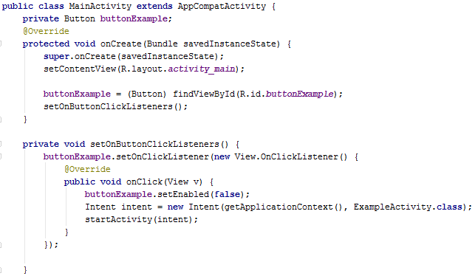
MainActivity.java
http://jhoobergs.github.io/AndroidForBeginners/
Notes:
Activity is a class that extends AppCompatActivity
onCreate is the first function that is launched
setContentView: Set layout to layout in res/layout/activity_main.xml
findViewById() get an object of the view
Intent: Used to open other activities

Slide 16
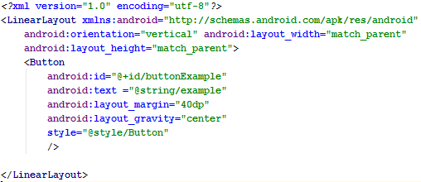
Res/layout/activity_main.xml
http://jhoobergs.github.io/AndroidForBeginners/
Notes:
Simple layout with only a button
It is assign with id buttonPlay so with can access it in the java code
Text with string resource
No width and height, because these parameters are defined in the style called Button

Slide 17
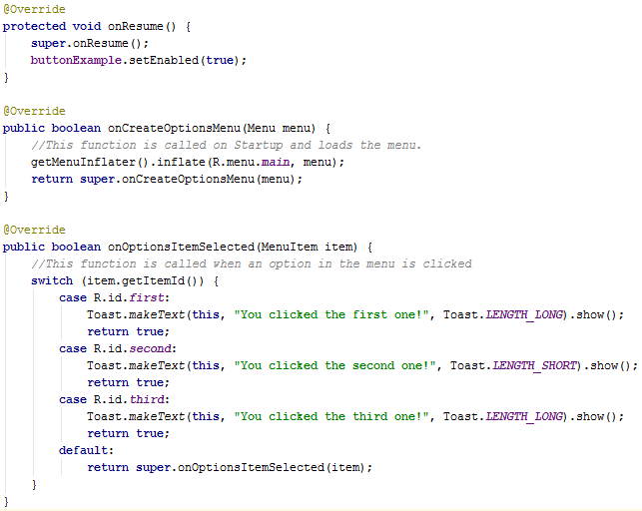
http://jhoobergs.github.io/AndroidForBeginners/
Notes:
OnResume is called when the activity will become visible again
OnCreateOptionsMenu is called on startup and loads the menu
- onOptionsItemSelected is called when an item in the menu is selected

Slide 18
http://jhoobergs.github.io/AndroidForBeginners/
Notes:
Menuitems have a title, id, icon and showAsAction

Slide 19
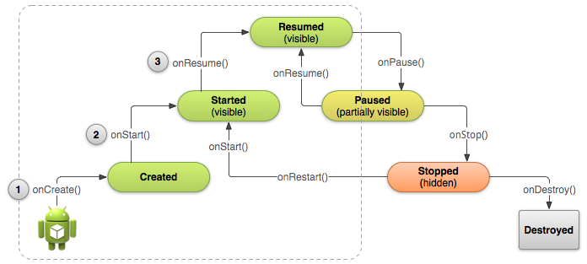
Activity Lifecycle
http://jhoobergs.github.io/AndroidForBeginners/

Slide 20
Your turn
Change the logo of the app.
Make a GameActivity that loads the layout activity_game.
Add a button so you can go from MainActivity to GameActivity.
Create a new instance of the game class
Add all pointsButtons to the game (id's are buttonPoints0..9)
Set the AnswerButtons to the game
Set the textview of the time to the game
Set the textview of the question to the game
Set the onClickListeners of the buttons
http://jhoobergs.github.io/AndroidForBeginners/
Notes:
- There will be an html page with a more in depth explanation of the assignements. (http://jhoobergs.github.io/AndroidForBeginners/)

Slide 21
Your turn
Add a landscape layout for activity_game (buttons alongside each other instead of on top)
Set the onWinListener
Add a menu with different layout for portait and landscape modus (1 of the items should be: New Game)
When clicked on new game, the game should restart. (game.restart())
Add a TextView in the layout that shows the level
http://jhoobergs.github.io/AndroidForBeginners/

Slide 22

Feedback
https://goo.gl/bQjItJ

