Slide 1

Weighing Black Holes:
My life as an astrophysicist
Dr. Janie K. Hoormann
School of Mathematics and Physics
CRICOS Provider Number 00025B

Slide 2
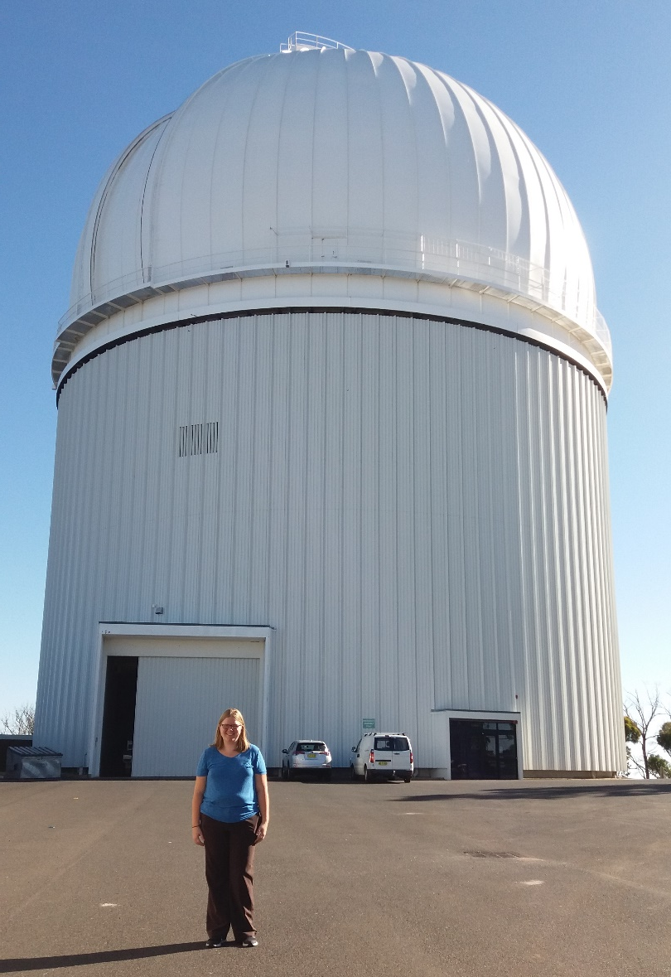
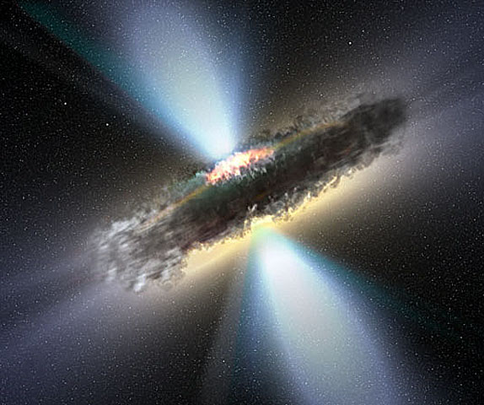
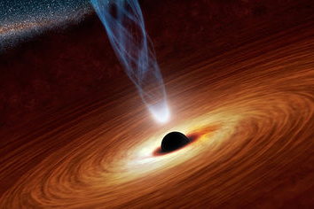
Weighing Black Holes
Measure the mass of the supermassive black holes found in the centres of galaxies
Do this observing how gas orbits the black hole
Big Questions:
How did supermassive black holes get so big?
How have galaxies grown during the past 12 billion years?
Image Credit: NASA/JPL
Image Credit: NASA/APOD: V.Veckman

Slide 3




How did I get here?
2004-2008
High School
2008-2012
University
2012-2016
Grad School
(Masters/PhD)
2016-2019
Postdoc
The Future
Academic
Do more postdocs
Become professor
Do research and teach
Industry
Data Science
Software Engineering
Science policy
And much more
Physics and Math were my favourite subjects
Astronomy was interesting
Liked the idea of research
Studied Astrophysics and Math
Really liked Astrophysics
Did not like Math
Enjoyed summer research projects
Studied Black Holes
Lots of computer simulations
Liked doing research and wanted to do more
Studied Black Holes some more
Used ‘real’ data from telescopes
Now supervise students doing their own research

Slide 4
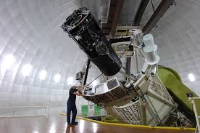
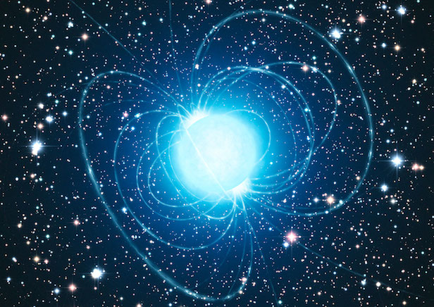
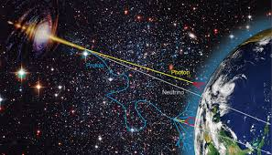
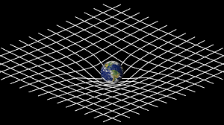
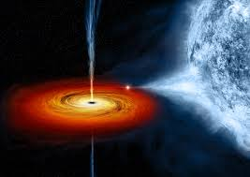
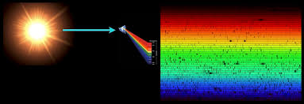
Why Astrophysics?
Optics
Liked dissecting why things are the way they are
I was particularly interested in astronomy
Astronomy combines many fields of physics
Magnetism
Particle Physics
Gravity
Thermodynamics
Chemistry

Slide 5




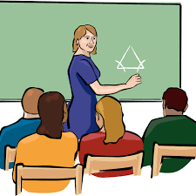
The Day To Day
Observing Black Holes
Analysing Data
Teaching
Meetings
Writing Papers

Slide 6
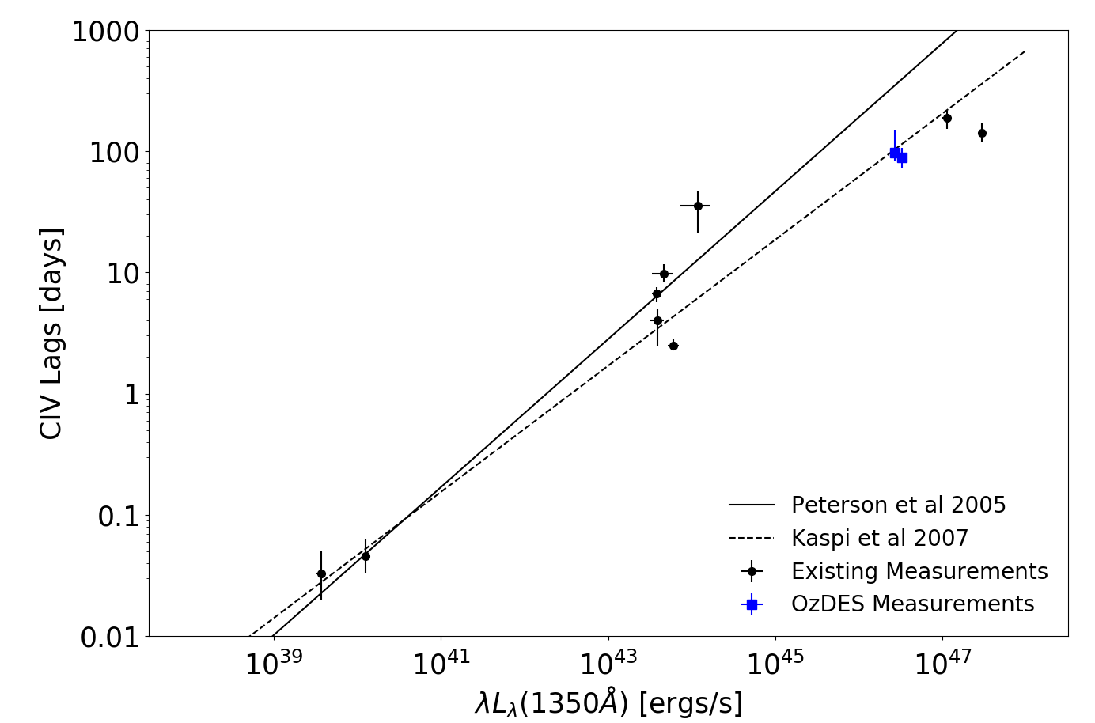
Some days you find out something about the universe no one else knows!
Most distant galaxies we have ever directly measured the structure around the black hole for!!!

Slide 7
My advice for you…
If you have an elective free and coding is an option – LEARN TO CODE!
It is extremely useful in many career paths
Take advantage of opportunities when they come up
But, don’t bite off more than you can chew
Try new things
You don’t know what you will like doing until you try it
You have lots of time to figure things out

Slide 8



CONTACT
Enquiries: Dr. Janie Hoormann
P: 07 3365 8213 E: j.hoormann@uq.edu.au
Web: https://smp.uq.edu.au/profile/2677/janie-hoormann
facebook.com/uniofqld
instagram.com/uniofqld
uniofqld

