Slide 1
Weighing Black Holes
Dr Janie K. Hoormann
School of Mathematics and Physics
University of Queensland

Slide 2
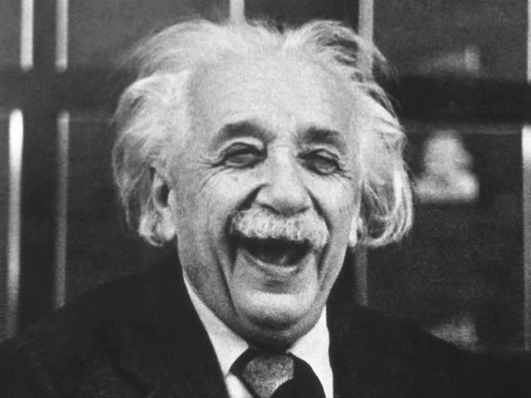
What is gravity?
General Relativity proposed by Albert Einstein in 1915
Gravity caused by a warping in spacetime
Has been extensively tested inside and outside our solar system

Slide 3
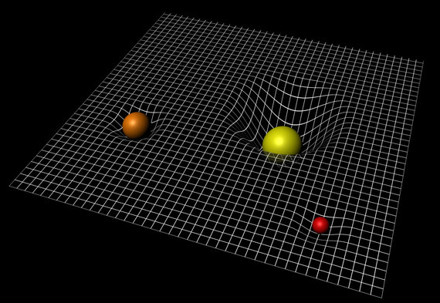
What is gravity?
General Relativity proposed by Albert Einstein in 1915
Gravity caused by a warping in spacetime
Has been extensively tested inside and outside our solar system
Image Credit: ESA-C.Carreau

Slide 4
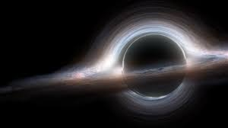
Black Holes
GR predicts the existence of black holes
Gravitational pull so strong that light can’t escape
Strongest gravitational fields that we know of
Image Credit: Interstellar

Slide 5
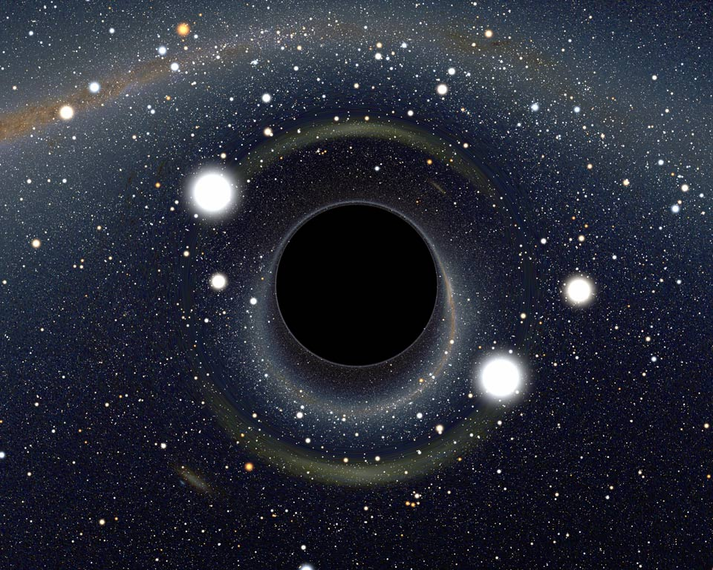
How Big are Black Holes?
Size defined by the size of the event horizon
Point of no return
Related to the mass of the black hole
Earth
Diameter -> 1.8 cm
Sagittarius A*
Diameter -> 23,600,000 km
Image Credit: Alain Riazuelo

Slide 6

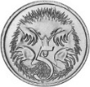
How Big are Black Holes?
Size defined by the size of the event horizon
Point of no return
Related to the mass of the black hole
Earth
Diameter -> 1.8 cm
Sagittarius A*
Diameter -> 23,600,000 km

Slide 7
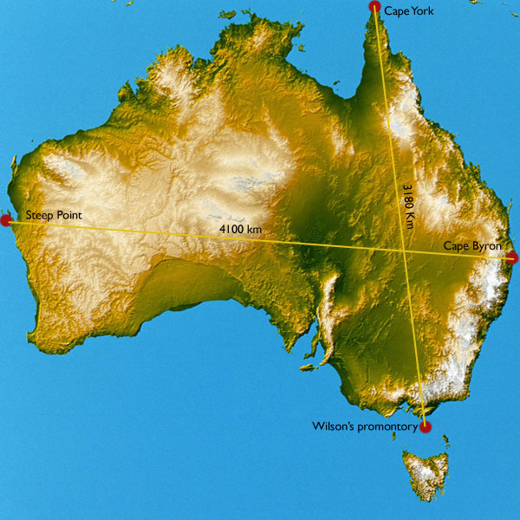

How Big are Black Holes?
Size defined by the size of the event horizon
Point of no return
Related to the mass of the black hole
Earth
Diameter -> 1.8 cm
Sagittarius A*
Diameter -> 23,600,000 km
5756 times!
Image Credit:
http://content.skwirk.com.au

Slide 8
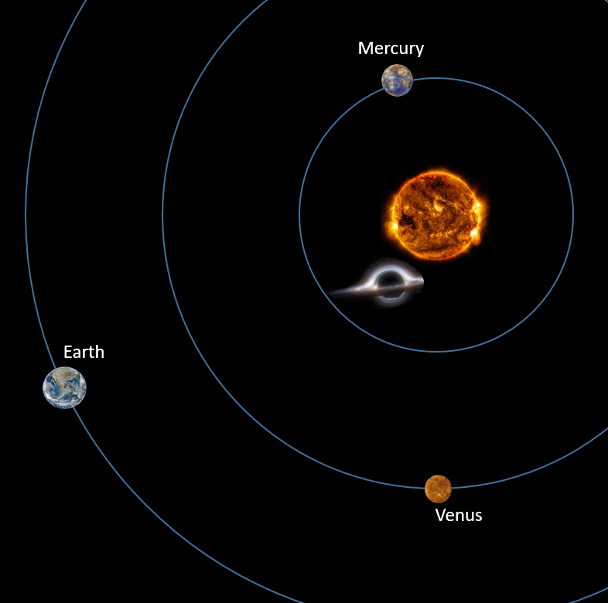
How Big are Black Holes?
Size defined by the size of the event horizon
Point of no return
Related to the mass of the black hole
Earth
Diameter -> 1.8 cm
Sagittarius A*
Diameter -> 23,600,000 km
Notes:
Imaging width of human hair on the sun

Slide 9
How do we observe something we can’t see?

Slide 10
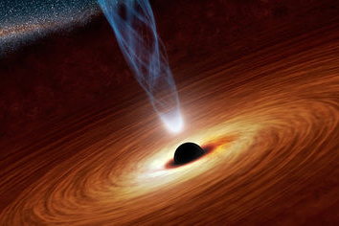
What do we see?
Look at the effect the black hole has on its surrounding
Paths of stars and gas orbiting the black hole far out
Look at the hot gas getting sucked into the black hole forming
Image Credit: NASA/JPL

Slide 11
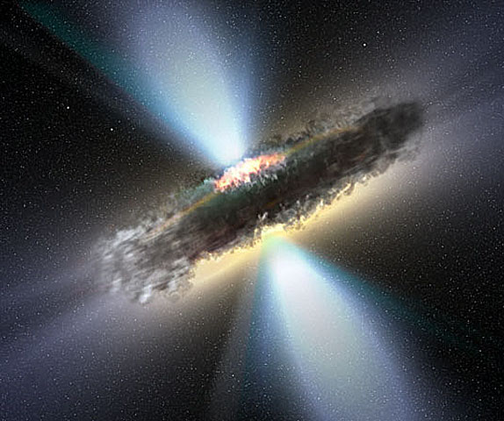
Orbits around Supermassive Black Holes
Look at orbit of stars around the galactic centre
Found Sagittarius A* has a mass 4 millions times that of the sun
Only works for very close black holes
Use timing data to look at gas orbiting supermassive black holes further away
Image Credit: NASA/APOD: V.Veckman

Slide 12
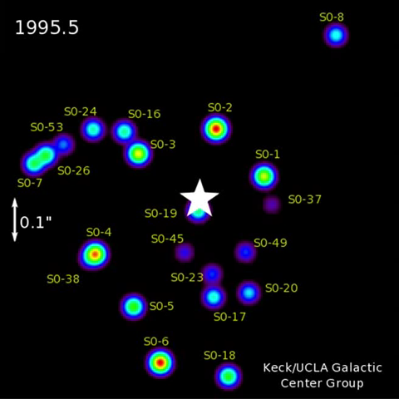
Orbits around Supermassive Black Holes
Look at orbit of stars around the galactic centre
Found Sagittarius A* has a mass 4 millions times that of the sun
Only works for very close black holes
Use timing data to look at gas orbiting supermassive black holes further away

Slide 13
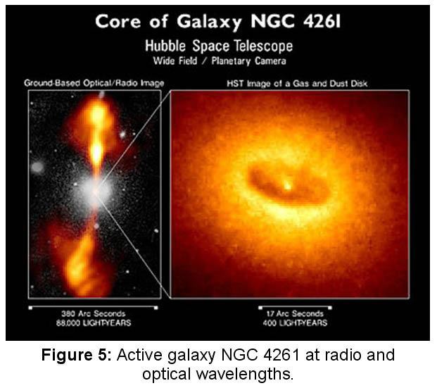
Image Credit: Walter Jaffe/Leiden Observatory, Holland Ford/JHU/STScI, and NASA

Slide 14
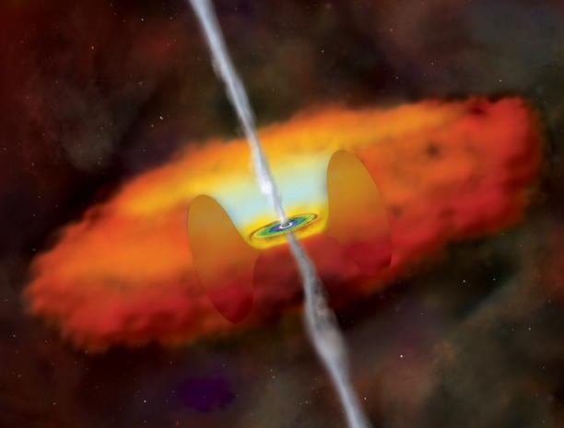
Masses of Supermassive Black Holes
Use a technique called Reverberation Mapping
Look at how light echoes around the most central region of the galaxy
Use that to determine how fast the gas orbiting the black hole is moving
Image Credit: CXC, Melissa Weiss

Slide 15
Masses of Supermassive Black Holes
Use a technique called Reverberation Mapping
Look at how light echoes around the most central region of the galaxy
Use that to determine how fast the gas orbiting the black hole is moving
Image Credit: CXC, Melissa Weiss

Slide 16

Masses of Supermassive Black Holes
Use a technique called Reverberation Mapping
Look at how light echoes around the most central region of the galaxy
Use that to determine how fast the gas orbiting the black hole is moving
Image Credit: CXC, Melissa Weiss

Slide 17
Masses of Supermassive Black Holes
Use a technique called Reverberation Mapping
Look at how light echoes around the most central region of the galaxy
Use that to determine how fast the gas orbiting the black hole is moving
Image Credit: CXC, Melissa Weiss

Slide 18
Masses of Supermassive Black Holes
Use a technique called Reverberation Mapping
Look at how light echoes around the most central region of the galaxy
Use that to determine how fast the gas orbiting the black hole is moving
Image Credit: CXC, Melissa Weiss

Slide 19

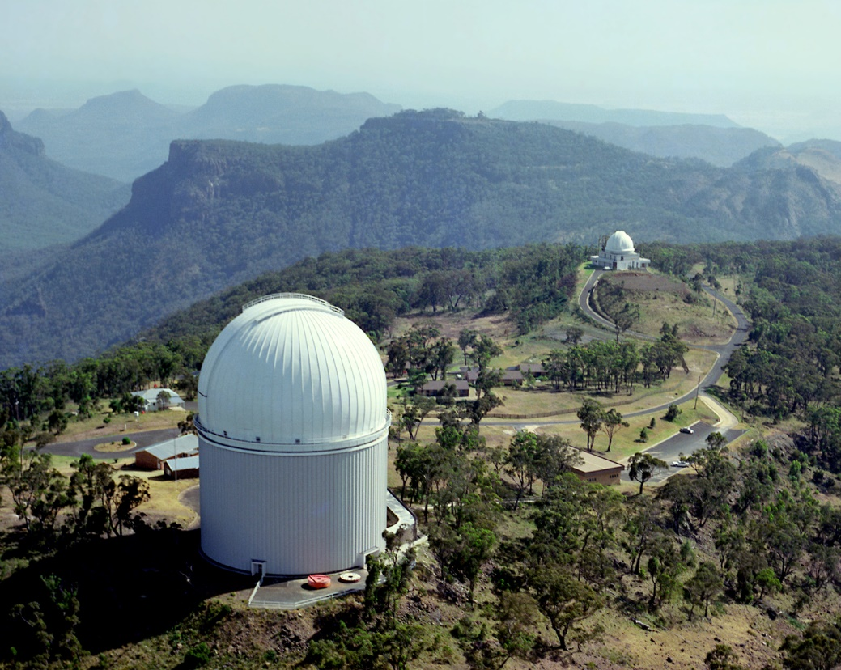
Australian Dark Energy Survey
Use optical data from 4 m telescopes
Anglo-Australian Telescope: Coonabarabran, NSW
Blanco Telescope: Chile
Regularly observe 771 supermassive black holes
Study how black holes and galaxies have grown throughout history
Image Credit: AAO

