Slide 1

COMP519 Final Project:
A Comparison of Graph and Relational Database Systems
Joel Horne
12/7/25

Slide 2
Overview
Joel Horne
COMP519 – Advanced Topics in DBMS
Dr. Jeremy Blum
Fall 2025
https://github.com/jhorne98/comp519-final-project

Slide 3
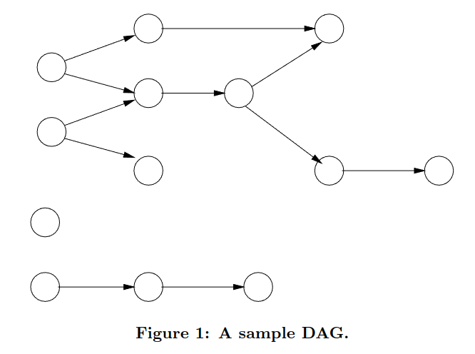
Learning Objectives
Understand Graph Database Concepts
Compare Relational and Graph Database Query Languages
Compare RDB and GDB Access Times
Recreate Experimental Methods from Source Paper:
  A Comparison of a Graph Database and a Relational Database – Vicknair et al.

Slide 4
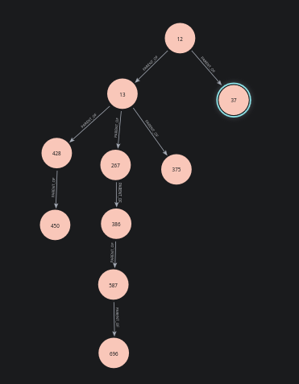

Experiment Design – Database Design
Four Sizes – 1K, 5K, 10k, 100k
Three Payload Types – Integer, 8Kb String, 32Kb String
  Random Payloads
  Randomly Assigned Parents
Each (Relational) Node Contains:
  ID (Primary)
  Payload
  Parent (Node ID)
Graphs Generated as Arborescences

Slide 5
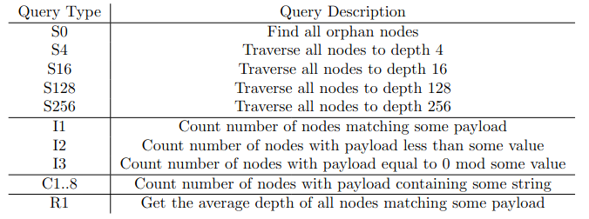
Experiment Design - Queries

Slide 6








Experiment Design - Databases
OQGRAPH

Slide 7
Hypotheses
(Mostly) Replicate Original Study
Neo4j Fastest on Traversal Queries (S, R)
Memgraph to be Among Faster DBMS
  Memory Usage
OQGRAPH to Function as well as Base MariaDB for Matching Queries (I, C)
Overall:
  Graph Databases Perform Best
  Databases Scale as in the Original Study

Slide 8
Experiences and Problems
Issues with Aerospike, Dgraph Query Systems
  Ultimately Removed
Different Schema from Source Paper
Inefficient Data Insertion in Apache AGE
  Incomplete Dataset (missing datasets with 100K items
Randomization Method did not Produce Deep Trees
  Max Depth when Tested on PostGres 100K Graph was 16
Visualization Tools
  Neo4j: Excellent Console/Visualizer Built In
  Memgraph Visualization Hampered by Dockerization

Slide 9
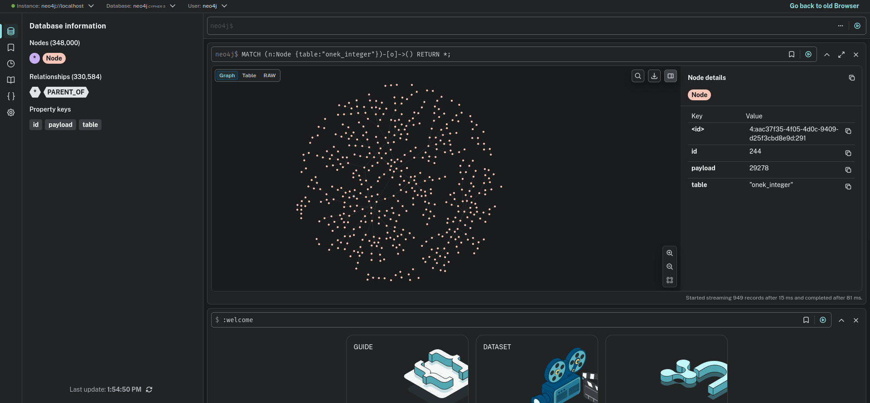
Neo4j Console

Slide 10

Results
Neo4j NOT the Fastest for All Query Types...
  Scales Well (Almost Constant for S Queries Until 100K)
  May be due to Table Layout
Postgres Fastest at Scale
  Outliers with Higher-Character C Queries in Apache AGE
S128 and S256 Showed No Real Difference
  Graphs may not have Large Enough Depths
Memgraph: Bad in Smaller Graphs, Better in Larger
OQGRAPH: Worse than MariaDB at Scale
  By Factor of 4

Slide 11
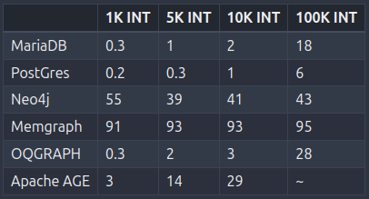
Table 1: Results S0

Slide 12
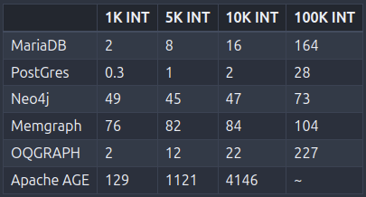
Table 2: Results S16

Slide 13
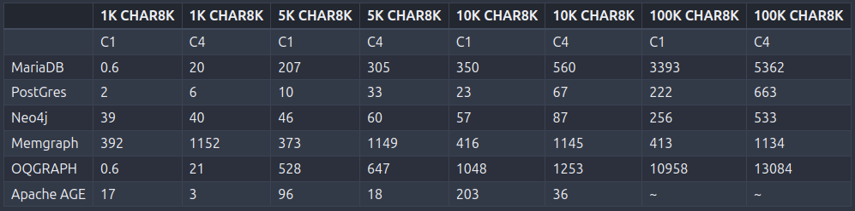
Table 3: Results C1, C4

Slide 14
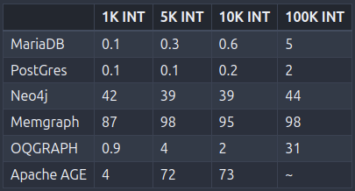
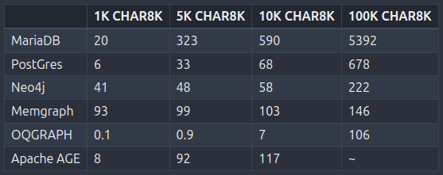
Table 4: Results R1

Slide 15
Key Takeaways
PostGres and Neo4j Perform Best
  Compete for Best Payload Retrieval Times at Scale
  PostGres Handles Traversal Best
Memgraph Does Well for Large DB
Apache AGE is Deprecated
OQGraph Performs worst
  However, OQGRAPH does have a very efficient Search Algorithm function: Performed best for R1 for Character Tables

Slide 16


Replication
Use Schema Layout from Source Paper
  (ID, Parent, Child, Payload)
Use Correct Memgraph Installation
  Not the Tutorial Docker Container
Use Distinct DB for Neo4j
Use Larger Databases
Create and Use More Advanced Queries
  Deeper Max Depths
  More Data Types (Blobs, Dates)

