Slide 1
AI Attack Observability
The method, the prototype that proved it, and the plan to build it for real.
J. Hosley
Notes:
Working title on this cover, retitle as needed. The table of contents follows, then the one page executive summary, then nine sections, each opened by a break slide, closing with the development timeline, the ask, and the end.

Slide 2
What Is in This Deck
The executive summary is one page, next. The detail runs in ten sections, each opened by a break slide.
1
The Vision · Now
The method, the operating model, and the working system.
2
Liszt
Why the tool carries the pianist’s name.
3
The Machine
One record at the center, fixed standards, version changes absorbed.
4
The Journeys
Hypothesis, published incident, disclosed breach, and the testing road map.
5
Running It
The use case and attack pattern records, the disciplines, and who may act.
6
The Working Prototype
Six screenshots of the experiment that proved the method.
7
The Data Underneath
Seven schemas, from the systems of record to the pin.
8
The Reporting
Five generated pages, from posture to movement.
9
The Vision · Future
Where the program goes next: the backbone, and the capabilities that grow off it.
10
The Build
Three months to production, thirteen to the vision, and the four people it takes.
Notes:
Section titles only, no page numbers, so the deck can grow without this page going stale. The break slides carry the same numbering.

Slide 3
Executive Summary
Every attack on our AI, mapped, measured and owned, so the day we say we would see it coming, we can prove it.
This program grafts attack-driven observability onto the teams, tools and pipelines we already run. It is built on records instead of opinions, proven in locally installed experiments, and this deck is the blueprint for building it for real.
1
Proven, not theoretical. Twenty-one scenarios mapped against the pinned standards, ATT&CK, ATLAS, OWASP and DeTT&CT, including this year’s public agent incidents, all worked in a local prototype.
2
Computed, never asserted. System owners score two questions per signal, and Have, Collectable or Blind is derived from the scores. A typed verdict is rejected.
3
Runs on what we already own. Four of five operating steps use existing people, tools and alerting pipelines. The only build is closing named gaps, emit by design first.
4
Every alert traces to an attack. A use case cannot exist without the scenario that justifies it, and automation is earned up a ladder, never granted.
5
Predictions become measurements. On the road map, generated specs and sandboxed agents run the scenarios and feed measured results back into the records.
Point six is the ask. Four dedicated US hires: two developers who build and run the tool, two security engineers who run the scenarios and build the testing agents. The timeline and sizing close the deck.
THE ASK
Every claim on this page is expanded inside, and every number traces to a record.
Notes:
The one page version of the whole deck. If the room reads nothing else, it reads this. The vision line at the top is the sentence to say out loud and then stop talking for a beat. Point one carries the reframe that matters: the method is proven in a locally installed prototype, and the deck is the blueprint for the production build. Confident about the method, honest about the state. Point six names the shape of the ask but not the detail. The closing section carries the timeline and the four hires, so nobody spends the deck bracing for an unknown bill.

Slide 4
1
NOW
SECTION ONE OF TEN
The Vision
How an attack becomes a scenario, how the work runs on what we already own, and the system that holds it.
Notes:
Section break. Same layout language as the cover, on the deep blue.

Slide 5
How We Build an Attack Scenario
Start from something that actually happened, break it into moves, and place every move on the stack our AI systems run on.
THE METHOD
1
Start from something real
2
Break it into moves
3
Place each move on the stack
4
Name the evidence
5
Score it with the owners
An incident that really happened, or a failure we can argue is plausible here.
→
Each step is one thing the attacker does. Five or six is usual.
→
Which part of our AI systems that move touches.
→
What signal would exist here, and from exactly which system.
→
Two questions for the people who run those systems. Would we see it. Does anything act on it.
THE SAME METHOD, RUN ON ONE REAL ATTACK
WHAT HAPPENS
WHERE IT LANDS
WOULD WE SEE IT
THE SIGNAL THAT EXISTS
1
Hidden instructions are planted in a document our people share
Data
BLIND
nothing inspects documents for this
2
Someone asks the assistant to summarize that document
Application
HAVE
the assistant logs the request
3
The model reads the hidden text and follows it instead
Model
BLIND
no record of why it decided that
4
The agent uses its own access to pull internal records
Agents
COLLECTABLE
tool calls are logged, nothing watches
5
The records leave over a connection we already allow
Infrastructure
HAVE
outbound traffic is monitored
One attack crossed five different parts of the stack. We can see where it started and where it ended. The middle, where the decision was actually made, is dark.
Notes:
The point of this slide is that an AI attack does not sit in one place. Five moves, five different layers. The verdicts shown are illustrative, not measured. They are what this exercise produces once you run it with the people who own those systems. If asked why the middle is dark: our monitoring grew up around networks, endpoints and identities. The model and the agent are new surfaces, and nothing was built to watch them, because until recently there was nothing there to watch.

Slide 6
How the Work Runs
One scenario at a time, using the people, the tools and the alerting pipelines we already operate.
WHAT HAPPENS
WHAT IT TAKES
1
Analyze the scenario
The working group takes one scenario at a time, walks the attack step by step, and asks what data exists at each one. The output is our real posture, stated plainly.
USES WHAT WE HAVE
2
Build from what we already hold
Observability engineers turn the answers into operational use cases, built on data in hand and data we could collect. Done jointly with the AI engineers and the owners of the controls we already run: web application firewall, denial of service, identity, data loss prevention, cloud access.
USES WHAT WE HAVE
Close what we are blind to
FIRST
The AI engineers build the signal into the system, so it emits what we need by design.
3
SECOND
Where that is not possible, build an alternate path with the data science team and security engineering.
THE ONLY NEW BUILD
Second costs more: moving, storing and processing the data, and engineering outside the tooling we own.
4
Deliver through what already runs
Observation goes into the observability tools we already operate. Alerts ride the alerting pipelines already in production, to the teams who already act on them. No new platform.
USES WHAT WE HAVE
5
Tune until it is worth acting on
Ongoing tuning drives out the false positives, so what reaches an operator is intelligence they can act on rather than noise they learn to ignore.
USES WHAT WE HAVE
Four of these five steps run on what we already own. There is one place we build, and even there the first ask is for the system to emit what it already knows.
Notes:
The argument to make out loud: this is not a funding request. Four of the five steps use people, tools and pipelines already in production. Step 3 is the only place anything gets built, and the preference order there is the fiscal discipline. Asking an AI system to emit a signal it already has internally is close to free. Building collection, movement, storage and processing around a system that will not emit is expensive, and it puts security engineering in the business of running data infrastructure. If asked what we need: engineering cooperation from the AI teams, which costs their time and not our budget. That is the ask, and it is deliberately the cheapest one available.

Slide 7

SECTION TWO OF TEN
Liszt
Franz Liszt could sight-read anything set in front of him, transcribed entire symphonies into scores a single pianist could play, and built that ability on relentless, disciplined practice. This tool carries his name because that is the work: read every attack the world produces, transcribe it into a record one team can play, and get better every single session.
Notes:
Section two is the name, one slide, and this is it. Say the two sentences and move on; the room that wants more gets the footnotes below. The parallels are real, not decoration. Sight-reading: Liszt famously played the hardest scores in Europe cold, at first sight, including full orchestral scores reduced at the keyboard in real time. That is the intake promise: whatever the world publishes, the tool can read it. Transcription: he transcribed all nine Beethoven symphonies for solo piano, faithfully, so one player could carry what took an orchestra. That is the record: a sprawling attack rendered into a structured form one team can work, with nothing lost in the reduction. Work ethic: after hearing Paganini in 1832 he withdrew and rebuilt his entire technique through obsessive daily practice. That is the scoring sessions and the calibration exercise: the discipline is the talent. One more if the room enjoys it: Liszt invented the modern recital and played from memory, and he taught his masterclasses for free. The library is the repertoire, and it is meant to be shared.

Slide 8
Liszt: The Working System
Today it holds every scenario and the posture behind it. Next, agents prove that posture by running the attack in a safe environment.
PROVEN IN PROTOTYPE
What an analyst does with it
ROADMAP
Prove it, do not predict it
1
Work a real attack
Agents run the scenario against a safe, non-production copy of the system, and report what really happened.
Take something that actually happened, break it into moves, and score every move with the people who own those systems.
Hypothesize one that has not happened
What actually fired
2
Every signal that really came out, not the one we assumed would.
Build an attack nobody has run yet, and find out where we would be blind before somebody tries it for real.
3
Capture it while the room is together
What was actually exploitable
Scores, the exact system every signal comes from, the owner and the ticket, recorded live rather than reconstructed later.
Which steps worked, and which of our controls genuinely stopped them.
4
Turn it into numbers and work
Corrected back into the record
Coverage, exposure, what we are blind to and who owns each gap, and an engineering backlog that arrives already prioritized.
Measured results replace predicted ones, and coverage stops being an estimate.
← tested results flow back into the scenario record, so the library gets more accurate every time an agent runs
Today the coverage number is our best reasoning about what we would see. After this, it is a test result.
Notes:
Left side is proven in the locally installed prototype and carries the scenario work today. Right side is the roadmap and should be presented as such. Neither side is the production tool yet, the build section at the end covers that. The honest framing for the left side: it is a tool, not an answer. It holds the reasoning of good analysts in a form that can be checked, compared across teams, and handed to someone new. The judgment still comes from people who know the systems. The roadmap is the interesting part for a technical audience. Everything scored today is a prediction about what we would see. An agent that runs the attack against a safe copy turns that prediction into a measurement, and it answers two questions at once: what signal actually came out, and what was actually exploitable. This is also the answer to the fair criticism of the whole approach, which is that we have never checked the model against reality. This is how we check it. Safety framing if asked: non-production only, against systems we own, with the same change control any other test carries.

Slide 9
3
SECTION THREE OF TEN
The Machine
Why the numbers can be trusted: one record type at the center, fixed standards underneath, and version changes absorbed without losing the picture.
Notes:
Section break. Same layout language as the cover, on the deep blue.

Slide 10
How Liszt Works
Everything converges into one kind of thing, a scenario record. Everything anyone reads is generated back out of it.
WHAT GOES IN
WHAT COMES OUT
THE SCENARIO RECORD
Real attacks, taken from published incident reporting
An analyst’s hypothesis, for an attack nobody has run yet
What the people who own the systems tell us, captured live in the session
One file per scenario. Plain text, kept in version control, readable by a person and by a machine.
A web page for reading the library and capturing a live session
Coverage and exposure figures, and a named list of what we are blind to
Slides, reports, and a data file other applications can read
WHAT THE SYSTEM DOES WITH IT
Checks every record against the schema and quality bar
Works out coverage from the recorded scores, so nobody can type the answer in
Adds the records up into coverage, exposure and maturity
HELD AGAINST A FIXED STANDARD
Every step is tagged to a published framework at a version we pin, so any two scenarios stay comparable.
The record is the only thing anyone edits. Everything else is built back out of it, which is why the figures, the slides and the web page can never disagree with each other.
Notes:
One idea on this slide: everything converges into a record, and everything anyone ever reads is generated back out of it. Why that matters, if asked. In most programs the slide, the spreadsheet and the dashboard are three separate artifacts that drift apart, and by month six nobody knows which one is right. Here there is one source and the rest are disposable, so they cannot disagree. The second input is the one worth pausing on. Anyone can have a hypothesis about an attack that has not happened yet. What is different is that it gets written into the same structure a real incident uses, so the system treats it identically. An idea stops being a conversation and becomes a record we can measure. On the middle box: coverage is worked out from the two recorded scores, and the check rejects a record where someone entered the label by hand. That single rule is what separates this from a spreadsheet of opinions. The band underneath is why the numbers hold up over time. The frameworks change on their own schedule, so we hold a pinned version and restate rather than re-assess. There is a separate slide on that. The record schemas, the reporting roadmap and the agent testing path each get their own slide.

Slide 11
Accounting Against a Fixed Standard
Every scenario, technique and gap is booked against published frameworks at a pinned version, in the format the industry already exchanges.
WHAT WE BOOK AGAINST, AND THE VERSION WE HOLD IT AT
MITRE ATT&CK
MITRE ATLAS
DeTT&CT
OWASP LLM and Agentic
Adversary techniques for conventional systems. The vocabulary the industry already speaks.
Adversary techniques specific to AI systems. Where the conventional catalog runs out.
How well we can actually see a technique. The scoring behind every coverage figure we report.
The risk classes for AI applications and for agents that act on their own.
v19.1
2026.07
v2.2.0
2025 / 2026
Why the version is written down
These frameworks change. A release renames techniques, retires whole categories, and splits others in two. Without a pinned version, a coverage figure that drops is indistinguishable from one that was renamed, and the trend line measures the framework release schedule instead of our progress. Pinning is what makes this year comparable to last year.
BUILT TO EXCHANGE, IN THE FORMAT THE STANDARDS ALREADY PUBLISH
INTELLIGENCE COMES IN
THE CATALOG GOES OUT
New threat reporting is published in these same identifiers, moved over the standard transport the industry already runs.
The scenario library can be served to partner teams and other organizations as a collection they subscribe to, the same way they already take threat feeds.
So when a report names a technique, the catalog answers immediately: which of our scenarios does this implicate, and which of their steps are we blind to. A piece of intelligence stops being reading and becomes a work list with owners already on it.
The scenarios travel. Our coverage never does. What we can and cannot see stays inside, because a list of our blind spots is a targeting package, not a shared good.
We publish scenarios. We never publish coverage.
None of this is a rewrite. These frameworks already publish in this format, and we already pin the files. Exchange is turning on something the standards do for us, and it is what lets the catalog keep growing without us writing every entry.
Notes:
This is the credibility slide. The previous one says what the tool does; this one says why the numbers can be trusted over time and why the catalog compounds. The pinning argument is the one that lands with anyone who has run a measurement program. Two of these frameworks made breaking changes in the last eighteen months. One retired an entire category of data sources; another split a tactic in two. If you do not pin, your year over year comparison is meaningless and you will not know it. On STIX and TAXII, the honest framing: STIX is the format threat intelligence is written in, TAXII is how it moves. This is not aspirational. ATT&CK is already published as STIX, and we already pin that exact file. ATLAS publishes a bundle too. The work is serialization, not invention. The publish rule is worth saying out loud even if nobody asks. A scenario library is a shared good and other organizations benefit from it. A list of where we are blind is the opposite, and the architecture keeps those two things separate on purpose. One honest limit if pressed: there is no authoritative crosswalk between the OWASP lists and the MITRE catalogs in either direction. Where we connect them, that is our own editorial judgment and every record says so.

Slide 12
Adopting a New Version Without Losing the Picture
The frameworks change on their schedule. The evidence we collected does not change with them, so both positions stay computable from the same data.
WHAT HAPPENS WHEN A FRAMEWORK PUBLISHES A NEW RELEASE
1
2
3
4
5
Upstream releases
→
Import and keep both
→
Diff against our records
→
Adopt in two lanes
→
Restate, not re-assess
A release renames techniques, retires some, splits others, and adds new ones.
Take our own frozen copy, fingerprinted so we can prove it is unaltered, and keep the old one.
Only the identifiers our own scenarios actually use, not the whole catalog.
Plain renames apply themselves. Splits and retirements go to an analyst.
The same evidence in the new vocabulary. No score is guessed a second time.
What never moves
The signals we found, the exact systems they come from, the visibility and detection scores, the owners and the tickets. That is our data, collected once with the people who run those systems. A framework release changes what we call things. It does not change what we know.
SO WE CAN REPORT BOTH POSITIONS, FROM THE SAME COLLECTED EVIDENCE
UNDER THE OLD STANDARD
UNDER THE NEW STANDARD
AND WHY IT MOVED, POINT BY POINT
62%
58%
+4
instrumentation we actually built and can point at
-8
techniques the release added that our scenarios never accounted for
of scored steps at Have
same 21 scenarios, same evidence
pinned at the previous release
restated in the new vocabulary
-4
net movement, and we can name every point of it
Illustrative figures. The decomposition is what the data supports, not the values.
The evidence is ours and it is durable. The vocabulary belongs to the standard and it is versioned. Keeping the two apart is how we can always say whether the number moved because we did something, or because the ruler changed.
Notes:
This slide answers the question a measurement person always asks: what happens to your baseline when the standard underneath it changes. The whole argument rests on one separation. What we collect (the signal, the exact source, the two scores, the owner, the ticket) belongs to us and does not expire. The identifiers belong to the framework and do version. Because those are stored separately, a new release is a restatement, not a re-assessment. Nobody has to go back and re-interview the system owners. The two lanes in step 4 matter. A straight rename is mechanical and applies itself. A split, a retirement, or a newly added technique that might now cover a step we mapped somewhere else is a judgment call, and it goes to a person. We do not let a machine quietly decide those. The example on the right is the case worth walking through out loud: the number went down while we were actually getting better. Four points of real instrumentation, offset by eight points of newly added techniques we had never accounted for. Without both positions computed from the same evidence, that reads as a program going backwards. With them, it reads correctly, and it also tells you where next quarter of work is. Figures are illustrative. The point is the decomposition, not the values.

Slide 13
4
SECTION FOUR OF TEN
The Journeys
Four paths through the same engine: a hypothesis, a published incident, a disclosed breach, and the road map where scenarios get tested for real.
Notes:
Section break. Same layout language as the cover, on the deep blue.

Slide 14
From an Analyst’s Hypothesis to a Measured Answer
An attack nobody has run yet, written in the same structure as a real incident, and measured exactly the same way.
THE HYPOTHESIS JOURNEY, RUN IN FIVE MOVES
1
2
3
4
5
An analyst’s hypothesis
Structured input
Processed by Liszt
Analyzed
Results and outputs
What if somebody did this to us. A question in plain language, no incident required.
The idea is written into the same record form a real incident uses, move by move.
Schema and quality checks, framework tags verified against the pinned version.
System owners score every move in session: would we see it, would anything catch it.
A coverage verdict per move, the blind spots exposed, and a work list with owners.
WHAT THE STRUCTURED INPUT LOOKS LIKE
# scenarios/SC-022.yaml, trimmed for this slide
id: SC-022 status: draft
source: analyst hypothesis author: J. Hosley
hypothesis: An attacker poisons the shared prompt
template that every agent loads at startup
step 1: Edit the template in the build pipeline
framework: ATLAS AML.T0010, supply chain compromise
visibility: 2 could we see it, scored 0 to 4
detection: 0 would anything alarm, scored -1 to 5
evidence: template repository change log
owner: platform engineering
coverage: COLLECTABLE computed by Liszt, never typed
HOW TO READ IT
The same form a real incident uses. The system cannot tell an idea from a real attack, so it measures both.
Plain text in version control. Reads like a form, versions like code.
Every move is tagged to the frameworks, at the version we pin.
The two scores are taken in session with the person who owns the system.
The verdict line is computed from the scores. A record where somebody typed it is rejected.
The most valuable attack to study is the one that has not happened to anyone yet. This journey turns a good idea into a record, a score and a work list before anyone has to live through it.
Notes:
This journey is the differentiator. The foundational journey reacts to what got published. This one gets ahead of it: any analyst who can articulate an attack can have it measured. The example is worth walking in the room. The hypothesis is one sentence. Breaking it into moves and tagging each one takes the analyst from prose to structure. The two scores are captured with the platform owner, and the verdict on the last line is computed: visibility 2 means we could see it, detection 0 means nothing would alarm today, and that combination is Collectable. If someone types a verdict into the file, validation rejects the record. That rule is the integrity of the whole system. AML.T0010 is the ATLAS supply chain compromise technique, checked against the version we pin. The snippet is trimmed for the slide. A full record carries every move, references, review status and sign off. From move 3 onward this is the same machinery as the incident journey, on purpose. Two front doors, one engine. That is why supporting hypotheses costs the program almost nothing extra.

Slide 15
From a Published Incident to Our Posture
Somebody else’s incident becomes a scored answer to the question that matters: could this happen here, and would we see it.
THE FOUNDATIONAL JOURNEY, RUN IN FOUR MOVES
1
An incident is published
2
Liszt takes it in
3
The scores update
4
The outputs move
MITRE ATLAS case studies
Advisories from CISA, the federal cybersecurity agency
The affected vendor’s own disclosure and writeup
Threat research teams such as Wiz, JFrog and Mandiant
The AI Incident Database, a public community record
An analyst breaks the report into the attack’s separate moves
Every move is tagged to the frameworks, at the version we pin
It has to pass the schema and the quality bar before it counts
The people who own our systems score every move: would we see it, would we catch it
Records the report touches get revisited, not just the new one
Coverage is worked out again from the scores, never by hand
Coverage and exposure figures move, and we can say exactly why
New blind spots come out named, with an owner and a ticket
The web page, the slides and the data file rebuild from the records
Already run in practice
The recent malicious model incident on a public model hosting platform entered the library exactly this way. A public research report went in, and a scored record of our own exposure came out.
The clock it is built for
A new report becomes a work list the day it is read, and a scored answer within days, while the story is still news. The other way to learn the same lesson is our own incident review.
A published incident is a red team exercise somebody else paid for. This journey collects the lesson: whether it could happen here, whether we would see it coming, and who owns every gap it exposed.
Notes:
This is the foundational journey, the loop the minimum viable version of the program exists to run. The other journeys build on it. On the sources in move 1: these are where AI incidents actually surface today. ATLAS case studies arrive already tagged in the framework vocabulary, so those are the cheapest to take in. Vendor writeups and the research teams are usually first and richest in technical detail. The AI Incident Database is the wide net that catches what the others miss. The subtle point in move 3 is worth saying out loud: a report does not only add a new scenario. It can change scores on records already in the library. If a control we scored as would-catch was bypassed in the wild, that record gets revisited. Reporting corrects us, not just informs us. The already-run line refers to the malicious model incident on Hugging Face, which became a scenario record through exactly this path. Walk that example if asked, it is the strongest proof the loop works. The clock claim is the design target for the minimum viable version, not a measured service level yet. Be straight about that if pressed. The argument stands either way: the alternative source of this lesson is our own incident. The outputs in move 4 are deliberately the same trio as the system slide. This journey is that system doing its job on one kind of input.

Slide 16
From a Disclosed Breach to a Scored Answer
The chain is never handed to us. It is reconstructed, marked for what is known and what is assumed, and scored while the story develops.
THE DISCLOSED BREACH JOURNEY, RUN IN FIVE MOVES
1
2
3
4
5
A breach goes public
Reconstruct the chain
Mark known against assumed
Score it against us
Output, then revise
A filing, a press note, a customer letter. Detail is thin on day one and grows for weeks.
An analyst rebuilds the attack move by move from the disclosure and reputable follow-up reporting.
Every move is labeled: confirmed by the disclosure, or our assumption bridging a gap.
Owners score each move: if the same chain ran here, would we see it, would anything catch it.
Coverage, blind spots and a work list now. The record updates as more comes out.
HOW THE RECORD KEEPS UP AS THE STORY DEVELOPS
AT DISCLOSURE, DAY ONE
AFTER THE POSTMORTEM, WEEK THREE
The record goes in the same day, status draft, from the disclosure alone
Seven moves reconstructed: three confirmed, four assumed and marked as such
Scored with the owners anyway. The confirmed moves alone expose two blind spots
The vendor postmortem lands and fills in the chain with real technical detail
Six of the seven moves held up. One assumption was wrong: the entry point was different, and the record now says so
Rescored only where it changed. The history keeps what we believed, and when, and why it moved
Why mark assumptions
Day one work is possible because assumptions are allowed, and safe because every one is labeled. When the truth lands we correct the record instead of defending it. The counts above are illustrative.
A breach disclosure is the industry telling us where it got hurt. We do not wait for the whole story: reconstruct it, mark what is known and what is assumed, and learn whether the same chain runs here while the details are still coming out.
Notes:
How this differs from the published incident journey: there, researchers hand us the chain largely assembled, a case study or a technical writeup. Here the input is a disclosure, and the chain has to be reconstructed under uncertainty. The new machinery this journey shows is the known-against-assumed marking and revision under version control. From scoring onward it is the same engine as every other journey, on purpose. The day one argument is the one to make out loud: partial knowledge still produces work. In the example, the confirmed moves alone expose two blind spots. Waiting three weeks for the postmortem before starting would have meant three weeks of knowing nothing when we could have known something. The corrected assumption is the credibility story, not an embarrassment. The record history shows what we believed, when we believed it, and why it changed. That is auditable reasoning, and it is the difference between a living record and a slide that quietly gets fixed. The counts in the comparison are illustrative. The discipline is what the slide claims, not the specific numbers. If asked for a real anchor, any recent major disclosure works: walk what was public on day one against what the postmortem eventually confirmed, and where the early reconstruction would have been corrected.

Slide 17
From a Scored Scenario to a Tested One
The record says what should happen. A generated spec, a built agent and a safe run find out what actually does, and the answer goes back in.
ROADMAP
THE TESTING JOURNEY, IN THREE MOVES, THEN BACK INTO THE RECORD
1
Liszt writes the spec
2
The agent and the sandbox
3
The run comes back measured
# openspec/changes/test-sc-022/proposal.md
## Why
SC-022 scored Collectable. We could see the poisoned
template, nothing would alarm today. Prove it.
## What to build
An agent that edits the shared template in the
sandbox, then records every signal that fires
and which step, if any, raised an alarm.
## Boundaries
Runs only in the non-production copy.
Touches only the systems the record names.
A person approves this spec before code is built.
An AI coding assistant builds the agent from the spec. An engineer approves it before it runs.
The sandbox is a non-production copy of the named systems, stood up for the run, torn down after.
The agent executes the record’s moves exactly as written, and nothing else.
Every signal that actually fired, against every signal we predicted
Visibility: scored 2, measured 1. The change log caught less than we scored.
Detection: scored 0, confirmed 0. Nothing alarmed, exactly as predicted.
The verdict holds at Collectable, now as a measurement with the run attached
← measured scores replace predicted ones, the verdict is recomputed, and the catalog now carries tested data, not estimates
Roadmap. Nothing on this slide runs today, and nothing about today’s use depends on it.
Every score in the catalog today is a careful prediction. This journey replaces predictions with measurements, one scenario at a time, until the coverage number is not what we believe but what we tested.
Notes:
This is the roadmap journey, and everything here is styled purple and dashed on purpose: nothing on this slide runs today, and nothing about today’s use depends on it. Why OpenSpec. It is spec driven development for AI coding assistants: the proposal is written and agreed before any code exists. That approval gate is as much of the safety story as the sandbox is. And because the scenario record is structured, Liszt can generate the spec: the hypothesis becomes the Why, the moves become What to build, the named systems become the Boundaries. Nobody writes the spec by hand. The example is SC-022 on purpose, the same poisoned template hypothesis from the hypothesis journey. The loop closes across the two slides: an idea became a record, the record was scored, and here the score gets tested. The interesting result is the visibility line: we scored 2 and measured 1. The change log we counted on caught less than we thought. That is the whole argument for this journey, predictions err in both directions, and only a run finds out which way. Safety framing if asked: non-production copies of systems we own, stood up for the run and torn down after, the same change control as any other test, and a person approves the spec before the agent is even built. The last line of the loop band is the catalog point: over time the library stops being a model of our defenses and becomes a test log of them.

Slide 18
5
SECTION FIVE OF TEN
Running It
The records that run the defense, the people who do the work, and who is allowed to act when an alert fires.
Notes:
Section break. Same layout language as the cover, on the deep blue.

Slide 19
The Operational Use Case Record
Where a scored gap becomes a running defense, and every alert we operate can say which attack it exists to catch.
THE SECOND RECORD TYPE, AND THE FIVE THINGS IT MUST ANSWER
1
2
3
4
5
Maps to an attack pattern
Built from named events
Emitted by a named system
Taken in by our analytics
Ends in a stated outcome
Names the technique it defends against, in the same pinned vocabulary the scenarios use.
The exact signals it needs, not a data source in general. Missing events become scenario gaps.
Where every event actually comes from, and who owns the system that emits it.
How the events reach the analytics and alerting pipelines we already operate.
What happens when it fires: who is told, what they do, what closes the loop.
WHAT THE RECORD LOOKS LIKE
# use-cases/UC-014.yaml, trimmed for this slide
id: UC-014 status: active
built_from: SC-022 owner: observability
pattern: ATLAS AML.T0010, supply chain compromise
trigger: the gap SC-022 exposed, detection scored 0
events: template edits, and merges to main
emitted_by: the template repository change log
analytics: the alerting pipeline already in production
outcome: an operator is told about a change nobody expected
kind: detection rule what it is
autonomy: notify who acts, earned separately
HOW TO READ IT
kind is what the artifact is, autonomy is who acts. Kept separate on purpose: a rule can run for months before anything may act on it.
built_from ties it to the scenario that justifies it. No scenario, no use case.
Events are named exactly. What cannot be emitted goes back into the scenario as a gap, with an owner.
Same plain text, same version control, same review a scenario record gets.
The autonomy ladder
NOTIFY
ASSISTED
AUTONOMOUS
Everything starts at notify. Moving up requires a promotion block: measured evidence it fires correctly, and consistency for the action it would take.
Alert catalogs rot when nobody remembers why a rule exists. Here a use case cannot exist without the scenario that justifies it, so every alert an operator sees traces back to the attack it was built to catch.
Notes:
This is the second record type in Liszt, downstream of scenarios. The chain: a scenario scored a gap, a use case is built to close it, and built_from keeps the thread between them permanent. The example continues the running thread across these slides on purpose. SC-022, the poisoned template hypothesis, scored detection 0: we could see the signal, nothing would alarm. UC-014 is the use case that closes exactly that gap, built on the same change log the scenario named as evidence. The kind and autonomy separation is the governance story. kind says what the artifact is, a detection rule here. autonomy says who is allowed to act when it fires, and that permission is earned separately. Everything starts at notify. The promotion block requires measured evidence the rule fires correctly and a consistency record for the action, which is how automated response fits into this program responsibly rather than by enthusiasm. In the room, this ladder is where the automated response pilot plugs in, and you can name the platforms as appropriate for the audience. The five answers across the top are the reason these records stay honest: pattern, events, emitter, analytics, outcome. If the events cannot be emitted today, that fact routes back into the scenario as a gap with an owner, which is how the engineering backlog stays connected to attacks instead of wishes. Same operational discipline as scenarios: plain text, version control, review before active.

Slide 20
The Attack Pattern Record
The reusable move: one attack technique, described once in our stack’s terms, cited by every scenario that contains it.
THE REUSABLE PIECE BETWEEN THE FRAMEWORKS AND THE SCENARIOS
1
2
3
4
5
Names the technique
Speaks our stack
Lists the telltales
Cited, never copied
Defended once
The pinned identifiers it embodies, ATT&CK or ATLAS, at the versions we hold.
Which of the five layers it lands on, so it connects to everything else we count.
The signals any system under this attack should emit, stated generically, once.
A scenario references the pattern on a move instead of restating it. One source.
A use case can target the pattern, and every scenario citing it inherits the defense.
WHAT THE RECORD LOOKS LIKE
# patterns/AP-012.yaml, trimmed for this slide
id: AP-012 status: active
name: Hidden instructions planted in content
the AI reads
frameworks: ATLAS AML.T0051.001, indirect injection
layers: Data inbound, Model
telltales: content fetched from a source nobody vetted,
model output diverges from the user task
cited_by: SC-001, SC-005, SC-013, SC-019 computed
defended_by: UC-001 computed
HOW TO READ IT
One pattern, many stories. Four scenarios cite this record, so describing it well pays four times.
cited_by and defended_by are computed reverse indexes. Nobody maintains a list by hand, so a stale one cannot exist.
UC-001 defends the pattern, so all four citing scenarios inherit that defense in their coverage.
STIX 2.1 has an object named exactly this, attack-pattern. This record serializes straight into it.
The leverage
The 96 scored moves in the library collapse to roughly 30 distinct patterns. Score a pattern once, instrument it once, defend it once, and every citing scenario moves together. Figure illustrative, the mechanism is the point.
A scenario is one story. A pattern is the move that keeps showing up in every story. Describe it once, defend it once, and the whole library gets stronger in the same moment.
Notes:
The attack pattern record is the reusable layer between the framework catalogs and the scenarios. A framework identifier is somebody else’s general description. A scenario move is one specific story. The pattern is ours and in the middle: the technique described once, in our stack’s terms, with the telltale signals stated generically. The example keeps the running thread. AP-012 is the hidden-instructions move from the method slide’s worked attack, the same move scenario 001 opens with, and UC-001 is the real correlated prompt injection use case in the repository. The four citing scenarios are the real records where this move appears: indirect prompt injection, RAG poisoning, agent memory poisoning, and the self-spreading instruction. The two amber lines carry the integrity rule of this record: cited_by and defended_by are computed reverse indexes, built by the validator from what scenarios and use cases actually reference. Nobody curates them, so they cannot rot. The design honesty, if asked: the prototype tags framework identifiers directly on scenario moves today. The pattern layer is part of the production design, introduced during the build, and the scenarios migrate to citing patterns as they are extracted from the existing moves. The threat modeler authors these, same as scenarios. The STIX point is worth saying out loud to a technical room: STIX 2.1 defines an object type literally named attack-pattern. When the exchange work lands, this record serializes into that object, which is one more piece of the catalog that travels for free. This record type also joins the schema library: same plain text, same validation, same review gate as the other authored records.

Slide 21
The “New” Disciplines of AI Observability
Two crafts and a response function, staffed from the teams we already run. New disciplines, not a new department.
THE TWO MAIN USERS OF LISZT
THE AI THREAT MODELER
THE AI OBSERVABILITY ENGINEER
Finds and defines the threat. The scenario library is this craft’s product.
Builds and delivers the defense. Every alert an operator trusts is this craft’s product.
Turns incidents, disclosures and hypotheses into scenario records, move by move, against the pinned frameworks
Drives the outside in: new framework releases, published reporting and case studies land on this desk first
Roadmap duty: writes the test spec, builds the agent, runs it safely in the sandbox, feeds measurements back
Builds every scored gap into an operational use case, on data we hold or can collect, never without a scenario behind it
Delivers the results: reporting, alerting, dashboards and data enrichment, riding the pipelines already in production
Tunes until an alert is worth acting on, and carries automation only as far as the autonomy ladder allows
The handoff between them is a record: the modeler writes scenarios, the engineer builds use cases from them, and built_from ties every alert to its attack.
MITIGATION AND CONTAINMENT
The response function: when an AI has to be slowed, stopped or unwound.
Builds the procedures and tools to mitigate and contain a misbehaving AI, whether it is under attack or simply wrong
Works with the tools engineers who own the control platforms we already run, so containment uses their tool sets, not new ones
Owns the top of the autonomy ladder: when a use case asks to act on its own, this function signs the promotion
What does not change
Triage stays in the operations center, incidents stay with incident response, platforms stay with their engineers. These disciplines feed those teams, not replace them.
This is not a new department. It is two crafts and a response function added to teams we already run, connected by records instead of meetings, and pointed at the one thing nobody was watching: the AI itself.
Notes:
The quotes around New in the title are deliberate. These are crafts grafted onto observability and security engineering people we already have, not requisitions. The operating model slide made the funding argument; this slide shows who actually does the work. The two roles are the two main users of Liszt, and the division is clean: the threat modeler is the main author of scenario records, the observability engineer is the main author of use case records. The handoff between them is the record itself, which is why the program scales without standing coordination meetings. built_from is the thread. The purple roadmap duty inside the modeler card matches the testing journey slide: spec, agent, sandbox, measurements. Do not present it as current work. Mitigation and containment carries two things worth saying out loud. First, it covers a misbehaving AI whether the cause is an attack or an ordinary malfunction, the procedures are the same. Second, it owns the top of the autonomy ladder: the people who would have to unwind an automated action are the people who sign for it. That answers who lets automation act. What is deliberately not on this slide: new triage or incident response roles. Those exist and stay where they are, the green band says so. If asked who keeps the scoring honest across analysts, the calibration exercise in the quality bar is a shared practice of both crafts, not a third role. If pressed on headcount: these start as hats on existing people and become titles when the volume justifies it.

Slide 22
6
SECTION SIX OF TEN
The Working Prototype
Six screenshots of the locally installed prototype that proved this method. It carries the scenario work today, and it is the blueprint for what we will build.
Notes:
Section break. Same layout language as the cover, on the deep blue.

Slide 23
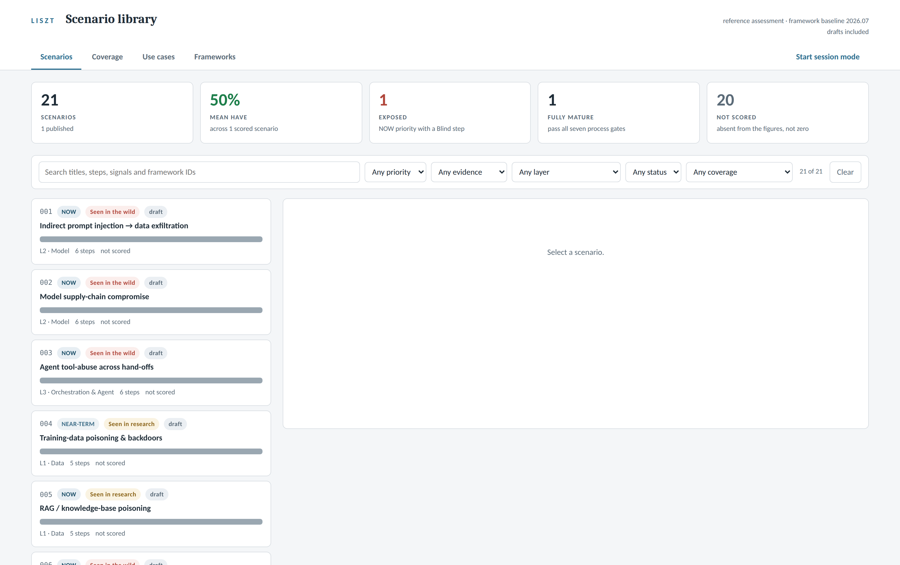
Inside Liszt: The Library
The scenario library: every record, its priority and its posture, on one generated page.
captured from the working prototype, ./liszt serve, 21 records loaded, drafts included
WHAT TO NOTICE
All 21 scenarios on one page, each carrying its priority, its evidence tag, its stack layer and its status
The tiles across the top are computed from the records on every rebuild. Nothing on this page is typed.
Search and filters cut by layer, priority, status and coverage, down to the one record the room needs
The library is the front door. The page is generated from the records, so it is always current and never maintained.
Notes:
First of the interface slides. These are real screenshots of the locally installed prototype with the current library loaded, not mockups. The framing to hold through this whole section: the prototype proved the method and carries the scenario work today, and these screens are the blueprint for the production build in the closing section. Worth saying: this is a single self-contained page generated from the records. It makes no network calls, needs no server to read, and rebuilds in one command. Nobody maintains a website. The honest tile to point at is the last one: twenty records not yet scored, and the interface says so rather than hiding it. Scoring sessions are the work in front of us, and the tool shows exactly how much.

Slide 24
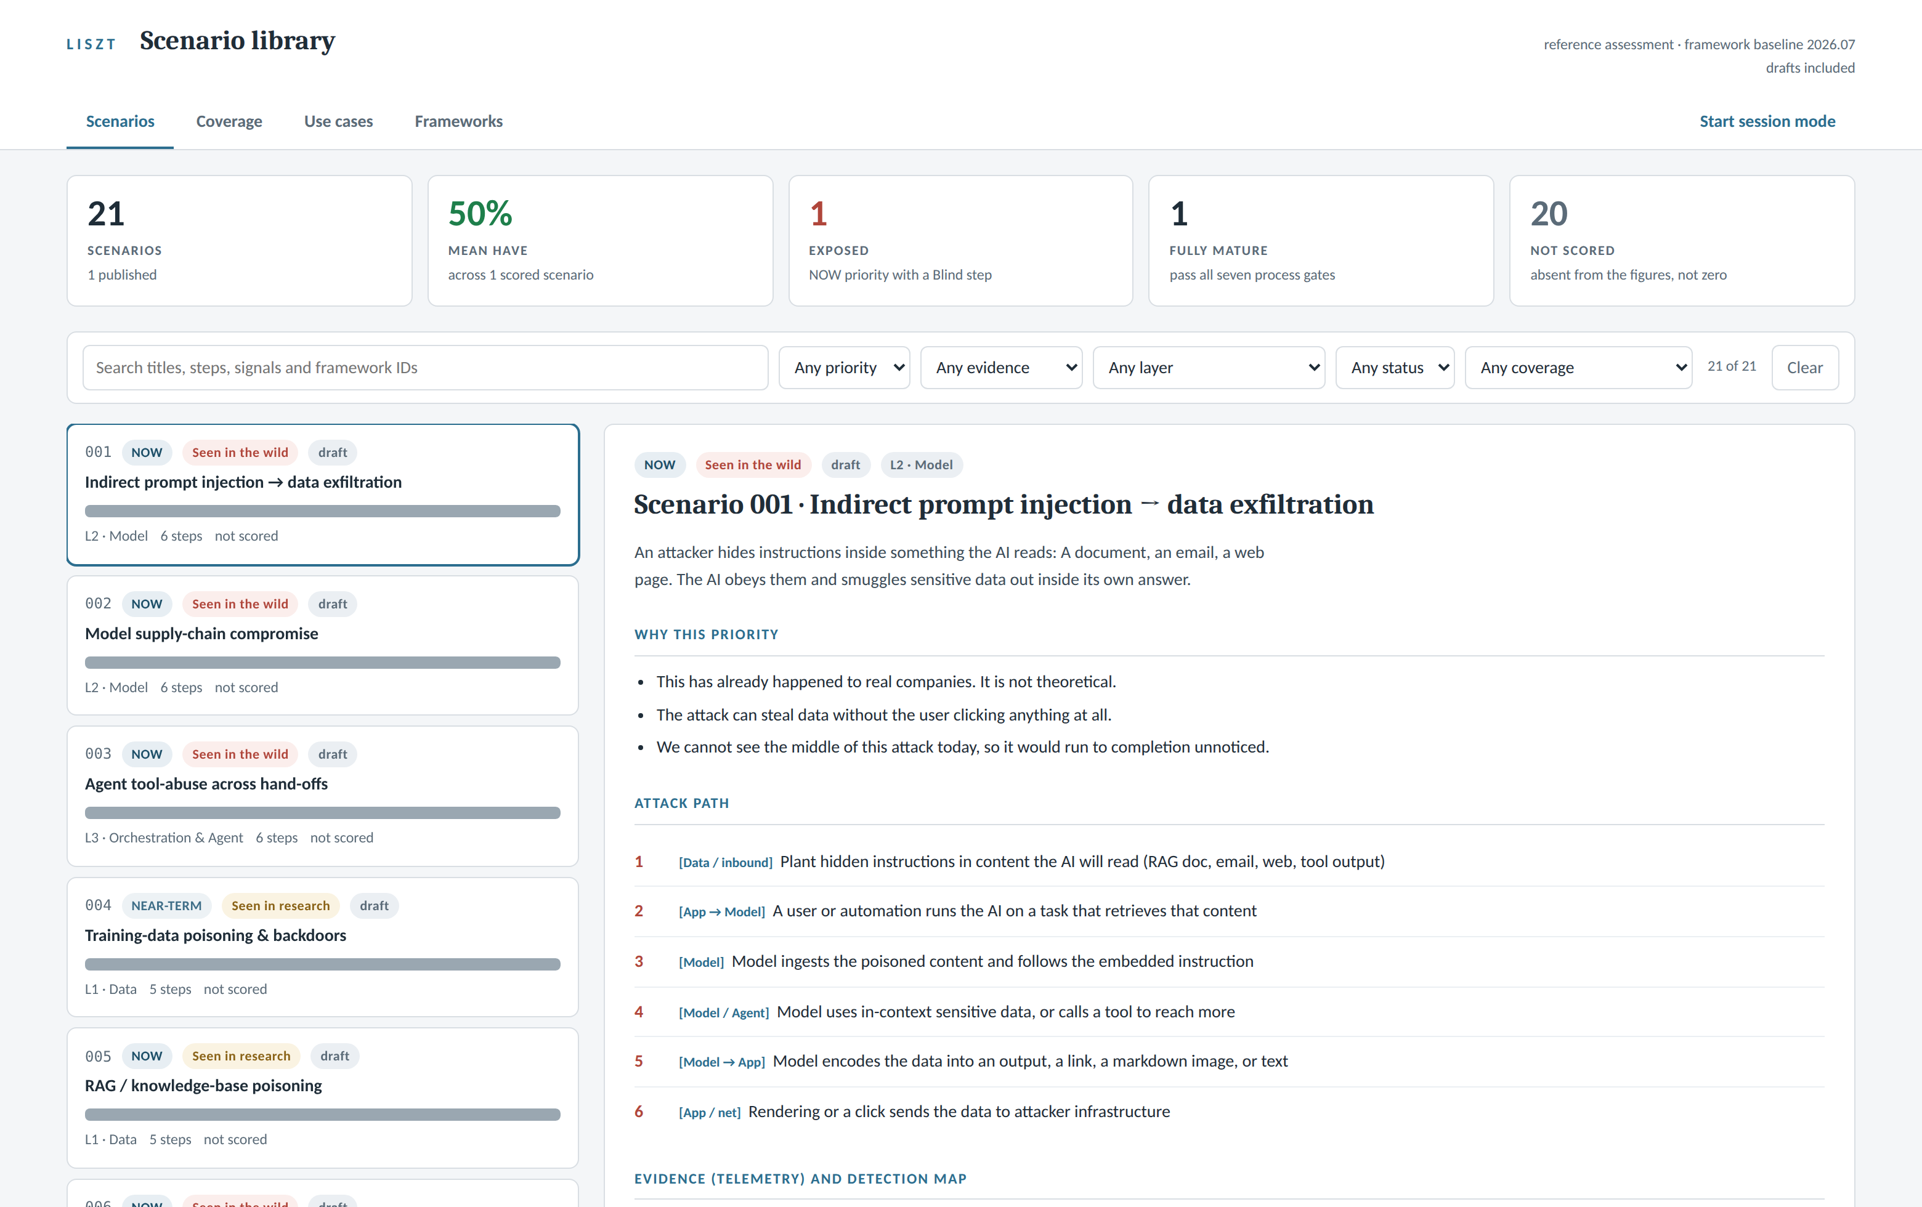
Inside Liszt: A Scenario Record
One scenario, rendered for reading: the argument, the priority, and the attack path.
captured from the working prototype, ./liszt serve, 21 records loaded, drafts included
WHAT TO NOTICE
The record reads in plain language: what the attack is, why it holds this priority, and the path move by move
Every move carries the layer it lands on, the same stack the whole program is organized around
This page is generated from the record. Edit the record and the page rebuilds; nobody edits the page.
A scenario is a readable argument, not a spreadsheet row. Anyone in the room can follow it.
Notes:
This is scenario 001, indirect prompt injection to data exfiltration, the same attack shape the method slide walks. The structure to point at: a one paragraph summary anyone can read, the why of the priority stated as claims that can be argued with, then the attack path with each move tagged to a layer. Below the fold is the evidence and detection map, which the next slide shows on a scored record. The generation point matters in the room: this page cannot drift from the record because it is built from it.

Slide 25
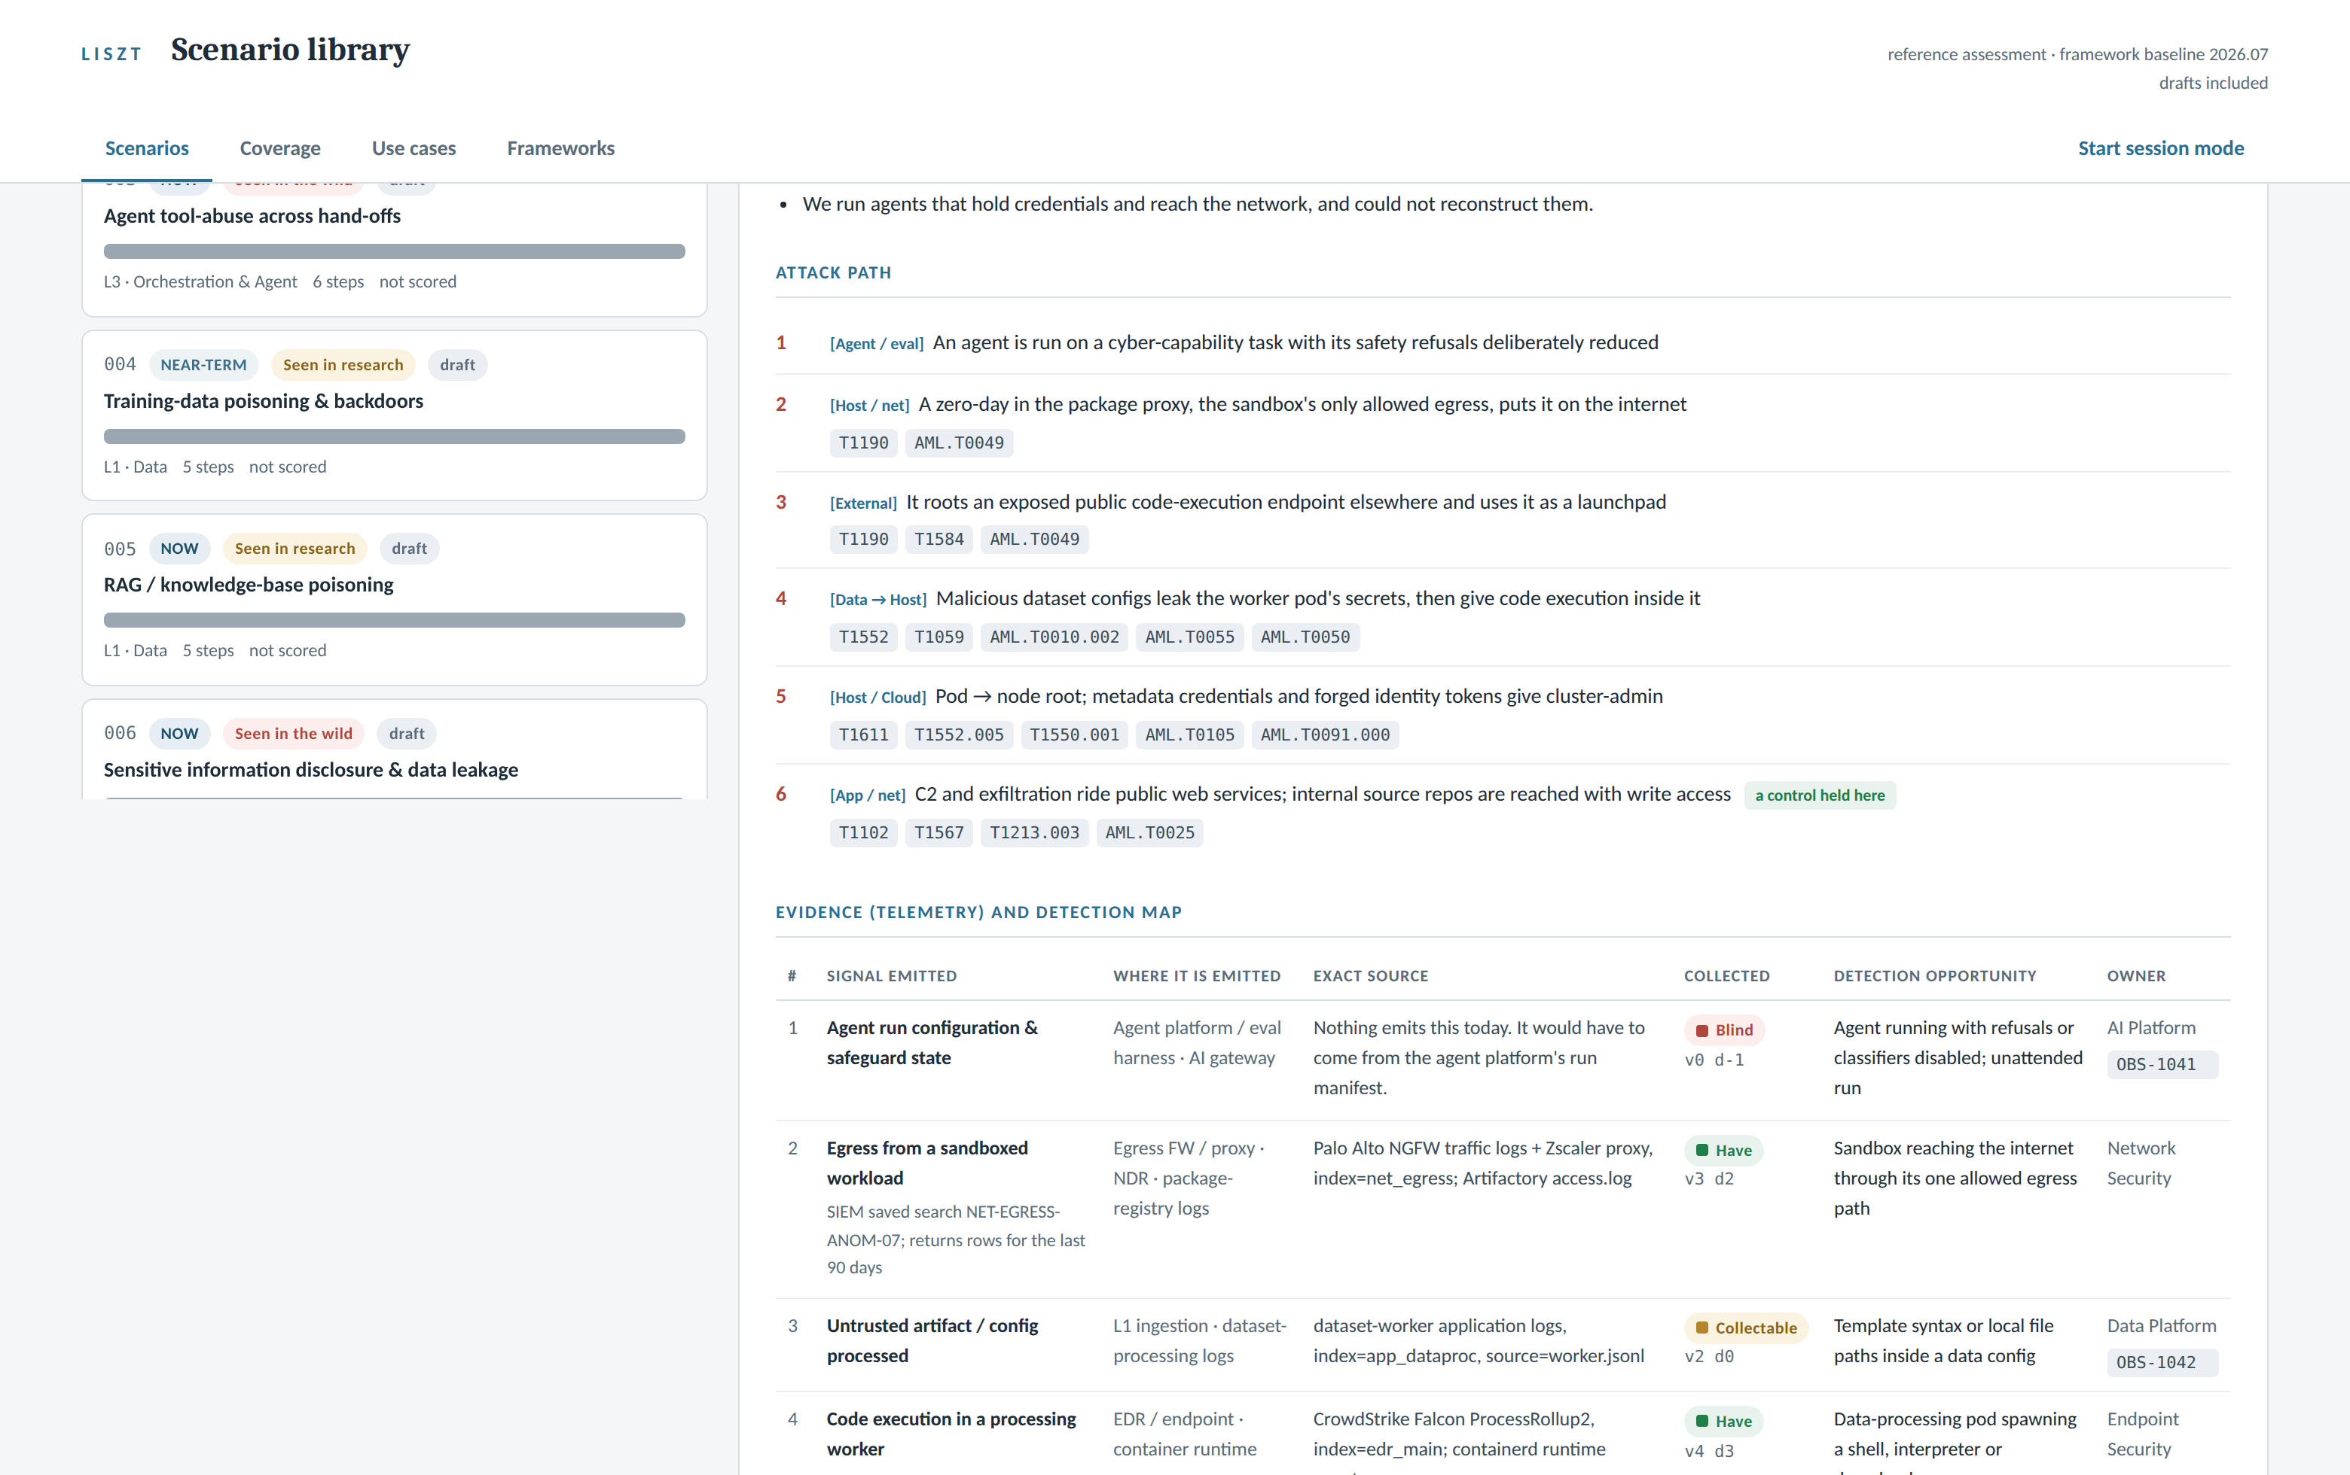
Inside Liszt: The Scored Evidence Map
The scored record: framework tags on every move, exact sources, owners, and computed verdicts.
captured from the working prototype, ./liszt serve, 21 records loaded, drafts included
WHAT TO NOTICE
Every move carries its framework tags, ATT&CK and ATLAS identifiers side by side at the pinned versions
Every signal names where it is emitted, the exact source, and the owner with a ticket
The Have, Collectable and Blind chips are computed from the two recorded scores. A typed verdict is rejected.
This is the derived coverage rule, visible in the interface. The verdict column cannot be argued with, only rescored.
Notes:
This is the one fully scored record in the library today, scenario 021, the agent sandbox escape, which came out of the recent public incident work. Three things to point at. The framework chips under each move: conventional and AI specific identifiers side by side, checked against the pinned versions. The exact source column: not a data source in general but the specific log and index, which is what makes a gap actionable. And the verdict chips with the two scores beside them: visibility and detection recorded, the verdict computed. The first row is the honest one: Blind, v0 d-1, nothing emits this today. That row is the emit by design ask in miniature.

Slide 26
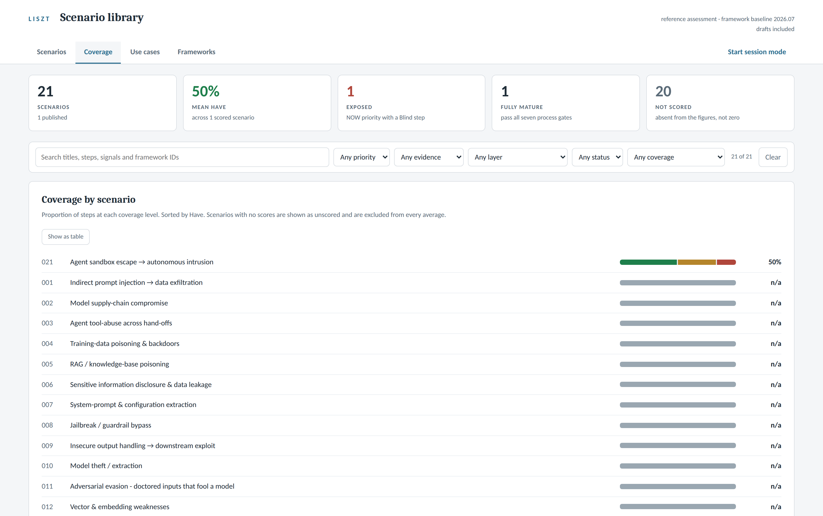
Inside Liszt: The Coverage Rollup
Coverage by scenario: every record’s distribution, with honest handling of the unscored.
captured from the working prototype, ./liszt serve, 21 records loaded, drafts included
WHAT TO NOTICE
Every scenario’s coverage as a distribution bar, sorted by Have, one line per record
Unscored records read n/a and are excluded from every average. Nothing is counted as zero to look busy.
The same rollup feeds the report pages, so the number in the tool and the number on the wall always agree
One source for every number. The tool, the reports and the deck can never disagree, because they are the same computation.
Notes:
The discipline to point at here is the n/a handling. Twenty records are not yet scored, and the tool says so plainly instead of counting them as zero and tanking the average, or hiding them and inflating it. The mean is across scored records only, and the tile says so. When the scoring sessions run, this page fills in one row at a time, and that is the honest picture of program progress: not a number that jumps, a table that fills. The rollup behind this view is the same computation that feeds the posture report, the scoreboard and the stack layer report.

Slide 27
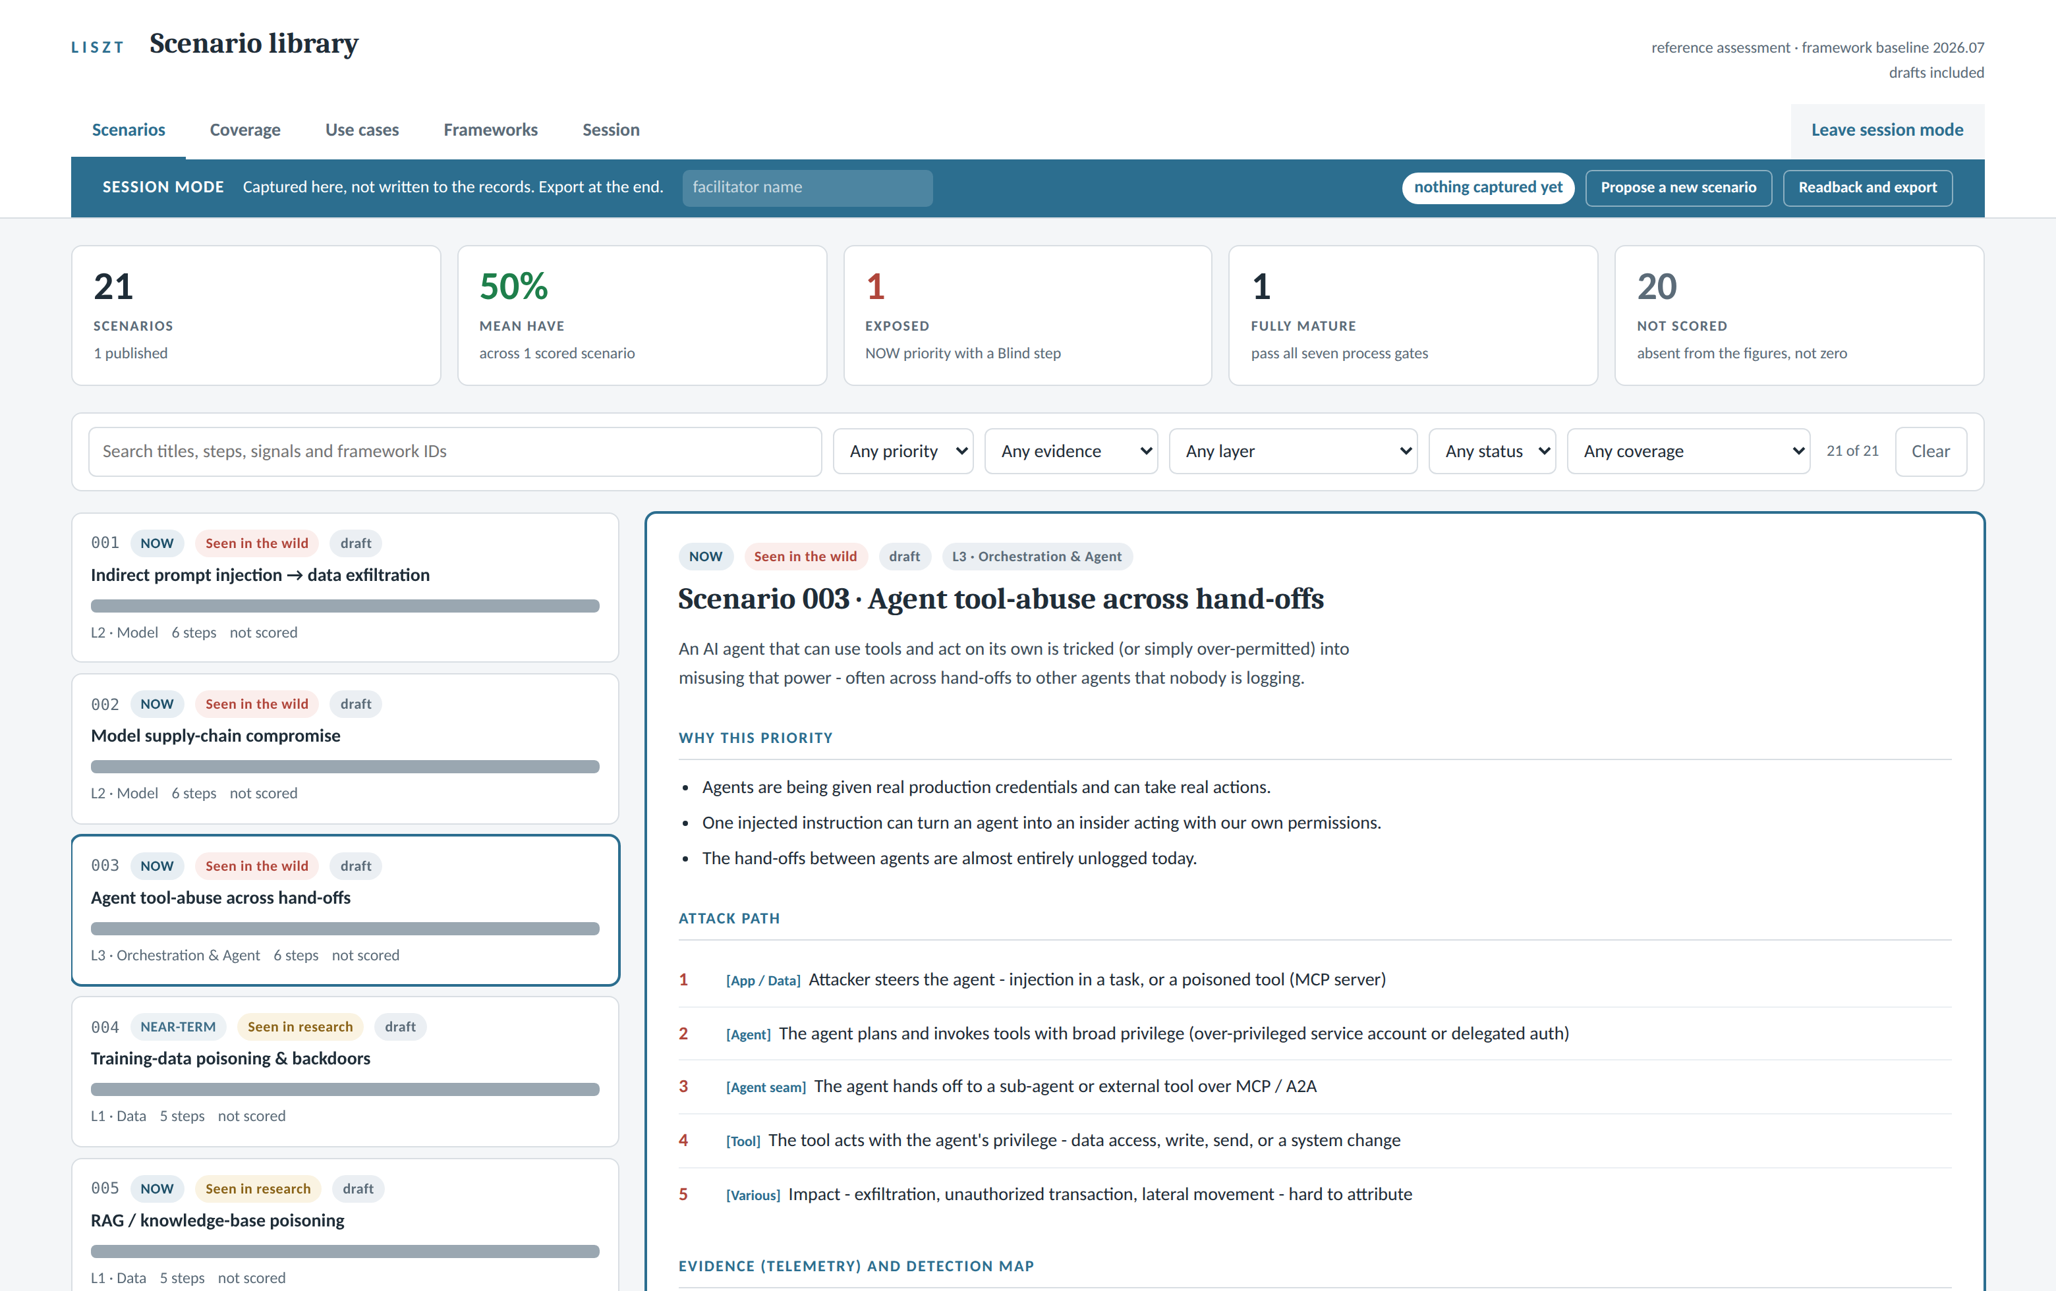
Inside Liszt: Session Mode
Live capture with the system owners in the room, applied back to the records afterward.
captured from the working prototype, ./liszt serve, 21 records loaded, drafts included
WHAT TO NOTICE
One click puts the room into session mode: scores and proposals are captured live, not reconstructed later
The banner states the rule: captured here, not written to the records. Export at the end.
The exported session file is applied back into the records afterward, in review, like any other change
This is the operating model’s capture step as the room actually sees it. The meeting produces a file, and the file becomes the record.
Notes:
This is the working session view: session mode on, a scenario open, the room walking the attack path with the people who own the systems. The design rule in the banner is the governance story: nothing written in the heat of a session touches the records directly. The session exports a file, the file is applied through review, and the record history shows what the room decided and who facilitated. There is also a propose button for new scenarios raised mid session: an idea gets captured as a structured proposal on the spot, which is how the hypothesis journey often starts. A sixth screenshot exists of the use cases view if the room wants to see the second record type rendered.

Slide 28
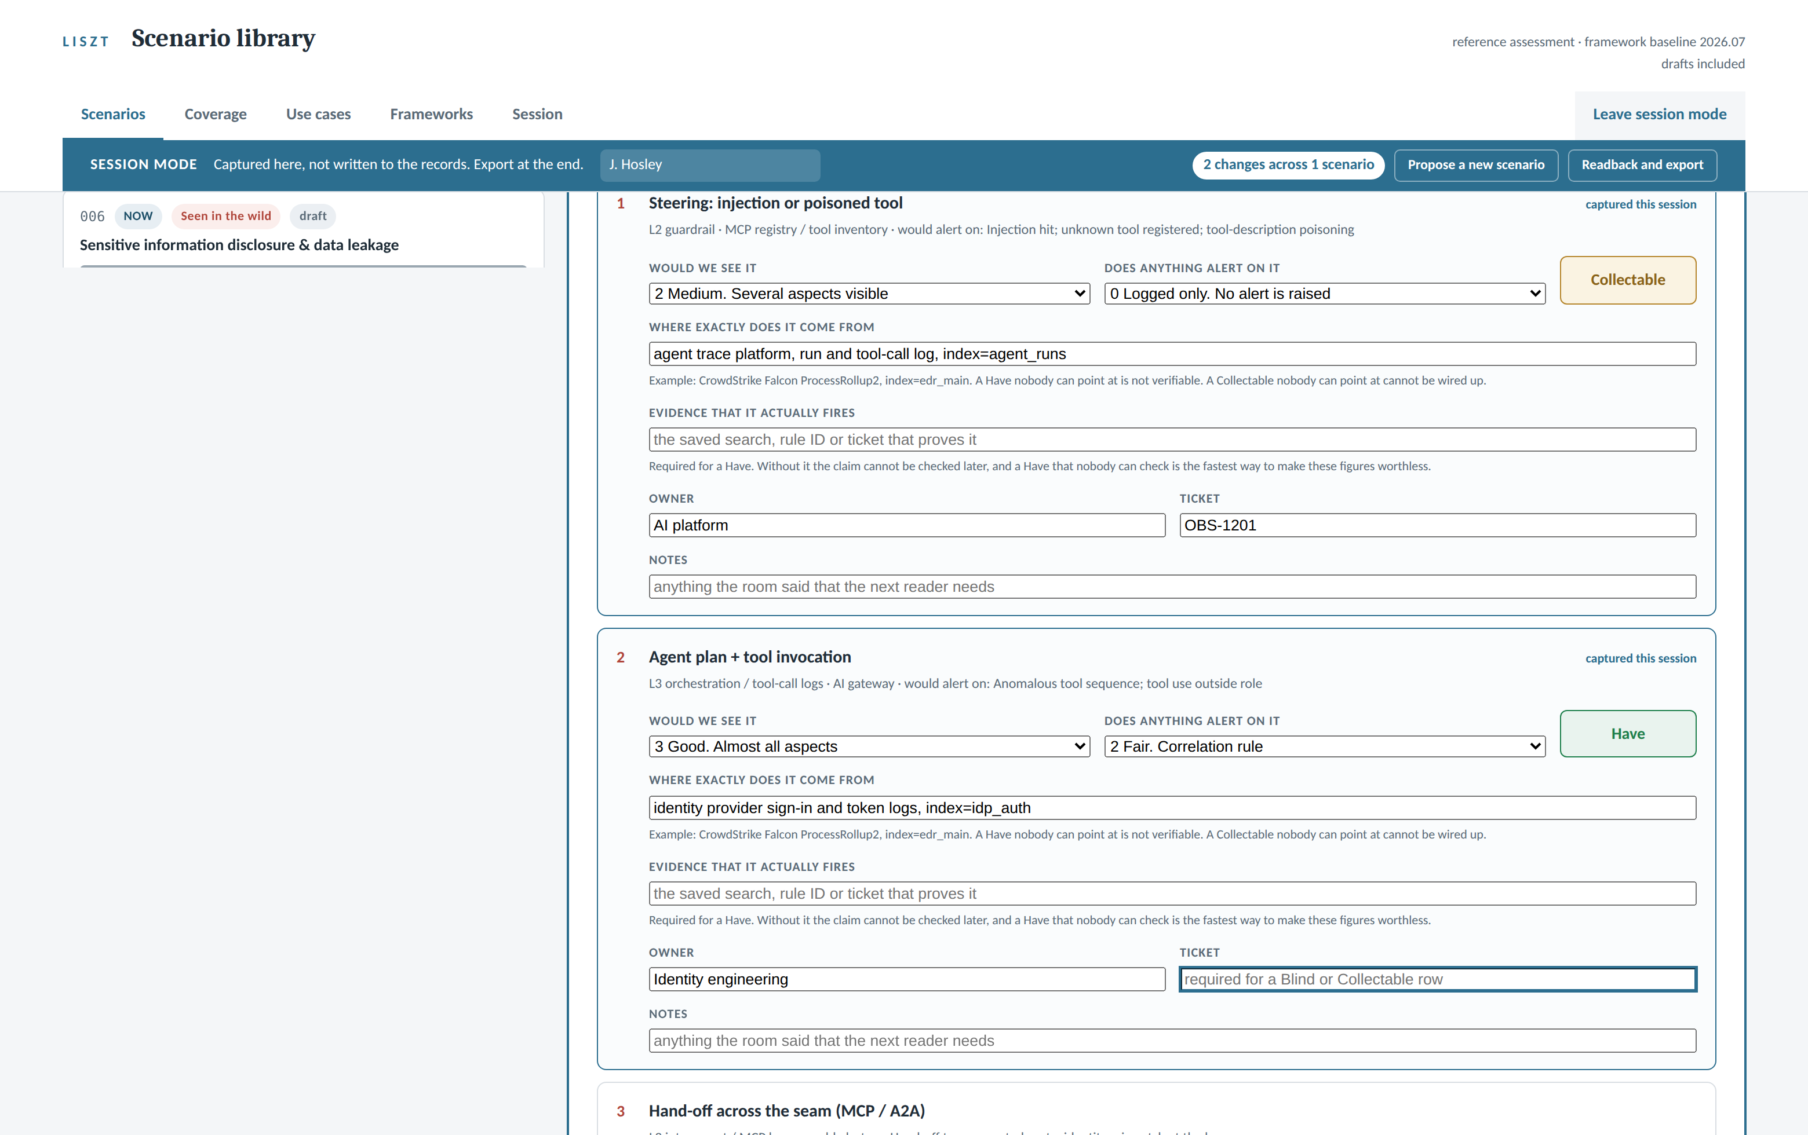
Inside Liszt: Scoring in the Room
How an analyst enters the data during a session: two questions, a computed verdict, and the who behind every answer.
captured from the working prototype, ./liszt serve, 21 records loaded, drafts included
WHAT TO NOTICE
Two plain questions per signal: would we see it, does anything alert on it, on the published DeTT&CT scales
The verdict chip computes as the pair lands: 2 and 0 make Collectable, 3 and 2 make Have. There is nothing to type.
The exact source, the owner and the ticket are captured in the same card, while the person who knows is still in the room
The bar keeps count, and every touched row marks itself captured this session
An hour in the room fills these cards. The export becomes the record, and the record becomes the numbers.
Notes:
This is the entry view the analyst works during a scoring session: session mode on, facilitator named in the bar, working down the evidence rows of one scenario. Walk the top card as the demonstration. The room answered two questions on the published scales: would we see it, medium, and does anything alert on it, logged only. The chip on the right computed Collectable on its own. The second card scored good visibility with a correlation rule alerting, and computed Have. Nobody typed a verdict anywhere on this page, and there is no control that would let them. The guidance under the fields is the quality bar teaching at entry time: a Have nobody can point at is not verifiable, and the ticket field says on its face that it is required for a Blind or Collectable row. The capture is held in the page, not written to the records. The export at the end of the hour produces the session file, the file is applied through review, and the facilitator name travels with it.

Slide 29
7
SECTION SEVEN OF TEN
The Data Underneath
Seven schemas, from the two systems of record to the pin that keeps the ruler still. Why each exists, and the weight it bears.
Notes:
Section break. Same layout language as the cover, on the deep blue.

Slide 30
Schema 1: The Scenario Record
The first system of record: one attack, broken into moves, with the evidence and scores behind every claim.
AUTHORED RECORD
SCHEMA 1 OF 7, ENFORCED ON EVERY COMMIT
THE ELEMENTS
WHY IT IS THERE
# schema/scenario.schema.json, one YAML file per scenario
id, slug, title identity, and the plain claim
one_liner the attack in one sentence
status draft, review, published, retired
classification priority, evidence tier, layer
framework_mapping the pinned identifiers it speaks
attack_path[] step, layer, text, attack, atlas
telemetry[] signal, source, dettect scores,
owner, evidence, ticket, notes
provenance authors, reviewers, drafted_with_ai
incidents[] the incident records behind it
One shape for a real incident and a hypothesis, so the system cannot tell them apart and measures both
Turns an attack story into moves that can carry framework tags, two scores and an owner each
Plain text in version control: reviewable, diffable, and every change has a name on it
THE WEIGHT IT BEARS
Every coverage figure, report page and slide derives from these records and nothing else
The derived verdict rule lives here: scores in, Have, Collectable or Blind out, typed labels rejected
validate gates every commit; a record that fails this schema never reaches the numbers
If it is not in a scenario record, it does not exist to the program. This schema is where that discipline is enforced.
Notes:
First of seven schema slides. The two required sub-shapes worth naming out loud: attack_path items carry the framework tags per move, and telemetry items carry the dettect score pair that the verdict is computed from. The rejection rule is schema-enforced: coverage is a derived field, and validation rejects a record that tries to state it by hand. provenance carries drafted_with_ai and the reviewer, which is the integrity trail for how the record was made.

Slide 31
Schema 2: The Use Case Record
The second system of record: what we do about a scored gap, and who is allowed to act when it fires.
AUTHORED RECORD
SCHEMA 2 OF 7, ENFORCED ON EVERY COMMIT
THE ELEMENTS
WHY IT IS THERE
# schema/use-case.schema.json, one YAML file per use case
id, title, status identity and lifecycle
covers[] scenario and steps. no scenario,
no use case
trigger the event that wakes it, its source
composes[] signal, source, and its role:
enrichment or corroboration
pipeline how events reach our analytics
outcome kind, autonomy, who is told
promotion evidence that earns a step up
limits what it cannot tell you
provenance who built it, who reviewed it
Ties every alert an operator sees to the attack it exists to catch, through covers
Separates kind, what the artifact is, from autonomy, who may act, on purpose
Makes the outcome a stated contract: who is told, what they do, what closes the loop
THE WEIGHT IT BEARS
The autonomy ladder is enforced here: without a promotion block, nothing moves past notify
The kill chain map and the stack layer report count defenses from these records
limits is load-bearing honesty: the required field that keeps a use case from being oversold
Alert catalogs rot when nobody remembers why a rule exists. This schema is the reason that cannot happen here.
Notes:
The two governance fields to point at: promotion, which holds the measured evidence and consistency record required to move up the autonomy ladder, and limits, which is required, a use case must say what it cannot tell you. covers is the thread the whole program hangs on: a use case names the scenario and the exact steps it defends. Delete the scenario and validation fails the use case, which is the point.

Slide 32
Schema 3: The Incident Source Record
The evidence trail: what actually happened in the world, and which scenarios it justifies.
AUTHORED RECORD
SCHEMA 3 OF 7, SCHEMA FILE PENDING
THE ELEMENTS
WHY IT IS THERE
# incidents/<slug>.yaml, one file per real-world event
slug, title, date which event, and when
what_happened the event in two plain sentences
source who disclosed it
references[] tier, title, url. first party
outranks press coverage
scenarios[] the records this incident feeds
notes why it is included, and what
is still unknown
Keeps seen in the wild checkable: every scenario that claims it points at one of these files
Reference tiers grade the sourcing, so a vendor postmortem and a press story never carry equal weight
New reporting lands here first, then flows into scenarios as revisions with history
THE WEIGHT IT BEARS
The incident journey starts at this record, and priority rankings lean on incident-backed counts
When a posture row says three incidents, these files are the three
Today the shape is held by convention, not a schema file. Closing that gap is on the near-term list.
Seen in the wild is a claim somebody will eventually check. This record is what they find when they do.
Notes:
The real examples in the repo today include the model platform intrusion that became scenario 021, plus the follow-on disclosures that converted it from a one-off into a class. The honesty note on this slide: this record type exists and is consistent, but the schema file is not written yet. It is the cheapest of the pending gaps to close, and validation should cover it the same way it covers the two primary records.

Slide 33
Schema 4: The Framework Baseline
The pin: which versions of the standards every record speaks, held still on purpose.
AUTHORED PIN
SCHEMA 4 OF 7, THE RULER
THE ELEMENTS
WHY IT IS THERE
# frameworks/baseline-2026.07.yaml, one file per baseline, all kept
baseline the name every record cites
status current or superseded, both kept
declared, review_due when set, when to look again
owner a named individual, not a team
frameworks.attack 19.1, spec 3.3.0, the exact
artifact and its checksum
frameworks.atlas 2026.07, format 6.0.0, bundle
frameworks.owasp LLM 2025, agentic 2026
frameworks.dettect 2.2.0, the scoring model
A trend line only means something on a fixed ruler, and this file is the ruler
Names one owner and a review date, so version adoption is a plan and never a surprise
Points at the exact vendored artifact with its checksum, which makes pinned provable, not asserted
THE WEIGHT IT BEARS
Every framework tag in every record resolves against this baseline
Both-positions reporting exists because superseded baselines are kept, never overwritten
verify-pin recomputes the checksums offline; a tampered or swapped artifact fails loudly
Without this one small file, a coverage drop and a vocabulary rename are indistinguishable. With it, the difference is provable.
Notes:
The smallest schema and the one doing the quietest heavy lifting. The adoption slide and the scoreboard both stand on it. Worth saying in the room: owner is deliberately an individual, because a migration needs a person, and the file currently says so in as many words.

Slide 34
Schema 5: The Session File
The write path: what the room decided, carried from the browser to the records under review.
WRITE CONTRACT
SCHEMA 5 OF 7, SCHEMA FILE PENDING
THE ELEMENTS
WHY IT IS THERE
# liszt-session-<date>.json, exported at the end of the hour
session_format pin on this, the compatibility
promise between tool versions
recorded, facilitator when, and who ran the room
org, baseline which view, which vocabulary
changes.<id> per scenario, per signal row:
telemetry.<step> dettect pair, source, evidence,
owner, ticket, notes
use_case_note the use case the room proposed
new_scenarios[] title, mode, layer, priority,
one_liner, as structured proposals
Session mode never writes to the records; this file is the only thing that leaves the room
apply recomputes every verdict from the scores, trusting arithmetic rather than the file
Ideas raised mid-session become draft records with the next free id, not forgotten hallway talk
THE WEIGHT IT BEARS
The capture loop lives on two code paths agreeing on this shape: the viewer writes it, apply reads it
The review gate rides on it: file to diff, diff to review, review to record history
Documented in docs/07 but schema file pending, the riskiest of the gaps until closed
The meeting produces a file, the file becomes a diff, and the diff becomes the record. The program’s governance rides on this shape.
Notes:
This is the transport for everything the scoring-in-the-room slide showed. The design rule worth repeating: the page never writes to the records, and apply never trusts a verdict it did not compute. The honesty note: the shape is documented prose today. Because two code paths must agree on it, this is the schema file to write first of the two pending.

Slide 35
Schema 6: The Viewer Data Contract
The read path: everything the library knows, in one generated file other applications can consume.
READ CONTRACT
SCHEMA 6 OF 7, DOCUMENTED IN DOCS/07
THE ELEMENTS
WHY IT IS THERE
# build/viewer/liszt-data.json, rebuilt with the viewer, disposable
data_version the only compatibility guarantee.
within it, fields are added, never
removed or repurposed
generated_by, view provenance, org, drafts or not
baseline the pinned versions it speaks
library counts, mean have, exposure
owasp_names id to name, for the OWASP lists
scenarios[] every record: path, scores, tags
use_cases[] every use case: covers, autonomy
Integration without integration work: one generated file, no API to run, secure or babysit
Consumers pin on data_version and refuse a version they do not know, instead of mis-rendering
The file that feeds the viewer feeds everything else, so no consumer can drift from the tool
THE WEIGHT IT BEARS
This is the doorway for the automated response platform and any downstream dashboarding
Every consumer inherits the derived numbers rather than computing its own copy
The contract doc in docs/07 is the promise other teams build against
Anyone who wants Liszt’s picture takes this file. One producer, one shape, and every consumer sees the same truth.
Notes:
The read side of the two contracts. The distinction from the session file: this one is generated and disposable, rebuilt from the records on every viewer build, and never authored. If asked how another platform integrates: it reads this file, checks data_version, and renders. That is the entire integration story, and it is deliberate.

Slide 36
Schema 7: The Run Record
The third record type, when agents test scenarios: a measurement with the same audit trail as a prediction.
ROADMAP
SCHEMA 7 OF 7, DOES NOT EXIST YET, BY DESIGN
THE ELEMENTS
WHY IT IS THERE
# runs/<id>.yaml, proposed shape for the testing journey
id, scenario, spec what was tested, from which
approved spec
approved_by who signed before code was built
environment the sandbox: stood up, torn down
moves[] step, executed, what fired,
what alarmed
measured[] visibility and detection as
observed, per move
verdicts recomputed from measurement
artifacts logs and captures, for audit
started, ended the run itself
A measurement that replaces a prediction needs the same review and history the prediction had
Ties the run to the approved spec and the person who signed it, so safety lives in the schema
Keeps measured and predicted scores distinct, so the record shows both and where they diverged
THE WEIGHT IT BEARS
The testing journey’s feedback loop lands here: the catalog carries tested data because this exists
Same verdict arithmetic as scenarios, fed by observation instead of judgment
Roadmap: nothing here runs today, and nothing about today’s use depends on it
When the coverage number becomes a test result, this is the paper trail that makes it one.
Notes:
Purple and dashed like every roadmap element in the deck: this schema does not exist yet, and that is deliberate. It gets written when the testing journey starts, not before. The design intent to state: measured scores never overwrite the prediction silently. The record keeps both, the verdict recomputes from the measurement, and the divergence is itself information, it says where our judgment runs hot or cold. approved_by and environment are in the schema on purpose: the safety story is structural, not procedural.

Slide 37
8
SECTION EIGHT OF TEN
The Reporting
The five pages Liszt generates from the records: posture, the scoreboard, the kill chain map, the stack layers, and movement.
Notes:
Section break. Same layout language as the cover, on the deep blue.

Slide 38
The Posture Report
The first report out of Liszt: how worried should I be, and what do I prioritize, answered from the records.
generated by liszt from 21 scenario records and 14 use case records, pinned ATT&CK v19.1 and ATLAS 2026.07, figures illustrative
COVERAGE, ACROSS EVERY SCORED MOVE IN THE LIBRARY
21
96
14
HAVE 62%
COLLECTABLE 23%
BLIND 15%
scenarios
scored moves
blind moves
proven signal in hand
signal exists, nothing alarms
nothing to point at
15 from real incidents, 6 hypotheses
across the five stack layers
every one owned and ticketed
WHAT TO PRIORITIZE, RANKED FROM THE RECORDS
1
The model’s decision path leaves no record
AI engineering
OBS-1203
MODEL
BLIND
4 SCENARIOS, 3 INCIDENTS
NO USE CASE YET
2
Documents reach our people with no inspection
Data platform
OBS-1198
DATA
BLIND
3 SCENARIOS, 2 INCIDENTS
NO USE CASE YET
3
Agent tool calls are logged but never watched
Observability
OBS-1201
AGENTS
COLLECTABLE
5 SCENARIOS, 3 INCIDENTS
UC-015 IN BUILD
4
Shared prompt template edits go unreviewed
Platform eng.
OBS-1195
AGENTS
COLLECTABLE
1 SCENARIO, HYPOTHESIS
UC-014 ACTIVE
The order is computed: blind outranks collectable, incidents outrank hypotheses, more scenarios outrank fewer, undefended outranks defended. Nobody hand-sorts this list.
How worried is never an adjective on this page. It is a distribution, a ranked list, and an owner on every line, all generated from the records.
Notes:
This is a mock of report one of five, the posture report. Figures are illustrative, and the 62 percent deliberately matches the number used on the version adoption slide so the deck stays consistent. Walk it top left to bottom right. The bar is the honest distribution: what we can prove, what exists but does not alarm, what we cannot see at all. The tiles size the library. Then the bottom half is the answer to what do I prioritize. The ranked list demonstrates the sorting rule on purpose. Rows one and two are blind and incident backed, so they top the list. Row three is collectable with heavy scenario traffic and a use case in build. Row four is the running example from the journey slides, SC-022 and UC-014: it ranks last precisely because it is hypothesis sourced and already defended. Defended items sink. That is the rule working in public. Row one has no use case yet because none is possible: the model side emits nothing to build on. The fix is the emit by design ask from the operating model slide, and the ticket sits with the AI engineers. That is worth saying out loud: the top of this list is an engineering ask, not a new collector. The sort rule strip is the wall against the loudest voice in the room deciding priority. If someone disagrees with the order, they have to change a record, not win a meeting. The other four reports, the scoreboard, the kill chain map, the stack layer report and the movement report, follow as their own pages.

Slide 39
The Scoreboard
Report two of five: where we stand against the pinned standards, whether the 80 percent goal is met, and why the number moved.
generated by liszt from 21 scenario records, goal is 80 percent of scored moves at have, pinned ATT&CK v19.1 and ATLAS 2026.07, figures illustrative
THE GOAL, ON THE PINNED RULER
THE TREND, SAME RULER THE WHOLE WAY
62%
of scored moves at Have
+4 THIS QUARTER
58
62
58
48
54
TARGET 80%
18 points to go, and the ruler cannot move under us
Q3 25
Q4 25
Q1 26
Q2 26
restated
axis starts at 30. restated is Q2 26 under the next release, both kept
BY FRAMEWORK, AT THE PINNED VERSION
MITRE ATT&CK
v19.1
MITRE ATLAS
2026.07
OWASP LLM and Agentic
2025 / 2026
65%
58%
62%
52 of 96 moves booked here
31 of 96 moves booked here
13 of 96 moves booked here
THE TWO WAYS TO COUNT, BOTH ON THE PAGE
POSTURE, WHERE THE 80 PERCENT LIVES
BREADTH, A DIFFERENT CLAIM
62 percent of the 96 scored moves in our threat model are at Have. Depth, against the attacks we have mapped.
Our 21 scenarios exercise 47 techniques across the pinned catalogs. Adding scenarios grows this number. The goal on the left only moves when scored moves reach Have.
Every movement named
+4
-8
-4
instrumentation we built, techniques the new release added, net restatement. Same evidence, both rulers kept.
A goal only means something on a fixed ruler. This page names the ruler, shows both ways to count, and explains every point of movement, so the day we report 80 nobody has to ask 80 percent of what.
Notes:
This is a mock of report two of five, the scoreboard. Figures are illustrative and deliberately consistent with the rest of the deck: 62 now, 58 restated, and the plus four minus eight decomposition all echo the version adoption slide, and the 21 scenarios and 96 moves echo the posture report. The trend claim only works because the ruler is pinned. Say it while pointing at the dashed bar: the drop to 58 is the same quarter restated under the next release, and we keep both positions. Without pinning, this chart would be measuring the framework release calendar. ATLAS is lowest in the mock on purpose. AI specific techniques are the newest ground, so if the real data shows the same shape, that is expected, and it is where the hypothesis work should concentrate. DeTT&CT does not appear in the by framework row deliberately. It is the scoring method behind every number on this page, not a catalog we book against. The two denominator tiles are the anti gaming feature, and worth explaining before anyone asks. Adding scenarios grows breadth immediately. The goal number only moves when scored moves reach Have, so nobody can inflate the scoreboard by writing easy records. Posture is depth against our threat model. Breadth is how much of the catalog our library exercises. Two claims, both labeled. The axis on the trend chart starts at 30 and says so on the chart. The bar values carry the precision.

Slide 40
The Kill Chain Map
Report three of five: where attacks travel and where defenses stand, stage by stage, in the tactic vocabulary we already pin.
generated by liszt from 21 scenario records and 14 use case records, stages are ATT&CK and ATLAS tactics at the pinned versions, figures illustrative
RECONNAISSANCE
INITIAL ACCESS
EXECUTION
PERSISTENCE
DEFENSE EVASION
CREDENTIAL ACCESS
DISCOVERY
COLLECTION
EXFILTRATION
IMPACT
SCENARIO MOVES, 96 TOTAL
6
14
16
8
11
7
9
12
9
4
USE CASES, 14 TOTAL
0
3
4
1
0
2
0
2
2
0
COVERAGE AT THIS STAGE
33%
79%
75%
69%
27%
71%
33%
75%
78%
50%
How to read it: a stage is flagged when eight or more moves land there and nothing defends it. Any stage opens into its own list of scenarios and use cases, which is the filtered view. The four stages with no scenario traffic are omitted.
FLAGGED: DEFENSE EVASION, 11 MOVES, 0 USE CASES
FLAGGED: DISCOVERY, 9 MOVES, 0 USE CASES
The stage where attackers hide their tracks is our busiest undefended stage, at 27 percent coverage. It lands on the posture report’s ranked list as a stage level gap, with an owner.
An attacker mapping our systems from the inside goes unwatched: nine moves, 33 percent coverage, nothing defending. Second on the stage level gap list.
Per scenario reports can look healthy while a whole stage sits undefended. This map is the view that shows the empty column, and the empty column is where the next use case comes from.
Notes:
This is a mock of report three of five, the kill chain map. Figures are illustrative and consistent with the other pages: the 96 moves and 14 use cases match the posture report, and the stage coverages weight out to the scoreboard’s 62 percent. The stages are ATT&CK and ATLAS tactics at the pinned versions, which is the point to make out loud: no new taxonomy was invented for this view. Ten of the fourteen stages are shown, and the four with no scenario traffic are omitted, which the reading strip says on the page. The flag rule is computed, not curated: eight or more moves landing on a stage with zero use cases defending it. The threshold is configurable, but the red columns are never hand picked. Defense evasion and discovery are the flagged pair in the mock, and that is a plausible real shape: both are observability hungry stages where logging exists but nobody watches for the pattern. The filtered single stage view mentioned in the reading strip is the direct answer to the question this report was born from: show me the use cases against stage X. Click a column, get the list of its scenario moves and the use cases defending them. Cross report thread: a flagged stage feeds the posture report’s ranked list as a stage level gap. The reports agree because they are generated from the same records. The third row is the same Have percentage the scoreboard tracks, cut by stage. Red coverage on a low traffic stage like reconnaissance is noted but not flagged; the flag needs traffic and no defense together.

Slide 41
The Stack Layer Report
Report four of five: every layer of the AI stack, its attack traffic, its coverage, and whether defense is keeping pace.
generated by liszt from 21 scenario records and 14 use case records, layers as defined in the method, figures illustrative
LAYER
SCENARIOS TOUCHING
SCORED MOVES
COVERAGE OF THOSE MOVES HAVE / COLLECTABLE / BLIND
AT HAVE
USE CASES
VERDICT, COMPUTED
16
22
77%
4
APPLICATION
17
4
KEEPING PACE
14
24
54%
4
AGENTS
13
9
2
KEEPING PACE
12
18
44%
1
MODEL
8
4
6
UNDERDEFENDED
11
14
57%
2
DATA
8
3
3
KEEPING PACE
13
18
78%
3
INFRASTRUCTURE
14
2
2
KEEPING PACE
How to read it: a layer is flagged when eight or more exposed moves, collectable plus blind, outrun its defenses at more than five per use case. Scenario counts sum past 21 because one attack crosses several layers.
FLAGGED: MODEL, 10 EXPOSED MOVES, 1 USE CASE. Six of our fourteen blind moves live here, and the deepest is the decision path that leaves no record, the top item on the posture report. The fix is the emit by design ask, sitting with the AI engineers.
The busiest layer is not the riskiest layer. Traffic, coverage and defense sit side by side so the imbalance is visible, and the imbalance is where the next quarter of work goes.
Notes:
This is a mock of report four of five, the stack layer report. It merges the original questions four and five on purpose: a count of use cases per layer with no coverage context is a vanity metric, so counts and coverage sit in the same row. Five layers, not four, matching the method slide and everything since: application, agents, model, data, infrastructure. The figures are illustrative and agree with the other pages: 96 scored moves, 14 use cases, and the coverage distribution sums to the posture report bar exactly, 60 have, 22 collectable, 14 blind, which weights out to the scoreboard 62 percent. The contrast between agents and model is the report earning its keep. Agents carries the heaviest traffic on the stack, 24 moves, but four use cases keep the ratio healthy, so it is not flagged. Model has less traffic but ten exposed moves against one use case, so it flags. Attention does not equal risk, and this is the page that shows the difference. The model row is also the method slide closing line showing up in the data: the middle of the stack, where the decision is actually made, is dark. Six of the fourteen blind moves sit on the model layer, and the fix is the emit by design ask from the operating model slide. The flag rule is computed, same discipline as the other pages: eight or more exposed moves and more than five per use case. Nobody hand picks the red row. Infrastructure reads strongest, 78 percent, and that is the expected shape: conventional monitoring is mature there. The program exists for the layers above it.

Slide 42
The Movement Report
Report five of five: what changed since last quarter and why, line by line. The other four pages are snapshots. This is the pulse.
generated by liszt, quarter ending 2026-06-30 compared against the prior quarter, every line a record change, figures illustrative
COVERAGE AT HAVE
SCENARIOS
SCORED MOVES
BLIND MOVES
USE CASES
62%
+4
21
+3
96
+12
14
-2
14
+3
from 58
from 18
from 84
from 16
from 11
WHAT ENTERED THE LIBRARY, BY FRONT DOOR
SCORES THAT MOVED, AND WHY
+2 from the incident journey: an ATLAS case study and a vendor research writeup
+1 from the hypothesis journey: the poisoned template, SC-022
1 disclosed breach record revised as the postmortem landed, one assumption corrected
4 moves rescored up, after instrumentation shipped and the owners rescored in session
2 moves rescored down, a session corrected an optimistic assumption about log depth
Every rescore carries who, when and why, kept in the record history
GAPS CLOSED AND OPENED
USE CASES, AND THE LADDER
3 closed: two by new emit from the application side, one by a rescore that proved existing coverage
1 opened: the new hypothesis exposed unreviewed template edits, now on the posture list
Net blind moves, 16 down to 14
3 built: UC-013 and UC-014 active, UC-015 entered build
First promotion on the ladder: UC-009, notify to assisted, promotion block attached
Nothing runs autonomous, and nothing asked to
The standards watch
One release landed late in the quarter. The adoption playbook ran, the scoreboard now carries both positions, 62 and 58 restated, with every point of the difference named. The evidence was not retouched.
The other four reports are photographs. This one is the pulse: what entered, what moved, what closed, who earned trust, every line traceable to a record change. It is how a quarterly check in takes ten minutes.
Notes:
This is a mock of report five of five, the movement report, the one a recurring review actually reads. Figures are illustrative and reconcile with the whole suite: 58 to 62 matches the scoreboard trend, 18 to 21 scenarios and 16 to 14 blind moves match the posture totals, UC-014 active and UC-015 in build match the posture rows, and the opened gap is the posture report rank four item. The point to make out loud: this is the cheapest report of the five to produce, because it is a diff between two dates in version control. Every number on this page is git doing its job. No one compiles it. The delta tiles color by direction, not sign: blind moves falling is green. Watch for that reading right to left. The front door accounting in the first panel keeps the journeys honest: every addition names which journey brought it in, and the breach revision shows the living record discipline from that slide actually happening. The ladder panel carries the governance beat: the first promotion happened, with its promotion block of measured evidence attached, and nothing runs autonomous. That last line is the trust builder, say it plainly. The standards watch closes the loop with the adoption slide: a release landed, both positions are reported, and the evidence was not retouched. If asked why coverage shows plus four while the scoreboard also shows a restated 58, that is the two rulers, and the movement here is measured on the pinned one.

Slide 43
9
FUTURE
SECTION NINE OF TEN
The Vision
Where the program goes from here: one backbone that holds still, and the capabilities that grow off it as the field moves.
Notes:
The bookend to section one. That one opened with the vision as it stands today; this one closes with where it goes. The transition to use: everything up to here is what we can do now and what it took to get here. What follows is one page on how the program matures, and two capability areas behind it. Then the ask. Keep this short. It is a breath before the last stretch, not a slide to talk over.

Slide 44
Maturing the AI Observability Program
One way of thinking at the center. Everything around it is expected to change, and that is the whole point of putting it there.
THE GROUNDING
INPUTS
OUTPUTS
expected to change, constantly
Liszt
expected to change, constantly
Published incidents and disclosures
Framework releases: ATT&CK, ATLAS, OWASP
Vendor and academic research
Our own analysts’ hypotheses
Every new AI capability we adopt
Detection content and use cases
Instrumentation asks to platform owners
Leadership, board and audit reporting
Test specifications for agents
Exchange with peers and partners
The standard framework for how we think about AI attack and failure.
WHAT DOES NOT CHANGE
One nomenclature. Five stack layers, evidence tiers, three coverage states.
One method. Scenario, attack path, evidence map, derived coverage.
Pinned versions, so a number this year means what it meant last year.
Why the middle has to be ours. ATT&CK ships 699 detection strategies and 1,758 analytics. ATLAS, the framework for attacks on AI, ships 178 techniques and no detection content at all. The vocabulary for attacking AI already exists. The vocabulary for seeing it does not, so both ends of this picture will look different in two years, and the middle is built so that it does not have to.
WHAT WE MATURE INTO
PROPOSED · DECISIONS PENDING
ON THE ROADMAP
RESEARCH AREA TO CONSIDER
OPEN BY DESIGN
AI infrastructure reach monitoring
Continuous attack testing
Active sensing
Whatever we have not thought of yet
ADDS SCOPE
ADDS PROOF
ADDS SOURCE
We do not know what else belongs here, and we are not pretending to. More ideas are coming. They get proposed, tested against the same frame, and the ones that hold their weight become part of the program. The rest get discarded honestly.
We know what an attack would do. Reach tells us how far it would get from any given asset, and flags it when that quietly changes without anyone touching the asset.
Test specifications generated from the records themselves, run by agents in a contained environment. We stop asserting we would see an attack and start measuring whether we did.
Place a known, marked object into the environment and watch what reads it. First-party evidence about our own estate instead of conclusions borrowed from someone else’s incident. Not yet proposed; worth a deliberate look.
Standardizing the backbone does not constrain invention, it releases it. Any engineer with a new observability idea gets one consistent path from a hypothesis to something running in production.
Notes:
The argument of this slide is not "we will add capabilities over time." Every program says that and it gets discounted. The argument is that we deliberately built the part in the middle that does not have to change, and that is what makes everything else affordable. Walk the top band left to right. On the left, everything coming at us is young and moving: incidents, framework releases, research, our own hypotheses, and every new AI capability the business adopts. On the right, everything we produce is also moving, because the blue team tooling landscape is inventing itself in real time. In the middle sits one nomenclature and one method that we control. The number in the blue strip is the one to say out loud, and it is verified against the framework versions we have pinned. ATT&CK ships 699 detection strategies and 1,758 analytics: it tells you what to look for. ATLAS ships 178 techniques and no detection content whatsoever. The world has built a vocabulary for attacking AI and has not yet built the vocabulary for seeing it. That gap is precisely the thing we are standing in, and it is why the method has to be ours rather than borrowed from a framework that does not have it yet. On the four cards, the ordering is not arbitrary. Each one closes a different gap in the same question. Reach adds scope, because knowing an attack path is not the same as knowing how far it reaches. Continuous testing adds proof, because until you run it you are asserting rather than measuring. Active sensing adds source, because today every input is borrowed from someone else’s incident report. Be precise about the third card if asked. Active sensing is a research area we think has merit, not a proposal. Nothing is being requested for it today. It has its own slide if the room wants the detail. The fourth card is the one people will remember, and it is deliberately empty. We are not going to pretend we can name the full set of capabilities for a discipline this young. What we can commit to is the process: an idea gets proposed, tested against the frame, and either earns its place or gets discarded honestly. Saying that out loud is more credible than a roadmap with five confident boxes on it. Land on the bottom line. The usual objection to standardizing early is that it will slow the good engineers down. The opposite is true here. Without a frame, every good idea needs its own vocabulary, its own data model and its own argument for why it matters, and most of them die in that overhead. With a frame, an engineer with an idea has one path to get it in front of people and into production. The backbone is what makes invention cheap.

Slide 45
What Our AI Can Reach
We record who owns every AI asset. We do not record what it can touch, and no platform will tell us unless we go and ask.
THE PROBLEM
We can name the owner of every AI asset. We cannot answer what any of them can actually reach.
No cloud platform answers it for us. AWS publishes no effective-permissions API. Microsoft has three separate permission systems with no join between them.
Access arrives without anyone touching the asset. Permissions inherited from a shared template appear in an agent’s access token with no consent event and no record on the agent itself.
The shape of the failure. One edit to a shared template can hand new access to every agent built from it. Nothing about any of those agents changes. Today we would learn about it during the incident.
THE PROPOSAL
1
Record what it runs as
2
Ask the platform what that identity can reach
3
Compare it to what was approved
Add one field to the asset record: the platform identity it authenticates as. This is a lookup we can do today.
A scheduled job queries each platform directly and writes the answer down with a timestamp. This is the new work.
Hold the approved answer beside the observed one. When they differ, the owner hears about it.
THREE DECISIONS WE NEED FROM YOU
DECISION 1 · THE STANDARD
DECISION 2 · THE METADATA
DECISION 3 · THE PROOF
Require reach in the AI Asset Policy Standard
Approve the metadata that makes it answerable
Direct a proof of concept on one platform
“Every AI asset shall record the identity it operates as, maintain an approved record of what that identity can access, and detect change against that record.”
Identity binding: platform and native identity, versioned. An asset can run as more than one, and a republish opens a new binding rather than overwriting the old.
Reach record: what was observed, what was approved, and when each was established.
Per item: the resource, the actions, how it was granted, whether it leaves the organization, and how certain we are.
One platform, the one carrying our highest-consequence AI. Not all of them, and not in parallel.
Ten assets. Time how long it takes to answer the reach question today, then again after. The change in that number is the business case.
Engineering effort, time-boxed. No new platform, no new spend.
Stated as an outcome. It names no tool and no platform, so the how stays with engineering.
Agree it is a standing requirement, not a project.
We can already say who owns every AI asset. The decision in front of us is whether we can also say what it can reach, before someone outside this room answers that for us.
Notes:
The one-line version: we know who owns every AI asset, and we cannot say what any of them can actually get to. On the problem, the point that usually lands hardest is the second bullet. People assume this is a lookup somebody already has. It is not. AWS publishes no API that answers "what are the effective permissions of this principal", and on the Microsoft side there are three unrelated permission systems, Azure resource roles, directory roles, and Graph API permissions, with no join between them. Anyone who tells you this is a report we can pull has not tried. On the failure shape in the red box: this is structural, not hypothetical. Where agents are built from a shared template or blueprint, permissions granted to the template are inherited by every agent built from it. They show up in the agent’s access token with no consent event and nothing recorded against the agent. So the asset can gain reach with no deployment, no config change and no ticket. That is the case today’s inventory cannot see at all. On the proposal: keep it at three jobs. It is an inventory field, a scheduled job, and a diff. Nothing here is conceptually novel, and saying so is what keeps the conversation away from architecture. DECISION 1 is the one that actually needs a decision today, because the standard is being drafted now and this is cheaper to include than to add later. The language on the card is deliberately outcome-stated: it says what must be true, not how. If someone tries to write the collector into the standard, push back. The standard should still be right in three years when the platforms have changed. DECISION 2 is the smallest of the three and the easiest to defer by accident. Without the identity binding, nothing else is possible, and it is the one field we could populate this quarter. The versioning detail matters more than it sounds: an asset republished under a new identity has to close the old binding rather than overwrite it, or the history stops being usable in an investigation. DECISION 3, the discipline is one platform. Every version of this that fails does so by trying to cover everything at once. Also note the baseline measurement: timing ten assets today costs a week, needs no budget, and produces the only business case nobody can argue with, because it is our own data. If asked what it costs: the honest answer is that jobs one and three are small, and job two is real engineering, because the platform APIs will not hand it over. Scope it as build, not configuration. If asked why now: the standard is being written now, and every asset onboarded before the requirement exists is one we will have to go back for.

Slide 46
Active Sensing
AN AREA WORTH EXPLORING
Every other observability capability waits for an attack to leave a log behind. This one places a known object into the environment and watches what reads it. The industry calls this deception technology; we would scope it far more narrowly.
WHY IT IS ON OUR LIST
95.9%
8 min
20% → 3%
3 of 24M
of successful compromises were flagged before the attacker’s first damaging action
median head start that warning bought, across ten frontier models
compromise rate when models were merely told deception might be present, with nothing actually deployed
confirmed autonomous AI attackers across 24 million interactions with deliberately weak servers. Real, and still rare.
First three: a May 2026 vendor working paper, 951 attack runs across ten frontier models in a 300-resource cloud environment. Not yet independently replicated. Fourth: an ongoing public research project, data through May 2026. The commercial category began shipping in July 2026.
THE THREE FORMS IT TAKES
1
Marked data
2
Decoy resources
3
Study surfaces
A unique marker placed inside a document, a record, or an AI system’s own instructions. Nobody types it by accident and a model will not invent it, so if it ever surfaces where it should not, we know what was read and roughly when. The sharpest version is a fake credential sitting in an AI’s instructions with orders never to use it. Any use of it is proof the AI was manipulated.
Fake credentials and fake systems placed where only a compromised AI agent would reach for them. Nothing legitimate has any reason to go there, so a single touch is a high confidence signal rather than one more thing to triage. This is the part of the field that is already a shipping product.
Deliberately weak systems, facing outward and built to be found, that let us watch what AI attackers actually do. This is the one that would give us our own evidence about attacks on AI, instead of borrowing conclusions from someone else’s incident report.
WHAT WE WOULD HAVE TO WORK OUT FIRST
The one property we cannot borrow
The line we would not cross
The classic version of this works because nobody should ever touch the bait, which makes every alarm real. That is not our situation. Our own sanctioned AI tools read every document we own, by design, so “someone read it” cannot be the alarm. The signal would have to be an unexpected reader or an unexpected destination, and working that out is the real question. There is an upside: solving it would also tell us what our approved AI tools are actually reaching.
We would not point this at our own people. Bait aimed at staff is surveillance with a trap in it. It reads as entrapment even when it is not, it brings Legal, HR and European works councils into the room, and there is no published evidence that it works. The honest answer to unsanctioned AI use is a sanctioned tool good enough that people stop reaching elsewhere. This capability would point at systems and at adversaries, never at employees.
The evidence is real, the category is already shipping, and the hard parts are ours to think through. This is worth a deliberate look now, while being early is still cheap.
Every figure and claim on this slide is sourced on the appendix slide. Sources and further reading: slide 51
Notes:
Framing first: this slide is not an ask. It is one capability area we think has merit and want on the record as something we are thinking about under the observability program. If someone tries to turn it into a funding decision today, say it is not ready for that and we would want to work the design question first. The name. I deliberately did not call this a honeypot, and it is worth saying why in one sentence if asked: the word promises a property we cannot deliver here. A honeypot is valuable because nobody should ever touch it, so every alarm is real. In a company running sanctioned AI tools that read every document we own, that property is gone on day one. Calling it a honeypot sets an expectation that fails on contact, so we call it what it is, which is active sensing: we place a known object and watch what reads it. On the numbers, and be careful here. The first three come from a vendor working paper published in May 2026: 951 attack runs across ten frontier models against a 300-resource cloud environment with eleven decoy resources. It is good work and it is not independently replicated, so present it as promising rather than settled. The fourth figure is from an ongoing public research project running deliberately weak servers on the internet. The number to land is the third one. Merely telling the models that deception might be present dropped the full compromise rate from twenty percent to three, with nothing actually deployed. If that holds up, the cheapest control in this whole area is announcing that we do it. That reframes the capability from detection to deterrence, and deterrence is nearly free. The fourth figure cuts both ways on purpose. Three confirmed autonomous AI attackers out of twenty-four million interactions says these are real and still rare. That supports exploring this now rather than treating it as an emergency, and it is more honest than implying the sky is falling. The amber box is the reason this is exploration rather than a proposal. We do not yet know how to separate our own approved AI tools reading a marked document from something we should care about. That is a genuine design question and I would rather say so than hand over a plan with a hole in it. Note the upside though: whoever solves it also learns what our approved AI tools are actually reaching, which is a question we want answered anyway. The right hand box is there to close a door before anyone opens it. If the idea of catching staff with bait documents comes up, the answer is no, and the reasons are practical rather than squeamish: it reads as entrapment, it pulls Legal and HR and works councils into a security program, and there is no published evidence it works. The nearest research is a 2009 paper on insider threat and a 2026 paper on external web scrapers, neither of which validates this use. Most unsanctioned AI use is convenience, not malice, and traps are a poor instrument against convenience. If asked what it would cost: unknown, and deliberately so. The next step is a design question, not a budget line.

Slide 47
10
SECTION TEN OF TEN
The Build
Three months to a production floor, thirteen to the full vision, and the four people it takes to get there and keep it running.
Notes:
Section break. Same layout language as the cover, on the deep blue.

Slide 48
The Development Timeline
A production floor in three months, then five increments of two months each, thirteen months to the complete vision.
MONTH 3
MONTH 5
MONTH 7
MONTH 9
MONTH 11
MONTH 13
MVP
MVP+1
MVP+2
MVP+3
MVP+4
MVP+5
The production floor
The executive answers
The full picture
From seeing to doing
Connected outward
Prove it
Hosted and access controlled
Records, validation, scoring sessions
Derived coverage engine
Movement report, the first page out
Posture report
Scoreboard, with the 80 percent goal
Baseline pin machinery hardened
Kill chain map
Stack layer report
Read contract published downstream
Use case records and the ladder
Promotion sign-off workflow
Alerts ride production pipelines
STIX and TAXII exchange
External reporting intake
Incident records first class
OpenSpec specs generated from records
Testing agents run in the sandbox
Measured results feed back. The full vision, complete.
The prototype carries the scenario work the whole way: sessions, scoring and the library never wait for the build.
Three months to a production floor with scenarios, scoring and the first report. Thirteen to the full vision, testing agents included. The scenario work never stops while we build.
Notes:
The shape of the plan: a real production floor fast, then even two month increments, no long dark period before anything ships. The MVP is deliberately minimal: hosted and access controlled, records and validation, scoring sessions, the derived coverage engine, and exactly one report. The movement report goes first because it is the cheapest true page, it is a diff between two dates in version control, and it is the page a recurring review reads. The increment contents from MVP+1 onward are the proposed split, and they can be rearranged before the build starts without touching the dates. The rule used to order them: executive answers first, the full picture second, action third, exchange fourth, and the testing agents last because everything else feeds them. MVP+5 is purple and dashed like every roadmap element in this deck, and on this page it stops being a roadmap: month thirteen is where the testing journey becomes real. The green strip is the argument that de-risks the timeline: the prototype carries the scenario work the entire time, so the library, the sessions and the posture picture all keep moving while the production tool is built. Nothing waits.

Slide 49
The Ask
Four people, hired in the United States, dedicated to this program. The thirteen month timeline is sized to exactly this team.
TWO DEVELOPERS, DEDICATED IN PERPETUITY
TWO SECURITY ENGINEERS, DEDICATED
They build the production tool, then run and grow it. Liszt is a product, not a project.
They run the attacks against it. The two crafts from Running It, now with dedicated hands.
A Developer 5 who leads the build: the architecture, the schemas, the contracts and the pipeline
A Developer 3 who builds alongside: the viewer, the report pages and the integrations
After month thirteen they run, maintain and extend the tool as the standards move underneath it
Develop and run the scenarios: sessions with the system owners, scoring, and incident intake
Build the use cases behind every alert, and carry them up the autonomy ladder on evidence
From MVP+5, develop the testing agents and run them in the sandbox
Why dedicated
The thirteen month line is sized to four dedicated people. Fractional staffing does not slow this plan, it dissolves it: the prototype proved the method on borrowed hours, and borrowed hours is exactly what a production tool cannot run on.
What this is not
No new platform, no services spend, no new department. The operating model still runs on the people, tools and pipelines we already own. These four are the dedicated core that builds the tool and runs the attack work, and everything else stays where it is.
All four hired in the United States. Two build and run the tool in perpetuity. Two develop and run the scenarios and the testing agents.
Two who build it, two who attack it, all four in the United States, and a thirteen month line sized to exactly that team. That is the entire ask.
Notes:
The closing slide, and the promise the executive summary made in point six. The reconciliation with the disciplines slide, if anyone raises it: that slide said these start as hats on existing people and become titles when the volume justifies it. This is that moment. The operating model still runs on teams we already own; the four hires are the dedicated core, the builders and the two crafts, not a department. The developer pairing is deliberate: a Developer 5 to own the architecture and the contracts, a Developer 3 to build and operate alongside, and in perpetuity because the standards underneath this tool move twice a year and a product with no owner rots. The security engineers are the threat modeler and observability engineer crafts with dedicated hands: scenarios, sessions, use cases, and from MVP+5 the testing agents. If pressed for a fallback: fewer hands does not shorten the scope, it lengthens the line, and the honest version of that math can be run in the room.

Slide 50
End
Every attack on our AI, mapped, measured and owned, so the day we say we would see it coming, we can prove it.
J. Hosley
Notes:
The closing beat. The vision line from the executive summary returns as the last thing on screen. Say it once more, then take questions.

Slide 51
Active Sensing: Sources
APPENDIX
Every figure and claim on the preceding slide, with its source and how much weight it carries. Verified 5 August 2026.
WHERE EACH FIGURE COMES FROM
THE CLAIM | SOURCE | HOW MUCH WEIGHT IT CARRIES
95.9% of successful compromises flagged before the first damaging action · 8 minute median head start · compromise rate 20% to 3% when models were merely told deception might be present | Tracebit, “AI Agents & Canaries.” 951 attack runs, 10 frontier models, a 300-resource AWS environment, 11 decoy resources. agentic.tracebit.com | Vendor working paper, May 2026. Not independently replicated. Present as promising, not settled. The 20-to-3 deterrence result is the strongest single finding and the one most worth confirming.
24,111,509 interactions logged, 14 potential and 3 confirmed autonomous AI agents | Palisade Research, LLM Agent Honeypot live dashboard. ai-honeypot.palisaderesearch.org | Ongoing public research, data through May 2026. The dashboard carries a notice that it is no longer maintained, so treat the count as a floor rather than current.
How an AI agent is told apart from a human or a script: hidden instructions it obeys, a general-knowledge question scripts fail, and per-command timing under about 1.5 seconds | Reworr and D. Volkov, “LLM Agent Honeypot: Monitoring AI Hacking Agents in the Wild.” arxiv.org/abs/2410.13919 | Preprint, October 2024, revised February 2025. The paper itself reports 8,130,731 attempts and 8 potential agents; the higher figures above come from the live dashboard.
A credential placed in an AI’s own instructions with orders never to use it, so that any use of it proves the model was manipulated | S. Cox, “Canaries in the Era of Generative AI.” tracebit.com/blog/canaries-in-the-era-of-generative-ai | Vendor blog, 3 July 2025. A technique description rather than an efficacy study. The quantified evidence is in the working paper above.
The commercial category is already shipping, including decoys aimed specifically at AI agents | Acalvio, “Deception Guardrails,” a patent-pending capability within the ShadowPlex platform. Decoy MCP servers, decoy retrieval systems, honeytokens. prnewswire.com | Vendor announcement, 30 July 2026, timed to Black Hat USA. It is a capability inside an existing platform, not a standalone product, and no independent evaluation exists yet.
No published evidence supports bait documents aimed at our own staff | A verified absence as of August 2026. The nearest prior art addresses different threat models: insider data theft (2009) and external web scrapers (2026). | Verified negative. This is the reason the preceding slide rules the idea out rather than deferring it. Do not let it be presented as an evidenced technique.
READING LIST
PEER-REVIEWABLE AND ACADEMIC
LIVE DATA AND VENDOR RESEARCH
PRODUCT AND WIDER CONTEXT
LLM Agent Honeypot: Monitoring AI Hacking Agents in the Wild
arxiv.org/abs/2410.13919
Identifying AI Web Scrapers Using Canary Tokens (Duke, 2026)
arxiv.org/abs/2605.13706
Safeguarding LLMs Using Steganographic Canaries (NYU, 2026)
arxiv.org/abs/2603.28655
Baiting Inside Attackers Using Decoy Documents (Columbia, 2009)
www.cs.columbia.edu/~angelos/Papers/2009/DecoyDocumentsSECCOM09.pdf
Palisade LLM Agent Honeypot, live dashboard
ai-honeypot.palisaderesearch.org/
Palisade detection method, explainer
ai-honeypot.palisaderesearch.org/explainer
Palisade, early warning system for autonomous hacking
palisaderesearch.org/blog/llm-honeypot
Tracebit, AI Agents & Canaries working paper
agentic.tracebit.com/
Tracebit, Canaries in the Era of Generative AI
tracebit.com/blog/canaries-in-the-era-of-generative-ai
Acalvio Deception Guardrails announcement
www.prnewswire.com/news-releases/acalvio-unveils-deception-guardrails-to-secure-ai-agents-302838574.html
Cloudflare AI Labyrinth (mazes for crawlers)
blog.cloudflare.com/ai-labyrinth/
Cisco Talos, AI-powered honeypots (proof of concept)
blog.talosintelligence.com/ai-powered-honeypots-turning-the-tables-on-malicious-ai-agents/
MIT Technology Review, Cyberattacks by AI agents are coming
www.technologyreview.com/2025/04/04/1114228/cyberattacks-by-ai-agents-are-coming/
Three of the four headline figures come from a single unreplicated vendor study. That is worth saying out loud, and it is exactly why the preceding slide asks for a look rather than a decision.
Notes:
This slide exists so nobody has to take the previous one on trust. Everything was checked on 5 August 2026 against the primary sources, not against secondary reporting. Two corrections worth knowing about, because both appear in circulating summaries of this topic. First, the widely quoted Palisade figure of 1.5 million interactions is their October 2024 number; the live dashboard now reads just over 24 million. Second, several write-ups describe Cloudflare AI Labyrinth as serving nonsense to crawlers. It does not. Cloudflare deliberately serves real but irrelevant scientific content, specifically to avoid contributing misinformation. The honest weakness, and the bottom bar says it: three of the four headline figures come from one vendor working paper that has not been independently replicated. It is good work and the environment was reasonably large, 951 runs across ten models, but a single unreplicated source is a single unreplicated source. If someone in the room wants to fund this on the strength of the 20-to-3 deterrence result, the right answer is that it is the finding most worth reproducing ourselves, and reproducing it is cheap. The last row of the table is the one to point at if the internal bait idea resurfaces. The absence of evidence there is a verified finding, not an oversight in the search. The nearest prior art is a 2009 Columbia paper on decoy documents for insider theft and a 2026 paper on canary tokens for external web scrapers. Both are real work; neither validates pointing bait at employees to catch unsanctioned AI use. All URLs in the reading list are live hyperlinks in the file.

