Slide 1

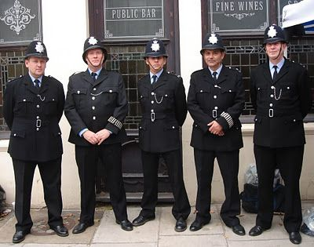
Understanding Crime Activity in the UK
By: Joshua Kaplan, Tim Ahn, and John Hotchkiss

Slide 2
The Importance of Understanding Crime
Educate populous
Reduce crime
Identify police abuse
Notes:
For our project, we decided to find a way to use the UK police database, a public database that contains information on all of the crimes in the UK, submitted by police departments. One of the primary responsibilities of a data scientist is to take data that is largely unintelligible in its raw form, and turn it into knowledge. That was our primary goal in this massive data project. Why is crime data worthy of such an effort? By gaining a better understanding of crime, and distributing that knowledge, one can contribute to the health of society.
One clear benefit of understanding crime data is to educate the citizenry. Before people decide where to live, for instance, it may be really helpful to look at a map that makes all of the data consumable.
A full understanding of crime will also yield hypotheses for how to reduce it, paving the way for policies and programs in government.
Finally, once the intricacies of crime are understood, it will be easier to identify what police action is contributing to crime prevention and which may be abuse.

Slide 3
Data Sources
Crime data from https://data.police.uk/
Published by the “Home Office” department of the UK government.
Published monthly
Started 12/2010
Economic data from https://www.nomisweb.co.uk/
Published by the Office for National Statistics
Access through “Query data”
Crosswalk files for aggregating data to the Local Authority District (LAD) level correctly from http://webarchive.nationalarchives.gov.uk/20160105160709/http://www.ons.gov.uk/ons/guide-method/geography/products/census/lookup/2011/index.html
Published by the Office for National Statistics
Shapefiles for mapping output areas from https://census.edina.ac.uk/easy_download.html
Published by University of Edinburgh
Notes:
These are the data sources that we used. Most of them were found through googling. The dataset that kicked it all off was the crime data. A link was posted to it in the sub-reddit datasets.
The first is a UK-wide crime database I already spoke of.
The second is the source for the Economic indicators that we evaluated.
The third contained the data required to aggregate from the street level crime data to the local authority district (LAD) level that we ended up applying for the majority of our analyses.
The fourth contained the shapefiles that we needed to create the mappings.

Slide 4
Agenda
Inspiration/Previous Work
Exploratory Data Analysis and Mapping
Discussion of Tools
Discussion of Analysis
Timetable of work
Possible Extensions
Notes:
Basically read the slide. I don’t know what else one does with an Agenda slide

