Slide 1
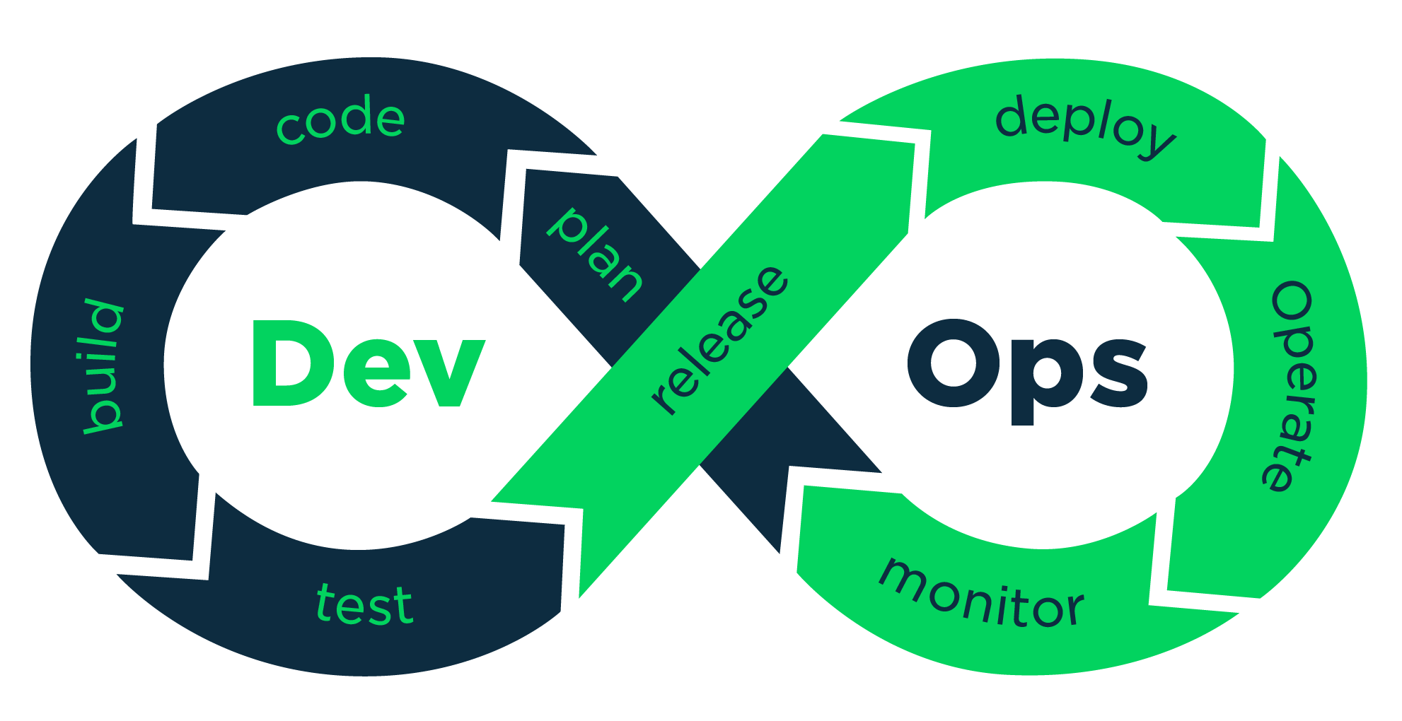
DevOps 101 for the VI Admin
Code, Git, and Infrastructure as Code
http://bit.ly/VMUGDevOps101

Slide 2

Howdy!
I’m Joe Houghes
I am here because I am a VMUG leader & I love to get people engaged and learning.
You can find me at @jhoughes or fullstackgeek.net
http://bit.ly/VMUGDevOps101

Slide 3

Who am I?
Sr. Solutions Architect @ Pure Storage
Co-leader – Denver PowerShell & VMware User Groups
Serial collector of Communities
Find me: Green Orange Colored hat, big grin & the loud "Howdy Y'all."
I have little shame, and try to share my learnings with others
Push yourself, Learn more, Don’t fear sharing
Share YOUR knowledge (Perspective is important)
Teach whatever you can (Be The Master)
Job vs Career
Don’t let any of this scare you!

Slide 4
So… how do I “do DevOps”?? This is an IT management philosophy.
For us, it’s a methodology of full stack engineering,
just for the infrastructure half of the stack.
Notes:
We’ll start here to understand what we’re getting into, especially for vSphere admins
Let’s level set some explanations, this is going to be basic concepts and discussing some things from a new perspective, so hopefully we will understand better
Will this session make anyone an expert… absolutely not, but it should help you to think about things a bit differently and see some basics in action, and will give you another step in your learning journey

Slide 5
DevOps in my organization
What if we don’t do software development?
What do we get?
Does everyone need to DevOps now?
What’s the point?
Notes:
This is still applicable if you’re not working in a software development shop and shipping your own code; we’re not taking Ops out of the loop here, we’re just making it more automated
DevOps works to create certain, specific outcomes, and it’s only useful when you want those outcomes
Nope, if you don’t like what DevOps will bring, then don’t “do Devops”
Really think about how you make changes to your environment, test those changes to your environment, and being able to “undo’ change to your environment
This is all about enabling the rapid deployment of software. When that software breaks, DevOps is meant to equally support a rapid deployment of a replacement version, or of the last-known-good version
Even if you’re not going to fully automate software and infrastructure deployment pipelines, you should be aware of what the capabilities are when it comes to automating your environments

Slide 6
Start with a Plan

Slide 7




Define Success at the beginning
Define a Goal - Tasks & measurable results
Speed & performance = advantage, not benefit
Standardization, validation, efficiencies
Small, incremental changes = can be verified (MVP)
Notes:
Head’s up, here’s my usual speech to user groups, since it’s not just relevant for code:
This is the same whether you are using the GUI or CLI. Plan for success, ALWAYS.
Expect difficulties or failures, and be prepared to adjust your plan, but still plan for success. As part of your plan, define it well and be explicit with facts, assumptions and minimum requirements.
Speed and performance are great, but they are an advantage to the org, not the true benefit of automation.
Think about the real benefit to the business, which is accuracy & repeatability. It’s not about impressing someone with your code. It’s not just about doing it fast but doing it correctly and being certain that it stays that way.
The goal of these efforts isn’t just about getting your operations into code, it is the benefits that you can gain from it: standardization, granular control, validation of configs, and testing for success.
We need to build & maintain tools in this fashion, and now our tools are mirroring our internal environment and operations.
This makes it easier to improve or even re-write even as we change platforms or technologies, which is what really matters to them in the long-term.
Try to be specific about steps/components and have an expectation before you start.
Don’t do more than is necessary to make minor changes, so that you can track those changes and results.
Then, make additional changes as necessary, but test and verify them along the way.
If we understand these concepts and work with our organizations to help them operate in this fashion, it enables us to be more valuable to the organization as enablers of the business, and they can more easily trust our capabilities.
Don't fear the changes as your company's needs grow, and we can have the ability to continue to provide value to the business, which leads to great things in your career.

Slide 8



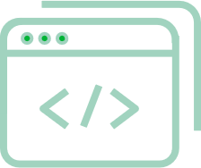
Don’t forget the PowerShell basics
Get-Help is your friend; make your life easier
PowerShell — Built for pipeline; embrace & use it
Stack cmdlets & results like Lego (Buy a set if you are outdated on the concept)
Forget what your teachers told you… Cheat/look up the answer whenever possible
Notes:
Follow the PowerShell way, even when building your own tool:
Remember what we learned about the PowerShell basics, look at the help files.
If you are still stuck or need more help, check out the examples and online documentation.
Other people are also normally glad to save you some pain in your journey.
The pipeline concept is simple: first, get an object, then work with it.
Once you learn how to leverage the pipeline to connect cmdlets together, you will see how quickly you can achieve massive results with PowerShell.
Seriously, get some Legos to practice.
The new sets can be a complex final product with many distinct steps to get you to that final product.
This is why you should have an expected result at the start, then specific steps to achieve that result.
Believe it or not, you can even cheat from yourself.
If you are trying to learn the code or find a specific setting, create or change it in the GUI and then pull it up in PowerShell to find how it was done.
The path to get there doesn’t matter to the business as long as you achieve success.
At the same time, you have to be careful with relying too much on searching, since searching is not the same as learning.
You can teach this to yourself if you just put in the effort, and you can always ask for help if you get stuck. Focus on the result, it is only important that you attain the goal or desired result.

Slide 9
Demo Time

Slide 10
Git Commands
git add
git commit
git push
git fetch
git merge
git pull

Slide 11
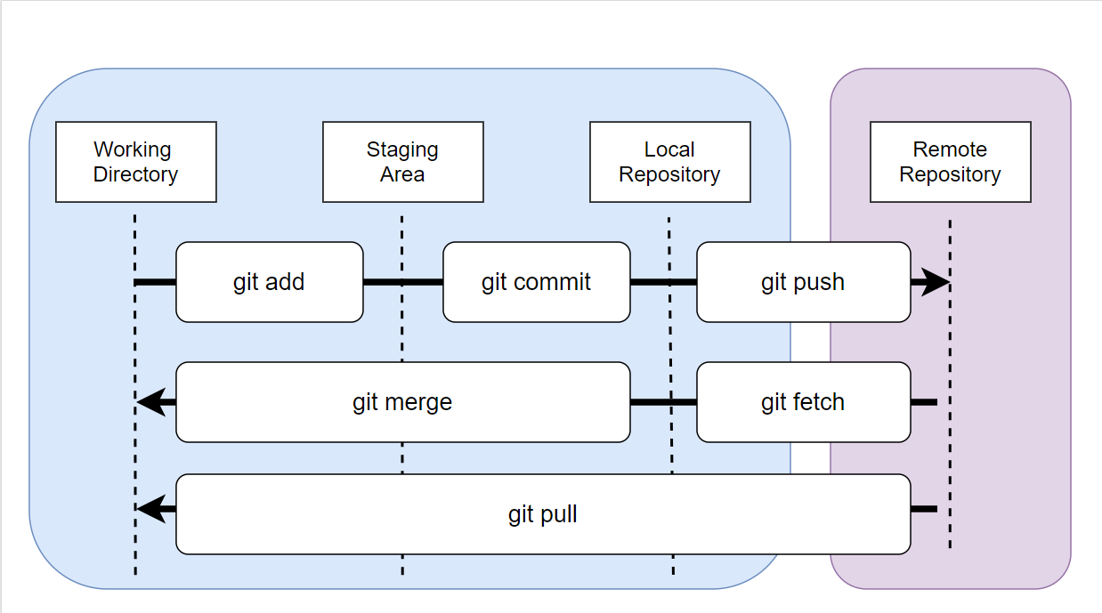
Git Flow

Slide 12
Demo Time

Slide 13
Stackstorm
Robust open-source automation engine
“If This, Then That” – easy logic
Event-driven automation
Sensors, triggers, actions, rules
Workflows, packs
Audits
Notes:
structured configuration languages that are both human- and machine-friendly

Slide 14
Packer
Open-source Infrastructure as Code (IaC) tool
Building of automated machine images
Hashicorp Configuration Language (HCL2)
Multiple platform builds from config
Variable files – automatic & defined
Notes:
structured configuration languages that are both human- and machine-friendly

Slide 15
Terraform
Open-source Infrastructure as Code (IaC) tool
Consistent CLI workflow
Hashicorp Configuration Language (HCL)
Declarative config files
Providers for resource dependencies
State files – resource map
Notes:
structured configuration languages that are both human- and machine-friendly

Slide 16
Ansible
Automation framework - relies on SSH & Python
Controller machine
Inventory for managed devices (not facts)
Playbook, module, task
Role for multi-playbook/files
Play – provision executer begin to end

Slide 17
Thanks!
More Resources
http://bit.ly/VMUGDevOps101
Any questions?
You can find me at @jhoughes & joe@fullstackgeek.net

