Slide 1
Automate Yourself Out of a Backup Job: Advanced PowerShell and API Usage
Joe Houghes
Solutions Architect
FullStackGeek, Lazy Admin

Slide 2
Begin with a plan

Slide 3













Know your capabilities
Veeam® components
Virtual environment and agents
Veeam Backup for Microsoft Office 365 and
Veeam Availability Orchestrator
Staged Restore, Secure Restore and xplorers

Slide 4




Defining success for your organization
Plan first
Speed or performance is not the point
Standardize, validate and repeat
MVP: “Minimum viable product”

Slide 5
Defining success of Availability
Before you code, define a goal. Think tasks and measurable results.
In this context, automation isn't solely about speed or performance.
Are you automating for the benefit of the business?
Focus on standardization, validation and efficiencies gained.
Use small, incremental changes that can be verified.

Slide 6
Veeam and PowerShell Basics

Slide 7



PowerShell basics
Get-Help is your friend and will make your life easier.
PowerShell is built for pipeline. Embrace and use it.
Stack cmdlets and results are like Legos.
(i.e., buy a set if you are outdated on the concept)
Forget what your teachers told you:
Cheat or look up the answer whenever possible.

Slide 8
Veeam-specific PowerShell tips*
Search Veeam cmdlets specific to your version: Get-VBRCommand [-V95] [-V90] [-V80]
What is your type? What are your members?
Now that you know your type, where can it be used? Get-Command -ParameterType *TypeName*
A little bit of validation — understand the allowed values of parameters: Look up the Veeam PowerShell enumerations

Slide 9
Starting at the beginning
Step 1
Start-
VBRConfigurationBackupJob
Step 2
What are you trying
to accomplish?
Think MVP.
Step 3
Add-PSSnapIn
VeeamPSSnapIn

Slide 10
Full infrastructure deployment
Fully automated Veeam installs and upgrades https://github.com/VeeamHub/powershell/tree/master/BR-UnattendedInstall
Fully automated Veeam deployment and configuration Simple: My VeeamON 2018 deployment example; 22 lines of code Deploy Windows Proxy/Repository, connects vCenter, creates backup job (VM tag), assigns daily schedule https://www.fullstackgeek.net/wp-content/uploads/Presentations/VeeamON2018_JoeHoughes.pdf Advanced: Automated deployment of Veeam on VMware with Veeam Linux Repo connected by Veeam PN Deploy and install Veeam Backup & Replication™ 9.5 Update 4 components on a new VM from Template (Chef) and Terraform, AWS VPC for Veeam Linux Repo and Veeam PN Sitegateway (Terraform), local Veeam Linux Repo https://github.com/VeeamHub/automation/tree/master/deploy_veeam_sddc_toolkit

Slide 11
OK, so now what?
Creating jobs targeting objects:
Hosts, clusters, VMs, templates, datastores, res. pools, tags (VMware)
Hosts, VMs, volumes (Hyper-V)
Windows Agent – VBR managed (server, WSFC); agent managed (workstation, server)
Linux Agent – VBR managed (server); agent managed (workstation, server)
Pro tip: Leverage vSphere Tagging to drive selection for items to be automatically picked up into existing jobs and schedules. Make your backups/backup copies run as a subscription model!
Setting Job Options:
Scheduling, active/synthetic fulls, retention of deleted VMs
Application aware (per VM) – VSS, transaction logs, SQL/Oracle, file exclusions, specific credentials, pre-freeze & post-thaw script options
Pre & post job script options, job notifications

Slide 12
Setting advanced options
Method 1: Native Veeam cmdlets:
Set-VBRJobAdvancedOptions
Set-VBRJobAdvancedBackupOptions
Set-VBRJobAdvancedStorageOptions
Set-VBRJobAdvancedViOptions
Set-VBRJobAdvancedNotificationOptions
Method 2: No parameter for Set-VBRJobAdvanced* cmdlet
$JobOptions = New-VBRJobOptions –ForBackupJob
$JobObjectVSSOptions = New-VBRJobVssOptions -ForObject
Notes:
How do I set all of these job options?

Slide 13
Automating with Update 4

Slide 14
Expanded PowerShell coverage Veeam Agents
Veeam Availability Suite™ Update 4 now allows full coverage for Veeam Agents:
Agent protection scopes Targeting AD containers/CSV files for dynamic deployment
Agent protection groups Deployment schedules/options, network usage and security
Agent backup schedule and scope Creation of agent backup jobs managed by backup and replication
Agent storage and backup options Compression, block-size and encryption, as well as full and synthetic full scheduling

Slide 15



Expanded PowerShell coverage Veeam Explorers
Update 4 includes PowerShell coverage for Veeam Explorers™:
Veeam Explorer for Microsoft SQL Server
Veeam Explorer for Microsoft Exchange
Veeam Explorer for Microsoft OneDrive
Veeam Explorer for Microsoft SharePoint
Veeam Explorer for Oracle

Slide 16
Takeaways
PowerShell types: https://helpcenter.veeam.com/docs/backup/powershell/veeam_powershell_types.html?ver=95
PowerShell enumerations:
https://helpcenter.veeam.com/docs/backup/powershell/enums.html?ver=95
Veeam unattended install:
https://github.com/VeeamHub/powershell/tree/master/BR-UnattendedInstall
Digging into PowerShell parameters:
https://richardspowershellblog.wordpress.com/2018/03/05/cmdlet-parameters/
Handy PowerShell scripts:
https://www.powershellgallery.com/packages/PowerShellCookbook/1.3.6

Slide 17
PowerShell Demos

Slide 18
Veeam API 101

Slide 19
API Basics
Application Programming Interface (Veeam hosts this from Backup Enterprise Manager)
REST – REpresentational State Transfer
Architectural style based on HTTP protocol and Uniform Resource Identifiers (URI) standards
Allows access & manipulation of text representations of resources Uses a uniform and predefined set of stateless operations
Uses HTTP methods – GET, POST, PUT, and DELETE)
Perform CRUD operations – create, read, update and delete
GET, PUT and DELETE methods are idempotent

Slide 20


Products with API coverage
Veeam Backup & Replication (via Veeam Backup Enterprise Manager)
Veeam Backup for Microsoft Office 365
Veeam Availability Orchestrator
Veeam Availability Console

Slide 21
Getting Started with Veeam API
Veeam Backup Enterprise Manager API for Veeam Backup & Replication
https://helpcenter.veeam.com/docs/backup/rest/overview.html
Veeam Backup for Microsoft Office 365 API
How to understand the API documentation and use it to navigate the API
Walkthrough of how to traverse the API to get specific information (i.e., mind map/workflow)
Performing basic functions through the API (i.e., start/stop/retry Veeam Backup & Replication and agent jobs)

Slide 22
(Content to Add)
Basics of Veeam APIs: Veeam Backup Enterprise Manager API for Veeam Backup & Replication, Veeam Backup for Microsoft Office 365 API, Veeam Availability Orchestrator API
How to understand the API documentation and use it to navigate the API
Walkthrough of how to traverse the API to get specific information (i.e., mind map/workflow)
Performing basic functions through the API (i.e., start/stop/retry Veeam Backup & Replication and agent jobs)

Slide 23
Veeam API Demos

Slide 24
Community projects (API-based) *These are unsupported products/projects
Self-service:
Veeam Backup for Microsoft Office 365 self-service web portal https://github.com/VeeamHub/vbo365-rest-self-service
Dashboards:
Veeam Backup for Microsoft Office 365 http://bit.ly/jdelacruz-veeamO365
Veeam Availability Console http://bit.ly/jdelacruz-veeamvac
Android apps:
vCoffee https://github.com/VeeamHub/vCoffee
Weeatcher https://weeatcher.github.io

Slide 25
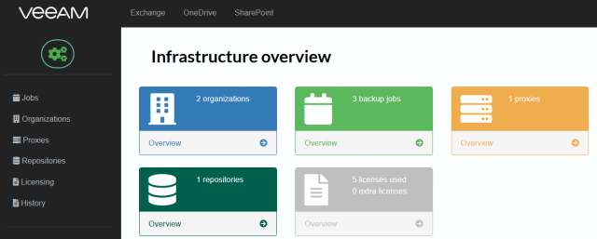
Veeam Backup for Microsoft Office 365 self-service

Slide 26
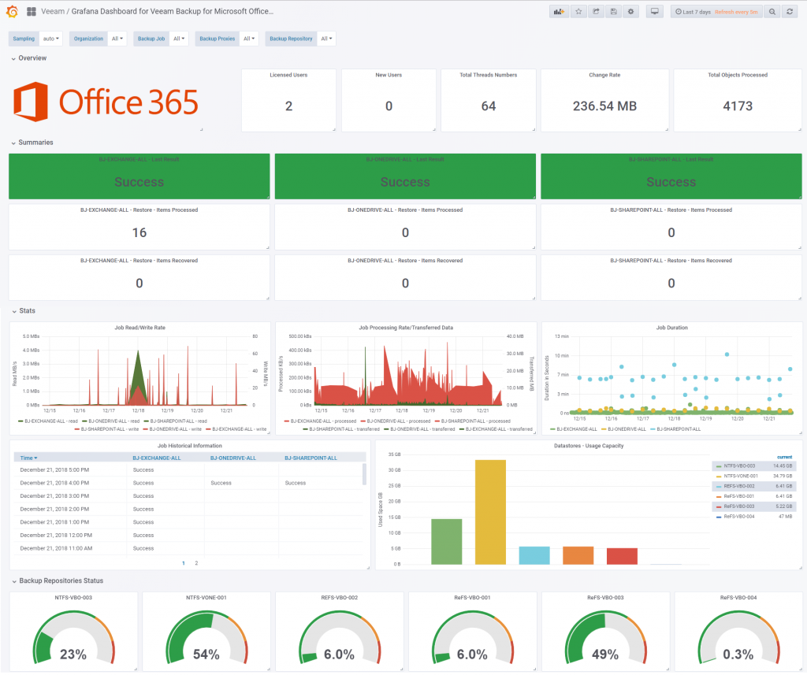
Veeam Backup for Microsoft Office 365 dashboard

Slide 27
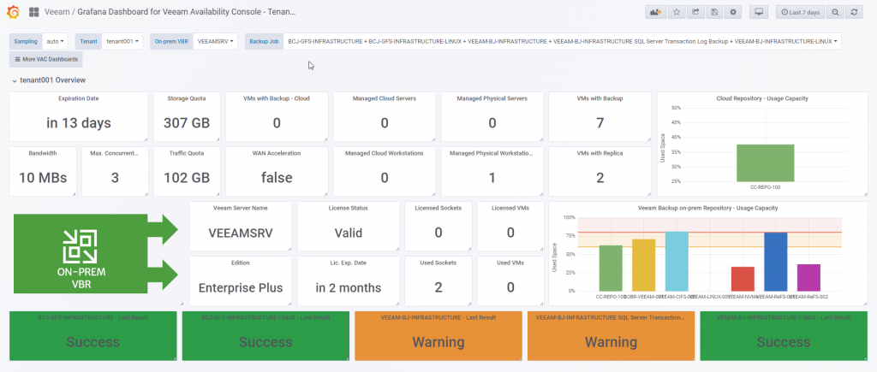
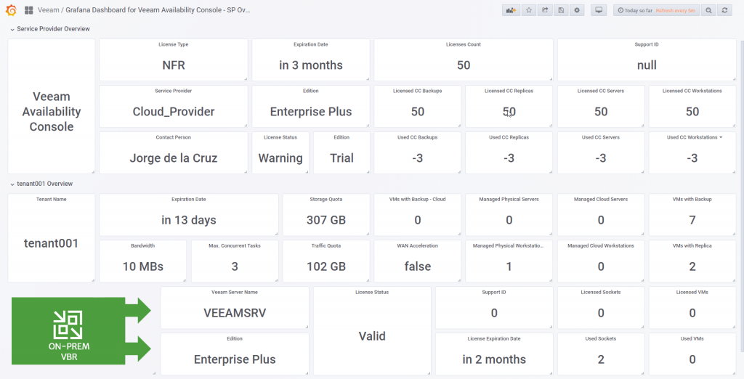
Veeam Availability Console dashboard

Slide 28
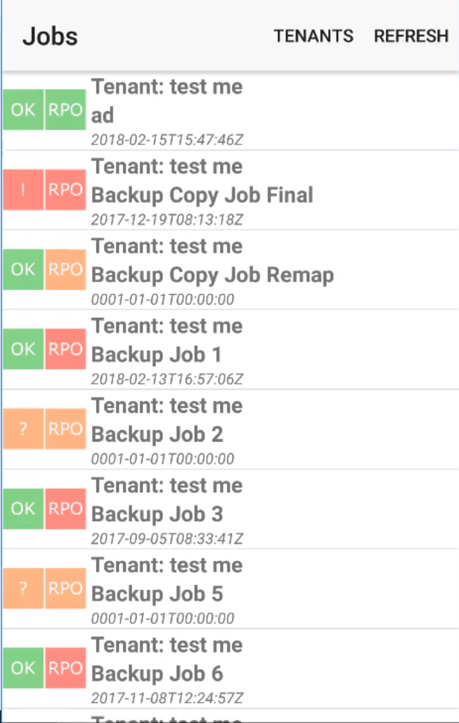
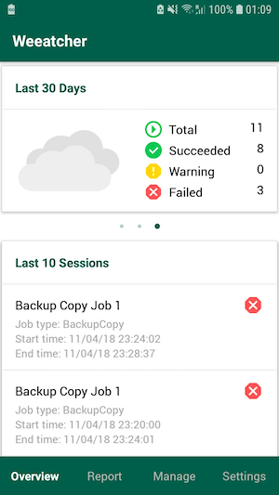
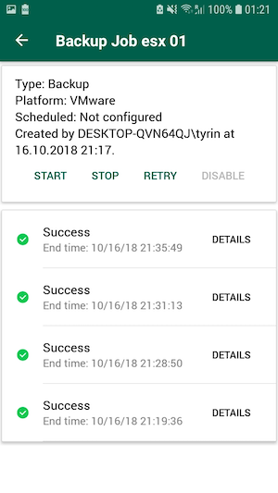
Android apps
vCoffee
Weeatcher

Slide 29
Thank you!

