Slide 1
Veeam and Automation
Joe Houghes
Solutions Architect, FullStackGeek, Lazy Admin

Slide 2






Automation Tasks
Veeam Components
Virtual environment & Agents
VBO & VAO
Staged Restore & Explorers

Slide 3
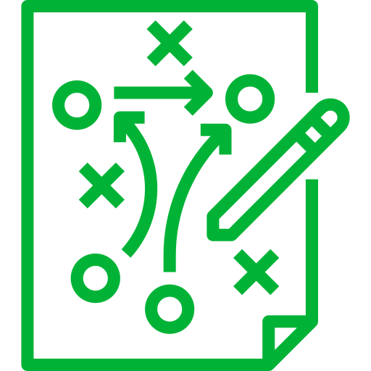

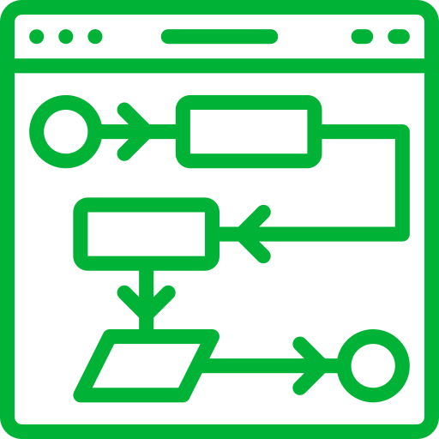
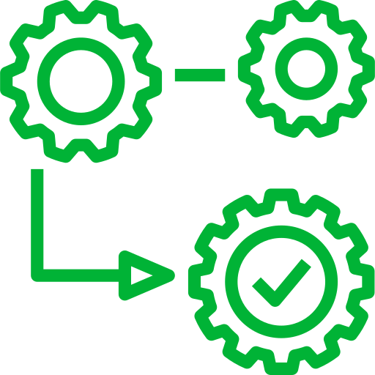
Defining Success for Your Organization
Plan first
Speed or performance - No
Standardize, validate and repeat
MVP

Slide 4


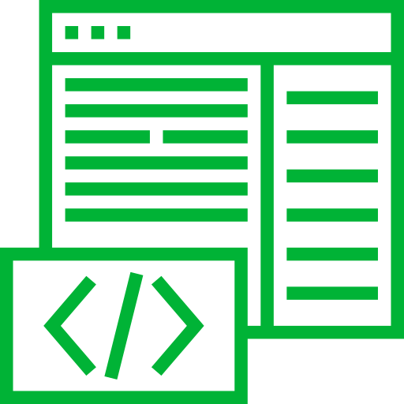
PowerShell Basics
Get-Help is your friend, make your life easier.
PowerShell - built for pipeline, embrace & utilize it
Stack cmdlets and results like Legos
(Buy a set if you are outdated on the concept)
Forget what your teachers told you:
Cheat/look up the answer whenever possible.

