Slide 1

From PowerCLI to API
Taking Your Automation Skills to the Next Level
Joe Houghes
Senior Solutions Architect
@jhoughes fullstackgeek.net

Slide 2
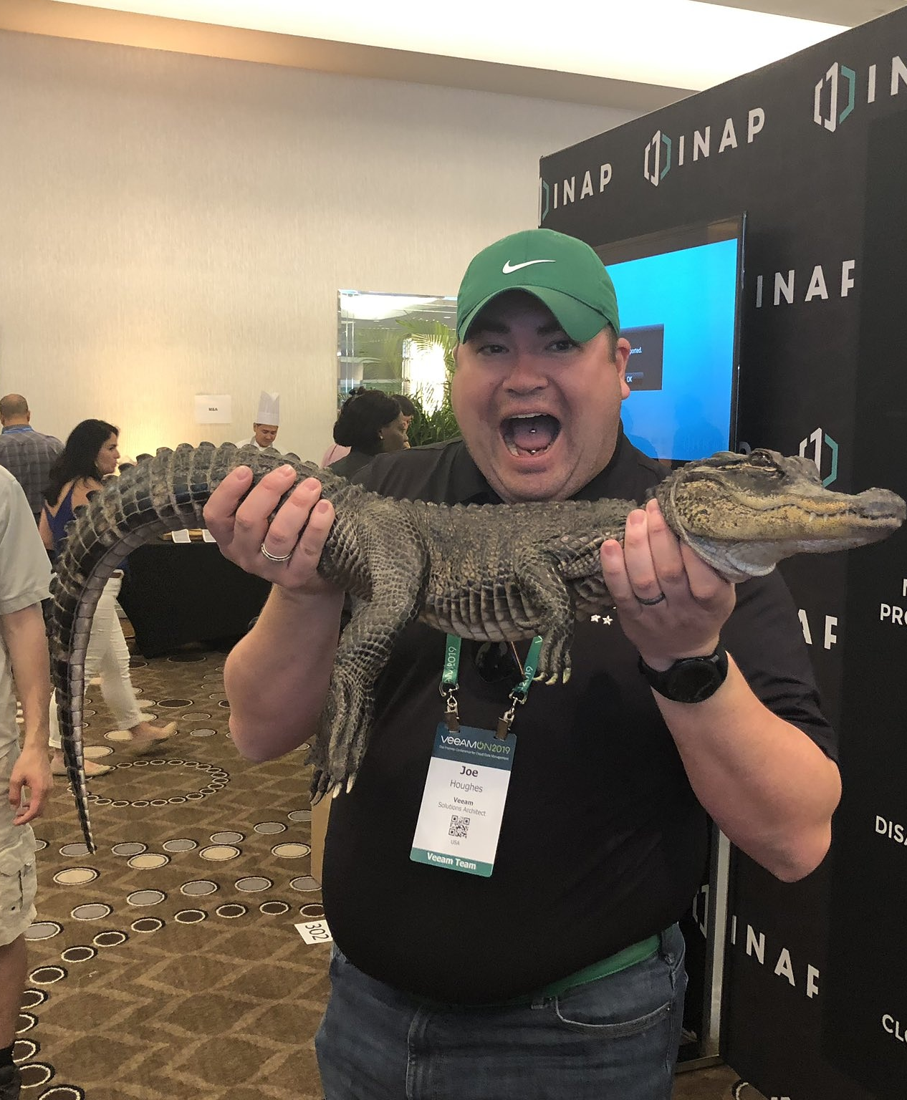



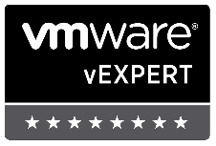



Who am I?
Sr. Solutions Architect @ Pure Storage
Denver VMUG/PSUG Leader
Find me: Green Orange Colored hat, big grin and the loud "Howdy Y'all."
I have little shame, and try to share my learnings with others

Slide 3
Who am I?
Sr. Solutions Architect @ Pure Storage
Co-leader – Denver PowerShell & VMware User Groups
Serial collector of Communities
Find me: Green Orange Colored hat, big grin & the loud "Howdy Y'all."
I have little (no) shame, and try to share my learnings with others
Push yourself, Learn more, Don’t fear sharing
Share YOUR knowledge (Perspective is important)
Teach whatever you can (Be The Master)
Job vs Career
Don’t let any of this scare you!

Slide 4




STARTING AT THE BEGINNING
Define a Goal - Think tasks and measurable results
Speed/performance = advantage, not benefit
Focus: standardization, validation, efficiencies gained
Small, incremental changes that can be verified (MVP)

Slide 5



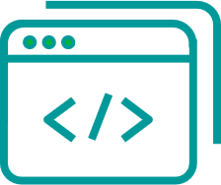
DON’T FORGET THE POWERSHELL BASICS
Get-Help is your friend; makes your life easier
PowerShell — Built for pipeline; embrace and utilize it
Stack cmdlets and results like Legos
Forget what your teachers told you: Cheat/look up the answer whenever possible

Slide 6
Which API?
SOAP
REST
Older API (protocol/standard)
Used by PowerCLI & pyVmomi
XML-based more rigid, not as simple as described
Many more examples for usage
Architecture used for newer APIs
Some new features only in REST
Translates more to other APIs outside of vSphere

Slide 7
The Tools
PowerShell
vCenter & VCSA apis
PowerCLI module
Interactive console
Simple scripts
Older SOAP API
VCSA API for intro
vCenter API for VM demos

Slide 8
Other Components
vCenter Server
VMware API Explorer (on your vCenter)
VMware documentation
https://developer.vmware.com/
https://code.vmware.com
Used in Demos:
VSCode
‘Show-Object’ (PowerShellCookbook module - PSGallery)

Slide 9
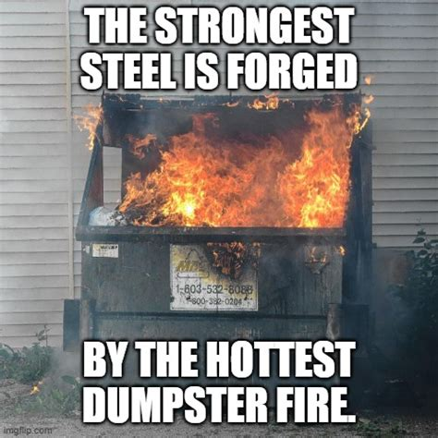
To the Demos!

