Slide 2
From Scripting to Toolmaking: Taking the Next Step with PowerShell

Slide 3
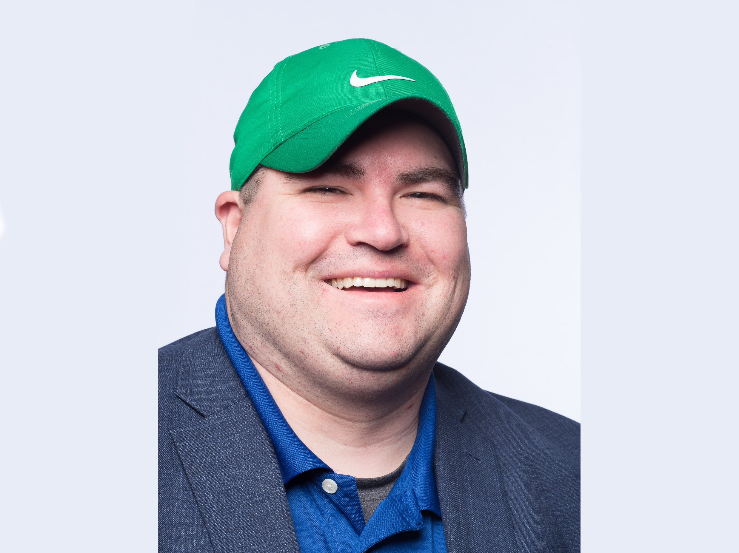
Joe Houghes
Veeam Software

Slide 4



About Me
Austin, Texas native; Solutions Architect @ Veeam
Co-leader - Austin VMUG & PowerShell User Group
Green hat, big grin and the loud "Howdy Y'all."
Automate yourself out of a basic IT job
Free yourself to perform higher-level tasks
Push yourself outside of your comfort zone
Learn more about any topic of interest
Stop letting fear keep you from sharing with others
Share your knowledge (Perspective is important)
Teach whatever you can (Be The Master)
#spiceworldATX
Notes:
Austin, Texas native; Solutions Architect @ Veeam
Co-leader - Austin VMUG & PowerShell User Group
Typically in training or community presentation
Green hat, big grin and the loud "Howdy Y'all."
Automation requires more in-depth thinking & focus
Result is then repeatable and consistent
Understand why we should do the easy tasks better
Jeff Snover – “No Technical Fellows of Cafeterias @ Microsoft”
Whose company makes more money or widgets based on your Exchange skills – Go O365
Push yourself to acquire new skills, always be willing to learn more about something that interests you
Keep technology fun & interesting - it can be a job, a hobby, and more importantly, an awesome career
Imposter syndrome is real – but push past it (or if you need very direct advice, get over it) and help out others
It is important to share your story and your journey, you may have learned something different, or explain something in a way that others can relate to
Sometimes it just takes the right perspective to understand a concept, and yours may be the perfect one for someone else
Teach whatever you can, don’t restrict this to IT or even technology
Plug for Don Jones & Be The Master – great book & workbook/planning methodology, even a great course – Just leave more than you took

Slide 5
Agenda
Start with a Plan
Concepts of Functions & Modules
Well-Defined Parameters
Pipeline Input & Error Handling
Tips to Cheat and Steal (Really, Borrow – and Give Credit)
What Comes Next - After You Ship
Other Resources and Advanced Topics to Learn
Takeaways: Basic concepts, sample code, other resources
*The chance to hang out with me* http://bit.ly/FromScriptingtoToolmaking
Notes:
Know what you’re trying to do, and write it down somewhere
Searching isn't learning

Slide 6
Why We’re Here

Slide 7
Who’s in the audience?
Who in the room is an IT Pro? How about a Developer?
Who uses VSCode for their scripting/toolmaking? PowerShell ISE? A different IDE, like PowerShell Studio? Notepad?
Who uses source control for their code?
Who uses unit testing (Pester) for their code?
Who is running, or has started testing, PowerShell Core? PowerShell 7?
How many PowerShell Experts in the room?
We’re all learning, so be sure to write it down and share with others.
Notes:
I'm not a PowerShell expert, I'm just a guy doing things and trying to help others, but I'd be glad to pick your brain

Slide 8
Challenges Faced by Customers
SMB & SLED – Coverage, budget, time, training
Commercial – Coverage, budget, time, app lifecycle, infrastructure
FED – Auditing, compliance, time, access restriction
Enterprise – Scalability, repeatability, time, auditing
MSP – Scalability, repeatability, time, auditing, customer capability
*Anyone in IT is always short of time, not tasks*
Notes:
NOTE: This list is based off my own experience and the issues I have been asked to resolve in past consulting/partner/service provider roles, and since coming onboard to my current role working with all segments and customers of any size.
All verticals can have some differing issues or pain points which are most relevant to the business and IT department.
This is meant to display that some customers can face similar challenges, and in the end we are all short of time. It also helps put everyone in the mindset around why we should be making tools.

Slide 9
Maintaining Control with Tools
How do you:
Deploy/Change/Backup new systems in your environment?
Make changes to your environment?
Handle advanced configurations & deployments?
Test/confirm/audit changes?
Is all of this a manual or automated process?
Notes:
Just move of the why we’re looking at toolmaking

Slide 10
The Planning Stage

Slide 11
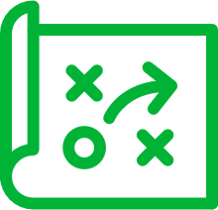

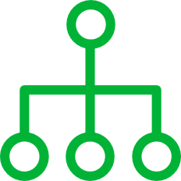

Start With A Plan
Define a goal. Think tasks & measurable results.
Speed/performance = advantage, not benefit.
Focus on standardization, validation and efficiencies gained.
Use small, incremental changes that can be verified.
Notes:
Plan:
You need a plan for today, tomorrow and some point in the future, whether that is next quarter or next year. This is the same whether you are talking IT operations in any environment from SMB to Enterprise.
Plan for success, ALWAYS. Expect difficulties or failures, and be prepared to adjust your plan, but still plan for success.
As part of your plan, define it well and be explicit with facts, assumptions and minimum requirements. As you go through this plan, and your toolmaking process, validate those facts and assumptions. Revise or refine this plan as any needs or requirements change, or as new features are required.
If the overall script or tool won’t change due to original scoping, whether that's because of time/personnel resource or need for a working version, identify these new/revised requirements for the next features to add in a future version.
Be sure to understand what your user or customers are doing today, understand their needs, and work to enable more people to be capable of getting/delivering that need in a more efficient way. Your real value to an organization as a toolmaker is to enable as many people as possible to be capable of performing your job, with your knowledge (or restrictions), to move on to other places where you can be most effective for your organization.
Be specific about steps/components, and setting an expectation before you start. This requires that your can define needs, or at least minimums, to accomplish some task.
Speed & Performance:
Speed and performance are great for organizations trying to shift to new workflows and deployment cycles, but they are an advantage to the org, not the true benefit of automation.
The real benefit is in doing it correctly, having repeatable results, and being able to ensure that it remains correct over time.
In my opinion, this is the way that any organization should be thinking about their application stacks & workloads. Consider this same mindset for your tools & orchestration.
Standardization, validation and repeatability:
These are the benefits that you can gain from automation: standardization, validation of configs, and testing for success.
As customer shift more to Lean, Agile or DevOps methodologies, they care more about the configuration and control of an application or even a workload, and less about the wrapper that the app/workload lives within.
We need to build & maintain tools in this fashion, and now our tools are mirroring our internal environment and operations. This makes it easier to improve or even re-write even as we change platforms or technologies, which is what really matters to them in the long-term.
MVP - “Minimum viable product”:
I advise all people in technology to use small, incremental, or granular changes that can be verified.
You have to be able to define your progress, whether success or failure, to know if you have attained your goal; this should have also been defined at the beginning, and revised or refined along the way.
What I specifically give them for detail on this point is "Don’t do more than is necessary to make minor changes, so that you can track those changes and results. Make additional changes as necessary, but test and verify them along the way."
If we understand these concepts and work with our organizations to help them operate in this fashion, it enables us to be more valuable to the organization as enablers of the business, and they can more easily trust our capabilities. Don't fear change as your company's needs grow or change, and we have the ability to continue to provide value to the business, which leads to great things in your career.
Don’t expect to immediately automate your environment, or that you will have accounted for all of the necessary components at the beginning. Be flexible and prepare for change or improvements.
-------------------------------------------------
This is the same whether you are using the GUI or CLI. Plan for success.
Think about the benefit to the business, which is accuracy & repeatability. It’s not about impressing someone with your code. It’s not just about doing it fast, but doing it correctly and being certain that it stays that way.
The goal of these efforts isn’t just about getting your operations into code, it is the benefits that you can gain from it: standardization, granular control, validation of configs, and testing for success
Try to be specific about steps/components, and have an expectation before you start.

Slide 12
Basics of a Toolmaking Plan
Determine your MVP (minimum viable product)
Document requirements & assumptions
Define your process in small tasks
Avoid unnecessary functionality
Try to keep code simple & readable
Notes:
Software development philosophies: KISS, DRY, Worse is better, YAGNI, MVP
Keep It Simple Stupid – Simple over complicated
Don't Repeat Yourself - reducing repetition
Worse if Better - quality does not necessarily increase with functionality
You aren't gonna need it – define a need before adding function
Minimum viable product - sufficient features to satisfy early adopters; complete set of features designed/developed after considering feedback from product's users
Think specifically about what you need from your tool and what are you trying to solve?
Small tasks handles separately helps to maintain code
Keeps things easier to rear & maintain

Slide 13
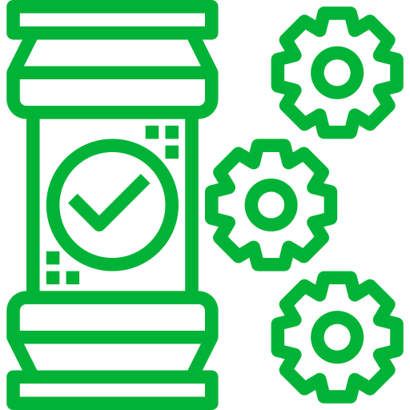
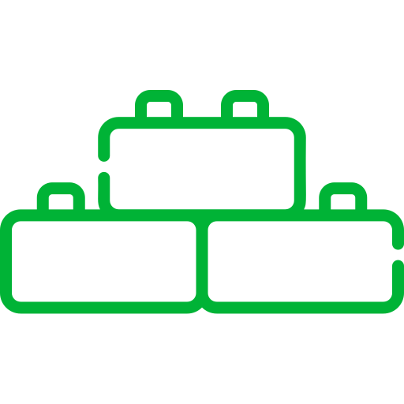
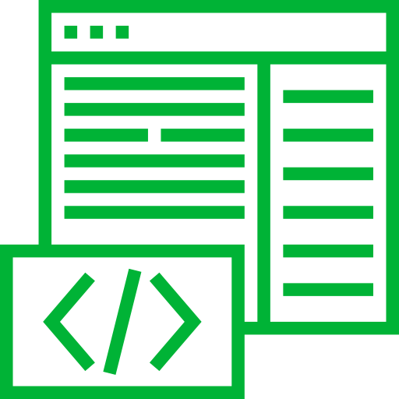
Don’t forget the PowerShell Basics
Get-Help is your friend, make your life easier.
PowerShell - built for pipeline, embrace & utilize it
Stack cmdlets and results like Legos
(Buy a set if you are outdated on the concept)
Forget what your teachers told you:
Cheat/look up the answer whenever possible.
Notes:
Follow the PowerShell way, even when building your own tool
Remember what we learned about the PowerShell basics, look at the help files. If you are still stuck or need more help, check out the examples and online documentation. Other people are also normally glad to save you some pain in your journey.
The pipeline concept is simple: first, get an object, then work with it. Once you learn how to leverage the pipeline to connect cmdlets together, you will see how quickly you can achieve massive results with PowerShell.
Seriously, get some Legos to practice. The new sets can be a complex final product with many distinct steps to get you to that final product. This is why you should have an expected result at the start, then specific steps to achieve that result.
Believe it or not, you can even cheat from yourself. If you are trying to learn the code or find a specific setting, create or change it in the GUI and then pull it up in PowerShell to find how it was done.
You can teach this to yourself if you just put in the effort, and you can always ask for help if you get stuck. Focus on the result, it is only important that you attain the goal or desired result.
The path to get there doesn’t matter to the business as long as you achieve success.

Slide 14
Starting Some Code

Slide 15
Script or Function – Why?
When to Script, When to Function
Scripts – All-in-one, self container, hardly updated
Functions – Tool-oriented, modular, easier to update for new functionality
Advantages of Functions
Module auto-loading
Public/internal repository
Easier to share
When to Use Both
Controller scripts – use to drive your functions/modules
Best of both worlds – customization for your environment, flexibility elsewhere
Notes:
First of all we want to understand when you may want to script something, and when you should write a function.
Scripts are an all-in-one point solution, most likely completely self contained or includes all required information, and are only updated when changes are necessary.
Functions are modular pieces of code, which should not contain any environment-specific information and should allow for input of any required
This gives the best of both worlds to allow customization for your environment, with flexibility elsewhere

Slide 16
Proper Function Naming & Conventions
Use proper/consistent naming for functions
Use proper/consistent naming for parameters (also variables)
Use approved verb & singular noun
Add prefix if necessary
Follow community best practices, use PSScriptAnalyzer

Slide 17
Advanced Functions Best Practices
Accomplished by [CmdletBinding()]
Add comment-based help (also MAML if online)
Perform only a specific task
Get data, process data, or output data (as objects)
Error handling – try/catch; throw, return, ErrorAction
Do NOT format, that is a separate function

Slide 18
Recommendations for Functions
Be careful with native cmdlets & functionality – Use #Requires
Verbose output with Write-Verbose
SupportsShouldProcess = WhatIf/Confirm
Use well-defined parameters
Type/Mandatory → Alias → Validation → Parameter Set → Pipeline Input
Understand the Begin/Process/End blocks, especially for pipeline

Slide 19
Getting More Advanced

Slide 20
Controller Scripts
This is where you import modules & automate your specific environment
Can contain environment specific data/variables
Avoid hard-coding usernames/passwords
Can truly build your outside-the-box Lego style customization
Menus, GUIs and JEA – oh my!

Slide 21
Next Steps for Functions
Create snippets to save time
Save your functions in modules with proper manifests
Leverage proxy functions to add/remove from native cmdlets
If using PowerShell v5+, consider using classes
Get your code into Git

Slide 22
Next Steps for Functions (cont.)
Create format.ps1xml files
Leverage type data
Look into Plaster for “scaffolding” of modules, Pester tests, DSC configs, etc.
Leverage Pester for unit testing of your code
Publish to internal or PowerShell Gallery

Slide 23
Community Resources

Slide 24
Additional Resources
PowerShell.org YouTube Channel: http://bit.ly/FromScriptingtoToolmaking
Functions/Toolmaking - Don Jones Toolmaking
Proxy Functions - Jeff Hicks - Accelerated Toolmaking
Optimizing Performance – Joshua King - Whip Your Scripts into Shape
The PowerShell Scripting & Toolmaking Book – Don Jones/Jeff Hicks
ATXPowerShell YT Channel - Debugging PowerShell in VSCode w/Josh Duffney
PSKoans – Learn PowerShell through Pester
Plaster – “Scaffolding” of modules, Pester tests, DSC configs, etc.
PlatyPS – Write PowerShell External Help in Markdown
Notes:
Jeff Hicks' POWERSHELL SCRIPTING AND TOOLMAKING TRAPS Session (SpiceWorld 2019) - https://github.com/jdhitsolutions/PowerShellScriptingTraps
PowerShell.org YouTube Channel:
Functions/Toolmaking - Don Jones Toolmaking (3 videos)
https://youtu.be/KprrLkjPq_c
https://youtu.be/U849a17G7Ro
https://youtu.be/GXdmjCPYYNM
Proxy Functions - Jeff Hicks - Accelerated Toolmaking
https://youtu.be/zWh4Y_7lNBg
Optimizing Performance – Joshua King - Whip Your Scripts into Shape
https://youtu.be/Yp_m5T_kyJU
eBooks:
The PowerShell Scripting & Toolmaking Book – Don Jones/Jeff Hicks
https://leanpub.com/powershell-scripting-toolmaking
Learn Windows PowerShell in a Month of Lunches, Third Edition
https://www.manning.com/books/learn-windows-powershell-in-a-month-of-lunches-third-edition
Learn PowerShell Toolmaking in a Month of Lunches
https://www.manning.com/books/learn-powershell-toolmaking-in-a-month-of-lunches
Learn PowerShell Scripting in a Month of Lunches
https://www.manning.com/books/learn-powershell-scripting-in-a-month-of-lunches
The PowerShell Best Practices and Style Guide
https://github.com/PoshCode/PowerShellPracticeAndStyle
Free eBook on PowerShell Advanced Functions
http://mikefrobbins.com/2015/04/17/free-ebook-on-powershell-advanced-functions/
PowerShell.org Books (DevOps Collective)
https://leanpub.com/u/devopscollective
ATXPowerShell YouTube Channel:
Debugging PowerShell in VSCode w/Josh Duffney
https://youtu.be/Kg5eKslokao
Modules (GitHub)
PSKoans – Learn PowerShell through Pester
https://github.com/vexx32/PSKoans
Plaster – “Scaffolding” of modules, Pester tests, DSC configs, etc.
https://github.com/PowerShell/Plaster
PlatyPS – Write PowerShell External Help in Markdown
https://github.com/PowerShell/platyPS

Slide 25
Questions?

