Slide 1
Requirements
Presented by:
Sherrie Dowdy
Jessica Horne
Saiping Chen

Slide 2
Vision Statement
The application, iDoor, will be primarily marketed as a tool for woodworkers to identify a description of a specified species of wood, and properties of the wood including specific gravity and coefficients for dimensional change. Unlike other software for woodworkers, iDoor can perform many of the calculations needed by woodworkers including density at a specified moisture content, moisture driven dimensional changes, and beam deflection. This application will perform calculations much more quickly than standard methods and will therefore improve the efficiency of woodworking. Most importantly this application will be easy to use for all woodworkers.

Slide 3
Stakeholders
The project stakeholders of iDoor are the people who will be affected by the success or failure of the project. The following have been identified as stakeholders:
Bill Pine (customer)
Bill Pine’s friends (user)
Developers of iDoor (developer)
Developer Management (developer)

Slide 4
Description
As a user, Mr. Pine, wants to see a description of a species of wood. Mr. Pine will
Determine the category of wood
Determine the species of wood
System will display the description

Slide 5
Description (continued)
Pine, Sugar
Sugar pine (Pinus lambertiana), the world’s largest species
of pine, is sometimes called California sugar pine. Most
sugar pine lumber grows in California and southwestern
Oregon.
The heartwood of sugar pine is buff or light brown, sometimes
tinged with red. The sapwood is creamy white. The
wood is straight grained, fairly uniform in texture, and easy
to work with tools. It has very low shrinkage, is readily
dried without warping or checking, and is dimensionally
stable. Sugar pine is lightweight, moderately low in
strength, moderately soft, low in shock resistance, and low
in stiffness.
1–15
Sugar pine is used almost exclusively for lumber products.
The largest volume is used for boxes and crates, sashes,
doors, frames, blinds, general millwork, building construction,
and foundry patterns. Like eastern white pine (Pinus
strobus), sugar pine is suitable for use in nearly every part
of a house because of the ease with which it can be cut, its
dimensional stability, and its good nailing properties.

Slide 6
Physical Constants
G_{b} - Specific Gravity Green and 12% Moisture content
ρ - Density at a specified Moisture Content (default = 20%, changeable by user)
C_{R}, C_{T} - Coefficients for Dimensional Change

Slide 7
Specific Gravity
Mr. Pine will specify the species of wood and then the system will determine the specific gravity green, G_{b} and the specific gravity at a 12% moisture content, G_{m} will be calculated by the system.

Slide 8
Specific Gravity (continued)
where M < 30
M = 20% by default

Slide 9
Specific Gravity (continued)
Green

Slide 10
Specific Gravity (continued)
12% Moisture Content

Slide 11
Density Calculation
Mr. Pine will specify the species of wood and then the system will determine the density at a specified moisture content.

Slide 12
Density Calculation (continued)
Green
Sugar Pine

Slide 13
Density Calculation (continued)
12%
Sugar Pine

Slide 14
Coefficients for Dimensional Change
The coefficients for dimensional change will be stored within the application to be used for the Moisture driven Dimensional Changes calculations.
Dimensional Change Radial Direction
Dimensional Change Tangential Direction

Slide 15
Beam Deflection
As a user, Mr. Pine wants to calculate beam deflection using the formula:
k_{b} and k_{s} are constants
W = total beam load
L = beam span
E = Elasticity
I = beam moment of Inertia
G = beam shear
A’ = modified beam area

Slide 16
Beam Deflection (continued)
Mr. Pine will
Choose Beam Deflection as the calculation he would like to perform
Specify the species of wood
Choose the grain of wood, flat grain vs. edge grain
Input
beam width, b
beam depth, h
beam load, W
beam span, L

Slide 17
Beam Deflection (continued)
The system will use Mr. Pines input to calculate the beam deflection by:
Calculate I, the beam moment of inertia, using the formula:
Calculate A’, the modified beam area, using the formula:

Slide 18
Beam Deflection (continued)
Combine input with information found in tables stored within the application to calculate the:
Elasticity, E
Beam shear, G
Obtain values of constants k_{b} and k_{s}
Use these values in the beam deflection formula to calculate and display the amount of beam deflection.

Slide 19
Beam Deflection (continued)
Calculating Elasticity
Using Table 4-3b. determine the Modulus of Elasticity
ex. 1.03 X 10⁶ lbf/in² for sugar pine
Increase this value by 10% giving you E_{L}
ex. E_{L}= 1.03 X 10⁶ lbf/in² * 1.10
E_{L}= 1.133 X 10⁶ lbf/in²

Slide 20
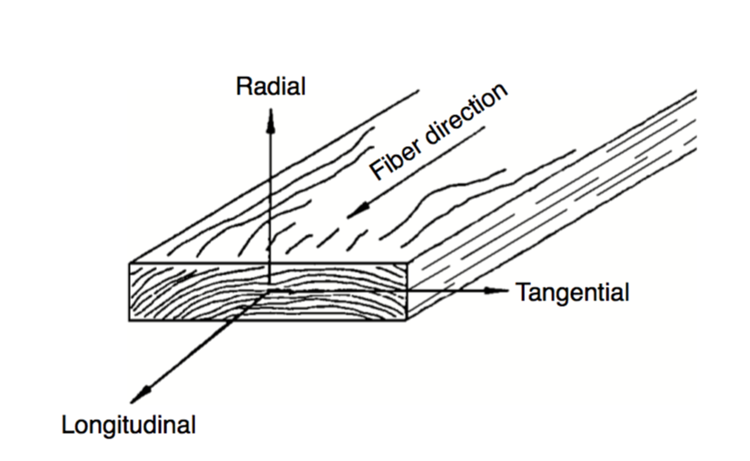
Beam Deflection (continued)
The beam shear calculation is dependent upon the user specified grain of the wood.
Flat-grained vertical faces, G=G_{LT}
Edge-grained vertical faces, G=G_{LR}
Figure 1. Showing grain direction

Slide 21
Beam Deflection (continued)
Calculating Beam Shear
Using Table 4-1 determine which ratio contains the beam shear you need.
ex. What is G_{LT} for sugar pine?
G_{LT}/E_{L} = 0.113
Using the previously calculated value for E_{L}
ex. G_{LT}/1.133 X 10⁶ lbf/in² = 0.113
G_{LT} = 1.28029 lbf/in²

Slide 22
Beam Deflection (continued)
Determination of k_{b} and k_{s}
k_{b} and k_{s} come from Table 8-1
Customer states for all calculations to use:
Beam loading – concentrated at midspan
Beam ends – both simply supported
k_{b} = 1/48
k_{s} = 1/4

Slide 23
Beam Deflection (continued)
Example:
Mr. Pine specifies
flat grained sugar pine wood
beam dimensions
width = 11.5 in.
depth = .75 in.
beam span = 36.0 in
beam load = 80 lb.

Slide 24
Beam Deflection (continued)
The system calculates:
the beam moment of Inertia

Slide 25
Beam Deflection (continued)
the modified beam area

Slide 26
Beam Deflection (continued)
The system calculates the following values from information found within tables stored in the application
Elasticity, E_{L}= 1.133 X 10⁶ lbf/in²
Beam shear, G_{LT}= 1.280 X 10⁵ lbf/in²
Constants
k_{b} = 1/48
K_{s} = 1/4

Slide 27
Beam Deflection (continued)
The system calculates the beam deflection
The first part of this equation calculates the bending deflection

Slide 28
Beam Deflection (continued)
The second part of the equation calculates the shear deflection
These are added to get the total beam deflection

Slide 29
Moisture driven Dimensional Changes
Mr. Pine wants to calculate the moisture driven dimensional changes of a specific wood.
He will
Choose the moisture driven dimensional changes calculation
Specify the species of wood

Slide 30
Moisture driven Dimensional Changes (continued)
The system will then perform and display the calculation using the formulas
∆D = change in dimension
D_{I} = dimension at start of change
C_{T} = dimension change coefficient tangential direction
M_{F} = moisture content at end of change
M_{I} = moisture content at start of change

Slide 31
Moisture driven Dimensional Changes (continued)
C_{T} = Dimensional Change Tangential Direction

Slide 32
Moisture driven Dimensional Changes (continued)
C_{R} = Dimensional Change Radial Direction

