Slide 1
Time Series Data Clustering: A brief survey
Jim Howard
January 18, 2011

Slide 2
Contents
What and Why
Time Series Distance Measures
Cluster Scoring
Clustering Algorithms
Data Modification
Dataset and Results
Conclusion

Slide 3
Contents
What and Why
Time Series Distance Measures
Cluster Scoring
Clustering Algorithms
Data Modification
Dataset and Results
Conclusion

Slide 4
What
Time series is a sequence of data points measured at successive times.
  Indexing the t element of time series i would be noted as
Cluster
Center:

Slide 5
Why?

Slide 6
Contents
What and Why
Time Series Distance Measures
Cluster Scoring
Clustering Algorithms
Data Modification
Dataset and Results
Conclusion

Slide 7


P-Norm / Root Mean Square
P is typically 1, 2 or inf
Root Mean Square is the normalized form of the 2-norm

Slide 8
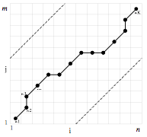

Dynamic Time Warping (DTW)
Finds the minimum cost warping path between two time series
Can be used on time series of different lengths

Slide 9

Short Time Series Distance
Looks only at the euclidian distance between the slope calculated between each pair of points within a time series

Slide 10
Contents
What and Why
Time Series Distance Measures
Cluster Scoring
Clustering Algorithms
Data Modification
Dataset and Results
Conclusion

Slide 11
Inter-Cluster Distance
Sum of the distance of all time series assigned to a cluster to that cluster center.

Slide 12

Silhouette (Matlab function)
Average of the ratio of the inter-cluster distance and the distance to the next closest cluster center
where is the distance between a time series x and the second closest cluster C

Slide 13
Contents
What and Why
Time Series Distance Measures
Cluster Scoring
Clustering Algorithms
Data Modification
Dataset and Results
Conclusion

Slide 14
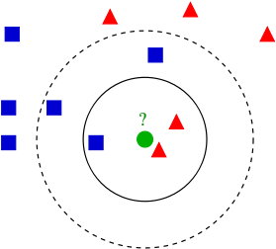
k-Nearest Neighbor (kNN)
Determines cluster based on majority vote
Requires classified data
  k = 3 circle is red
  k = 5 circle is blue

Slide 15

k-Means
Initialize K clusters
repeat
  calculate cluster centers
  determine new time series assignment
  calculate
until

Slide 16

Agglomerative Clustering
Initialize the set of clusters with each cluster containing exactly one time series
repeat
  calculate the pair-wise average distance between each cluster
  merge the two clusters with the shortest distance
until the number of clusters is equal to 1

Slide 17
Clustering Algorithms
kNN
  Fast to run and implement
  Requires classified data
kMeans
  Fast training time
  Must know the number of models to stop on
  Gets stuck in local minima frequently (varies based on initial random clusters)
Agglomerative Clustering
  Slowest training time
  Useful when ideal number of clusters is not known
  Deterministic

Slide 18
Contents
What and Why
Time Series Distance Measures
Cluster Scoring
Clustering Algorithms
Data Modification
Dataset and Results
Conclusion

Slide 19
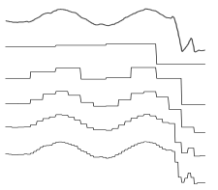
Haar Wavelet
Takes the average of adjacent time series values.
Example:
one level transform
Notes:
Book on many more wavelet methods for time series analysis by Donald Percival and Andrew Walden from the University of Washington

Slide 20
Hidden Markov Models (HMM)
Represent a cluster as a HMM trained on the set of time series assigned to that cluster.
Distance Measure is then the log likelihood of a time series to a given HMM
Typically require some initial “smart” guess of clusterings for usage with clustering algorithms (kMeans especially)

Slide 21

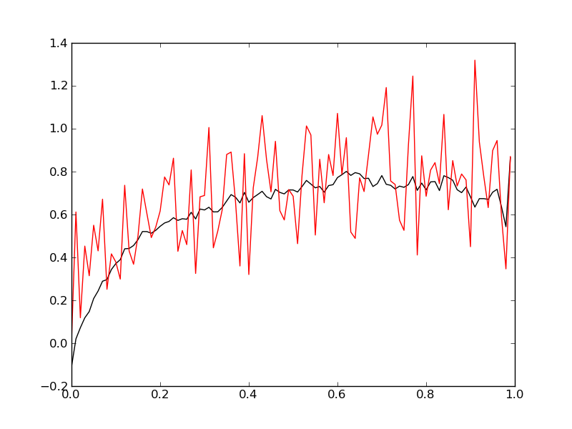
Locally Weighted Linear Regression
applies linear regression to each point in the time series
Uses batch gradient descent for point level linear regression.
Drop the offset
Notes:
t = 5 for this dataset

Slide 22
Contents
What and Why
Time Series Distance Measures
Cluster Scoring
Clustering Algorithms
Data Modification
Dataset and Results
Conclusion

Slide 23
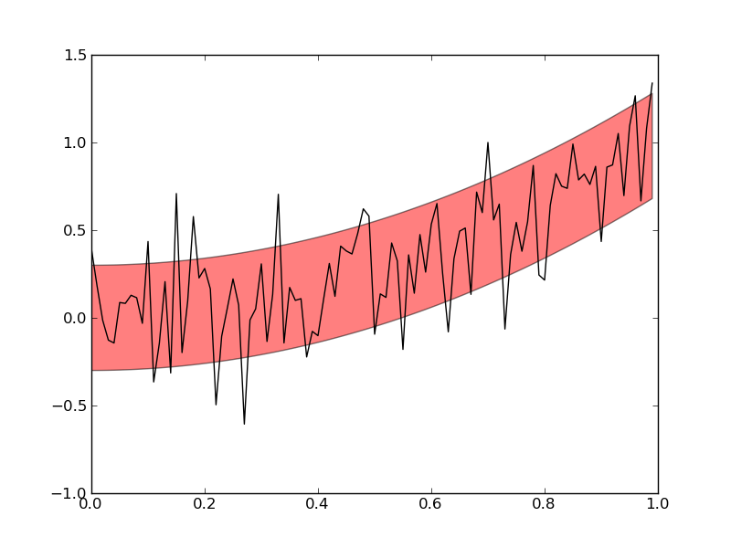
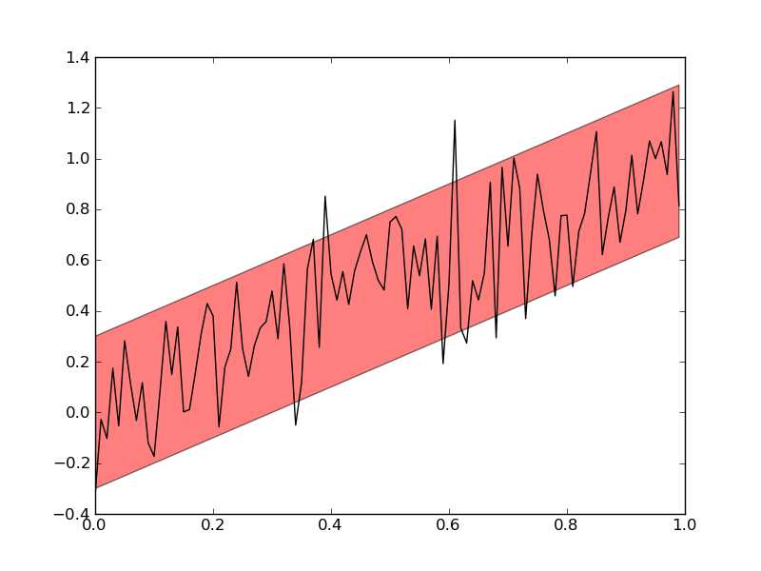
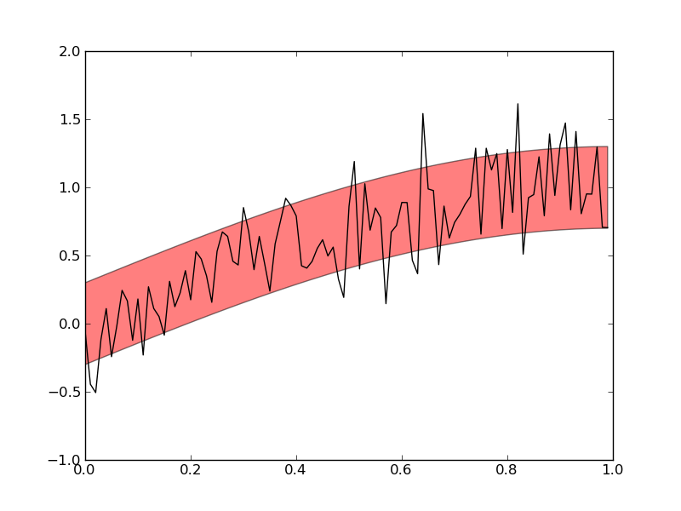
Notes:
50 of each datapoint.
Points are perterbed by a gaussian noise with a variance of 0.25 and mean 0

Slide 24
Results
Clustering Algorithm | Pre-processing | Distance Metric | Train Accuracy | Test Accuracy | Silhouette | Inter-cluster dist
kNN | Haar | L2 | 0.67 | 0.57 | NA | NA
kNN | Haar | Linf | 0.68 | 0.55 | NA | NA
kNN | Haar | DTW | 0.63 | 0.57 | NA | NA
kMeans | Haar | L2 | 0.59 | 0.59 | 0.65 | NA
kMeans | Haar | Linf | 0.57 | 0.61 | 0.78 | NA
kMeans | Haar | DTW | 0.59 | 0.61 | 0.33 | NA
kNN | None | L2 | 0.57 | 0.71 | NA | NA
kNN | None | Linf | 0.53 | 0.56 | NA | NA
kNN | None | DTW | 0.55 | 0.58 | NA | NA
kMeans | None | L2 | 0.59 | 0.57 | 0.76 | 2.62
kMeans | None | Linf | 0.59 | 0.61 | 0.78 | 2.63
kMeans | None | DTW | 0.57 | 0.54 | 0.76 | 2.64

Slide 25
Results (Cont)
Clustering Algorithm | Pre-processing | Distance Metric | Train Accuracy | Test Accuracy | Silhouette | Inter-cluster dist
Agglom | None | L2 | 0.58 | 0.57 | NA | NA
Agglom | None | Linf | 0.56 | 0.55 | NA | NA
Agglom | None | DTW | 0.63 | 0.57 | NA | NA
KNN | LWLReg | DTW | 0.69 | 0.51 | NA | NA
KMeans | LWLReg | L2 | 0.57 | 0.59 | 0.04 | 0.4
KNN | LWLReg | L2 | 0.69 | 0.56 | NA | NA

Slide 26
Contents
What and Why
Time Series Distance Measures
Cluster Scoring
Clustering Algorithms
Data Modification
Dataset and Results
Conclusion

Slide 27
Conclusions
Despite the numerous different distance measures, nothing seems to considerably beat DTW (confirmed by Ding, Trajcevski, et al, 2008)
Each clustering algorithm should be selected based on the clustering task.

