Slide 1
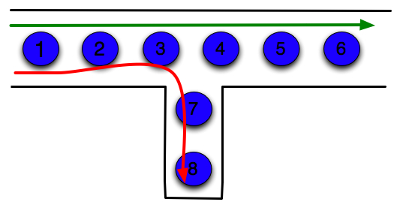
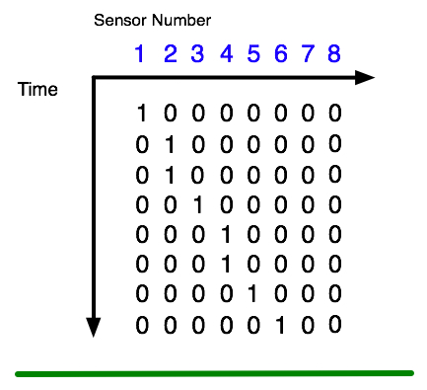
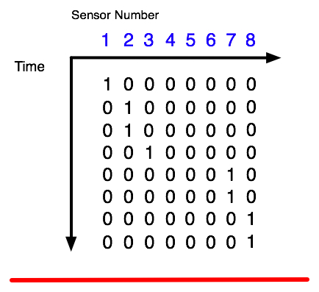
Context based prediction

Slide 2
Context based prediction
Context
Without Context
Green Pixels: Original Data
Red Pixels: Predicted Data
Yellow Pixels: Accurate Predictions

