Slide 1



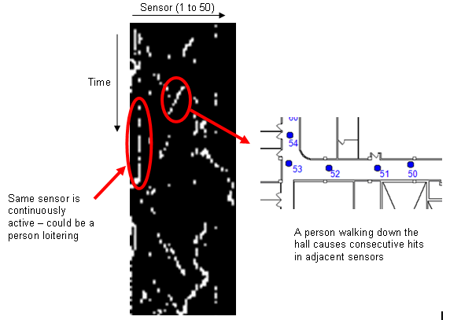
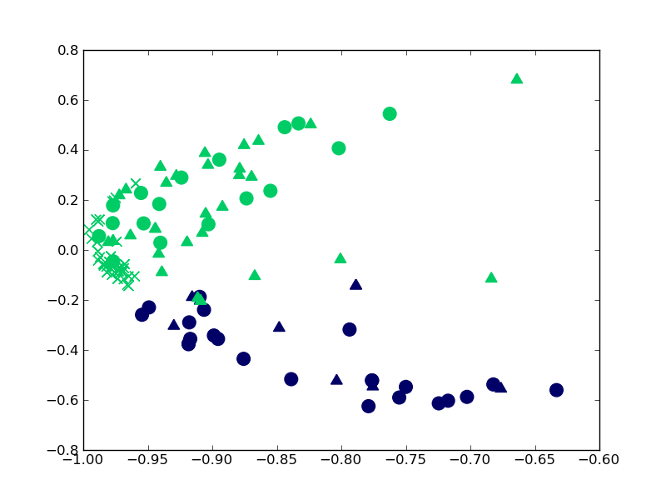
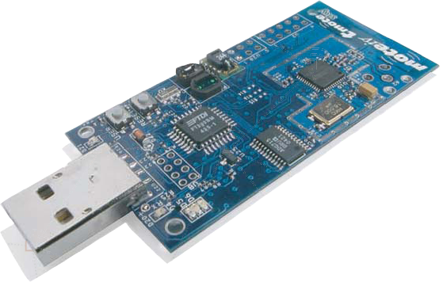
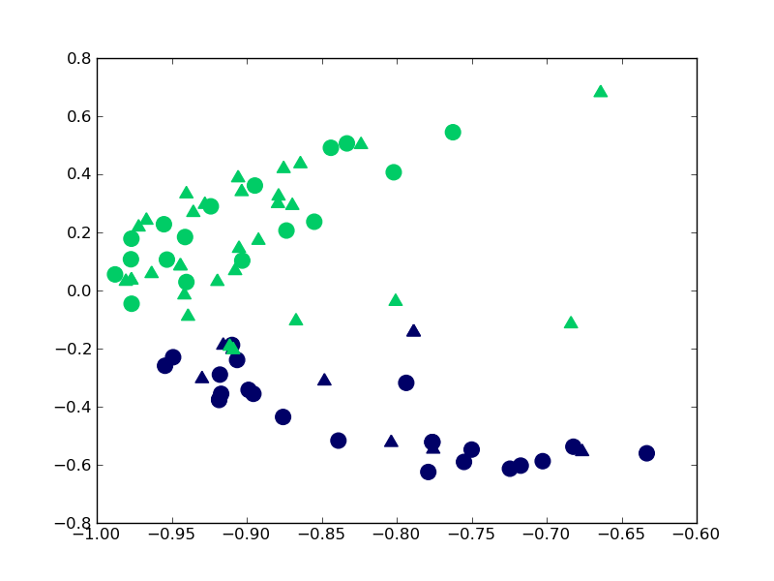
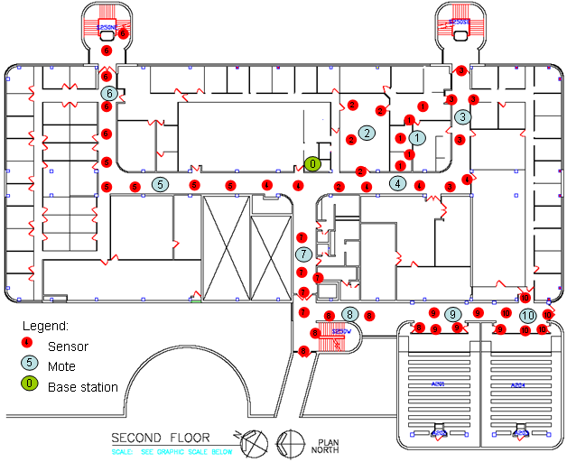
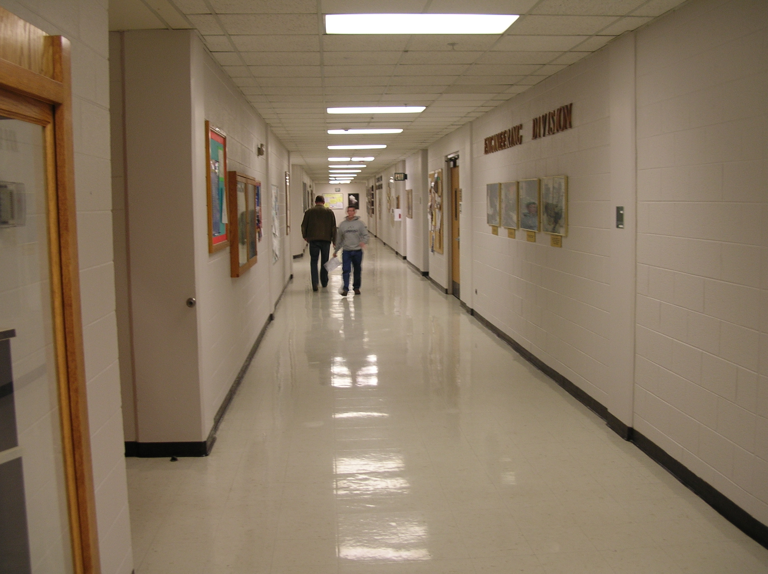
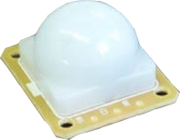
Activity Recognition in a Dense Sensor Network
James Howard, William Hoff
Center for Automation, Robotics, and Distributed Intelligence
Colorado School of Mines
Motivation
Using a collection of small anonymous sensors we look to recognize and predict human behavior within a building. Accurate behavior prediction will allow for the creation of building environmental control schemes designed to reduce energy consumption.
Figure 4 shows an example clustering of latent class projected data with green data representing cluster 1 and blue data representing cluster 2. Circles represent times from 7:00 - 7:50 am. Triangles represent times from 6:00 - 6:50 pm.
Because most activity in the morning is associated with building entrance events and most activity in the evening is associated with building exit events, the split between cluster one and cluster two is expected.
Data Representation
Sensor data is represented in the form of a two dimensional matrix H(t,s), where the columns are sensors and the rows are time intervals (Fig 2). Local movement patterns appear as structures in the matrix. For example, a person walking down the hall causes consecutive hits in adjacent sensors, which appears as a diagonal streak.
Figure 3. Representative Hidden Markov Models trained from local neighborhood data
Methodology
Using a hierarchical approach allows us to recognize activities at different time scales. First we use local sensor information for 10-20 second length activities. We then use this information as the basis for global activity prediction at the range of 5-10 minutes.
Global Activities
We analyze the large scale distribution of local patterns over time using the method of probabilistic latent semantic analysis [2]. The method discovers a small number of latent or “hidden” classes in the distribution of detected local events.
We divide the local patterns into fixed length time periods, and find latent classes in the distributions. For any new period of time, we can represent it as a combination of latent classes. Applying k-means clustering on this latent class space allows us to assign a class label to any new activity (Fig 4).
System Design
We designed a sensor network consisting of wireless computer “motes” and passive infrared (PIR) motion sensors [1]. These were mounted in hallways and rooms in a large campus building (Fig 1).
Figure 2. Example of sensor data in the form of a two dimensional matrix.
Figure 5. Classifying lunch time (x) data onto early/late split
Local Activities
Network topology is inferred from the sensor data. Strong correlation scores define the local neighborhood for each sensor.
High activity data sensed from local neighborhoods is then clustered using a k-means clustering algorithm. The resulting cluster is then represented by a Hidden Markov Model trained on all data within that cluster. Figure 3 shows some of these trained Hidden Markov Models.
Projecting data extracted from the beginning of typical lunch times (12:05 pm - 12:20pm), we see in figure 5 that all data is projected to our cluster associated with building exit.
Acknowledgments
National Science Foundation (grant CNS-0931748), The Lockheed Martin Corp. and Northrop Grumman
References
[1] W. Hoff, J. Howard, “Activity recognition in a dense sensor network,” 1st Int’l Conf on Sensor Networks & Applications, 2009
[2] T. Hofmann, “Probabilistic Latent Semantic Indexing”, Int’l SIGIR Conf on Research & Development in Information Retrieval, 1999
Figure 1. Sensor network; small dots are the PIR sensors; larger dots are motes.
Figure 4. Clustering of latent class projected data. Early Morning (o) and evening (triangle)

