Slide 1
Behavior Recognition:
Detecting behaviours in dense sensor fields
James Howard
Dr. William Hoff (Advisor)

Slide 2
Problem
Develop methods to recognize and predict activities of groups of people from a sensor network.
  Want to calculate:
      probability density of n people in room R at time t in the future.
Develop methods to incorporate contextual information to assist in these predictions

Slide 3
Outline
Prior Work
Our Approach
  Hidden Markov Models
  Probabilistic Latent Semantic Analysis
What’s next?

Slide 4
Prior Work
Bobick, MIT Media labs
  Numerous papers on activity recognition. Primarily uses video. Established a motion hierarchy
Wren, Mitsubishi labs
  Very similar setup to ours. Papers focus on determining motion through a set of binary infrared sensors.

Slide 5
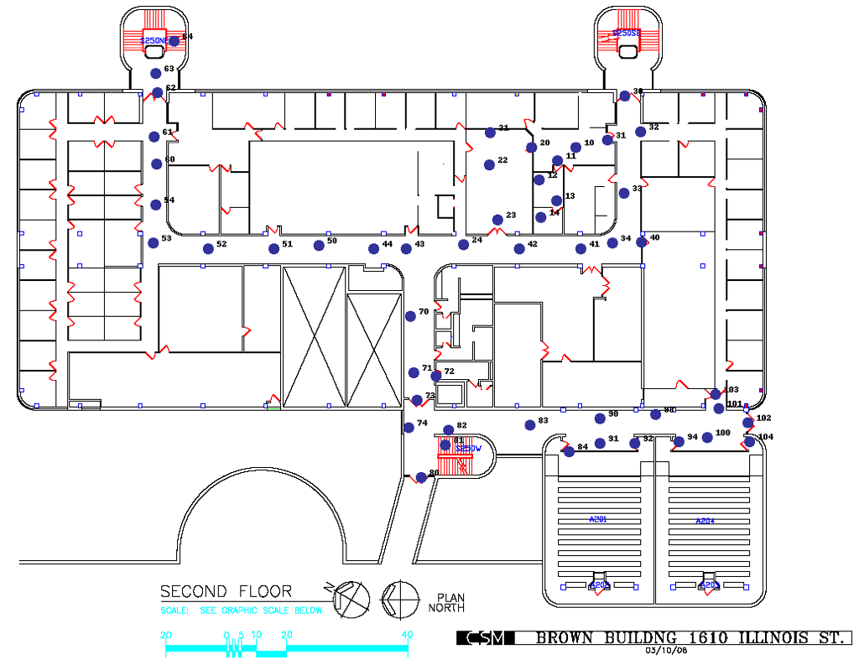
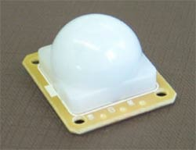
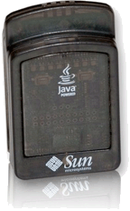
Environment

Slide 6
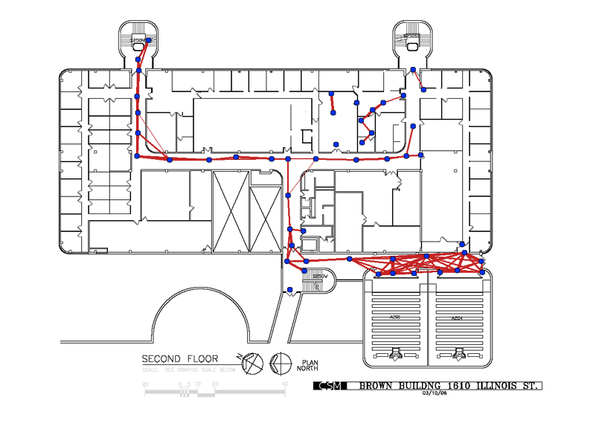
Network topology
Use cross correlation to determine sensor neighbors
Line thickness corresponds to value of correlation coefficient
Example of a five node neighborhood

Slide 7


Raw data representation
past
Five sensors correspond to five columns of data
Time
Since sensor order matters, this is probably two people walking from right to left down hallway.
current
Sensors

Slide 8
Network Motion

Slide 9

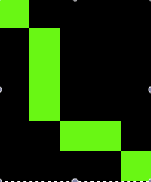

Local Behavior
Neighborhood level (4 to 6 sensors)
  Typically 10 - 20 seconds in length

Slide 10


Markov Model
Definitions
  States (N States)
  Sequential States (T instances)
  Markov Property: Probability of future state depends only on current state. History Independent.

Slide 11
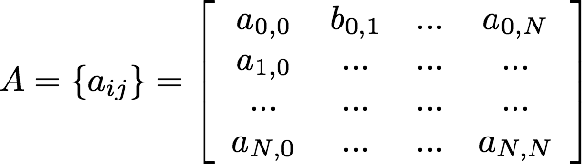
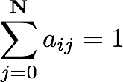
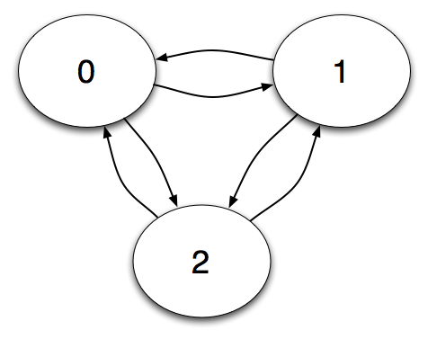

Markov Model
State transition matrix

Slide 12

Hidden Markov Model
Differences
  A distinction is now made between observations and the states.
    States are now a probability distribution of observations
  Dictionary of possible observations (M possible)

Slide 13



Definitions
Observation symbol probability distribution
Initial State distribution
Model

Slide 14



Primary Use
Given an observation sequence
Most interested in calculating the probability of that sequence

Slide 15
HMM - Fitting our Problem
Sensors {53, 52, 51, 50, 44}
  Binary
  Dictionary has 2^5 or 32 possible values to represent all possible states that 5 sensors could be in at anyone time.

Slide 16

HMM - Fitting our Problem
Number of states is related to the length of the observation
  Attempt to tie one state to each second of observation
Want: Maximize
0
1
2
3
4
5
6

Slide 17
Unsupervised Model Training
Choose a fixed number of models to produce
Assign to each observation a random model
While convergence is not sufficient
      Determine center of each model
      For each observation reassign to model whose center is a best fit
        Remove observation if it is sufficiently far from center of model
For each removed observation, assign to best fit model

Slide 18




Fitting our Problem - Outcome

Slide 19
Movie - Animation of patterns

Slide 20
Global Behavior
Floor to building level
Minutes in length
Can’t use Hidden Markov Models in same way as we have been using them due to growth rate of observation dictionary

Slide 21



Probabilistic Latent Semantic Analysis
Definitions:
  Documents set (N time instances)
  Vocabulary (M words/markov models)
  Latent class set (K classes)

Slide 22

Probabilistic Latent Semantic Analysis
Term-document matrix: Number of times each term (markov model) is used in each document (time window)

Slide 23






Probabilistic Latent Semantic Analysis
Aspect Model (Generative Model)
  Can generate
    Select with probability
    Select with probability
    Select with probability
  Joint Model

Slide 24

Probabilistic Latent Semantic Analysis
Want
  Achieve through calculating expectation of model

Slide 25




Expectation Maximization
Iteratively Calculate
Then

Slide 26

Fitting our Problem
Words = Hidden Markov Models
Documents = Time window from raw data
Dictionary becomes Hidden Markov Models for each neighborhood.
Document window.
Counts of each HMM instance are collected.

Slide 27
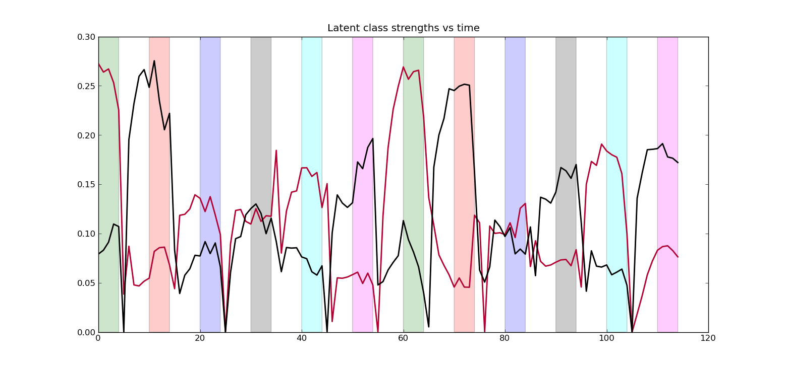
Results - Auditorium

Slide 28
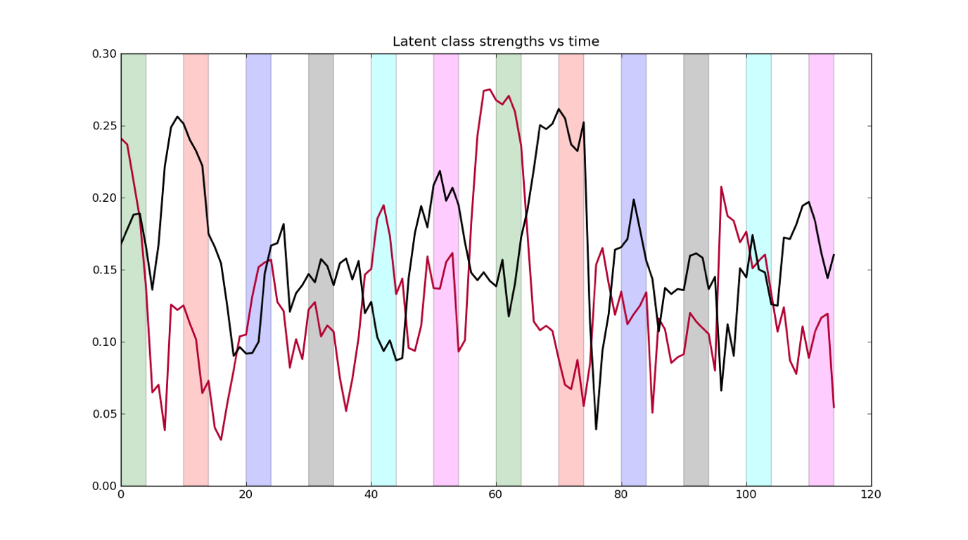
Results - Noisy Auditorium

Slide 29
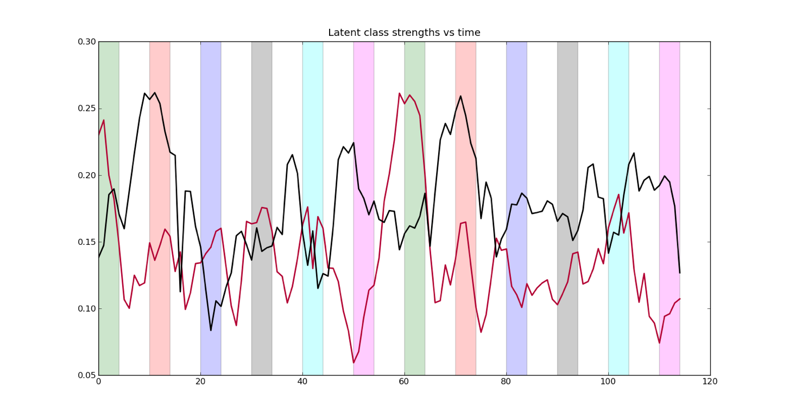
Results - Very Noisy Auditorium

Slide 30
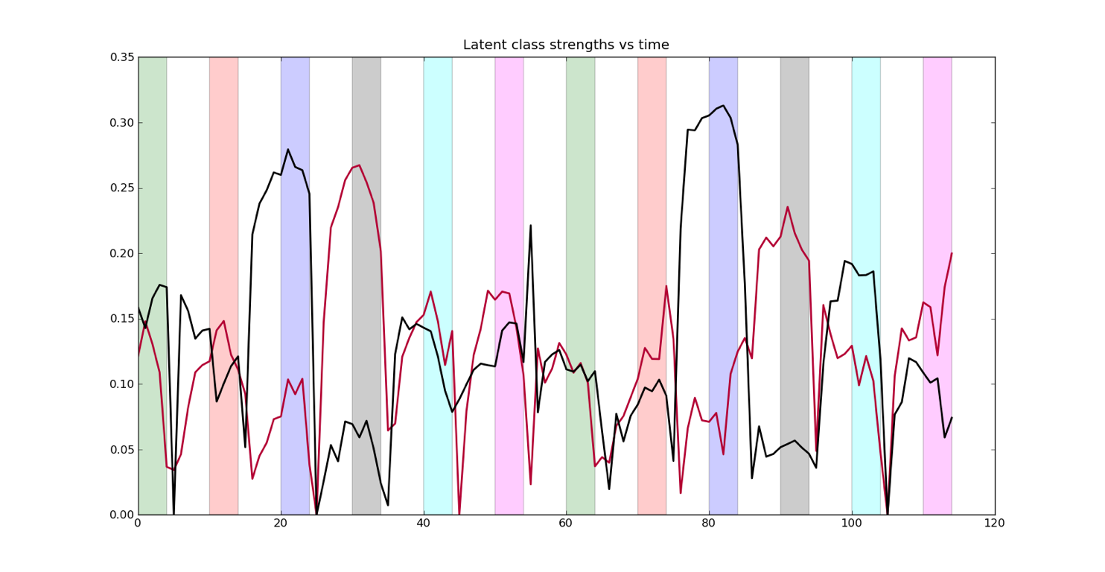
Results - Meeting

Slide 31
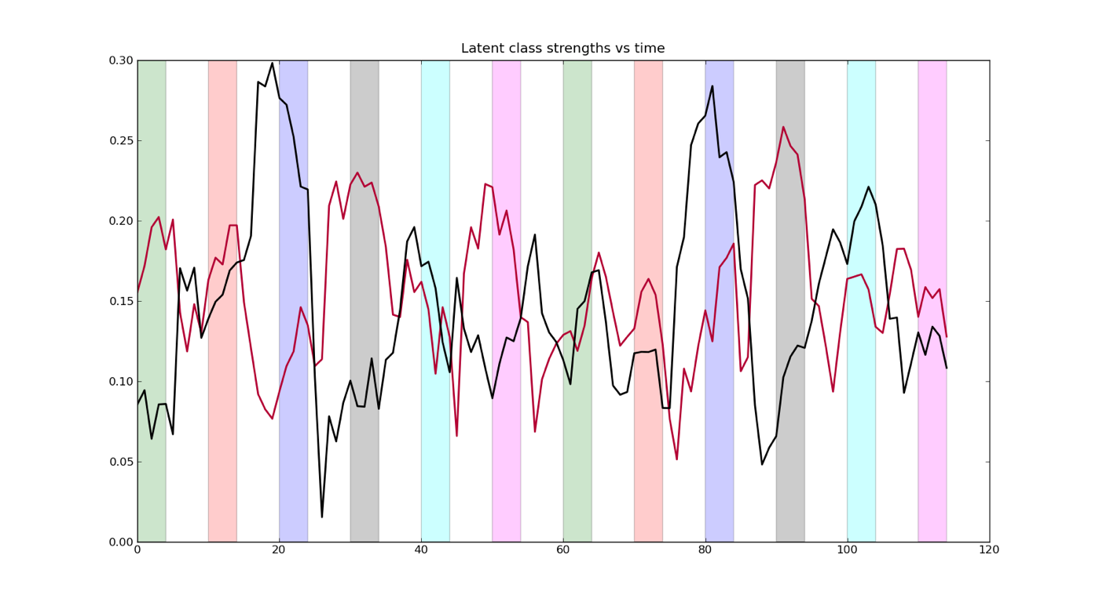
Results - Noisy Meeting

Slide 32
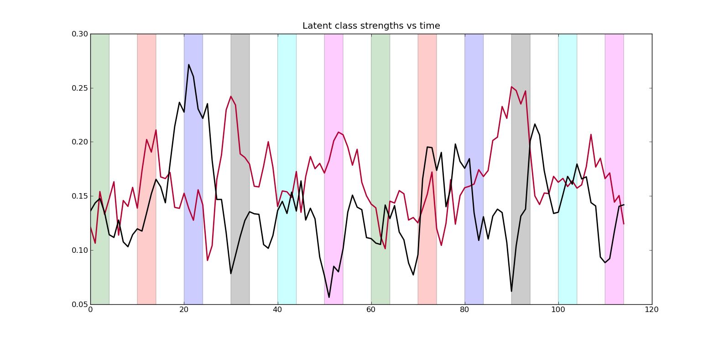
Results - Very Noisy Meeting

Slide 33
Future
Extend to recognition of simultaneous events
Extend initial particle filter results
  Use behavior analysis to improve
Explore accuracy of global behavior correlations
Expand our work to use video

Slide 34
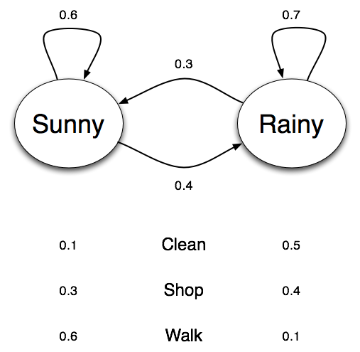
Example
States:
Sunny, Rainy
Observations:
Clean, Shop, Walk

