Slide 1
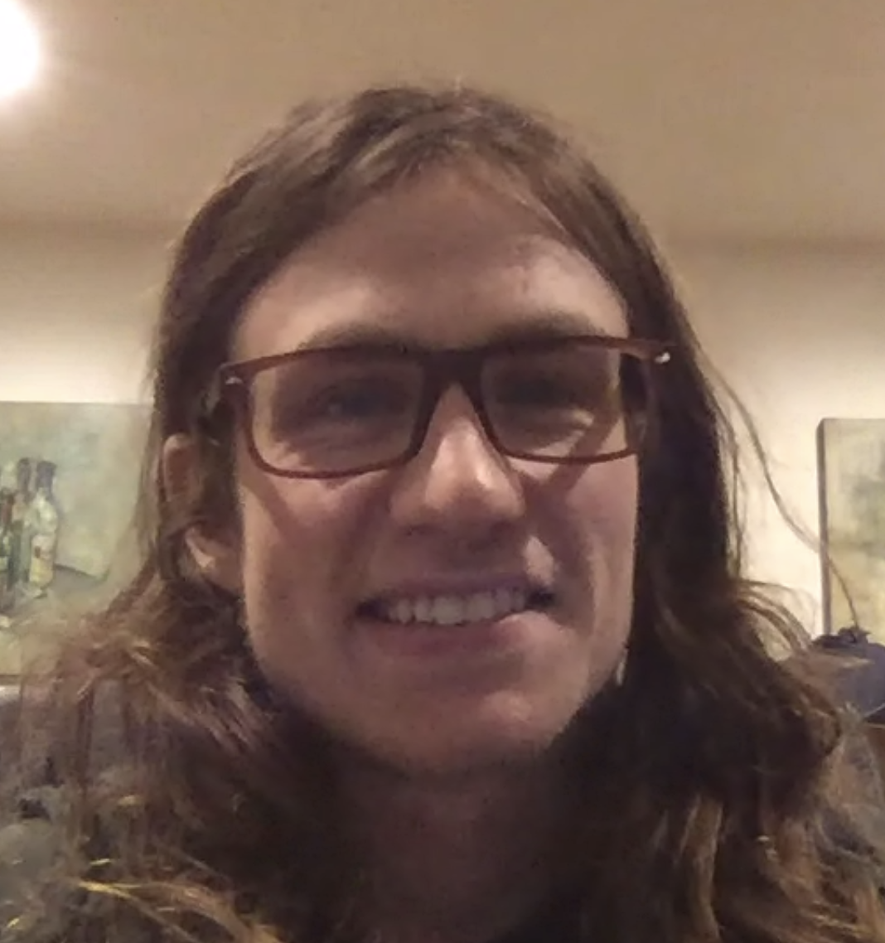


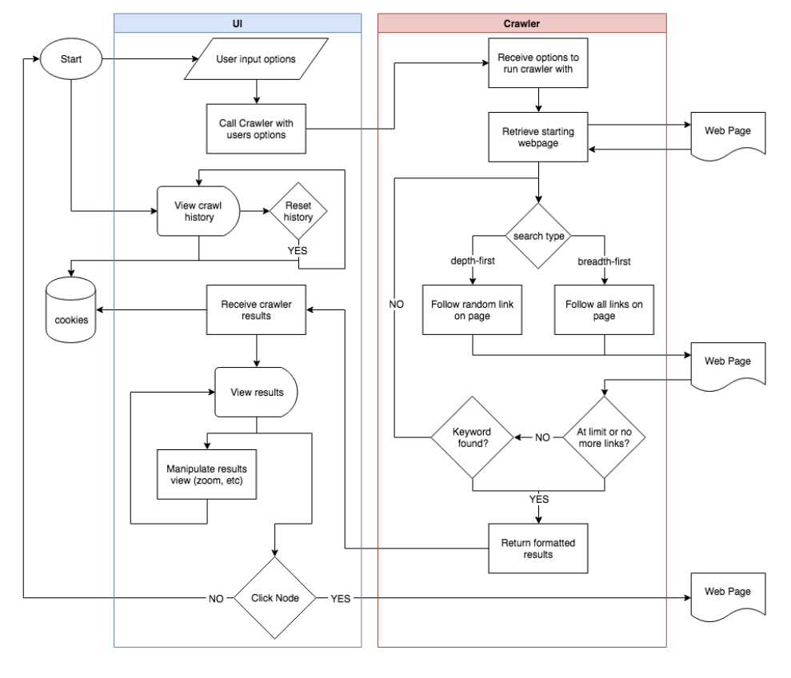
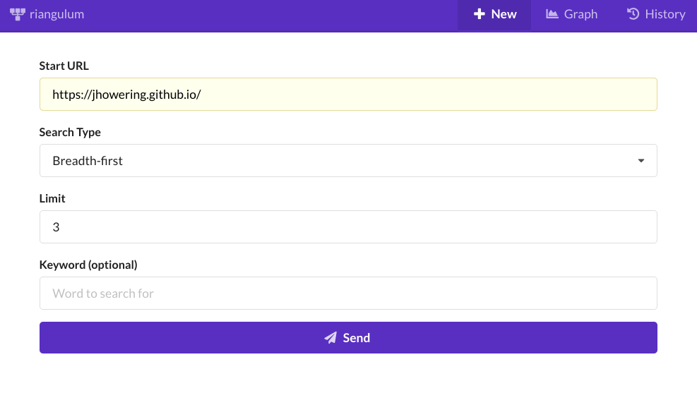
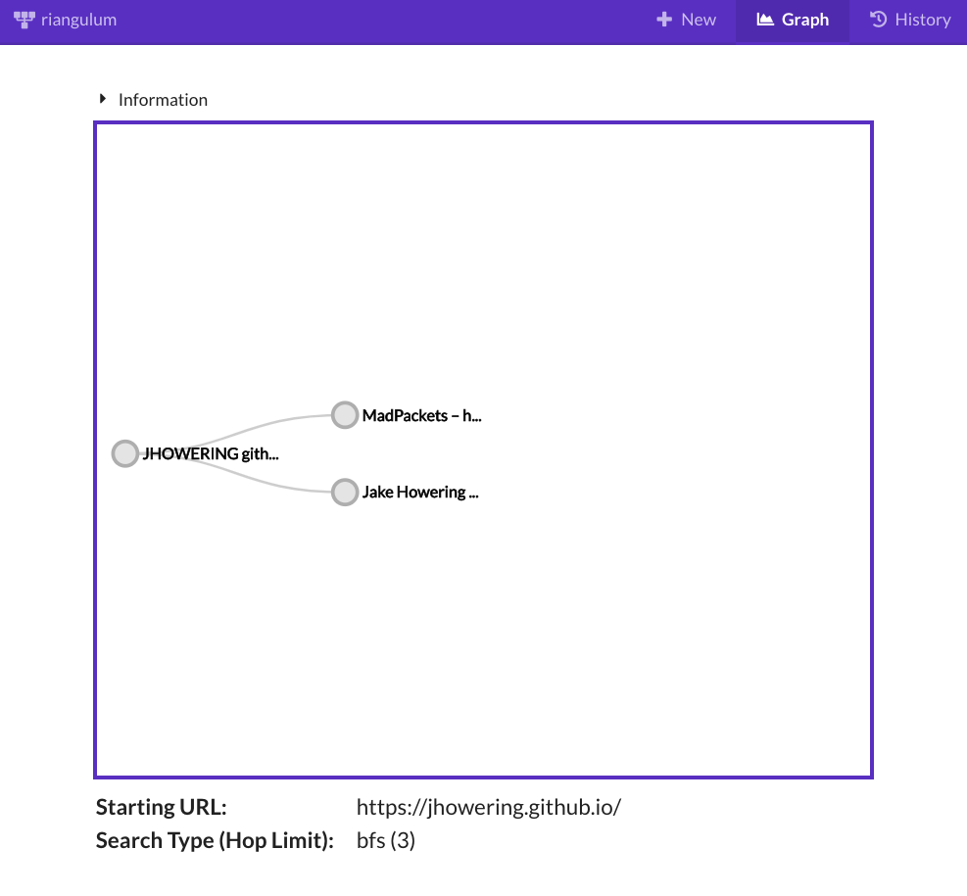
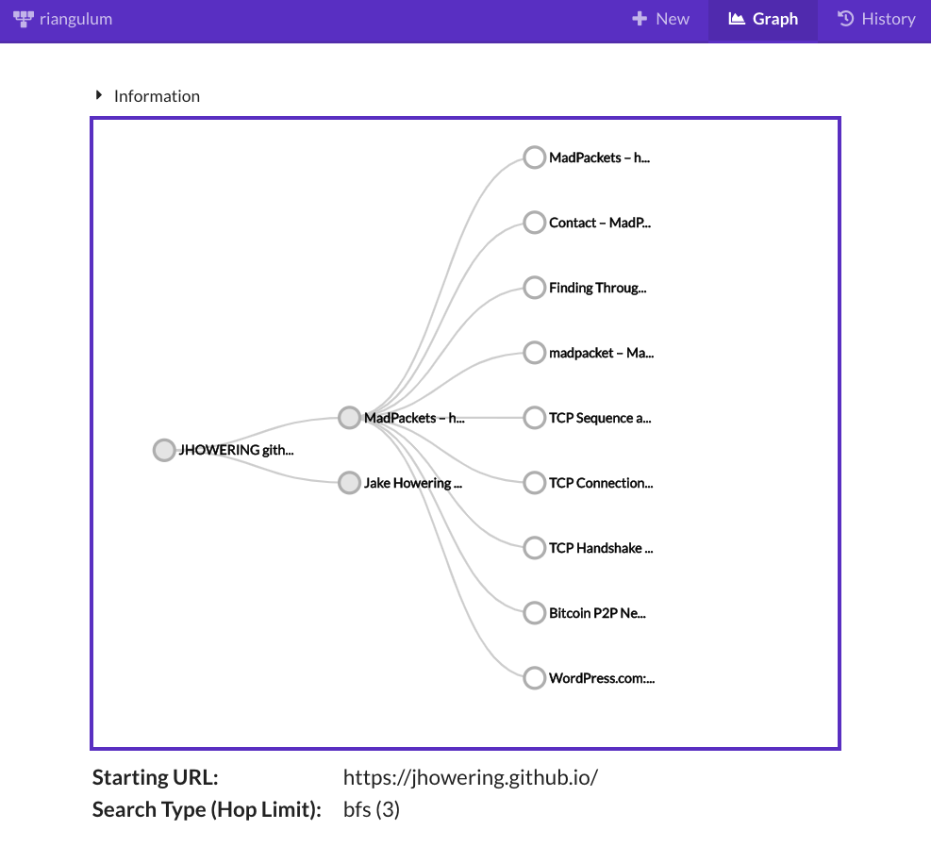
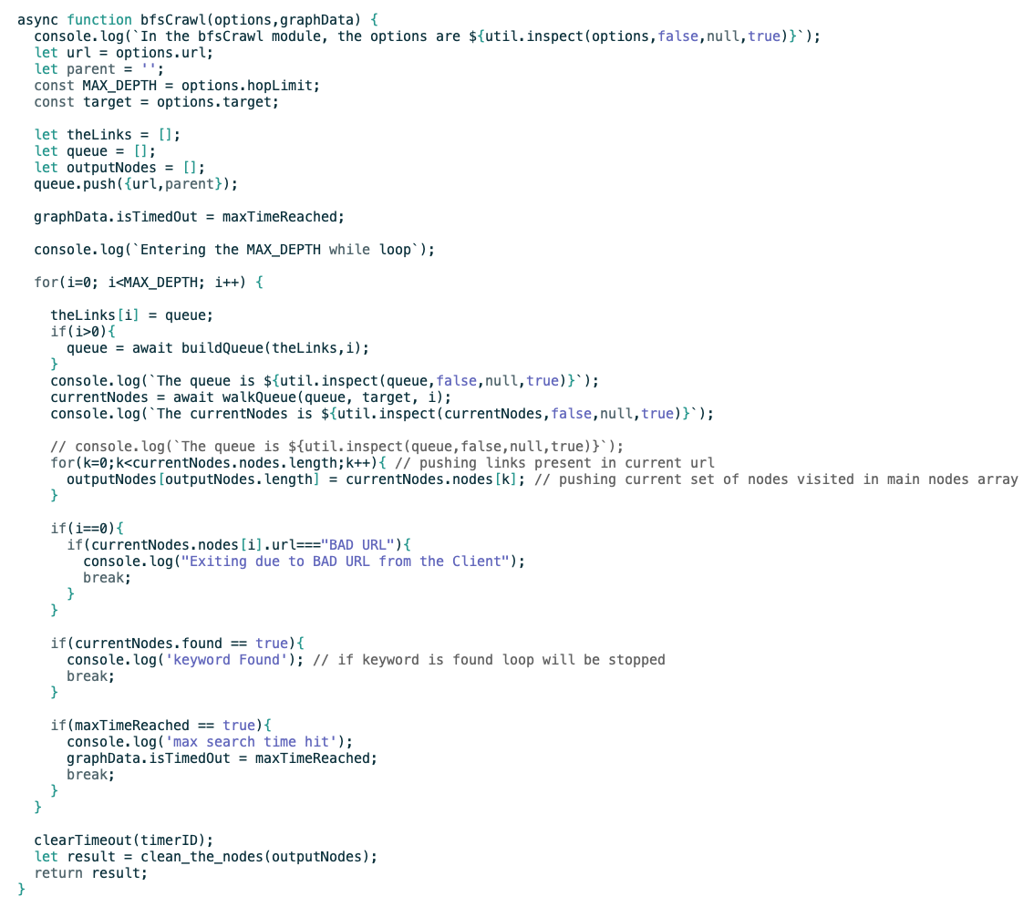
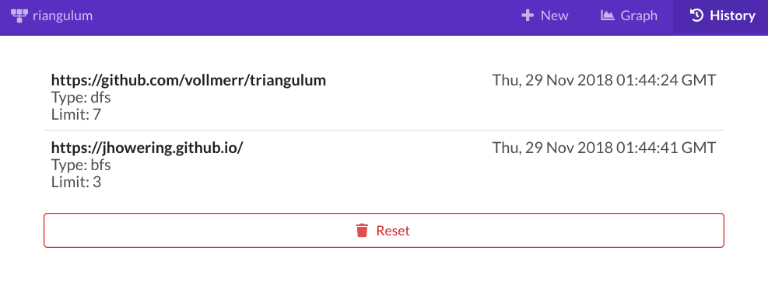
Development TEAM
Graphical Web Crawler
Ryan Vollmer
A web-based application that allows users to systematically traverse the internet. Starting at a site chosen by the user, referenced pages are stored and traveled to, where the process is repeated. Upon completion, the user can visualize and interact with this network.
Fair Oaks, CA
Sidharth Sengupta
Portland, OR
Jake Howering
1
After navigating to the application, the user is prompted to submit a
Raleigh, NC
Our initial interest in this project was due to the technology and requirements involved. Gaining familiarity in web scraping, user interface design, and data visualization were skills we wanted to improve. Throughout the course, we gained a deep insight into full-stack development and best practices for working in a small development team.
crawl form. They enter a starting URL, search type (depth-first or breadth-first search), and a search limit. Optionally, they can enter a keyword which will halt the search if the keyword is found on the page.
Local
Storage
Crawl Form
2
When the crawl is complete, a graph
will be displayed that contains the crawl results. The user can reveal/hide next-level links by clicking on the node. The user can navigate to node URLs in a new tab by clicking the node label. If searching for a keyword, the relevant node will be marked in red.
System Flow
Crawl Visualization
Software ARCHITECTURE + ADDITIONAL TOOLS
The user interface (UI) is comprised of a react.js application which makes POST calls through WebSockets to the API with the users options for a crawl. A new subprocess is created with the crawler which is waited upon by both the API and UI. The node.js-based crawler performs the actual building of websites based off the input provided by the UI, and passed through the API. After a successful crawl the users history of crawls is updated in their local storage and the data visualization of the crawl is displayed to be interacted with. The following additional tools were used in the application:
Node-fetch/Cheerio – Tools used for getting page resources and parsing + querying the data, respectively.
Semantic UI React – Front-end development framework for quickly adding React-compatible, styled components.
D3/React D3 Tree – Used for manipulating and visualizing crawl data. The latter is a open source React component that uses the D3 procedures in a React-compatible methodology.
Cypress/CircleCI – Cypress was used for end to end testing, with helpful features like screen recording and UI interaction. CircleCI was used to run continuous integration tests, preventing issues with automatic deployments.
Heroku – Our hosting platform that provided automatic deployments or configured manual deployments for testing.
Source code from our breadth-first search crawl algorithm. For full source code, please visit our GitHub repository:
https://github.com/vollmerr/triangulum
Crawl Search History
3
On the history page, users can see a list of their past
crawls with all relevant search parameters. Clicking the entry will load a graph of the search. History can be cleared with the reset button.
Please visit our application at https://osu-triangulum.herokuapp.com

