Slide 1
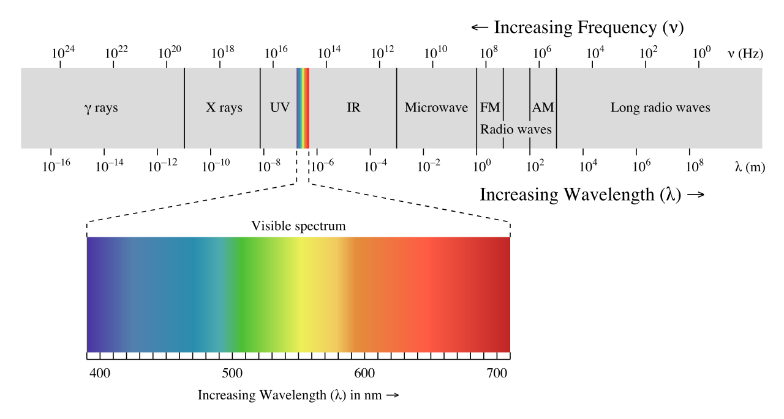
Notes:
Light: waves have a “wavelength” – literally how long one of the waves is from peak to peak. Light waves have a wavelength from around 400nm (billionths of a meter) to 700nm. The different wavelengths give us the different colors.
Waves can actually be longer and shorter than this. There is actually nothing special about light that makes it different to all these other waves – it’s just we happen to have evolved with detectors for detecting that range of wavelengths.

Slide 2
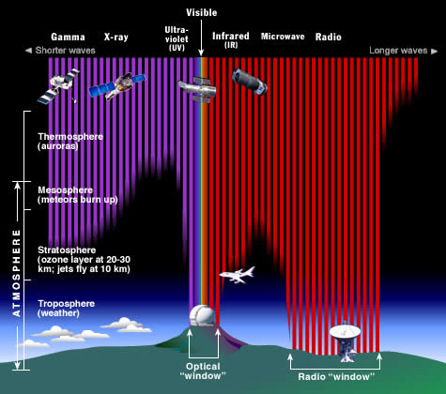
Notes:
You might ask why that wavelength range.? The sun produces light across all the wavelengths, but the atmosphere absorbs almost all the wavelengths, there is a small range of wavelengths around the visible spectrum and another range out at radio wavelengths that allow the light through.

Slide 3
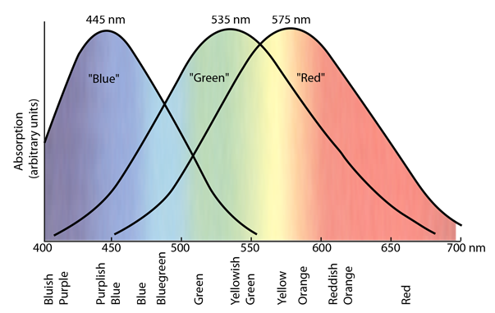

Slide 4
