Slide 1
Orientation to Object Oriented Programming
Guest Lecturer: J. Paterson, Glasgow Caledonian University, Glasgow G4 0BA, Scotland.
James.Paterson@gcu.ac.uk @jhpaterson

Slide 2

Why object oriented?
Software is complicated!
Orientation to Object Oriented Programming
<number>

Slide 3
Why object oriented?
Modern software systems can have many thousands, or even millions, of lines of code
Need ways to keep large software projects manageable by humans
For inspiration, look at how complex operations are performed in the “real world”, for example:
  Organisations, such as large companies
  Complex machines, such as computers
Orientation to Object Oriented Programming
<number>

Slide 4
How do they work?
Entities
  “things” which perform a role
  Have the knowledge they need to perform this role
  Have one or more actions they can do
Messages
  An entity can ask another to perform an action
  Can be a request for something, or a command to do something
  Don’t need to know how it’s done
Orientation to Object Oriented Programming
<number>

Slide 5

Example – a restaurant
Simple example of a company
Cook can cook food
Waiter can take food to table
Waiter tells cook to cook what customer ordered
Cook tells waiter food is ready
entities – actually people in this example
messages
Orientation to Object Oriented Programming
<number>

Slide 6
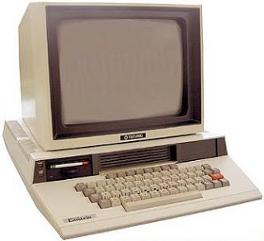
Example – a computer
entities – hardware components in this example
Processor can run a program
Hard disk can store data for
a program
Screen can display output
Processor tells disk to store data
Processor asks disk for data
Processor tells screen to display data
messages
Orientation to Object Oriented Programming
<number>

Slide 7
Types
Back to restaurant example
Unless it’s very small, there will probably be more than one waiter
Several entities of the same
type
Can play the same role
Do the same actions
Have different properties,
for example their names
Mika
Kimi
Valtteri
Orientation to Object Oriented Programming
<number>

Slide 8

Creating entities
How does a waiter entity get created?
The restaurant, or probably the
manager, hires waiters
The job description defines what
the role of the entity is
When a person is hired to do that job, a new waiter entity is created in the restaurant
Orientation to Object Oriented Programming
<number>

Slide 9

Composing entities
There may be more than one cook in the restaurant
Cooks work together
to prepare food
Cooks belong to the
kitchen
Kitchen is an entity composed of cooks
Waiter sends message (order) to the kitchen
Kitchen can send message to each cook
Orientation to Object Oriented Programming
<number>

Slide 10
Similar, but different
Everyone in the kitchen is a cook
Can do the same action (cook food)
But, there might be special types of cook:
Head Cook, can cook, like the others, but can also:
  tell other cooks to cook part of dish
  ask other cook when part will be ready
  put food on plate for waiter
Cook who can do a dish that others can’t do
Orientation to Object Oriented Programming
<number>

Slide 11
Connections and collaboration
Entities need to know about the other entities they must collaborate with
They are connected, or associated
Waiter needs to know how to send order to kitchen
Kitchen needs system for passing order details to cooks
But:
Waiter now doesn’t need to know about cooks
Orientation to Object Oriented Programming
<number>

Slide 12
Other entities
That’s enough of the restaurant example
We’ll move on next to see how a similar model works in software
But, can you think what other things in the restaurant might also be entities? Note that:
  Sometimes entities send messages
  Sometimes entities receive messages
  Sometimes messages contain entities
Orientation to Object Oriented Programming
<number>

Slide 13
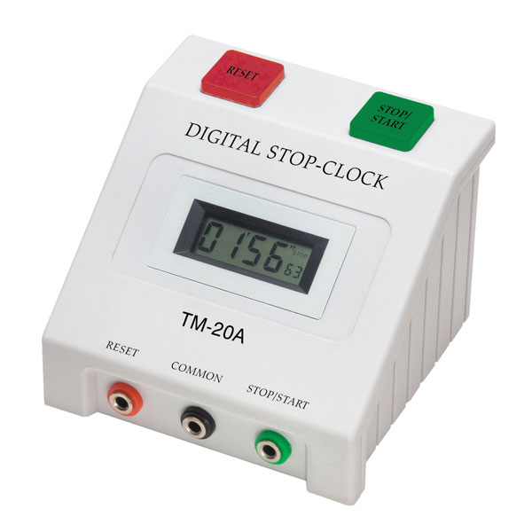
An object oriented program
Digital Stop-Clock program
Works quite similarly to a
“real” hardware clock
First version will show hours and minutes only
Based on example in “Objects First with Java” by Barnes & Kolling
Orientation to Object Oriented Programming
<number>

Slide 14
Parts of the system
we will look inside this part to see how it works
Timer
controls timing
Clock
calculates time to be displayed after each timer “tick”
Display
Shows time calculated by Clock
Orientation to Object Oriented Programming
<number>

Slide 15
What does the Clock do?
Responds to timer tick each minute
Calculates new minutes value and how it should be displayed
Checks if we have reached 60 minutes
Calculates new hours value and how it should be displayed
Prepares result for display
How can we split this work up?
Three entities – clock, hours and minutes
Orientation to Object Oriented Programming
<number>

Slide 16
Assigning the work
Clock
  Responds to timer tick each minute
  Checks if we have reached 60 minutes
  Prepares result for display
Minutes
  Calculates new minutes value and how it should be displayed
Hours
  Calculates new hours value and how it should be displayed
Orientation to Object Oriented Programming
<number>

Slide 17
Types of entity
Clock is different from Hours
Clock is different from Minutes
But,
Hours and Minutes do the same job
  Hold a value
  Increment that value when asked
  Format the value for display
They are instances of the same type - Number
Orientation to Object Oriented Programming
<number>

Slide 18
Messages
Clock
Gets message from timer to respond to tick
Gets message from display to get time to show
Sends message to each Number to tell it to increment value held
Sends message to each Number to ask for value for display
Note that timer and display are also entities, although we are not looking into them here
Orientation to Object Oriented Programming
<number>

Slide 19
Making the entities
Now we know what entities we need, and have an idea of what they will do
How do we create these entities?
What does an entity in a program look like?
We can’t see it – it’s just 1s and 0s in the computers memory when the program runs
We need to tell the computer what each entity should be like, what it can do and how to create it
Orientation to Object Oriented Programming
<number>

Slide 20
Classes
A class is a template which tells the computer what a specific type of entity is like
When we write an object-oriented program, we write code for the classes
A template, or class, includes:
  Properties, or information each entity holds
  Instructions which define the actions an entity of that type can do – these are called methods
  Instructions on how to create an entity of that type
Orientation to Object Oriented Programming
<number>

Slide 21
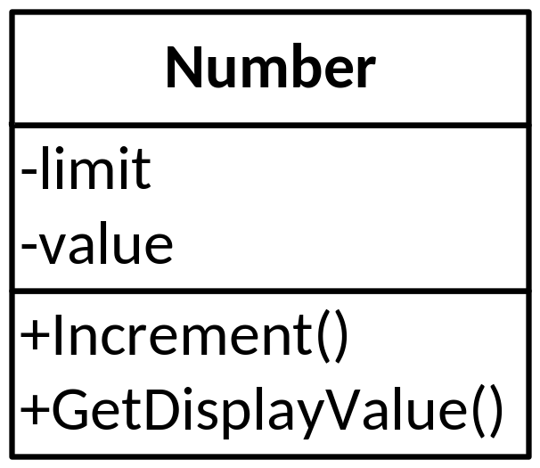
Class diagram
Before we write the code, it is useful to create a class diagram
Shows the class name, the properties and method names for each class
limit – maximum value for the Number, will be 24 for Hours and 60 for Minutes
value – current value for the Number, will be 0 to start with
Class diagram is part of UML – Unified Modeling Language
Orientation to Object Oriented Programming
<number>

Slide 22

Coding the class
Now, at last, we need to write some code for this class
Example is in C#, but would look quite similar other OO languages such as C++, Java, Python, PHP,…
name of class
all code for class goes inside { } brackets
Orientation to Object Oriented Programming
<number>

Slide 23
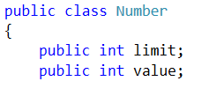
Instance variables
Properties are represented as instance variables
Declared inside the class
these variables are both integers, declared as int in C#
public – can be “seen” in code outside this class
Orientation to Object Oriented Programming
<number>

Slide 24

Methods
Methods defined inside class
Each method has a declaration line and a code block (marked by { } brackets) containing the code which executes the action
void – this method is a command, doesn’t give back an answer
Orientation to Object Oriented Programming
<number>

Slide 25
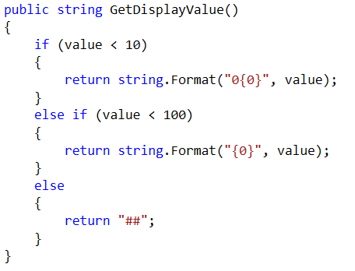
Methods
string – this method is a query, give back an answer (as a string)
some methods also need parameters – information to be passed into the method – this one has an empty parameter list
this action needs to make decisions (do we display a leading 0 or not?)
return – if method gives back an answer, we need at least one return statement which says what to give back
Orientation to Object Oriented Programming
<number>

Slide 26
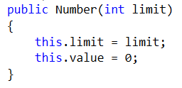
Setting the initial property values
Often need a constructor to set starting values of instance variables
Looks like a method, but has same name as class and no return type
value always starts at 0, but limit will depend on whether we want this number to display minutes (60) or hours (24), will be different for different instances of Number
Orientation to Object Oriented Programming
<number>

Slide 27

Creating a Number
The class defines the entity type
We need to create actual entities when program runs – these are called objects
AN OBJECT IS AN INSTANCE OF A CLASS!!!
The “magic word” for creating is new
this code creates two objects of type Number with different limits
where does this code go? – we’ll find out soon
each object is represented by a variable whose type is the class name
Orientation to Object Oriented Programming
<number>

Slide 28
Sending a message to a Number
To get the Number to increment or give back display value, we need to send it a message
A message is a call to a method
minutes is the object we just created
we can use the return value to set a variable
where does this code go? – we’ll find out soon
Orientation to Object Oriented Programming
<number>

Slide 29
Creating the Clock
Now we have a Number class and can create and use Number objects
Need to write the Clock class
Remember, a Clock is composed of two Number objects (hours display and minutes display)
Need to show this relationship in the class diagram
Orientation to Object Oriented Programming
<number>

Slide 30
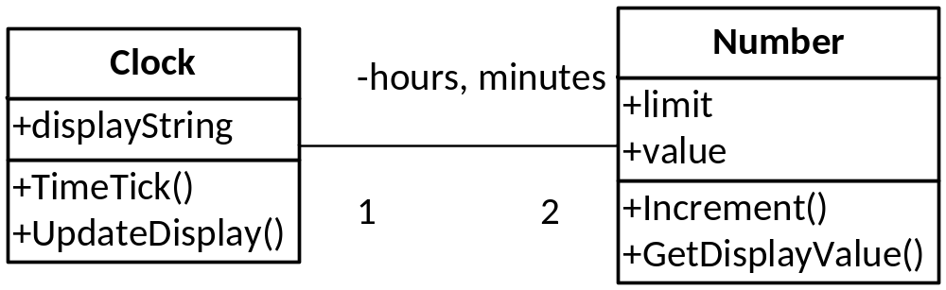
Class diagram
Relationship is shown as a connector on the diagram
1 Clock is related to 2 Numbers
Orientation to Object Oriented Programming
<number>

Slide 31
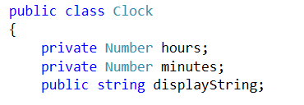
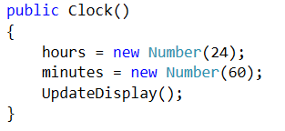
Clock code
Related objects are declared as instance variables
the type of the instance variables is the name of their class - Number
the related objects are created in the Clock constructor
Orientation to Object Oriented Programming
<number>

Slide 32
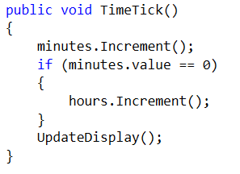
Messages from clock to Numbers
The Clock’s TimerTick method sends messages to the related Number objects
increment hours only if minutes has rolled over to 0
what message is sent to the Numbers in the UpdateDisplay method? – look at the code to find out
Orientation to Object Oriented Programming
<number>

Slide 33
Messages to Clock
Clock’s TimerTick will only happen if a message is sent to the clock
That message comes from the Timer component of the system
This is in the GUI MainWindow code in this example, which we are not looking at here
Similarly, the GUI code asks the Clock for its displayString and displays it
Clock does not actually display or control timing – that is not its job!
Orientation to Object Oriented Programming
<number>

Slide 34
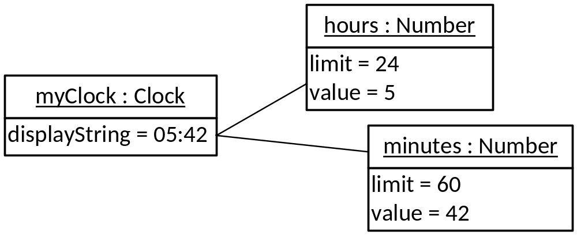
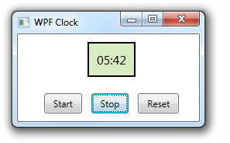
Object diagrams
Class diagram shows code structure
Can be useful to draw object diagram
Shows “snapshot” of what objects exist in memory at a point in time when program is running
Orientation to Object Oriented Programming
<number>

Slide 35
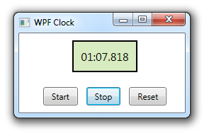
Your task
Your challenge will be to modify this Stop Clock program so that it shows minutes, seconds and thousandths of a second….
Orientation to Object Oriented Programming
<number>

Slide 36
Improving the Clock example
There are some OO programming techniques we can use to make the clock example a bit better
We will control the way that the properties of an object are changed
We will see a nice solution to the problem of extending the display of a number to three digits
Orientation to Object Oriented Programming
<number>

Slide 37

Private and public
In example so far, all instance variables and methods are public
Code in other classes can
read the values
Could also change
the values
Sometimes we prefer to keep
the information in instance
variables private
Orientation to Object Oriented Programming
<number>

Slide 38

Why private
Valtteri
Jari-Matti
Sometimes it’s not sensible to
allow other entities to change
properties
Sometimes we want to prevent
properties being given invalid
values which would cause
errors
We can use encapsulation
Orientation to Object Oriented Programming
<number>

Slide 39
Encapsulation in the Clock example
displayString in Clock is read by GUI, but is calculated by the Clock itself – other code should not change it
limit and value of Number have a limited range of valid values
  0->99 for limit (2 digits)
  0->limit for value (value can’t exceed limit)
Orientation to Object Oriented Programming
<number>

Slide 40
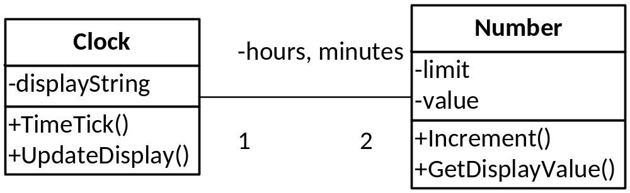
Private/public in class diagram
- sign means private
+ sign means public
Orientation to Object Oriented Programming
<number>

Slide 41
How do we encapsulate?
In many OO languages, need to provide methods to get and/or set value of instance variable – getters and setters
Can make variable read-only by just providing get method
Getter/setter methods are public, while instance variables are private
C# has its own unusual, but very useful, way of doing this
Orientation to Object Oriented Programming
<number>

Slide 42
C# properties
“Property” in C# has a special meaning
A C# property is a particular piece of code which can wrap a getter and setter in a single block of code marked out with { } brackets
Get and/or set are in blocks inside this property
Usually name property same as variable but with capital letter at start
Orientation to Object Oriented Programming
<number>

Slide 43
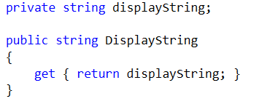
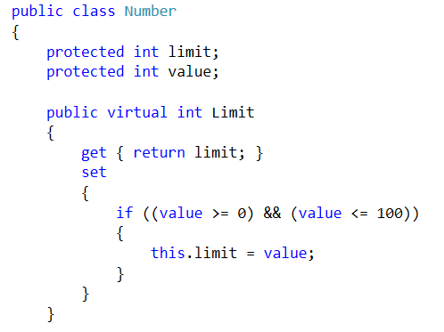
Properties for Clock and Number
Rewrite to encapsulate instance variables
Note – value highlighted in blue is C# key word, not the name of the variable!
DisplayString is read-only – no set block
what’s this? – we’ll come back to it later
can’t set limit > 100 for two digits
Orientation to Object Oriented Programming
<number>

Slide 44
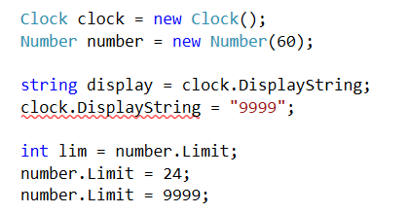
Using properties
OK, there is a get block
Error, there is no set block
OK, there is a get block
OK, there is a set block
No error, there is a set block, but code in set block will prevent invalid value
These are just examples of using properties – in the program, the Limit property is actually set in the constructor of Number
Orientation to Object Oriented Programming
<number>

Slide 45
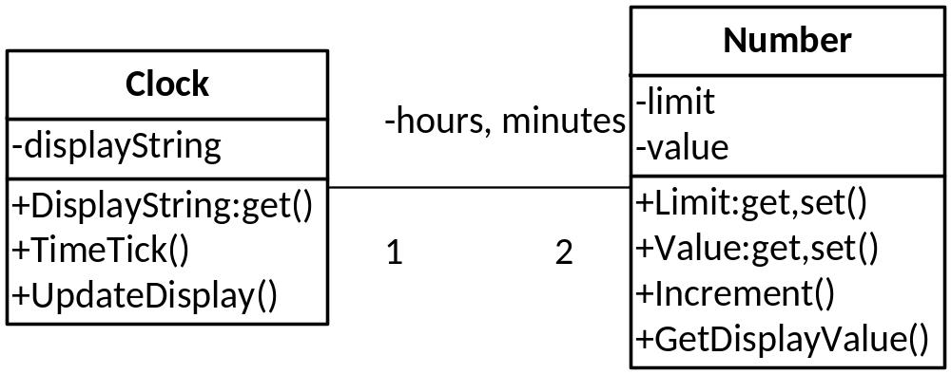
C# properties in class diagram
show C# properties as methods as UML does not include properties
Orientation to Object Oriented Programming
<number>

Slide 46
Deriving new types
One solution for displaying three digits:
  Check if the limit of the Number is > 99
  If so, add two leading 0s if value < 10, one leading 0 if value < 100
Or, could create a special type of Number which always displays three digits - ThreeDigitNumber
Does most things exactly the same way as the original type of Number, but handles leading 0s in its own special way
Orientation to Object Oriented Programming
<number>

Slide 47
Inheriting
Some things in ThreeDigitNumber will work exactly the same way as Number
  Increment method
  limit and value instance variables
  Value property (makes sure value is not > limit)
These can all be inherited from Number
NOTE: the whole process of deriving new types from existing ones is often called inheritance
Orientation to Object Oriented Programming
<number>

Slide 48
Overriding
Some things in ThreeDigitNumber do the same job as Number, but do it differently
  Limit property needs check not > 1000
  GetDisplayValue will return a three-digit string
These are defined in the class ThreeDigitNumber
Override the versions in Number – an instance of ThreeDigitNumber will use its own versions
Orientation to Object Oriented Programming
<number>

Slide 49
Extending
The special type can sometimes do things that the original type did not do at all
Can add completely new methods which are not inherited and which do not override methods
No examples of this in ThreeDigitNumber
Can you think of any new behaviour which could be added to a Number?
Orientation to Object Oriented Programming
<number>

Slide 50

Some jargon
The original class, from which the new class is derived, is called the superclass
The new class is called a subclass
There is no limit to how far
you can go – you can have
a subclass of a subclass of
a subclass…
Orientation to Object Oriented Programming
<number>

Slide 51
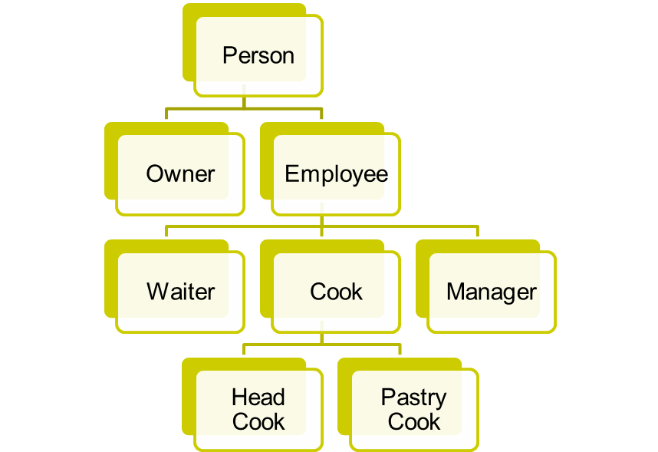
Inheritance hierarchy
A set of classes which are all derived from a single class is called an inheritance hierarchy
Models many real-
world situations
Orientation to Object Oriented Programming
<number>

Slide 52
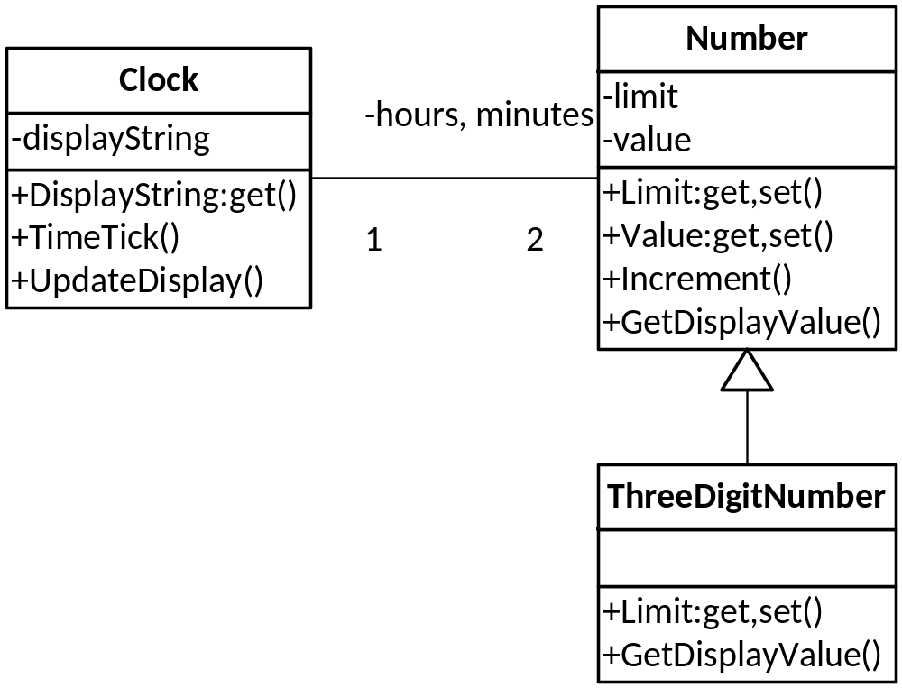
Class diagram final version
this connector indicates inheritance – “points” to superclass
Orientation to Object Oriented Programming
<number>

Slide 53




Creating a subclass
subclass : superclass
property marked as override – version
in superclass (Number) now marked as virtual
subclass constructor : superclass constructor
method marked as override – version
in superclass (Number) now marked as virtual
note that the exact details of how to create subclasses differ considerably between languages
Orientation to Object Oriented Programming
<number>

Slide 54
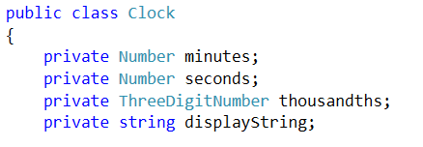
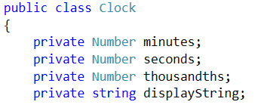
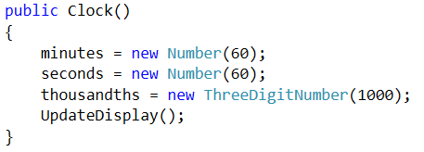
Setting up the new clock
instance variables
constructor
will also work with instance variables like this, and same constructor - polymorphism
Orientation to Object Oriented Programming
<number>

Slide 55
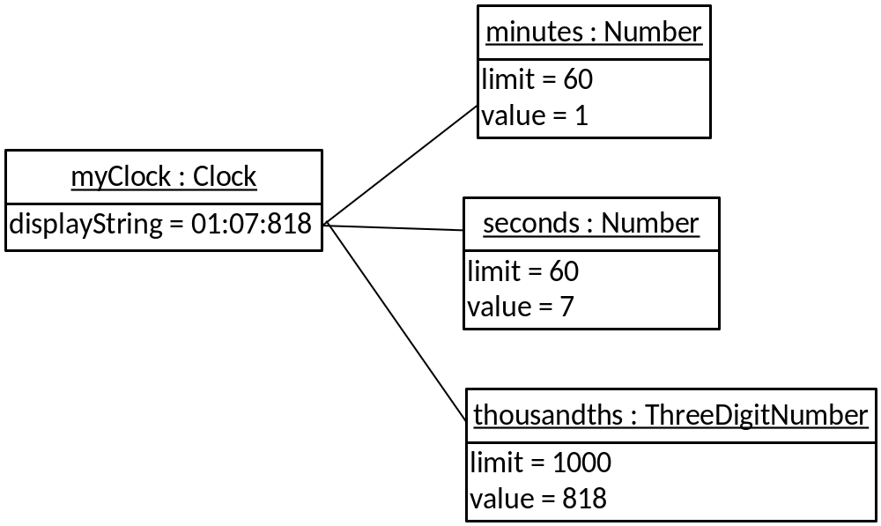
Object diagram final version
Orientation to Object Oriented Programming
<number>

Slide 56
One more diagram
There are several types of diagram in UML
You have seen:
  class diagram – shows structure of types which you need to code
  object diagram – shows snapshot of objects at run-time
Neither of these show the messages which pass between objects
One further type of diagram which does show messages is the sequence diagram
Orientation to Object Oriented Programming
<number>

Slide 57
Sequence diagram
A method runs in response to a message
  Method contains code which defines some steps – the algorithm for the method
  Some steps themselves send messages
A sequence diagram shows messages which are sent when a method runs
  Can also show control structures (if-else, loops) which determine when messages are sent
  Useful way of understanding what objects are involved in an action and how they communicate
Orientation to Object Oriented Programming
<number>

Slide 58
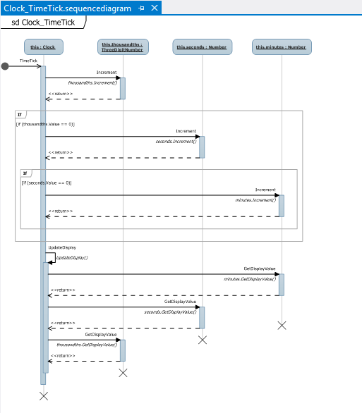
Sequence diagram for clock TimeTick
this was created by Visual Studio from the code– can look at it there to see the details
next slide zooms in to show how it works
Orientation to Object Oriented Programming
<number>

Slide 59
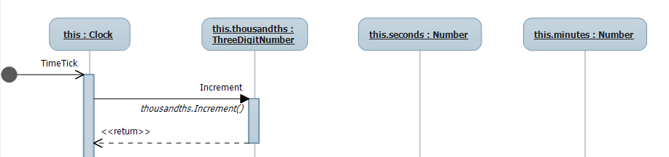
How the sequence diagram works
message from outside to Clock
objects which take part in this action are shown along the top
each object has a timeline
message from Clock to first Number
time is represented vertically – we move down the diagram as time goes on
Orientation to Object Oriented Programming
<number>

Slide 60
Going further
This has been a introduction to the key ideas of Object Oriented Programming
Still more important concepts to learn in detail
  Polymorphism, Interfaces, and so on
Just as important is to learn how to think in an Object Oriented way
  Needs practice, with experience it all makes sense
Good luck with learning OOP in future!
Orientation to Object Oriented Programming
<number>

