Slide 1
Structured Data and Web Services
Guest Lecturer: J.Paterson, Glasgow Caledonian University, Glasgow G4 0BA, Scotland, James.Paterson@gcu.ac.uk, @jhpaterson

Slide 2
Web services
The term refers to clients and servers that communicate over the Web’s HTTP protocol
Can be used as a means of communicating between components within a web application - Ajax
Can be a set of public services that together form a scalable, and inexpensive computing platform “in the cloud”
Structured Data and Web Services
#<number>

Slide 3
Types of Web Service
SOAP
  Simple Object Access Protocol
  Allows a client program to call a function which runs on a remote server
  Call, parameters and return values are formatted as XML
REST
  REpresentational State Transfer
  Client calls service with HTTP URL
  Return value formatted as XML or JSON data
Structured Data and Web Services
#<number>

Slide 4
SOAP services and XML
Calls/results sent in a specific standard XML format – SOAP “envelope”
Also need a way for client program to learn how to format calls and interpret response
Web Services Description Language (WSDL) is an XML format which gives description of the functions available on a service
Client program uses WDSL information to build a client-side “stub” function
Structured Data and Web Services
#<number>

Slide 5
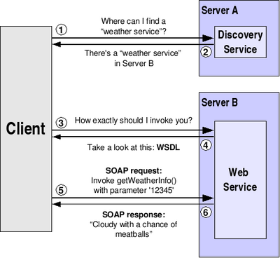
SOAP information flow
Structured Data and Web Services
#<number>

Slide 6
SOAP service example
Create service using Microsoft WCF
Service is a C# class
Client is a console application, also written in C#, which calls methods of the service
Client and service are in separate projects
  Could actually be on separate computers on the internet
  Could even be written in different programming languages
Structured Data and Web Services
#<number>

Slide 7
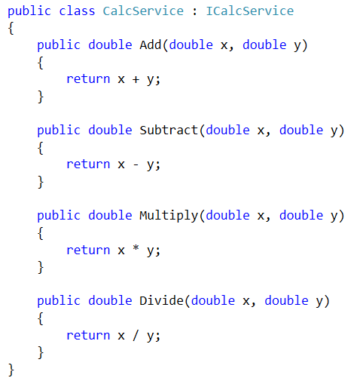
Service class
Structured Data and Web Services
#<number>

Slide 8
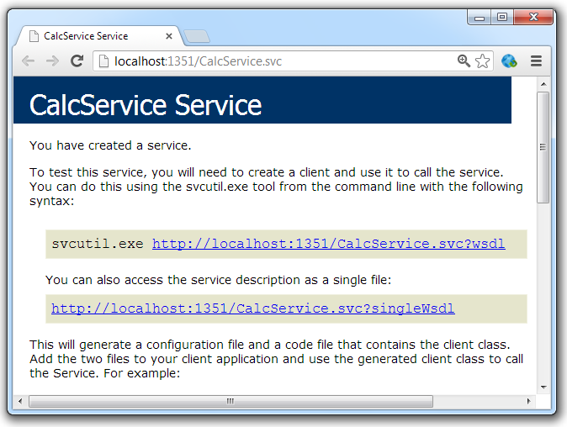
Viewing service home page
Structured Data and Web Services
#<number>

Slide 9
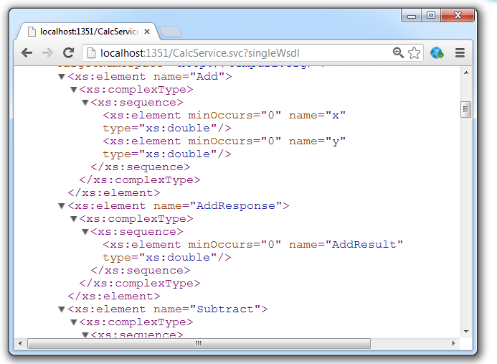
Viewing WSDL for service
the part of the XML shown here describes the Add method and the response it returns
Structured Data and Web Services
#<number>

Slide 10
Using the service
Simple example client (console application)
Visual Studio can create a Service Reference
Reads WSDL and creates a client-side stub class
Client program can call methods of service by calling stub methods
Looks like ordinary method calls, but actually sends SOAP-formatted XML over the network to the service
Structured Data and Web Services
#<number>

Slide 11
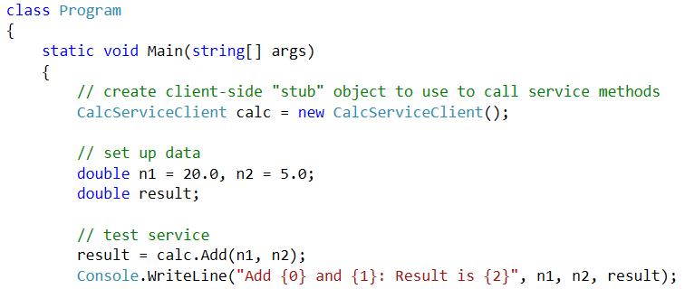
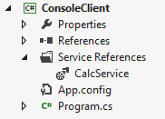

Client program
stub class created when you Add Service Reference in Visual Studio
call service method (also call
Subtract/Multiply/Divide)
output
Structured Data and Web Services
#<number>

Slide 12
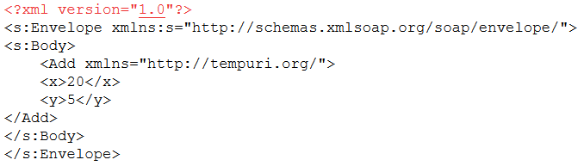
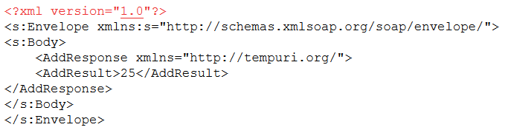
SOAP messages in this example
Transported within HTTP request and response (captured using a web proxy)
Request body
Response body
Structured Data and Web Services
#<number>

Slide 13
REST services
Service calls are simple HTTP requests
Think of a service as a resource, rather than a function, which is identified by a URL
Relatively easy to construct requests in most languages without creating stubs
No standard formats for data
Widely used for public APIs, e.g. Twitter, Flickr, to allow developers to create custom client programs
Structured Data and Web Services
#<number>

Slide 14
REST requests
GET requests used for calls which retrieve resources
Call parameters sent as URL query parameters
POST/PUT/DELETE requests used to change resources on server
Data sent URL query params or as HTTP request body
Structured Data and Web Services
#<number>

Slide 15
REST example - Geonames
Provides a range of geographic information
We will look at the postal code search service
Given a postal code and country, as URL parameters, service returns place name, latitude and longitude, etc.
Documentation at www.geonames.org
Example call:
  http://ws.geonames.org/postalCodeSearch?postalcode=15110&country=FI
Structured Data and Web Services
#<number>

Slide 16
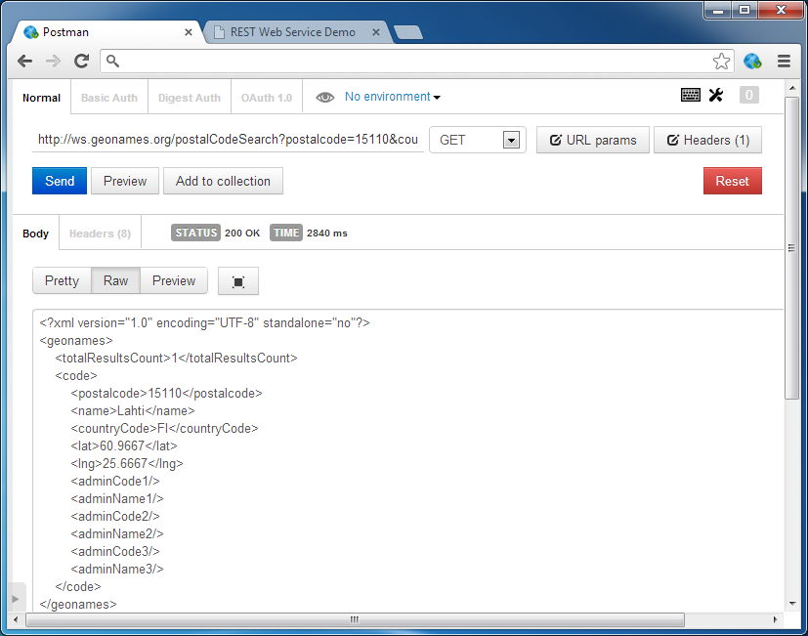
Testing a REST service
Chrome POSTMan is a useful Chrome plug-in which lets you build and send a REST service call and view the response
data returned as XML
Structured Data and Web Services
#<number>

Slide 17
Using a REST service
Client program needs to:
  Build HTTP request for service call
  Turn data returned into something which it understands, e.g. by parsing XML
  Do something useful with the result
REST clients can be written quite easily in most languages
Commonly used with JavaScript/Ajax, service called directly from browser
Structured Data and Web Services
#<number>

Slide 18
JSON
Many public REST services give option to get data as JSON (JavaScript Object Notation) instead of XML
Text-based data format like XML
More compact format, less network traffic
Much easier to work with in JavaScript, as data format is identical to format for creating an object in JavaScript
No support for schemas and validation, though
Structured Data and Web Services
#<number>

Slide 19
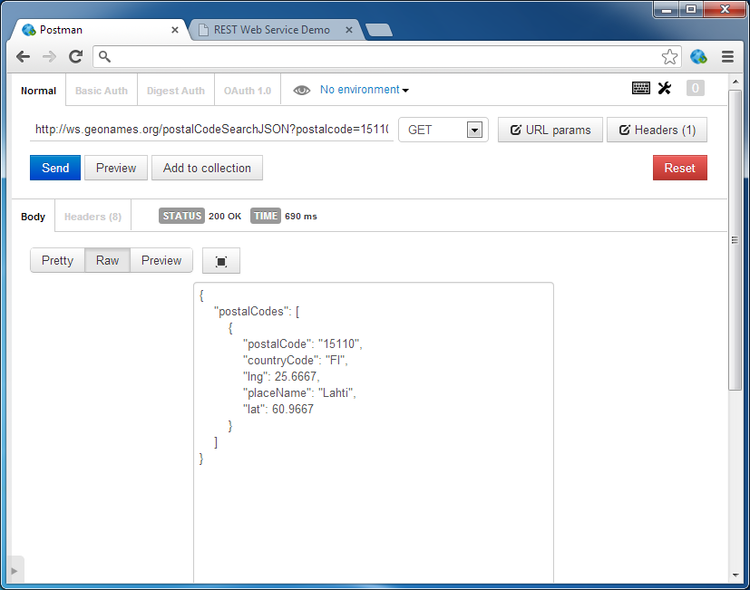
Testing a JSON REST service
data returned as JSON – this is the same information as the XML example before
Structured Data and Web Services
#<number>

Slide 20
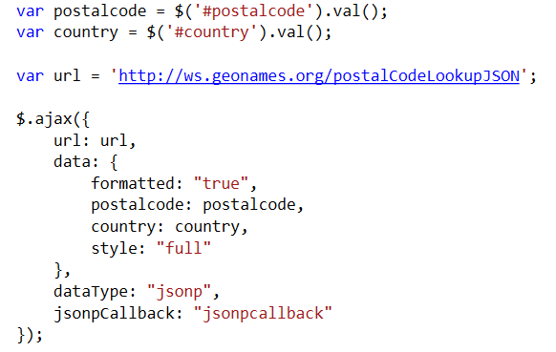
A JavaScript client
Use jQuery to send Ajax call to service URL
Structured Data and Web Services
#<number>

Slide 21
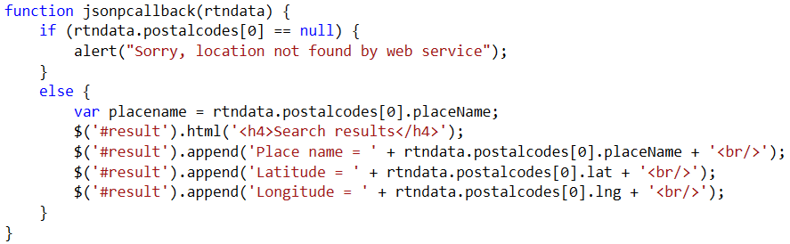
A JavaScript client
Ajax callback function gets JSON data, can access properties directly, no need to parse
Structured Data and Web Services
#<number>

Slide 22
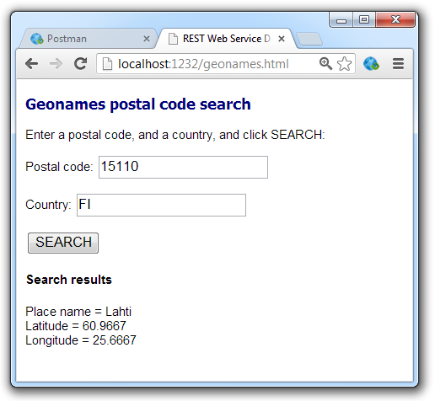
A JavaScript client
Clicking SEARCH button sends Ajax request
Callback uses the JSON data to update the page
Structured Data and Web Services
#<number>

Slide 23
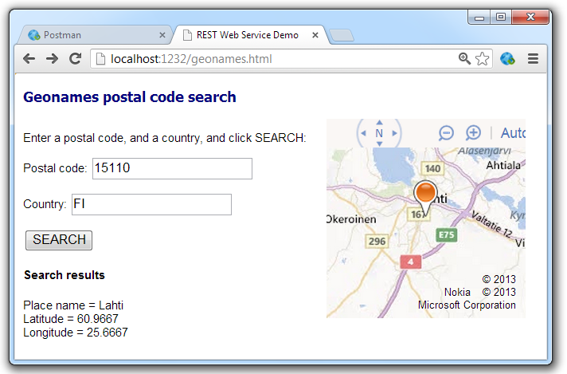
Combining Web Services
Public web services are often combined, e.g. geolocation data from one service can be combined with a mapping service
Structured Data and Web Services
#<number>

Slide 24
Summary
Web Services make use XML or JSON for service description, service calls and service responses
SOAP services use standard XML format for calls/responses
REST services use HTTP requests for calls, XML or JSON for responses
Full example code: github.com/jhpaterson/LahtiWebServices
Structured Data and Web Services
#<number>

