Slide 1
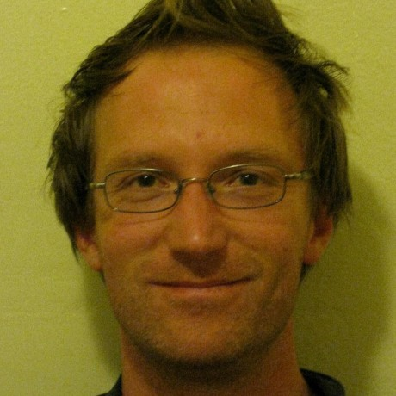
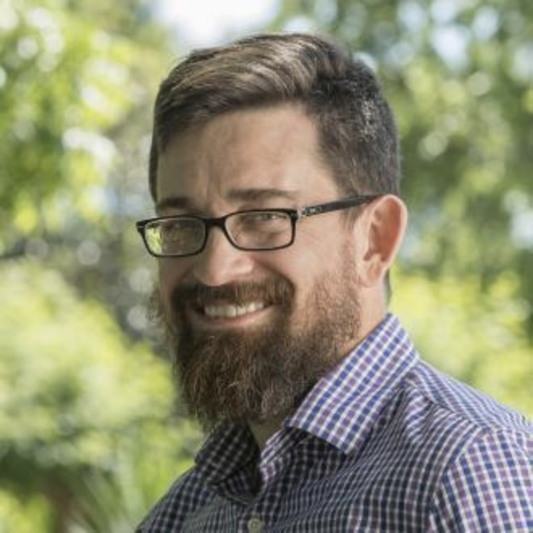
Signed Biodiversity Data Packages
A Method to Cite, Verify, Mobilize, and Future Proof, Large Image Corpora. Digital Data in Biodiversity Data Conference 2023
@ Arizona State University 5-7 June 2023. doi:10.5281/zenodo.7990927
Jorrit H. Poelen https://jhpoelen.nl
Ronin Institute, UC Santa Barbara Cheadle Center for Biodiversity and Ecological Restoration
https://orcid.org/0000-0003-3138-4118
Jason Best https://fwbg.org/about-us/staff/jason-best/
Botanical Research Institute Texas
https://orcid.org/0000-0002-7414-5523

Slide 2
At Digital Data in Biodiversity Conference 2022, Jason Best accepted my offer to make a copy of their 13 TB image corpus for a ☕ and a 🍪.

Slide 3
On 05/23/22 14:43, Jorrit Poelen wrote:
Hey Jason -
Thanks for the chat earlier at the Digital Data conference.
I am serious about taking on this 13 TB image corpus challenge.
[...]
thx,
-jorrit

Slide 4
On 5/23/22 16:32, Jason Best wrote:
Hello Jorrit,
Thank you for the offer to provide additional back up for our images! BRIT is home to three primary and distinct plant collections which we acquired when they were orphaned by their original universities.
[...]
Let me know how you like your coffee and cookies.
Thanks!
Jason

Slide 5
On 5/23/22 16:32, Jason Best wrote:
Hello Jorrit,
Thank you for the offer to provide additional back up for our images! BRIT is home to three primary and distinct plant collections which we acquired when they were orphaned by their original universities.
[...]
Let me know how you like your coffee and cookies.
Thanks!
Jason

Slide 6
Incentivized Goal
Create 💾 of [...] three primary and distinct plant collections [...] to get ☕ and 🍪.

Slide 7
1. How do I efficiently access, and verify, hundreds of thousands of images?
2. How do I cite a version of a large image corpus?

Slide 8
1. How do I efficiently access, and verify, hundreds of thousands of images?
2. How do I cite a version of a large image corpus?

Slide 9
Botanical Research Institute of Texas (BRIT) makes their digital collections available via Darwin Core Archive URLs.

Slide 10
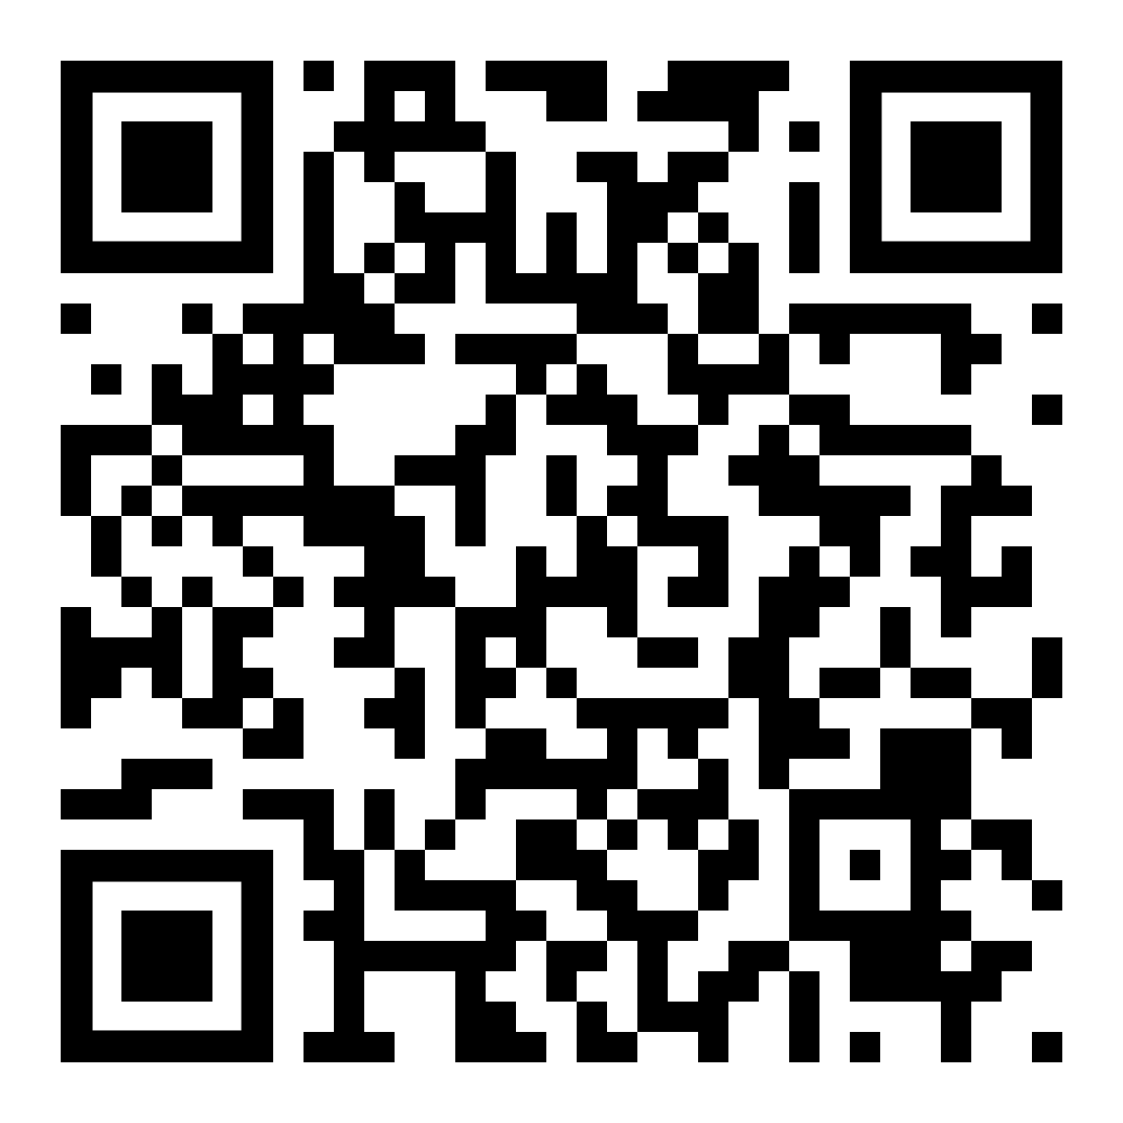
Botanical Research Institute of Texas (BRIT) makes their digital collections available via Darwin Core Archive URLs.
And, URLs are prone to link rot and content drift*.
* Elliott et al. 2020 doi:10.1016/j.ecoinf.2020.101132

Slide 11
Version Tracking Workflow*
step 1 of 3: Capture the BRIT DwC-A URLs.
echo\
https://sernecportal.org/portal/content/dwca/VDB_DwC-A.zip\
https://sernecportal.org/portal/content/dwca/NLU_DwC-A.zip\
https://portal.torcherbaria.org/portal/content/dwca/BRIT_DwC-A.zip\
| tr ' ' '\n'\
| preston track\
| grep hasVersion\
| preston cat\
[...]

Slide 12
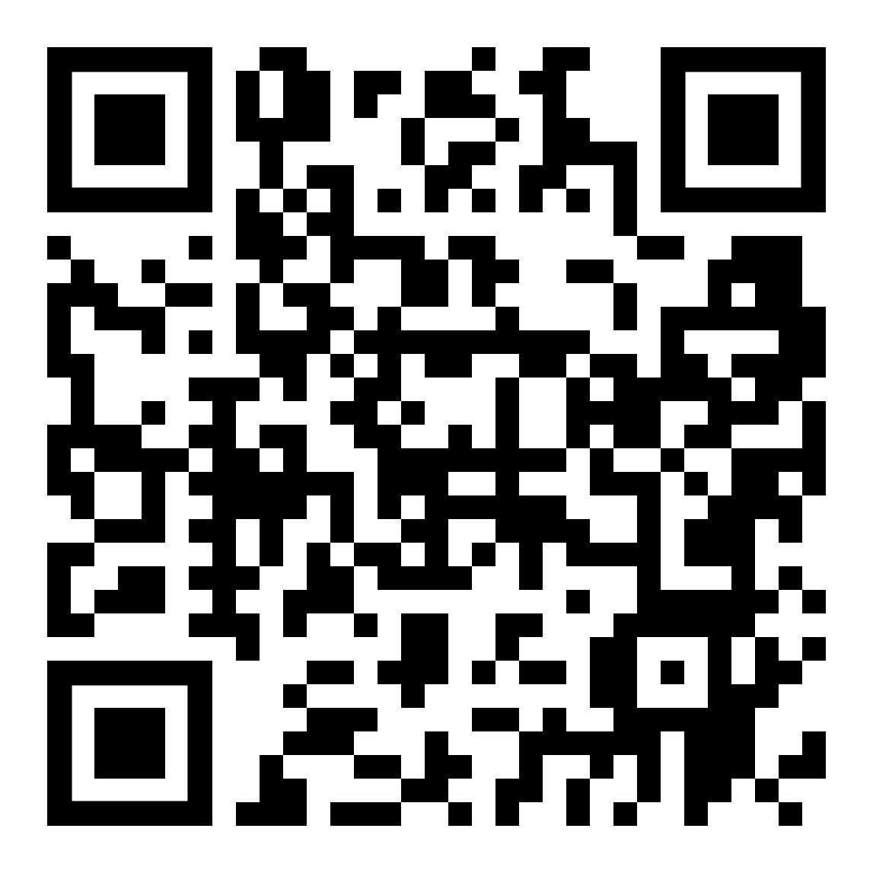
Version Tracking Workflow*
step 2 of 3: Version DwC-As and their images
[...]
| xargs preston track\
| preston dwc-stream\
| ./list-image-urls.sh\
| xargs -L25 preston track
* see https://github.com/bio-guoda/preston-brit-2022 for more info

Slide 13
Version Tracking Workflow*
step 3 of 3: Wait for workflow to complete.
⏲️

Slide 14
Version Tracking Workflow*
step 3 of 3: Wait for workflow to complete.
⏲️.
Two Weeks

Slide 15
Version Tracking Workflow*
step 3 of 3: Wait for workflow to complete.
⏲️..
Four Weeks

Slide 16
Version Tracking Workflow*
step 3 of 3: Wait for workflow to complete.
⏲️.. .
Six Weeks

Slide 17
Version Tracking Workflow*
step 3 of 3: Wait two months for workflow to complete.
⏲️.. ..💾
Eight Weeks

Slide 18
(Verifiable) BRIT Stats @ 2022-06-06
preston history\
--remote https://linker.bio\
--anchor hash://sha256/76d40abccfc71bc2cdaf4ea4a6003b9ac49123b27abe9f0d81e233299baf5e94\
| tail -n1 | preston cat | grep zip\
| preston dwc-stream --remote https://linker.bio\
| jq -c 'select(.["http://rs.tdwg.org/dwc/terms/basisOfRecord"] == "PreservedSpecimen")'\
| wc -l
990632 (~1.0M preserved specimen records)*
preston history\
--remote https://linker.bio\
--anchor hash://sha256/76d40abccfc71bc2cdaf4ea4a6003b9ac49123b27abe9f0d81e233299baf5e94\
| tail -n1 | preston cat | grep zip\
| preston dwc-stream --remote https://linker.bio\
| jq -c 'select(.["http://purl.org/dc/terms/type"] == "StillImage")'\
| wc -l
826195 (~0.8M still image records)*
* as of 2023-05-30, same URLs yielded 1155419 (~1.2M) preserved specimen records and 923363 (~0.9M) still image records
* see https://github.com/bio-guoda/preston-brit-2022 for more info

Slide 19
1. How do I efficiently access, and verify, hundreds of thousands of images?
2. How do I cite a version of a large image corpus?

Slide 20
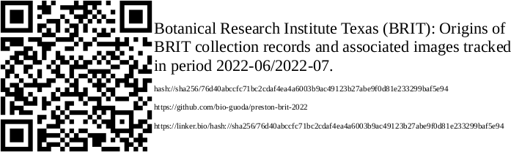
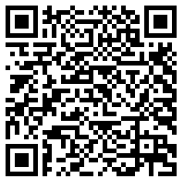
Cite BRIT Image Corpus
preston qrcode\
--remote https://linker.bio\
--anchor hash://sha256/76d40abccfc71bc2cdaf4ea4a6003b9ac49123b27abe9f0d81e233299baf5e94\
> qrcode.png
Elliott et al. 2023 Sci Data doi:10.1038/s41597-023-02230-y

Slide 21
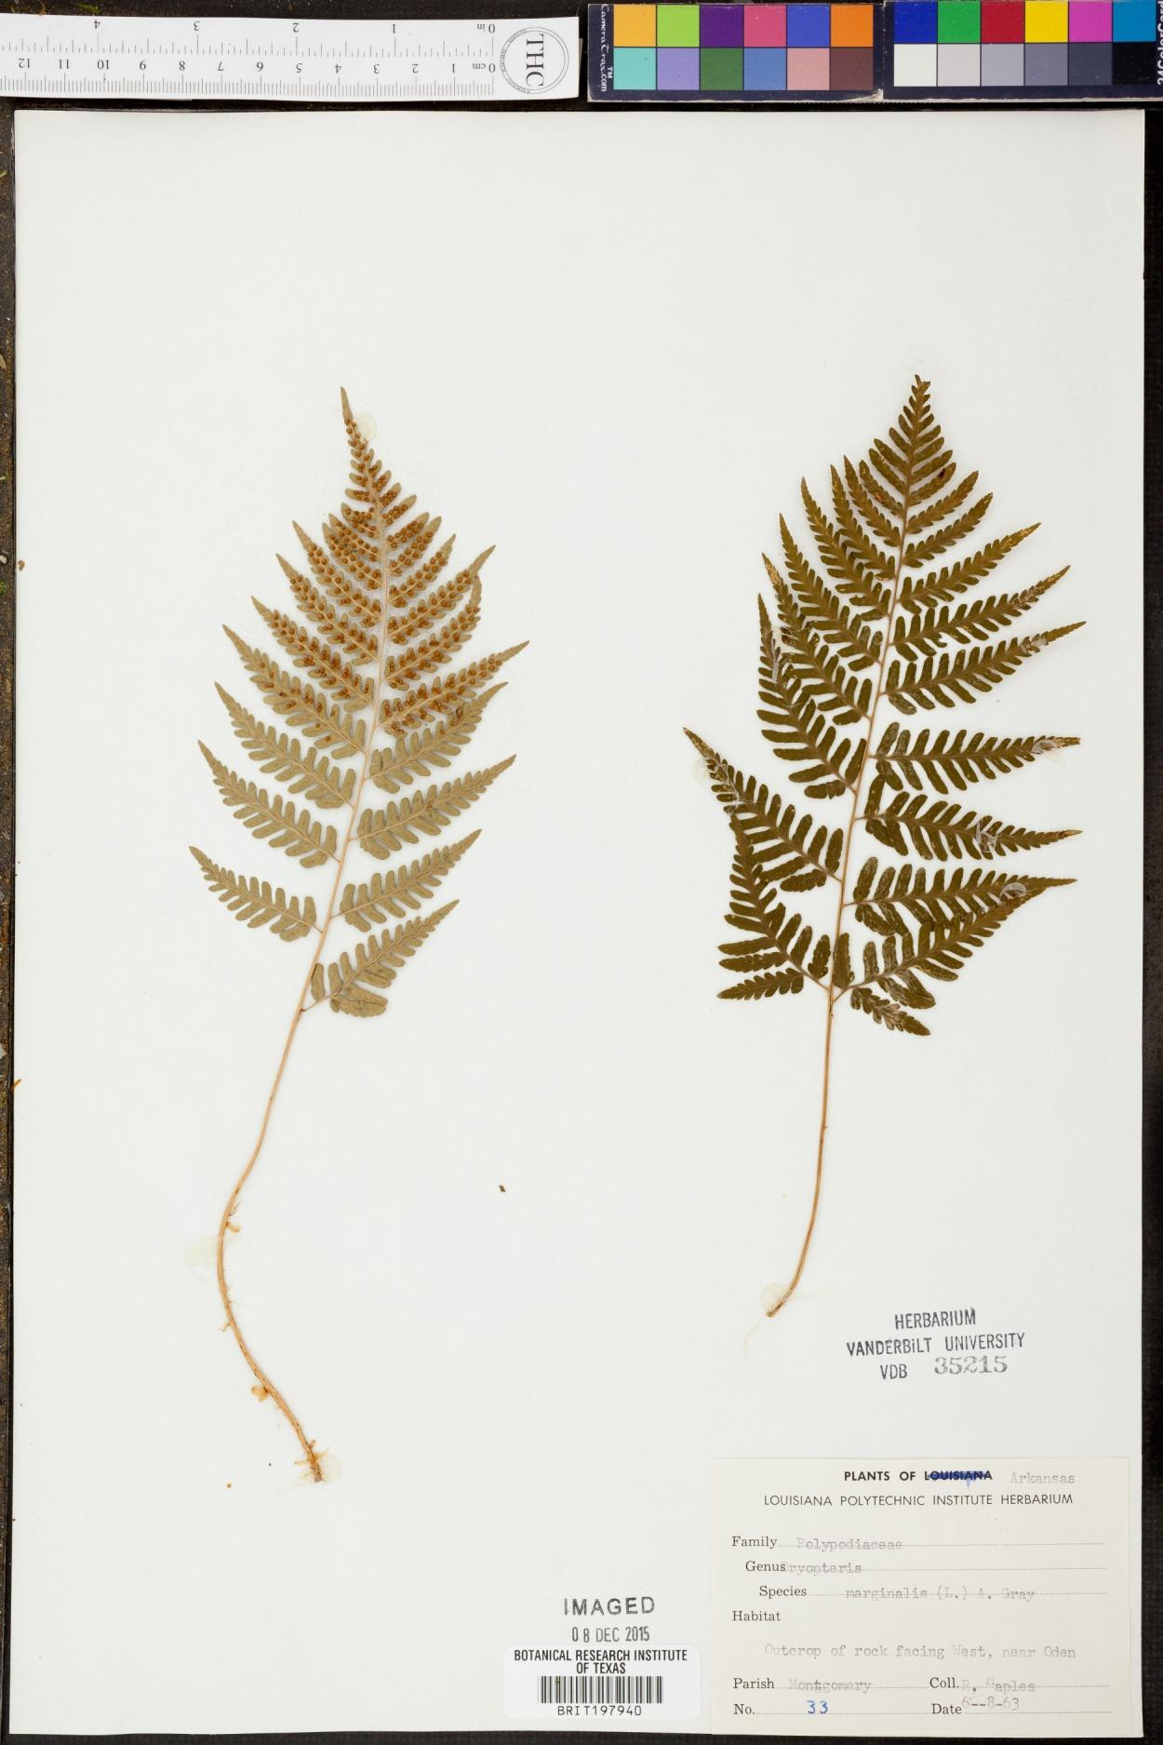
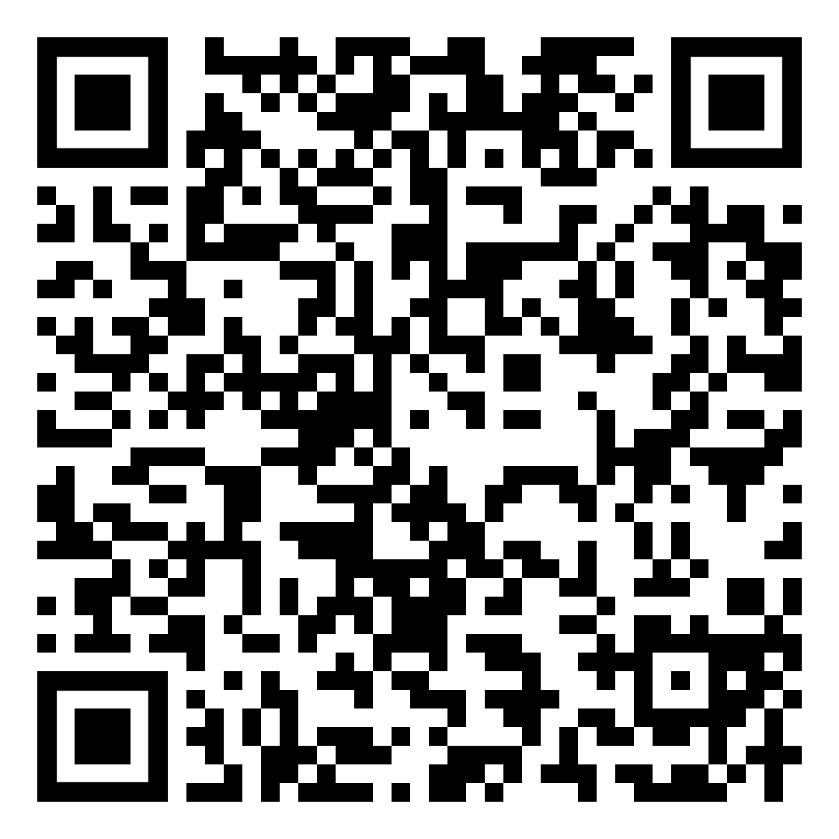
Cite Individual Image
preston head --anchor\
hash://sha256/76d40abccfc71bc2cdaf4ea4a6003b9ac49123b27abe9f0d81e233299baf5e94\
| preston cat\
| tail -n1 | grep -oE 'hash[^>]*'
hash://sha256/baefd416a0122a254dd68b97e41ada80764f5a0fcb13d626429b3e08403a4bb2

Slide 22
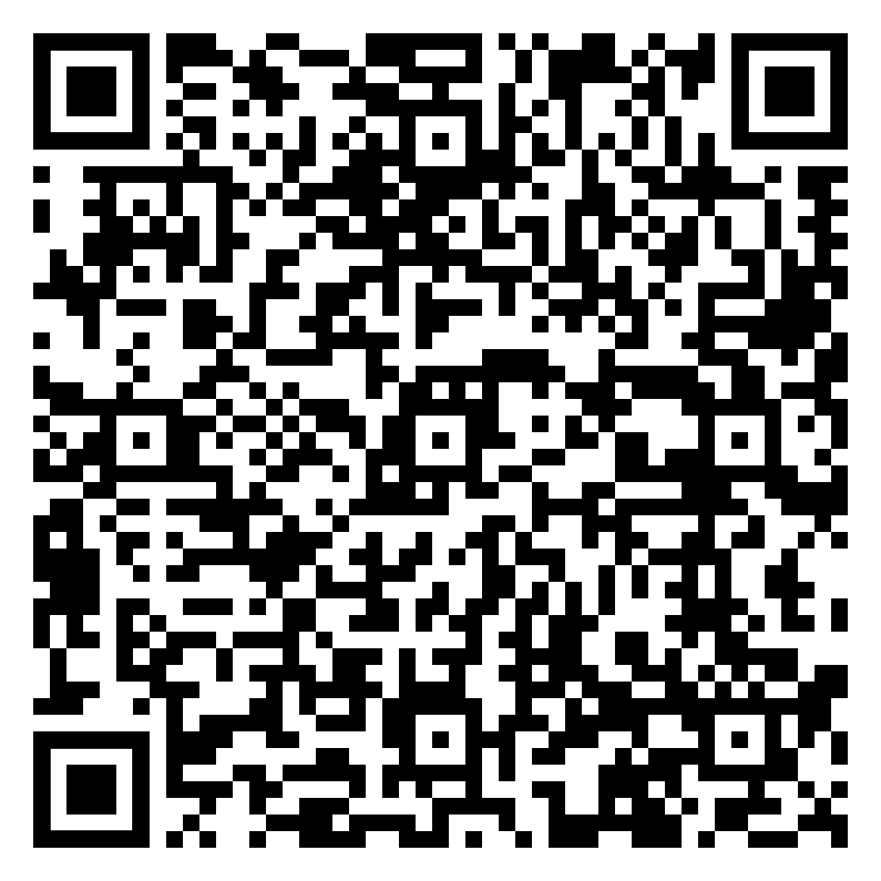
Cite Individual Image Metadata
preston history\
--remote https://linker.bio\
--anchor hash://sha256/76d40abccfc71bc2cdaf4ea4a6003b9ac49123b27abe9f0d81e233299baf5e94\
| tail -n1 | preston cat | grep zip\
| preston dwc-stream --remote https://linker.bio\
| grep "00-bGGY6Kb3fK4hTT6CPQSp5P/resize:1250/format:jpeg"\
| jq --raw-output '.["http://www.w3.org/ns/prov#wasDerivedFrom"]'
line:zip:hash://sha256/371984ca4566b7b6bc760d0766873b469e12af2d87ce9218f1da888a1b4c3948!/multimedia.csv!/L134160
curl 'https://linker.bio/line:zip:hash://sha256/371984ca4566b7b6bc760d0766873b469e12af2d87ce9218f1da888a1b4c3948!/multimedia.csv!/L1,L134160'\
| mlr --icsv --oxtab cat
coreid 17134933
[...]
Owner Vanderbilt University Herbarium (VDB)
[...]
UsageTerms CC BY-NC (Attribution-Non-Commercial)
WebStatement http://creativecommons.org/licenses/by-nc/3.0/
[...]
providerManagedID urn:uuid:bd1740da-ea8c-489f-b3c4-8f0a7b87affd
MetadataDate 2018-01-02 12:35:50
format image/jpeg
associatedSpecimenReference https://sernecportal[...]?occid=17134933
type StillImage

Slide 23
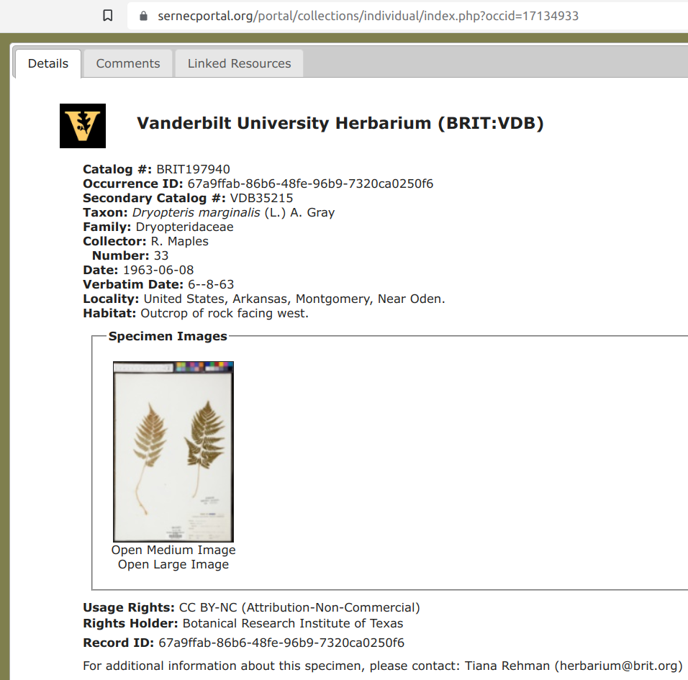
Cite Individual Image Metadata
preston history\
--remote https://linker.bio\
--anchor hash://sha256/76d40abccfc71bc2cdaf4ea4a6003b9ac49123b27abe9f0d81e233299baf5e94\
| tail -n1 | preston cat | grep zip\
| preston dwc-stream --remote https://linker.bio\
| grep "00-bGGY6Kb3fK4hTT6CPQSp5P/resize:1250/format:jpeg"\
| jq --raw-output '.["http://www.w3.org/ns/prov#wasDerivedFrom"]'
line:zip:hash://sha256/371984ca4566b7b6bc760d0766873b469e12af2d87ce9218f1da888a1b4c3948!/multimedia.csv!/L134160
curl 'https://linker.bio/line:zip:hash://sha256/371984ca4566b7b6bc760d0766873b469e12af2d87ce9218f1da888a1b4c3948!/multimedia.csv!/L1,L134160'\
| mlr --icsv --oxtab cat
coreid 17134933
[...]
Owner Vanderbilt University Herbarium (VDB)
[...]
UsageTerms CC BY-NC (Attribution-Non-Commercial)
WebStatement http://creativecommons.org/licenses/by-nc/3.0/
[...]
providerManagedID urn:uuid:bd1740da-ea8c-489f-b3c4-8f0a7b87affd
MetadataDate 2018-01-02 12:35:50
format image/jpeg
associatedSpecimenReference https://sernecportal[...]?occid=17134933
type StillImage

Slide 24
How to transfer our
verifiable BRIT image corpus using an openly accessible reliable transportation infrastructure?

Slide 25
Transfer Rates
Method | Duration | Rate (image/s) | Locality
Web API | 2 months | 0.2 | US > Germany
rsync via internet* | about a day | 10 | Germany > MN 55406
rsync via USB 3.0* | about an hour | 250 | Minnesotan kitchen table
US Postal Service* | 3 days** | 3 | MN 55406 > TX 76107
* Signed corpus can be independently verified after transfer.
** Transfer included a weekend.

Slide 26
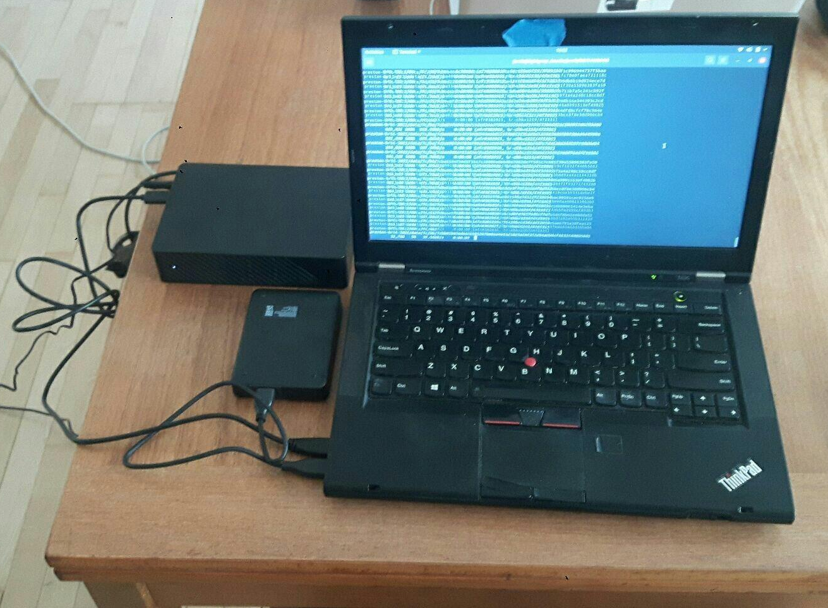
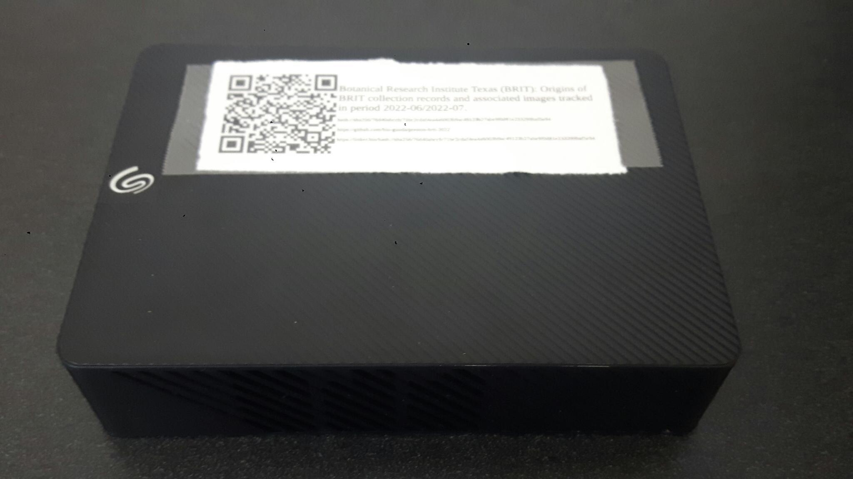
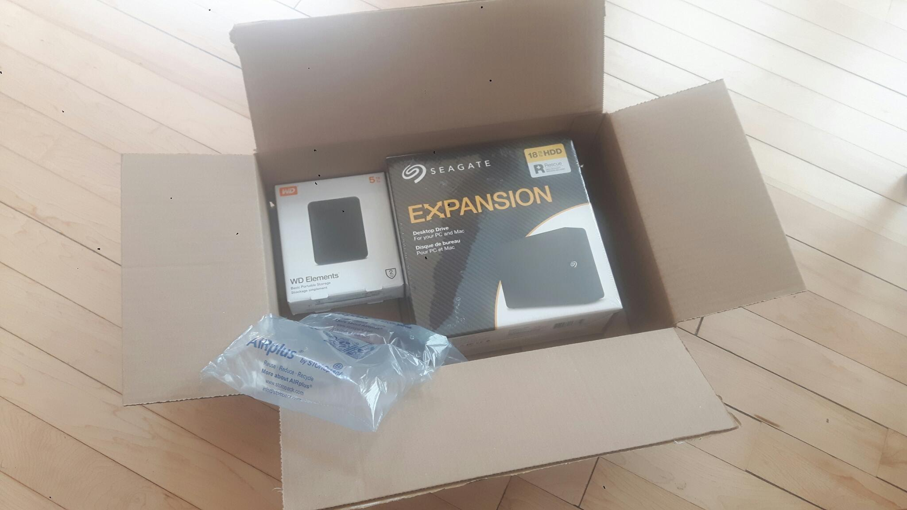
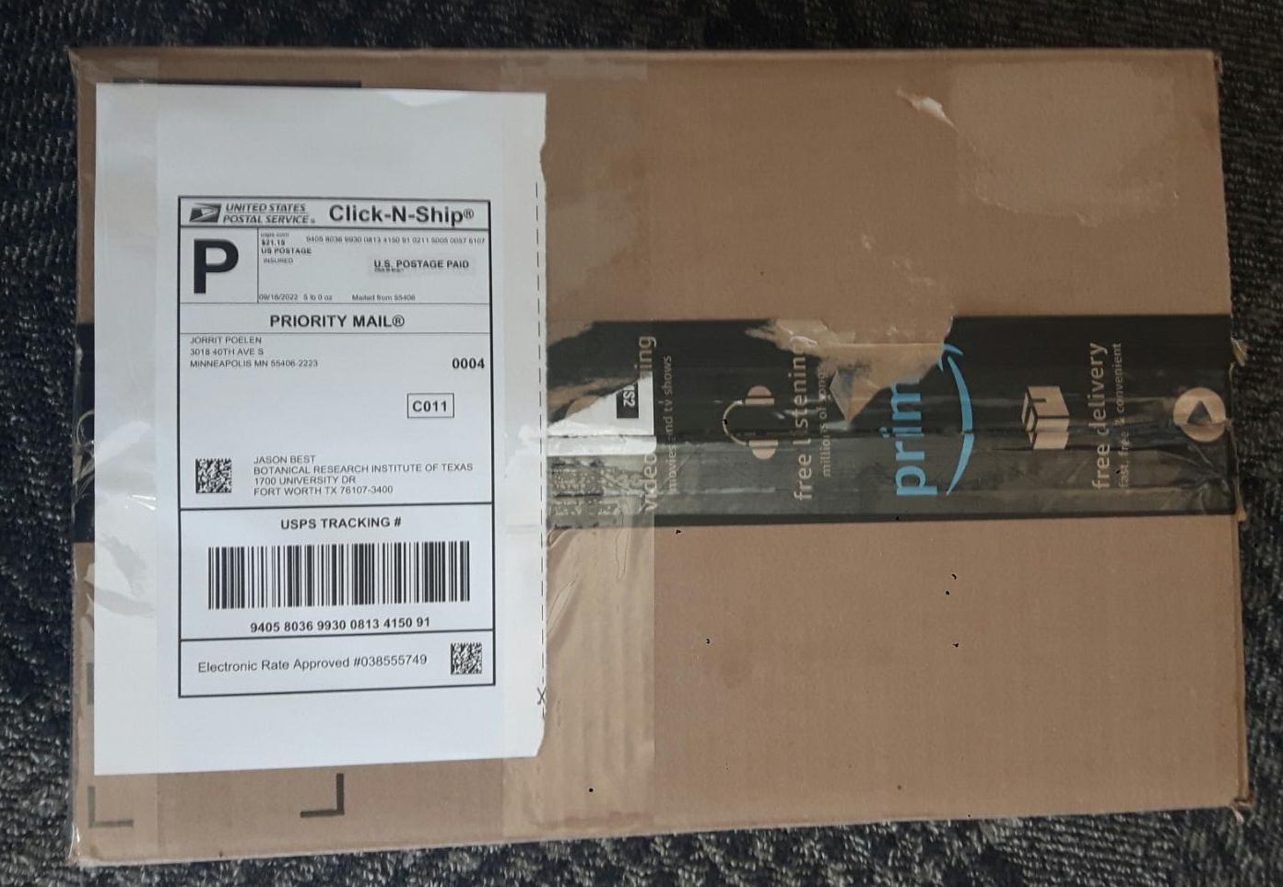
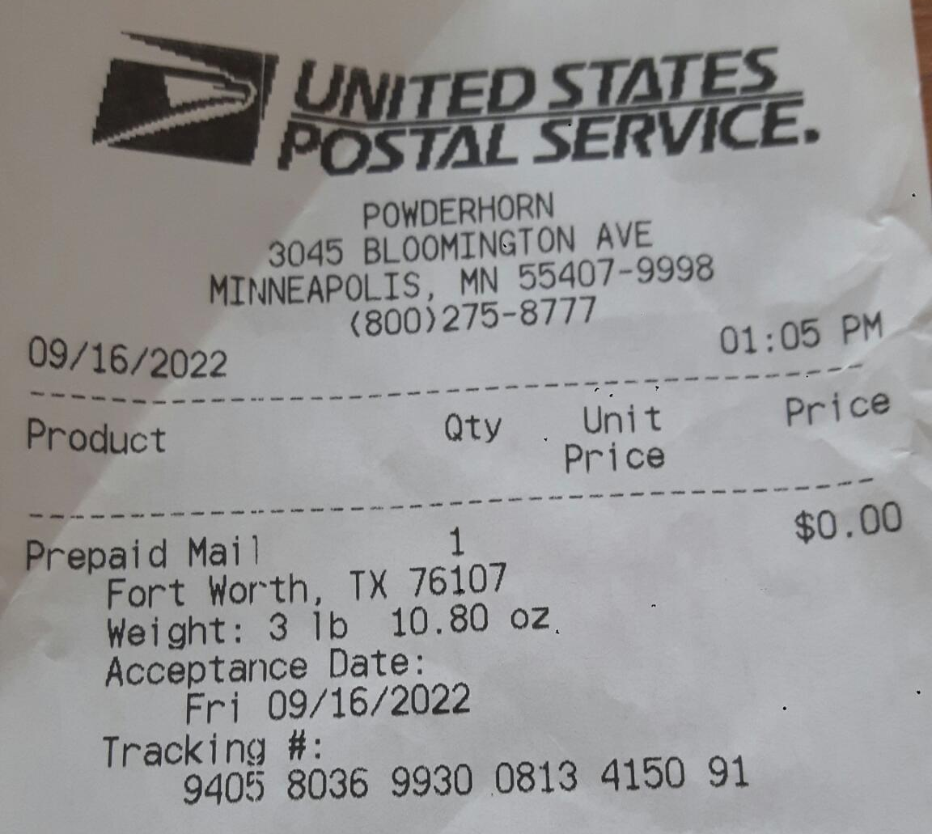
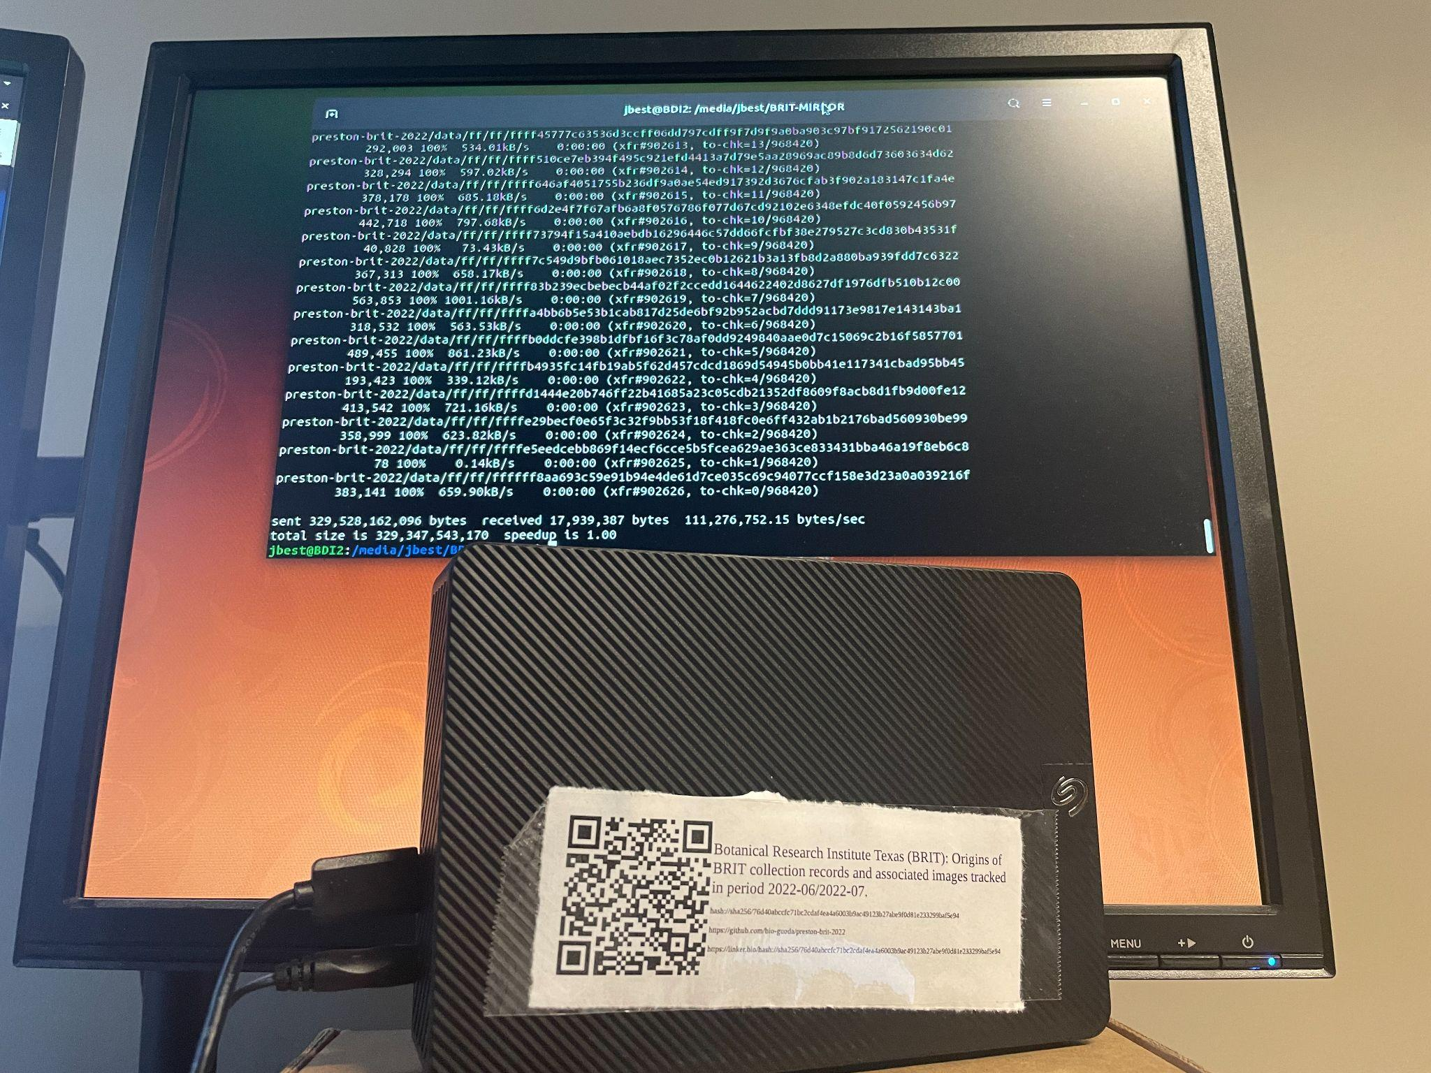
Jorrit receives storage media from Jason.

Slide 27
Jorrit transfers BRIT corpus onto storage media.

Slide 28
Jorrit labels the storage media.

Slide 29
Jorrit boxes storage media for shipping.

Slide 30
USPS acknowledges receipt.

Slide 31
Jason copies verified corpus onto BRIT servers.

Slide 32
Incentivized Goal
Create 💾 of [...] three primary and distinct plant collections [...] to get ☕ and 🍪.

Slide 33
Incentivized Goal
Create 💾 of [...] three primary and distinct plant collections [...] to get ☕ and 🍪.
✅

Slide 34
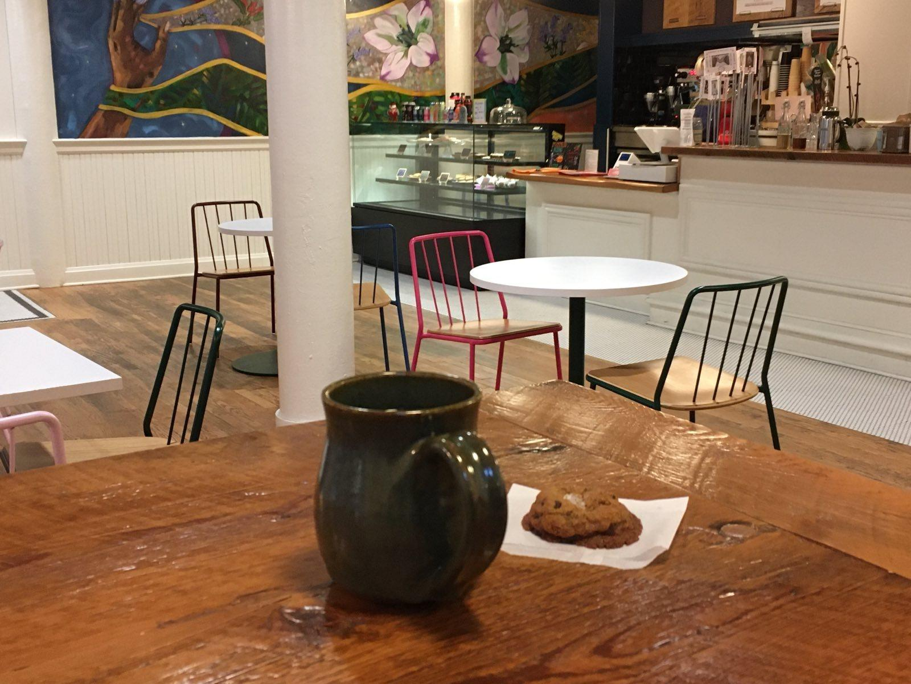
coffee
cookie
order #199255707 / 2022-10-07T08:15-05:00 @ Hark! Cafe, Minneapolis, MN

Slide 35
1. How do I efficiently access, and verify, hundreds of thousands of images? Version, package, and sign.
2. How do I cite a version of a large image corpus? With a data package signature.

Slide 36
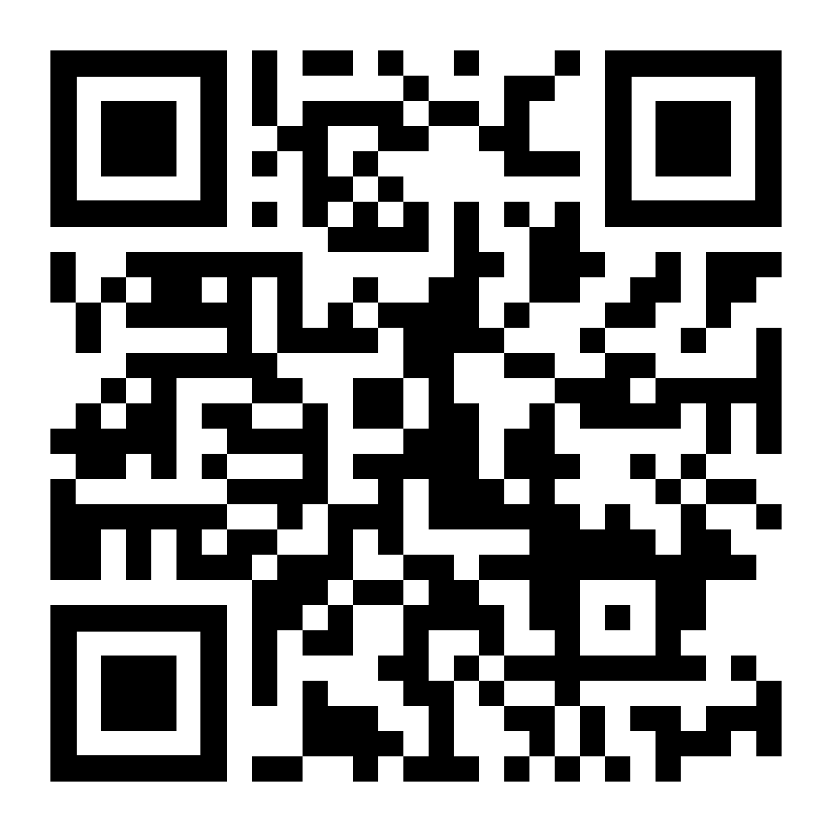
Methods
MJ Elliott, JH Poelen, JAB Fortes (2020). Toward Reliable Biodiversity Dataset References. Ecological Informatics. https://doi.org/10.1016/j.ecoinf.2020.101132
MJ Elliott, JH Poelen, JAB Fortes (2023). Signing data citations enables data verification and citation persistence. Scientific Data. https://doi.org/10.1038/s41597-023-02230-y

Slide 37
1. How do you efficiently access, and verify, hundreds of thousands of images?
2. How do you cite a version of a large image corpus?

Slide 38
Funding / Acknowledgments
Jason Best, USPS, Hark! Cafe in Minneapolis, NSF OAC 1839201 and iDigBio for facilitating discussions on biodiversity informatics.

