Slide 1
Mobilizing Bat1K
through versioned, machine readable and automatically generated data publications. Jorrit Poelen (UC Santa Barbara Cheadle Center, Ronin Institute, GloBI)

Slide 2
Guiding Questions
How to keep track of Bat1K data corpus?
How to cite specific versions of the Bat1K data corpora?
How to share specific versions of the Bat1K data corpora?

Slide 3
Reuse, reuse, reuse.
Darwin Core Archive -> GBIF, GloBI
Taxonomic Alignment Tools ¹ -> align with specific versions MDD, NCBI Taxonomy
Signed Data Citations ²

Slide 4
At NASBR 2024
Jorrit -> Ariadna -> Sonja -> Meike -> Bat1K data

Slide 5
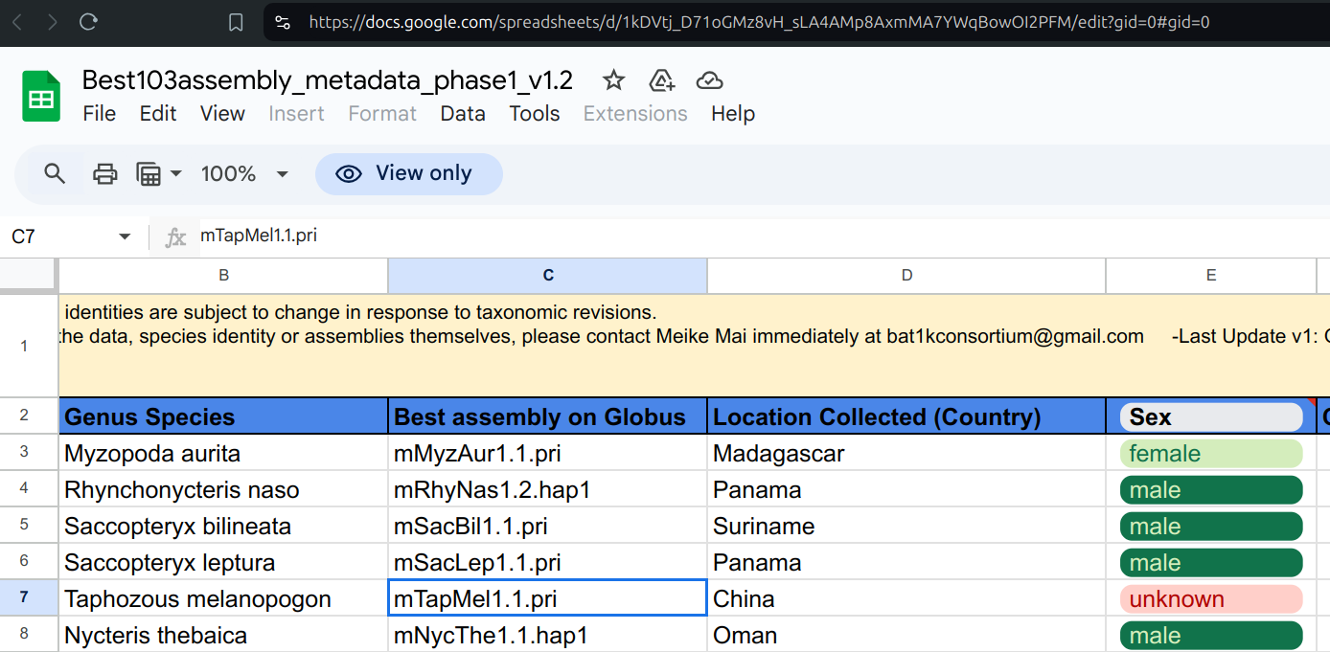
Google Sheet
Best103assembly_metadata_phase1_v1.2 accessed at https://docs.google.com/spreadsheets/d/1kDVtj_D71oGMz8vH_sLA4AMp8AxmMA7YWqBowOI2PFM/edit?gid=0#gid=0 on 2024-10-27.

Slide 6
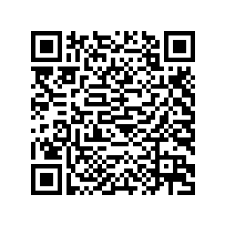
Google Sheet -> Versioned, Machine Readable Data Package
preston track\ --message "Bat1K Genome Index"\ https://docs.google.com/spreadsheets/d/1kDVtj_D71oGMz8vH_sLA4AMp8AxmMA7YWqBowOI2PFM/edit?gid=0#gid=0\ | sha256sum
Signature of Bat1K data package: hash://sha256/710cccc378e6d41e7d2e214bcaf08af76886d9df6e389dc0177c1460fb5c3999 .

Slide 7
Deriving bat1k.tsv
preston cat\ --remote https://linker.bio,https://softwareheritage.org\ hash://sha256/710cccc378e6d41e7d2e214bcaf08af76886d9df6e389dc0177c1460fb5c3999\ | grep hasVersion\ | grep tsv\ | preston cat\ --remote https://linker.bio,https://softwareheritage.org\ | tail -n+2\ | tee bat1k.tsv

Slide 8
Taxonomic Alignment through Nomer: Find (mis-)Alignments
Using Nomer ³
cat bat1k.tsv\ | nomer append\ --properties <(echo 'nomer.schema.input=[{"column":0,"type":"externalId"},{"column": 1,"type":"name"}]') mdd\ | grep -v HAS_ACCEPTED_NAME\ | cut -f2\ | tail -n+2
Lasiurus ega Hipposideros swinhoii

Slide 9
Next Steps
Versioned Bat1K -> DwC-A - Add meta.xml and eml.xml to describe schema according to Darwin Core Archive to enable:
Indexing by GBIF as bat occurrences through vouchered specimen/genome
Indexing by GloBI as bat<>human interactions evidenced by vouchered specimen/genomes to enable automated data reviews ⁴

Slide 10
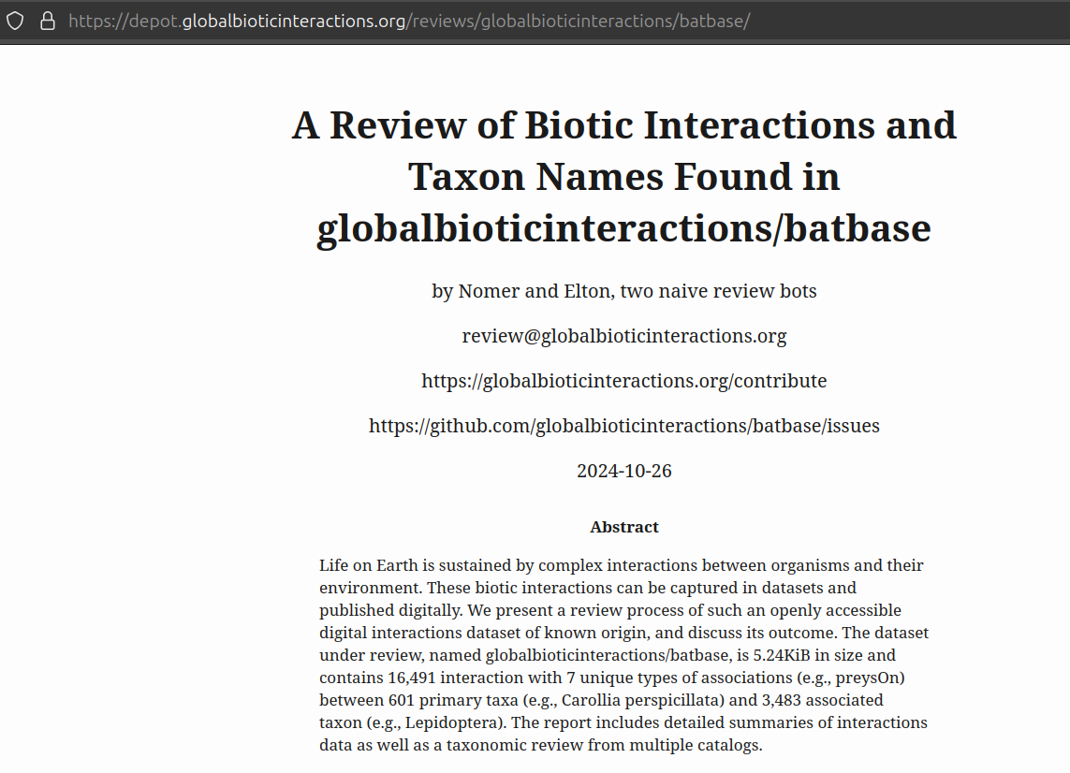
Take Aways
track, version and package original data
implement automated data review workflow
implement automated data product workflow
Geiselman, Cullen K. & Sarah Younger. 2020. Bat Eco-Interactions Database. www.batbase.org https://github.com/globalbioticinteractions/batbase/archive/9c65cfeee1a054f9db8cd8bf6892017fd1b3c840.zip 2024-10-25T22:39:59.352Z 6755e9ff065849a8a7472858e98b62458fab93e4c20006f823e844a3ee77f5f2 see also https://depot.globalbioticinteractions.org/reviews/globalbioticinteractions/batbase/

Slide 11
Notes
1. https://github.com/globalbioticinteractions/nomer
2. Elliott M.J., Poelen, J.H. & Fortes, J.A.B. (2023) Signing data citations enables data verification and citation persistence. Sci Data. https://doi.org/10.1038/s41597-023-02230-y hash://sha256/f849c870565f608899f183ca261365dce9c9f1c5441b1c779e0db49df9c2a19d
3. Poelen, J. H. (ed . ) . (2024). Nomer Corpus of Taxonomic Resources hash://sha256/b60c0d25a16ae77b24305782017b1a270b79b5d1746f832650f2027ba536e276 hash://md5/17f1363a277ee0e4ecaf1b91c665e47e (0.27) [Data set]. Zenodo. https://doi.org/10.5281/zenodo.12695629
4. Geiselman, Cullen K. & Sarah Younger. 2020. Bat Eco-Interactions Database. www.batbase.org https://github.com/globalbioticinteractions/batbase/archive/9c65cfeee1a054f9db8cd8bf6892017fd1b3c840.zip 2024-10-25T22:39:59.352Z 6755e9ff065849a8a7472858e98b62458fab93e4c20006f823e844a3ee77f5f2 see also https://depot.globalbioticinteractions.org/reviews/globalbioticinteractions/batbase/

