Slide 1
Unleashing Ollscoil na Gaillimhe / University of Galway’s Research Data Into the Future
Jorrit Poelen https://jhpoelen.nl

Slide 2
Guiding Questions
How do you cite your research data?
How do you lookup cited data now?
How do you lookup cited research data 40 years from now?

Slide 3
Research Data In the Wild
While walking the land, I am the pen on the paper; while drawing this map, my pen is myself walking the land. I wanted to short circuit the polarities of objectivity and subjectivity, and try keep faith with reality. – Tim Robinson

Slide 4
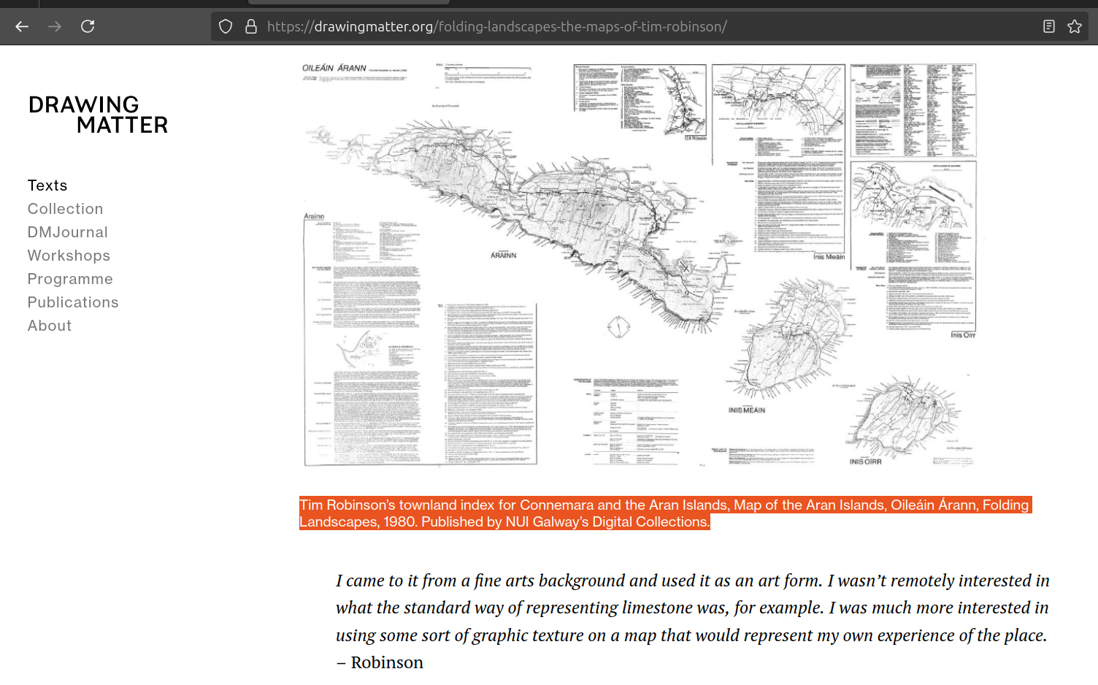
There’s a Map on the Internet. . .
Retrieved from https://drawingmatter.org/folding-landscapes-the-maps-of-tim-robinson/ on 2025-03-02.

Slide 5
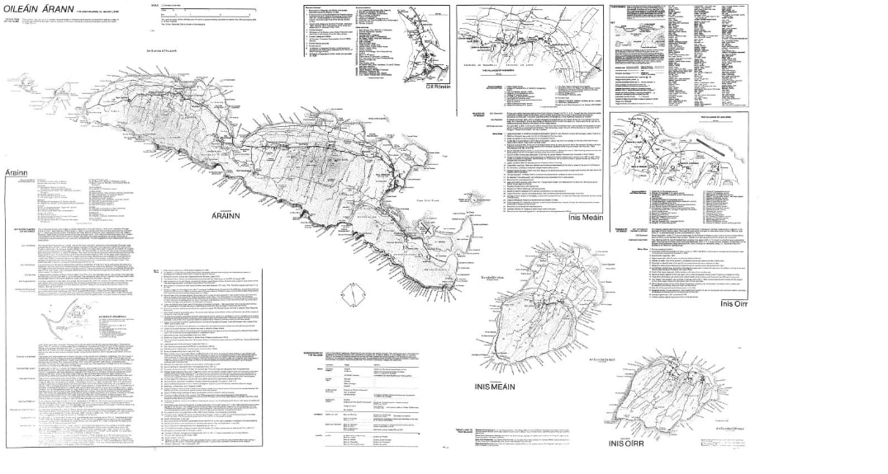
There’s a Map on the Internet. . .
Tim Robinson’s townland index for Connemara and the Aran Islands, Detail, Map of the Aran Islands, Oileáin Árann, Folding Landscapes, 1980. Published by NUI Galway’s Digital Collections.

Slide 6
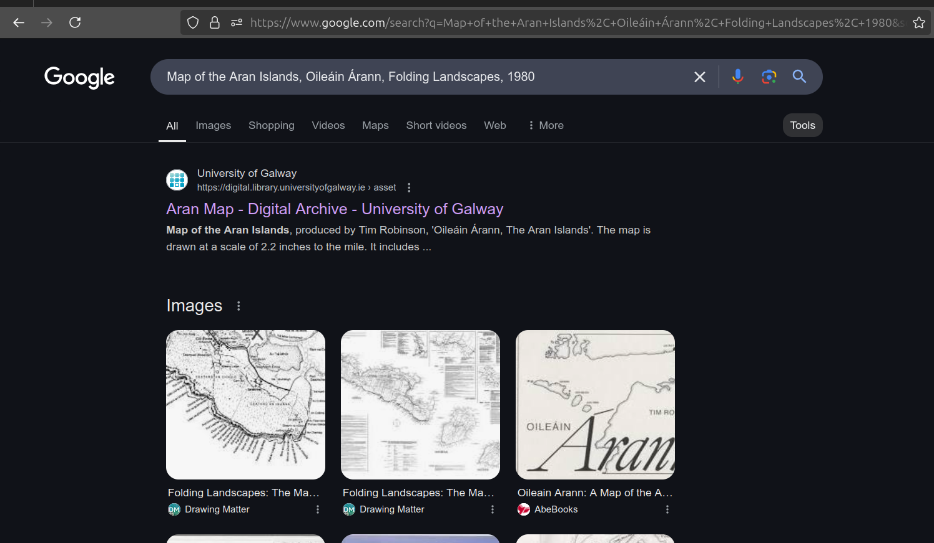
But, Where is the Original?
Internet search results for “Tim Robinson’s townland index for Connemara and the Aran Islands, Detail, Map of the Aran Islands, Oileáin Árann, Folding Landscapes, 1980.” on 2025-03-02

Slide 7
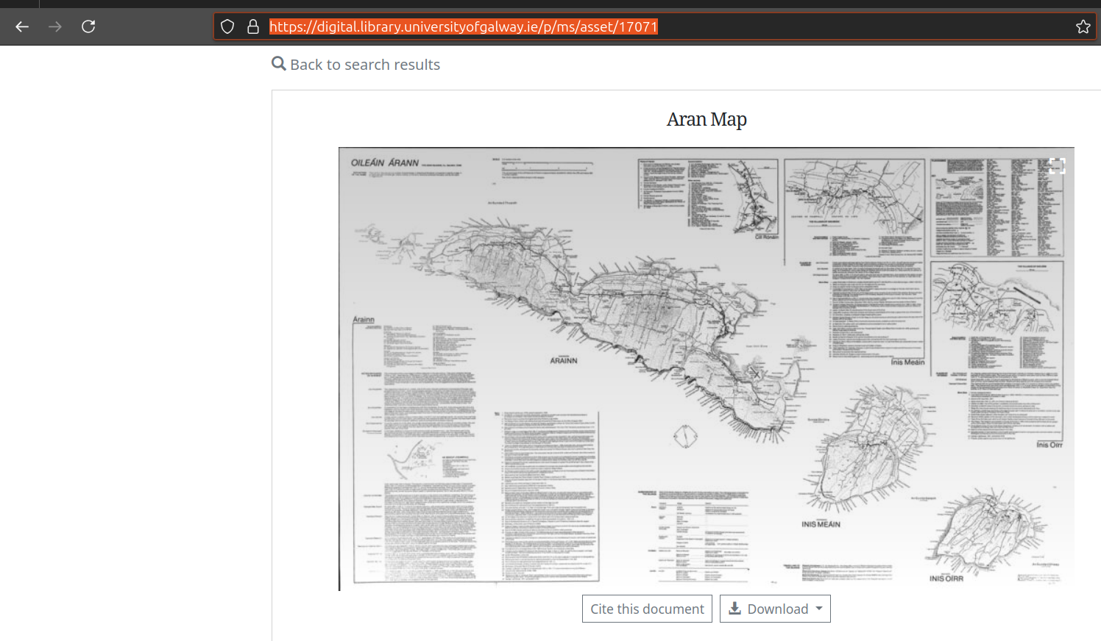
This One?
webpage at https://digital.library.universityofgalway.ie/p/ms/asset/17071 accessed on 2025-03-02

Slide 8
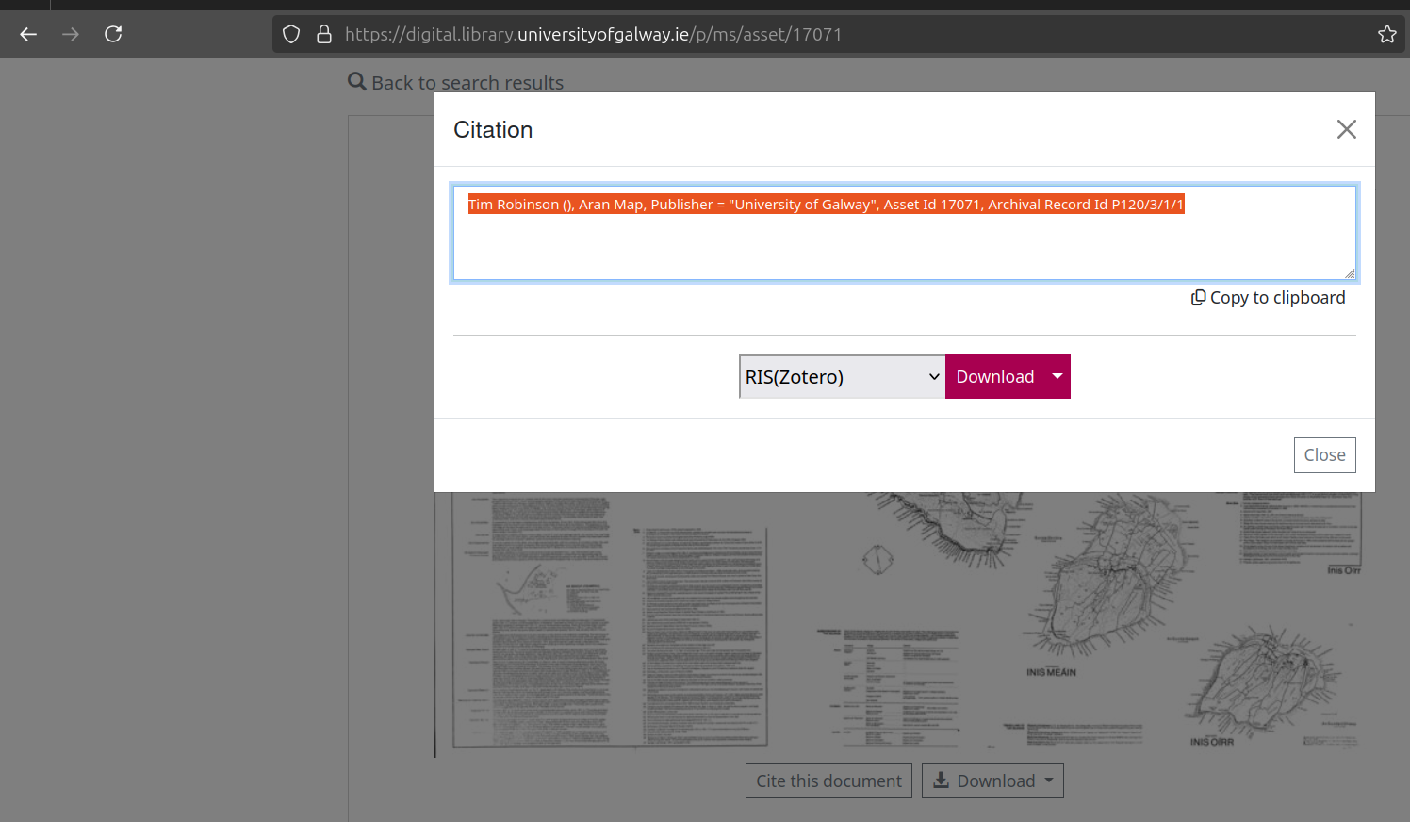
With Preferred Citation
Preferred citation - Tim Robinson (), Aran Map, Publisher = “University of Galway”, Asset Id 17071, Archival Record Id P120/3/1/1

Slide 9
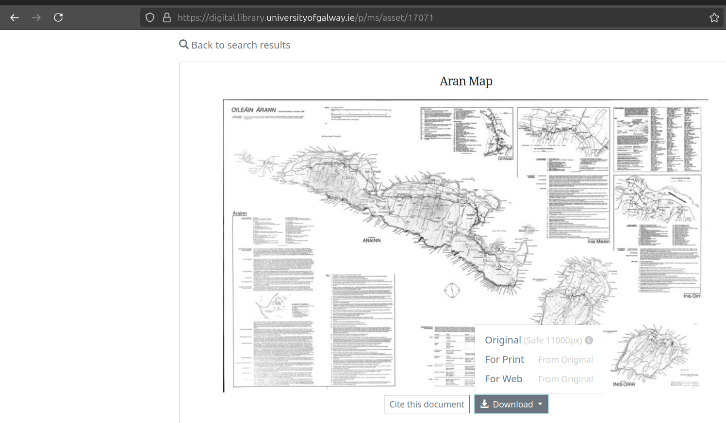
But . . . Which One are We Citing?
Variants of Robinson’s Aran Map: Print, Web, Original

Slide 10
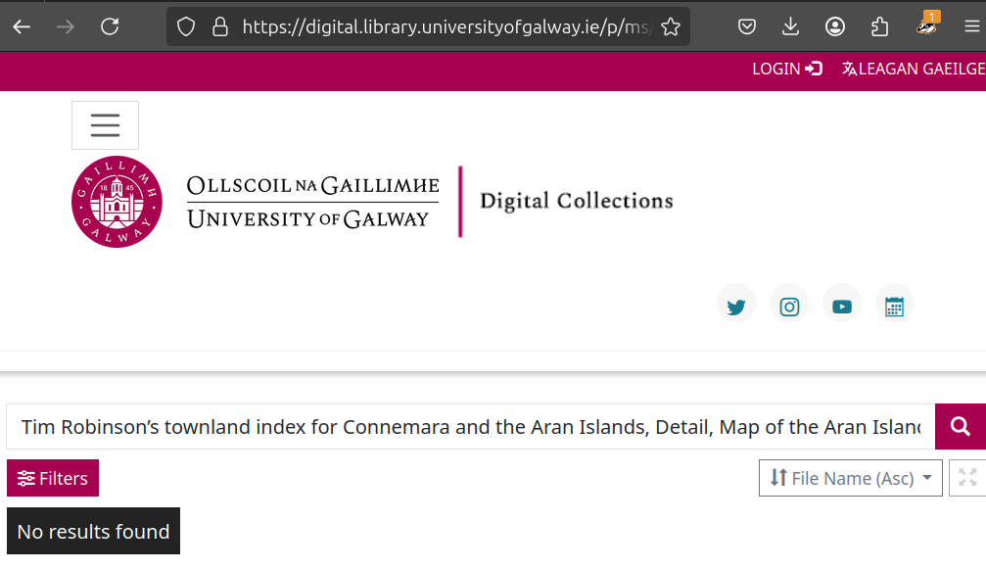
Trying NUI Galway’s Digital Library …
https://digital.library.universityofgalway.ie search results for “Tim Robinson’s townland index for Connemara and the Aran Islands, Detail, Map of the Aran Islands, Oileáin Árann, Folding Landscapes, 1980.” on 2025-03-02

Slide 11
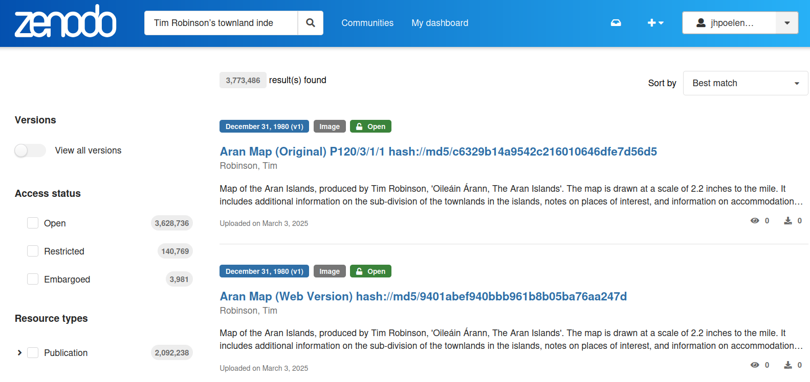
Trying Zenodo . . .
Zenodo search for “Tim Robinson’s townland index for Connemara and the Aran Islands, Detail, Map of the Aran Islands, Oileáin Árann, Folding Landscapes, 1980.”

Slide 12
How To Retrieve Robinson’s Map Today?
turn on the internet
open a web browser
search the internet for keywords
and rely on a delicate and complex socio-technical network
inspect result pages
use mouse to click on a link that looks like Robinson’s map
download image and trust its authenticity

Slide 13
How To Retrieve Robinson’s Map 40 Years From Now?
turn on the internet (Still there?)
open a web browser (Grandma, what is a browser?)
search the internet for keywords (Internet search? Huh?)
and rely on a delicate and complex socio-technical network
inspect result pages
use mouse to click on a link that looks like Robinson’s map
download image and trust its authenticity

Slide 14
How To Retrieve Robinson’s Map 40 Years From Now?
turn on the internet
open a web browser
search the internet for keywords
and rely on a delicate and complex socio-technical network
inspect result pages
use mouse to click on a link that looks like Robinson’s map
download image and trust its authenticity
Likely will not work due to intricate network of dependencies.

Slide 15
How To Retrieve Robinson’s 40 Years From Now?
My (Crazy?) Proposal: Sign the citation ¹
Robinson, T. (1980). Aran Map (Print Version) P120/3/1/1 hash://md5/9027bb8d372e4ffb9fabe74cab6a3434. University of Galway. https://doi.org/10.5281/zenodo.14958167

Slide 16
How To Retrieve Robinson’s Map 40 Years From Now?
… by searching the universe (in, and beyond, the internet) for the content with the unique fingerprint hash://md5/9027bb8d372e4ffb9fabe74cab6a3434 .
… in addition to searching by keywords

Slide 17
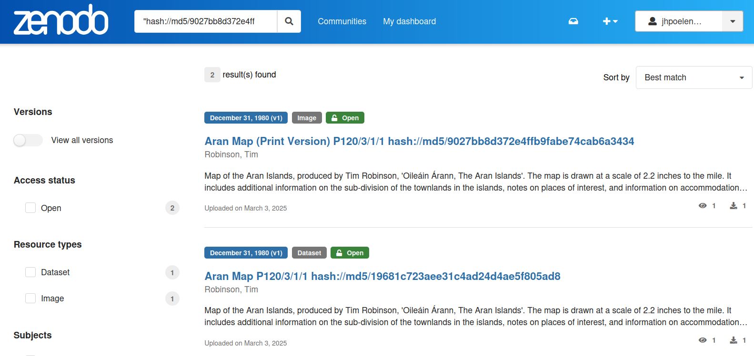
Zenodo Search, Take 2.
Searching Zenodo for “hash://md5/9027bb8d372e4ffb9fabe74cab6a3434” on 2025-03-03

Slide 18
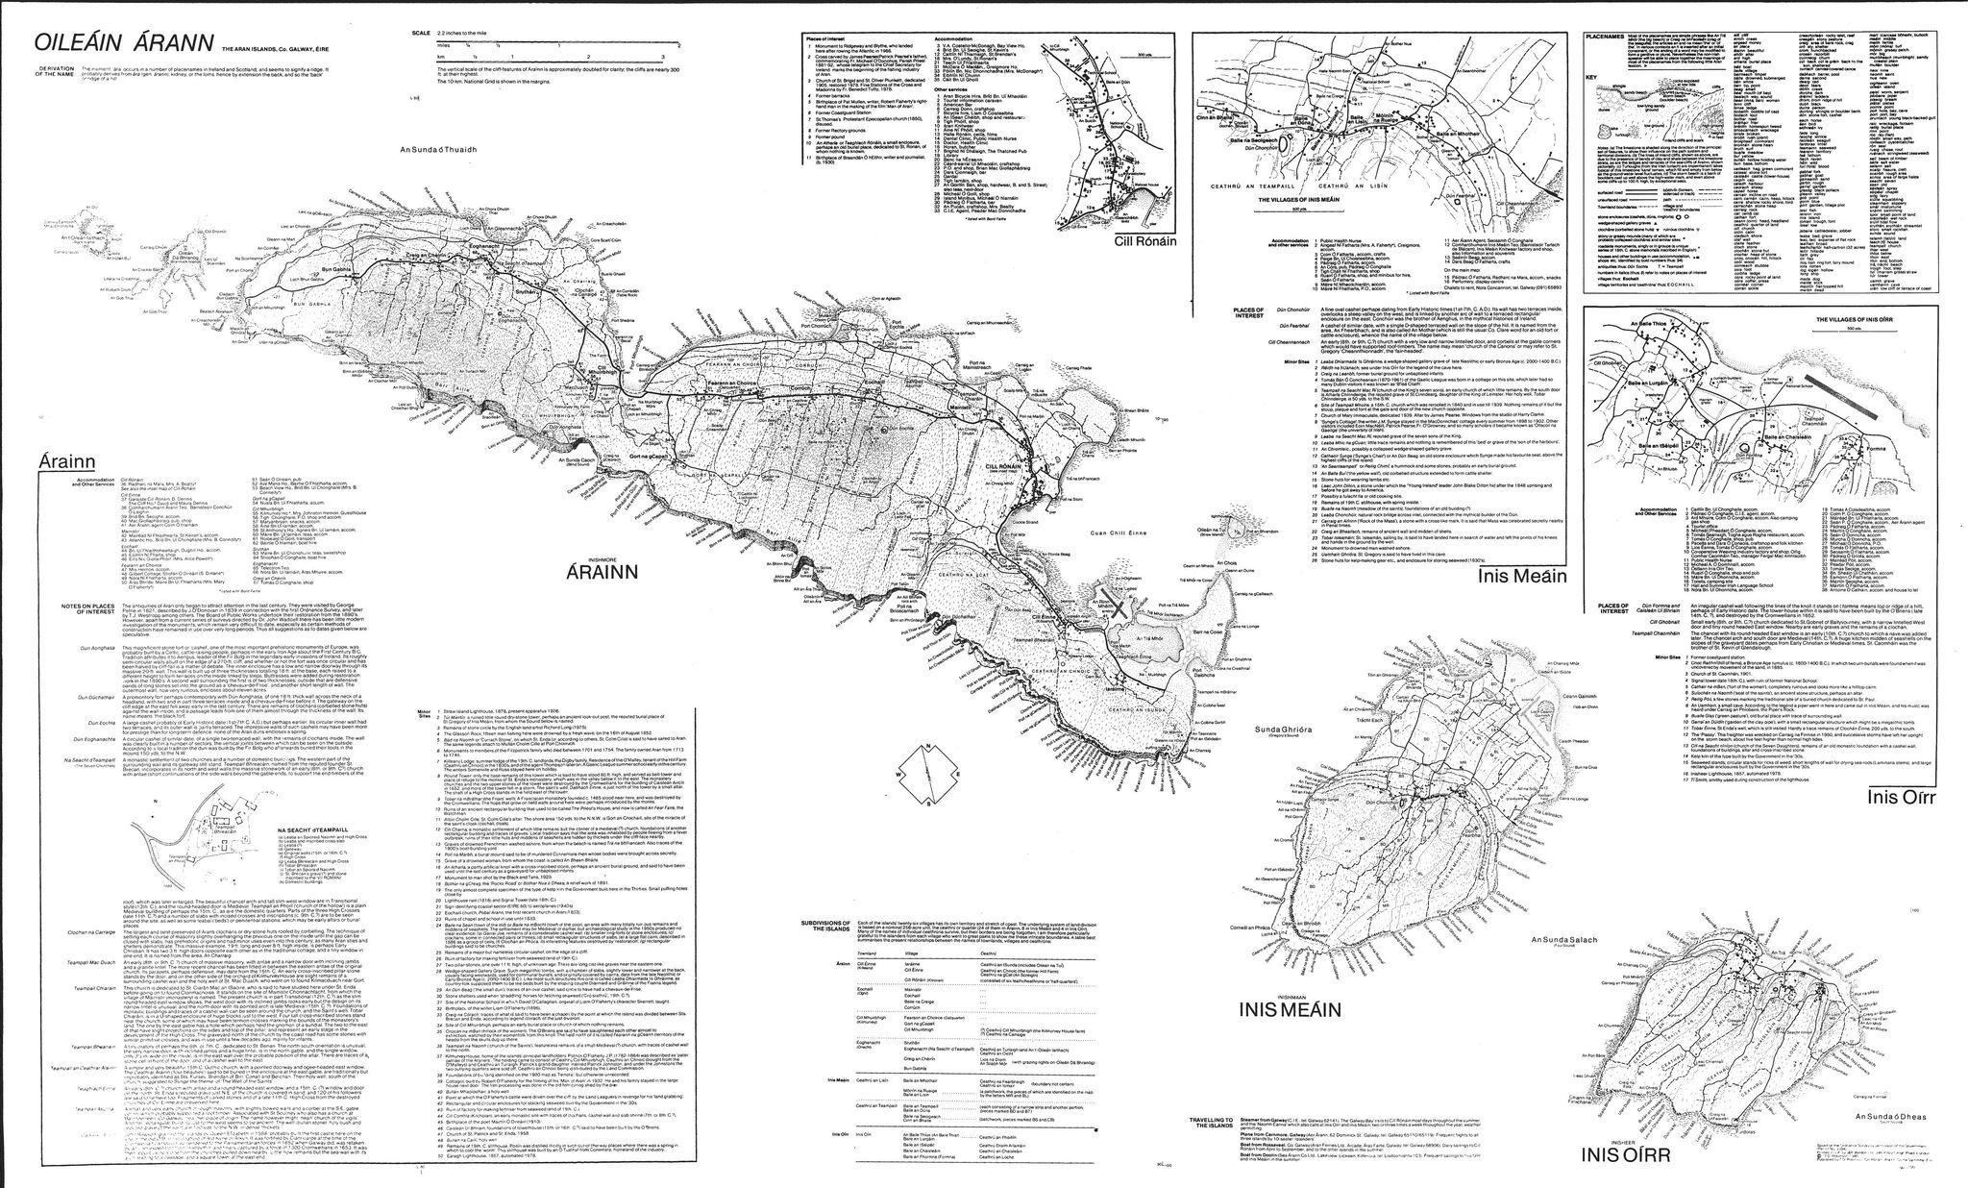
How Would You Carry Robinson’s Maps Into The Future?
Tim Robinson (), Aran Map, Publisher = “University of Galway”, Asset Id 17071, Archival Record Id P120/3/1/1.

Slide 19
Guiding Questions
How do you cite data?
How do you look up cited data now?
How do you look up cited data 40 years from now?

Slide 20
Extra

Slide 21
Internet Is Designed For Exchanging Information
The internet is a powerful tool for exchanging digital information. But the Internet’s contents changes constantly: websites are launched and taken down, webpages change, and content gets archived or lost.²

Slide 22
Internet Is Location-based
By design, a web address, or Uniform Resource Locator (URL), points to a specific internet location from which a resource, like a webpage, can be retrieved. However, a URL does not provide a way to verify that a retrieved webpage was the one we asked for. ³

Slide 23
Finding Content By Their Location Is … Tricky
Imagine using a URL-like reference to find a book at a library: instead of locating a book by what it is (e.g., title, author), you refer to a book by its location (e.g., third shelf on the second row next to the window). With this, a book becomes unfindable if moved to another shelf. And, if you do manage to find a book at the referenced location, how would you know you’ve found the book you are looking for? ⁴

Slide 24
Finding Content By Their (Summarized) Content Is … What Librarians Do
Instead of pointing to where books are located, librarians point to them using a bibliographic reference. For practical reasons, only a few identifying clues are included in such a reference (e.g., author, year of publication, title, and publisher). So, librarians refer to content by what it is, and knowing where it may be located is secondary. ⁵
A bibliographic citation:
Darwin, C. 1859. On the Origin of Species. John Murray.

Slide 25
Notes
1. Elliott M.J., Poelen, J.H. & Fortes, J.A.B. (2023) Signing data citations enables data verification and citation persistence. Sci Data. https://doi.org/10.1038/s41597-023-02230-y hash://sha256/f849c870565f608899f183ca261365dce9c9f1c5441b1c779e0db49df9c2a19d
2. Jorrit Poelen. 2024. Unleashing Digital Knowledge Into The Future. Accessed on 2024-02-06 at https://linker.bio line:hash://sha256/8ac18eb75ff20d40d1d60bb6ad5a745eb528093d1ffbe373e3847c13146091eb!/L12
3. Jorrit Poelen. 2024. Unleashing Digital Knowledge Into The Future. Accessed on 2024-02-06 at https://linker.bio line:hash://sha256/8ac18eb75ff20d40d1d60bb6ad5a745eb528093d1ffbe373e3847c13146091eb!/L14
4. Jorrit Poelen. 2024. Unleashing Digital Knowledge Into The Future. Accessed on 2024-02-06 at https://linker.bio line:hash://sha256/8ac18eb75ff20d40d1d60bb6ad5a745eb528093d1ffbe373e3847c13146091eb!/L16
5. Jorrit Poelen. 2024. Unleashing Digital Knowledge Into The Future. Accessed on 2024-02-06 at https://linker.bio line:hash://sha256/8ac18eb75ff20d40d1d60bb6ad5a745eb528093d1ffbe373e3847c13146091eb!/L18

