Slide 1
Movie Recommendation System
Heesuk Jeong
(500350619)

Slide 2
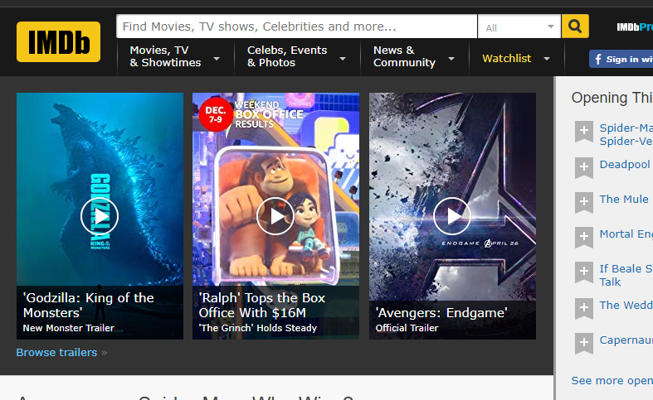
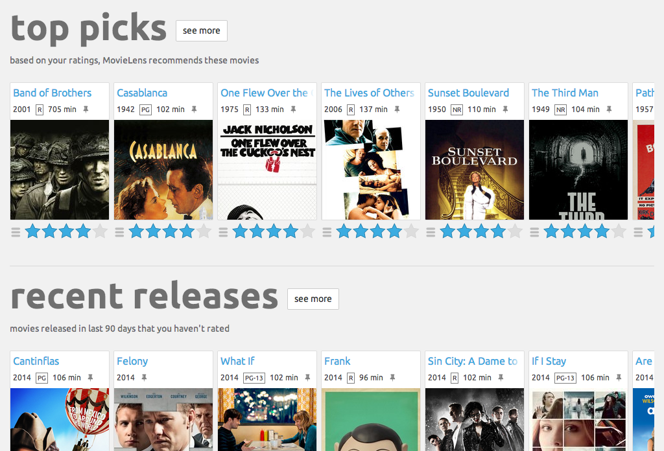
Recommender System
Given an item, predicts preference of a user

Slide 3
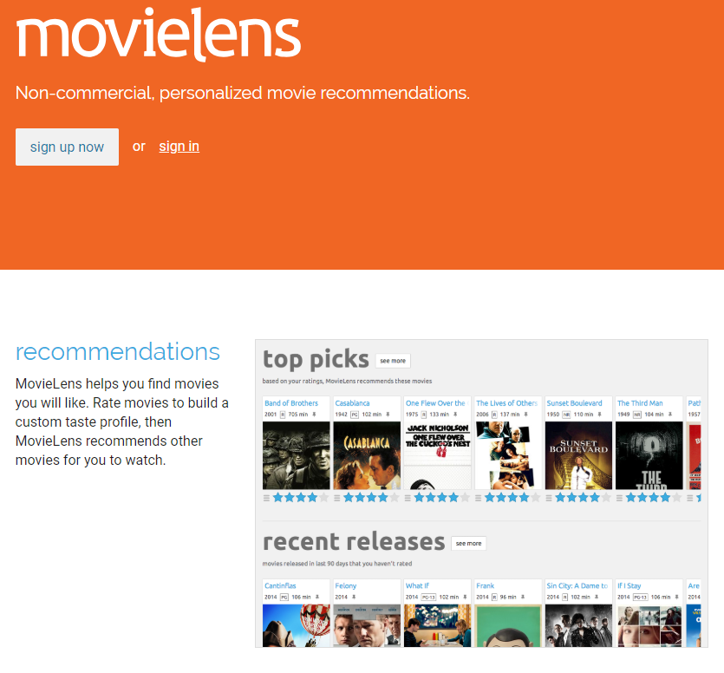
Movielens – 1M Dataset
1 million ratings from 6,000 users on 4,000 movies.
ml-1m.zip
movies.dat
ratings.dat

Slide 4
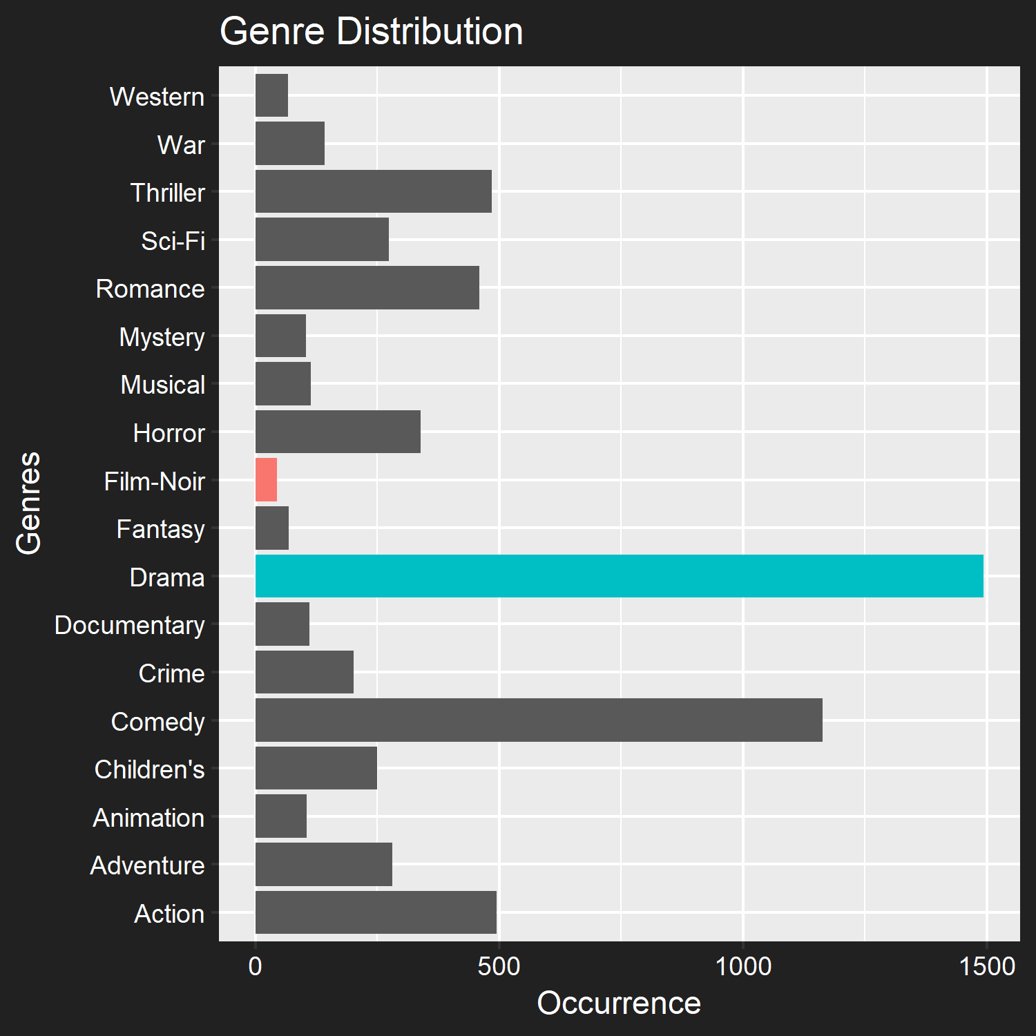
movies.dat
3,883 observations, 3 attributes
movieId
title
genres

Slide 5
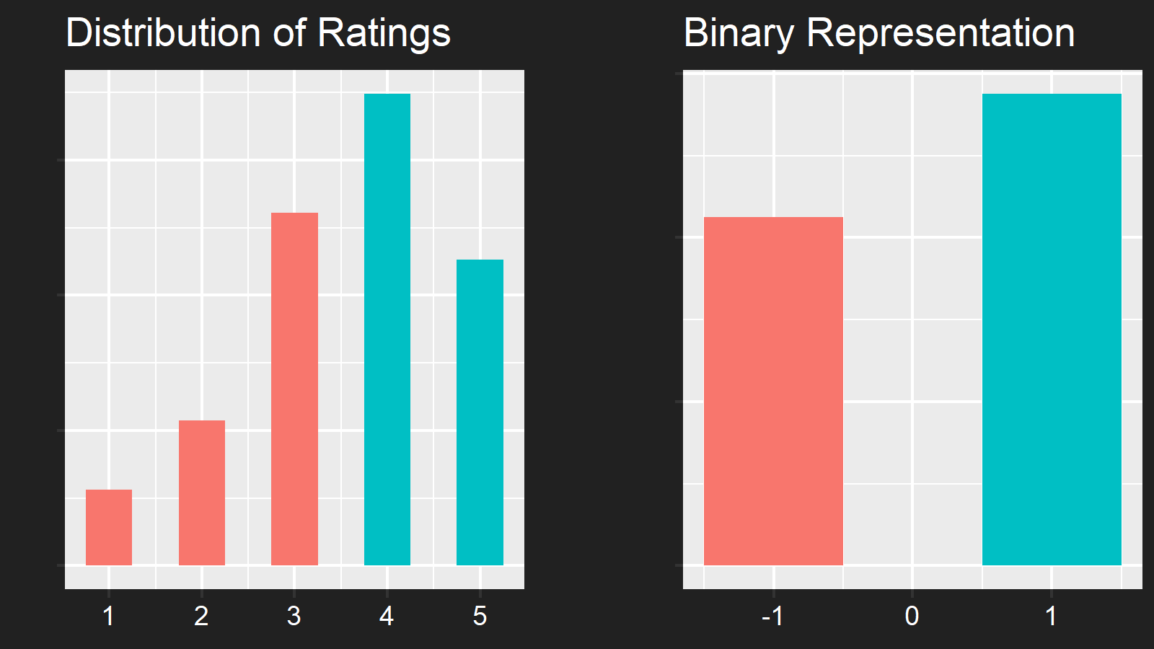
ratings.dat
1,000,209 observations, 3 attributes
userId
movieId
ratings

Slide 6
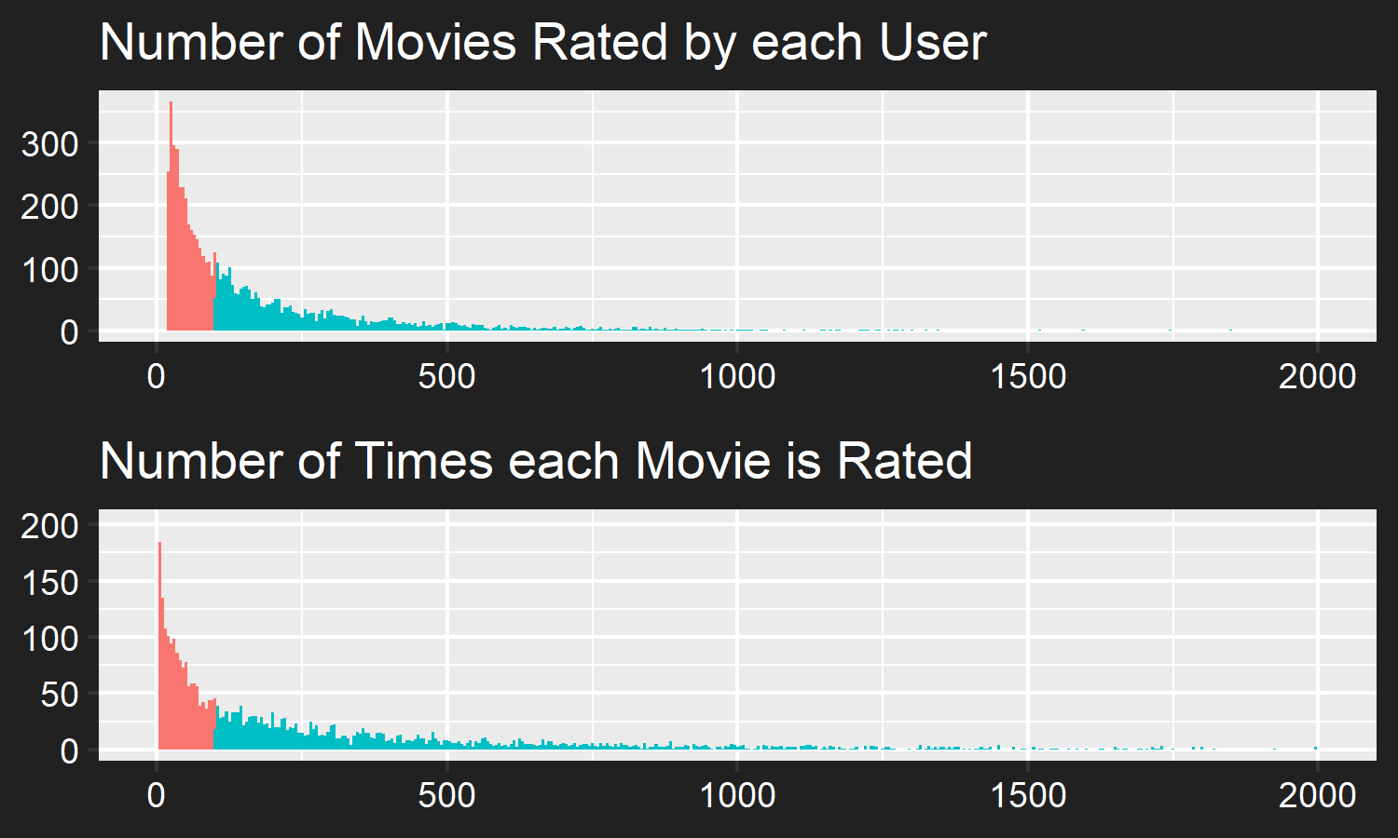
Issue: Sparsity of Ratings

Slide 7
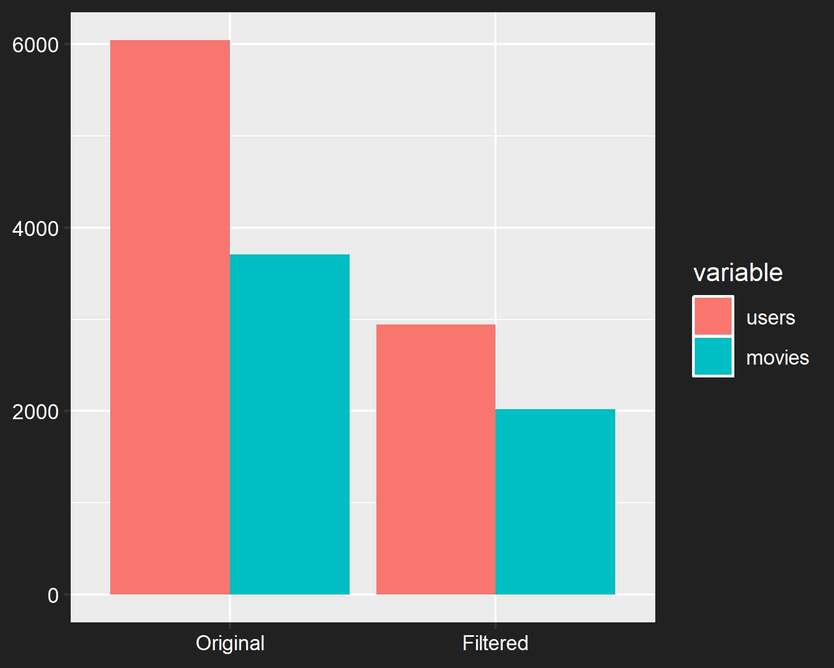
Secondary Filtered Dataset
Original Dataset
1,000,209 Observations
4.47% Dense
Filtered Dataset (n ≥ 100)
795,382 Observations
13.38% Dense

Slide 8
Validation
60% Train Set
40% Test Set
 | movies
users | 1 | 2 | 3 | 4 | 5 |  | m
1 | 1 | -1 | 0 | 0 | 1 |  | 0
2 | -1 | 0 | -1 | 1 | 0 | … | 0
3 | 0 | 0 | 1 | 1 | 0 |  | 0
4 | 0 | 0 | 1 | -1 | 0 |  | 1
5 | 0 | 1 | 0 | 0 | 1 |  | 0
 |  |  | … |  |  |  | …
n | 1 | 0 | 0 | 0 | 1 | … | -1
 | movies
users | 1 | 2 | 3 | 4 | 5 |  | m
1 | 1 | -1 | 0 | 0 | 1 |  | 0
2 | ? | 0 | -1 | 1 | 0 | … | 0
3 | 0 | 0 | 1 | 1 | 0 |  | 0
4 | 0 | 0 | ? | -1 | 0 |  | 1
5 | 0 | ? | 0 | 0 | 1 |  | 0
 |  |  | … |  |  |  | …
n | 1 | 0 | 0 | 0 | ? | … | -1

Slide 9
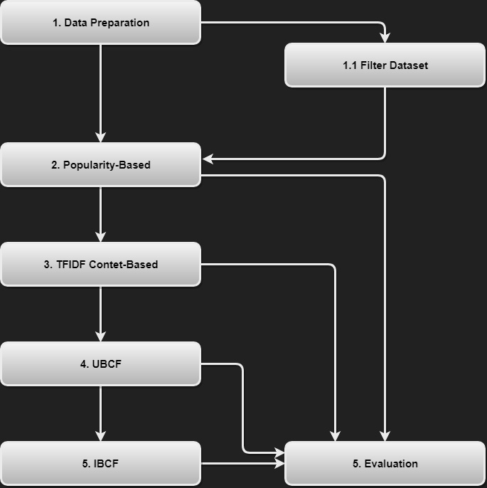
Approach

Slide 10

Popularity-Based
Average rating given a movie
Used as a benchmark model

Slide 11
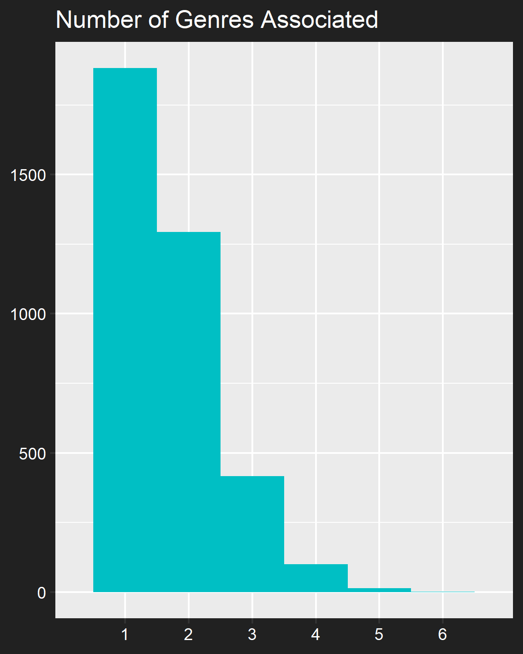
Genre-Based Filtering
Each movie has 1 to 6 genres
Genres distributed unevenly
TF-IDF values of genres used to create user-profile

Slide 12
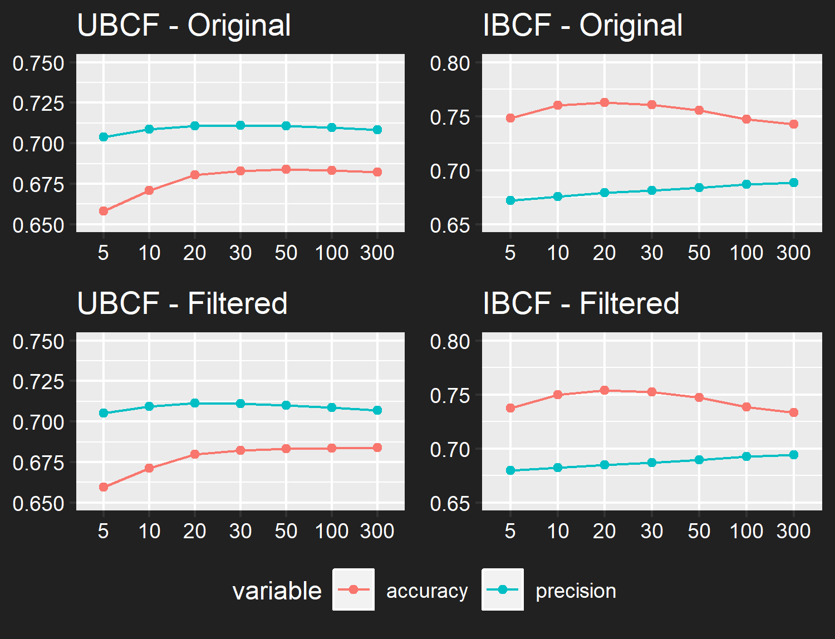
Collaborative Filtering
Cosine Similarity
Number of Neighbors
K = 30

Slide 13
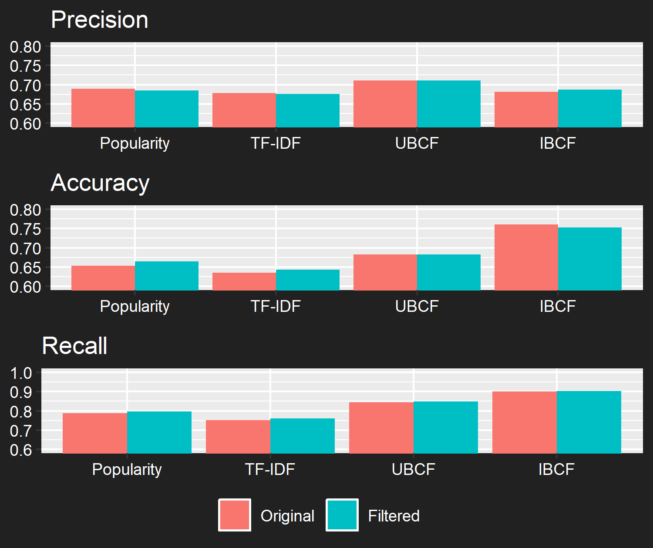
Effect of Filtering Dataset was Not Significant
Higher Density
Smaller Dataset

Slide 14
Evaluation
Primary Metric
Precision
Secondary Metric
Accuracy
Recall
Original Dataset | Precision | Accuracy | Recall
Popularity-based | 68.94% | 65.39% | 78.77%
TFIDF | 67.78% | 63.48% | 75.12%
UBCF (k = 30) | 71.11% | 68.28% | 84.44%
IBCF (k = 30) | 68.10% | 76.08% | 90.11%
Filtered Dataset | Precision | Accuracy | Recall
Popularity-based | 68.78% | 66.03% | 79.44%
TFIDF | 67.79% | 63.75% | 75.62%
UBCF (k = 30) | 71.28% | 67.84% | 84.46%
IBCF (k = 30) | 68.90% | 75.01% | 90.26%

Slide 15
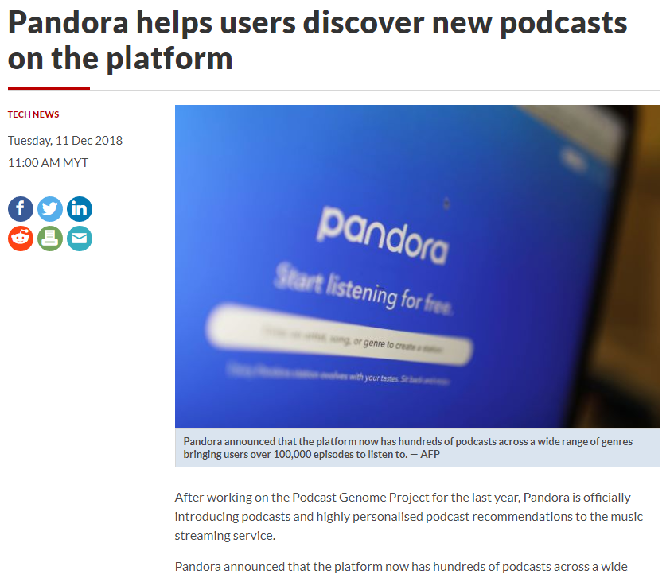
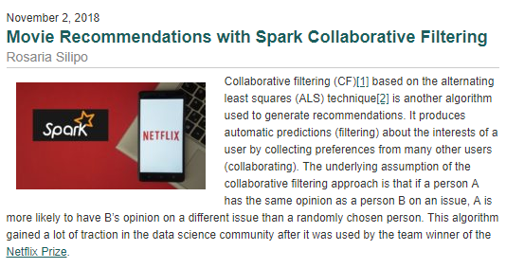
Importance of Recommender Systems
Amount of data available online is always increasing
Broad scope of application

