Slide 1
CSA0714- COMPUTER NETWORKS
APPLICATION OF COMPUTER NETWORKS IN ONLINE BANKING

Slide 2
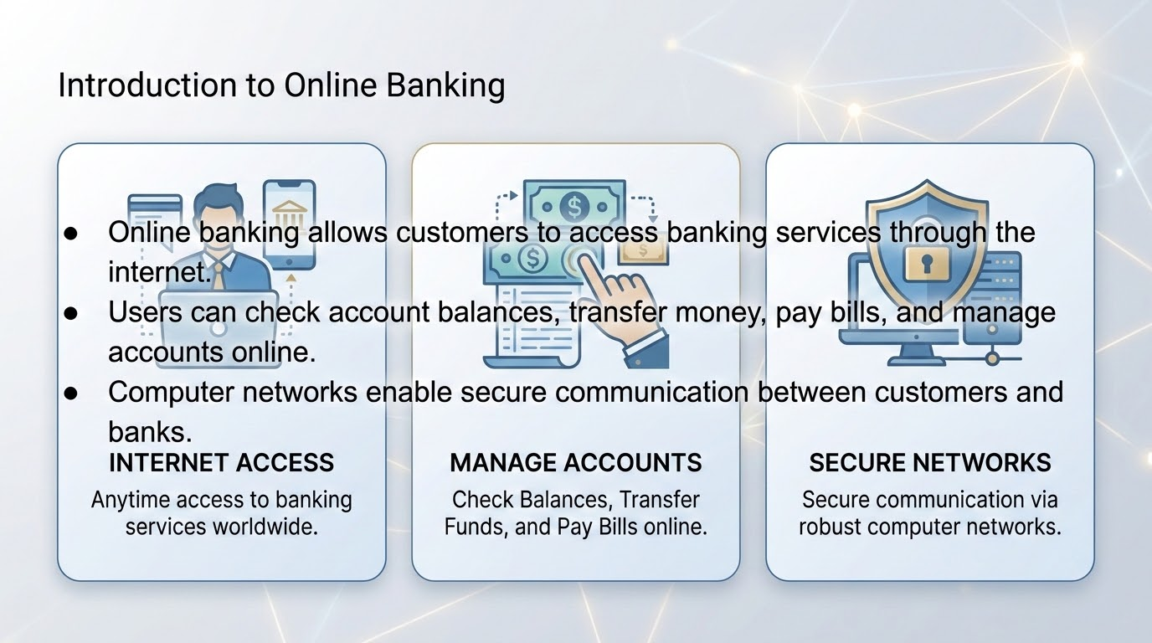

Slide 3
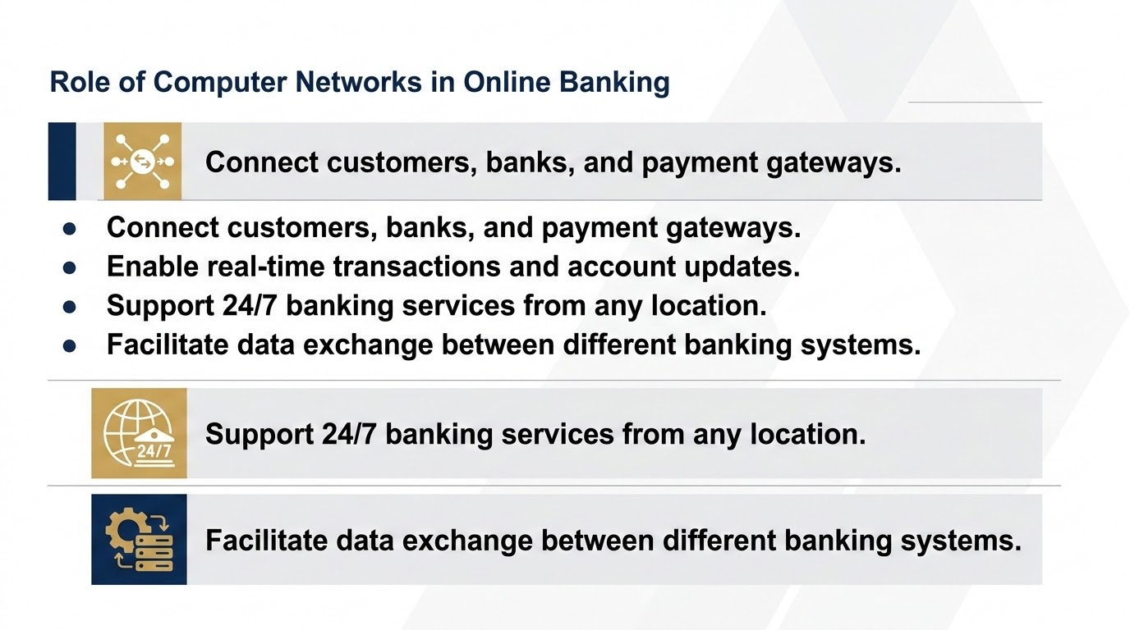

Slide 4
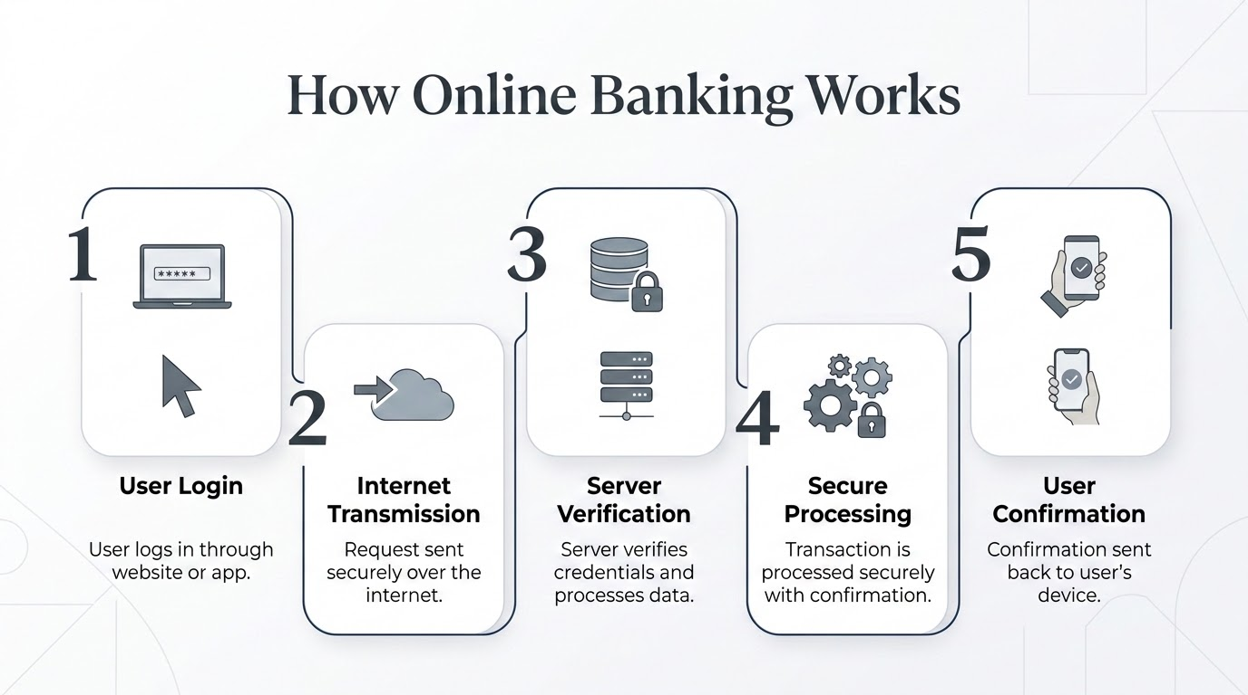

Slide 5
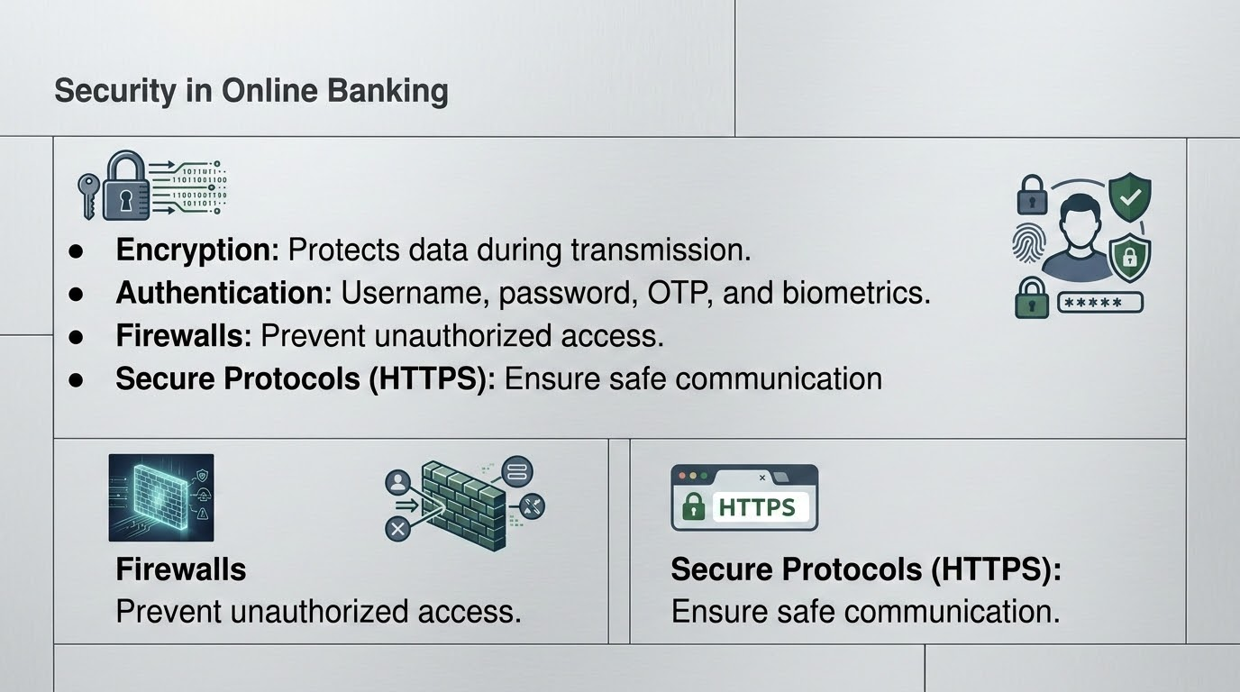

Slide 6
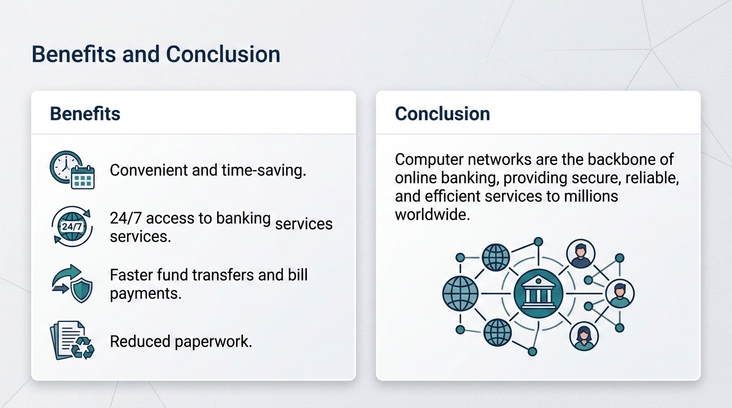

Slide 7


