Slide 1
Final Project Case Study in Spark for ETL
Stockham, Jessica
CSCI E-63 Big Data Analytics, 2023
Harvard University Extension School
Prof. Zoran B. Djordjević

Slide 2



Problem Statement
Discover which federal government agencies have the highest web traffic and which have lowest traffic and how this varies over time.
Target Audience: Federal Agencies
Why this matters:
Websites that have little traffic may be poorly designed or not well-publicized.
When websites have very high traffic -> be prepared to meet high demand
Image credits
https://logodownload.org/wp-content/uploads/2021/03/united-states-postal-service-usps-logo-0.png
https://blogs-images.forbes.com/insider/files/2014/02/5790406220_408d8d3810_b.jpg
https://cccblog.org/wp-content/uploads/2016/08/US-DOT-logo-1-1024x745.png

Slide 3

Software and Technology
Apache Airflow 2.6.0 (data pipeline workflow orchestration)
Python version 3.9
Python Packages:
requests
json
pandas
datetime
PyMySQL
SQLAlchemy
altair
Apache Spark 3.3.1 (pyspark)
mySQL
Operated within a virtual environment

Slide 4
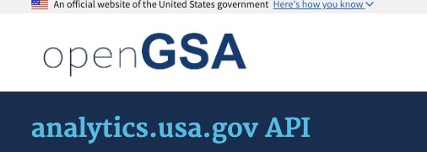
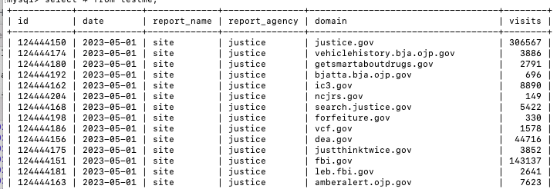


Dataset
Query:
<agency name>: Looped through all 27 federal agency names
<report name>: Queried the “site” report = # of visitors to each website domain
Result: Daily website visits for every website domain for every agency

Slide 5
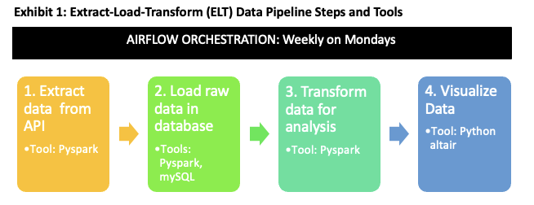
Data Pipeline
Currently: About 3 million rows of data
Historical Data: Large API pull data Jan 1, 2019 – April 30, 2023
May 1, 2023 Data Onward: Weekly batch pull with data pipeline
Create aggregate monthly website counts for each agency
constants.py
main_api_pull.py batch_api.py transform.py visualize.py

Slide 6
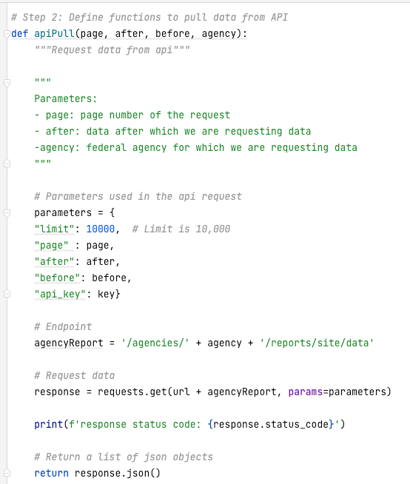

API Pull Code Snippet
Code snippet: API pull
Parameters:
Limit
Page
After
Before
api_key

Slide 7
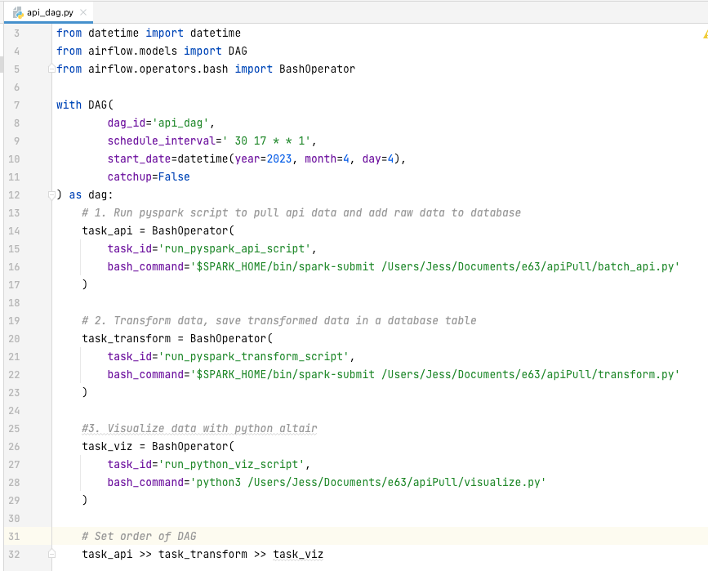

Airflow Code Snippet: api_dag.py
Schedule interval:
Crontab syntax
Run every Monday at 17:30 UTC
3 Tasks
task_api
task_transform
task_viz
Set order of tasks with >> operator

Slide 8
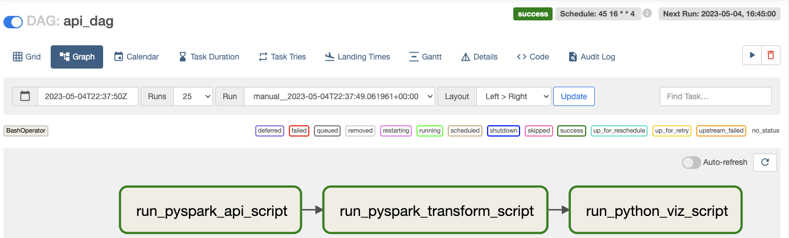
Airflow Web Server: http://localhost:8081
api_dag: Schedule, Last Run
Directed Acyclic Graph (DAG)

Slide 9
High-Level Results
Most visited agencies in 2023:
Department of Health and Human Services
Postal Service
Commerce
Treasury
Least visited agencies in 2023:
Nuclear Regulatory Commission
U.S. International Development
National Science Foundation
Housing and Urban Development

Slide 10
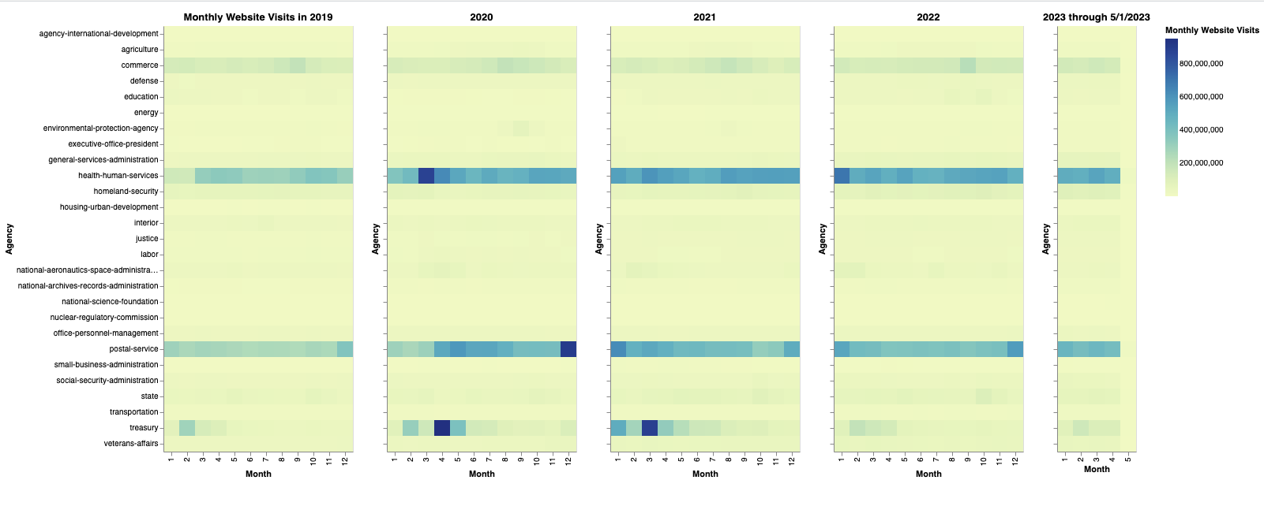
Results: heatmap visualization

Slide 11
Lessons Learned
General:
Start as simple as possible when learning a new tool. Make sure a basic trivial example is working first before you launch into your project code.
Then, test every little step of your code in your data pipeline before you string it altogether
Apache Airflow
Airflow uses the UTC timezone for scheduling jobs, not your local computer’s time zone.
If you want your DAG to start running right, make sure that your start_date in your schedule is far enough back.
E.g., if you want your weekly batch job to start today, make sure your start_date is more than 7 days in the past.
If you need to change something in the configuration file airflow.cfg, after you are done, you have to reset the airflow db (airflow db reset) and also shutdown and restart the webserver and the scheduler before you are ready to go again.

Slide 12
Pros/Cons
Pros:
Airflow has a user-friendly visual display of the pipeline.
Cons
No specific cons identified for Apache Airflow beside the technical hiccups I noted on the last slide

Slide 13
Future Work
GSA API
Pull down more data from the gsa api: “device” report (mobile, desktop) so agencies can understand how user interacts with their content. Identify anomalies (e.g., maybe the mobile format is terrible for a particular domain).
Conduct detailed trend analysis and visualizations at the agency level and for individual website domains
Economic Data
Integrate weekly stock market data, monthly jobs reports into the data pipeline. How does the economy correlate with the demand for particular websites?
Twitter Data
Understand how topics of interest for each agency evolve over time and if certain topics are correlated with higher website hits
Pull out topics of conversation, number of followers
Use neo4j to conduct a network analysis of key influencers
Serve up visualizations on a website (e.g., Flask)

Slide 14
Thank you!
YouTube 2-minute video: https://youtu.be/AYaaRbIt7I4
YouTube 15-minute video: https://youtu.be/CKeJR5OuxSQ
git Repo: https://github.com/jhsmith22/e63finalproject.git

