Slide 1
Beyond Residence
Mobility-Driven PM2.5 Exposure Disparity
in the Washington DC Metropolitan Area
Data Sources: GHAP PM2.5 · SafeGraph Patterns · ACS Demographics
Study Period: January 2018 – November 2021 (47 months) · 2,548 CBGs · 4.2M residents

Slide 2
MOTIVATION
Standard EJ Research Misses Mobility
STANDARD APPROACH
THIS STUDY
Where does someone live?
Where does someone go?
Residential PM2.5 → Demographics predict residential exposure
→ Ignores where people actually go
→ Understates true burden
Mobility-Adjusted PM2.5 → Visitor-weighted destination PM2.5
→ Δ = destination − origin exposure
→ Captures true daily burden
VS

Slide 3
DATA & METHODS
Three Data Sources, One Integrated Pipeline
GHAP PM2.5
SafeGraph Patterns
ACS 2019
1km monthly rasters
2018–2021 · CV-R²=0.97
Wei et al. Nature Comm. 2023
POI visitor flows
origin → destination CBG
2,548 CBGs · 47 months
CBG demographics
Race · Income · Poverty
Vehicle access · Education
→
→
Key Variable:
Average Difference in PM2.5 = visitor-weighted mean of ( PM2.5_{destination} − PM2.5_{origin} ) per CBG
Positive = residents travel into worse air than they live in | Negative = residents travel into cleaner air
Spatial Error Model (SEM) · Queen contiguity weights · λ = 0.984 · AIC improvement: +540 → −4,002

Slide 4
SCALE
The Scale of Mobility-Driven PM2.5 Exposure in the DMV
4.2M
85%
81%
DMV residents in this study
Already above EPA 9.0 μg/m³ at home
Travel into even worse air through mobility
2,548 CBGs · 47 months · 2018–2021
Residential PM2.5 exceeds 2024 annual standard
Population in net-worse CBGs
+0.451
0.765
40%
Mean additional PM2.5 burden from daily mobility (μg/m³)
Moran's I — strong spatial clustering
Face high pollution both at home AND on the move
Pushes already-exceeded EPA 9.0 standard 5% further — mobility compounds a baseline violation
Exposure burden is not random — it follows geography
Compound burden — above median on both dimensions
Pop-weighted mean delta = +0.451 μg/m³ · Residential methods understate true exposure by 4.4% · Sources: GHAP PM2.5 · SafeGraph · ACS 2019

Slide 5
DEMOGRAPHICS
Transit Dependence — Not Race — Drives Mobility Exposure
% No Vehicle — Strong
% Nonwhite — Negligible
Car-free CBGs travel to incrementally less worse air — they are already urban/central. Car-owning suburbs commute into higher-PM2.5 corridors.

Slide 6
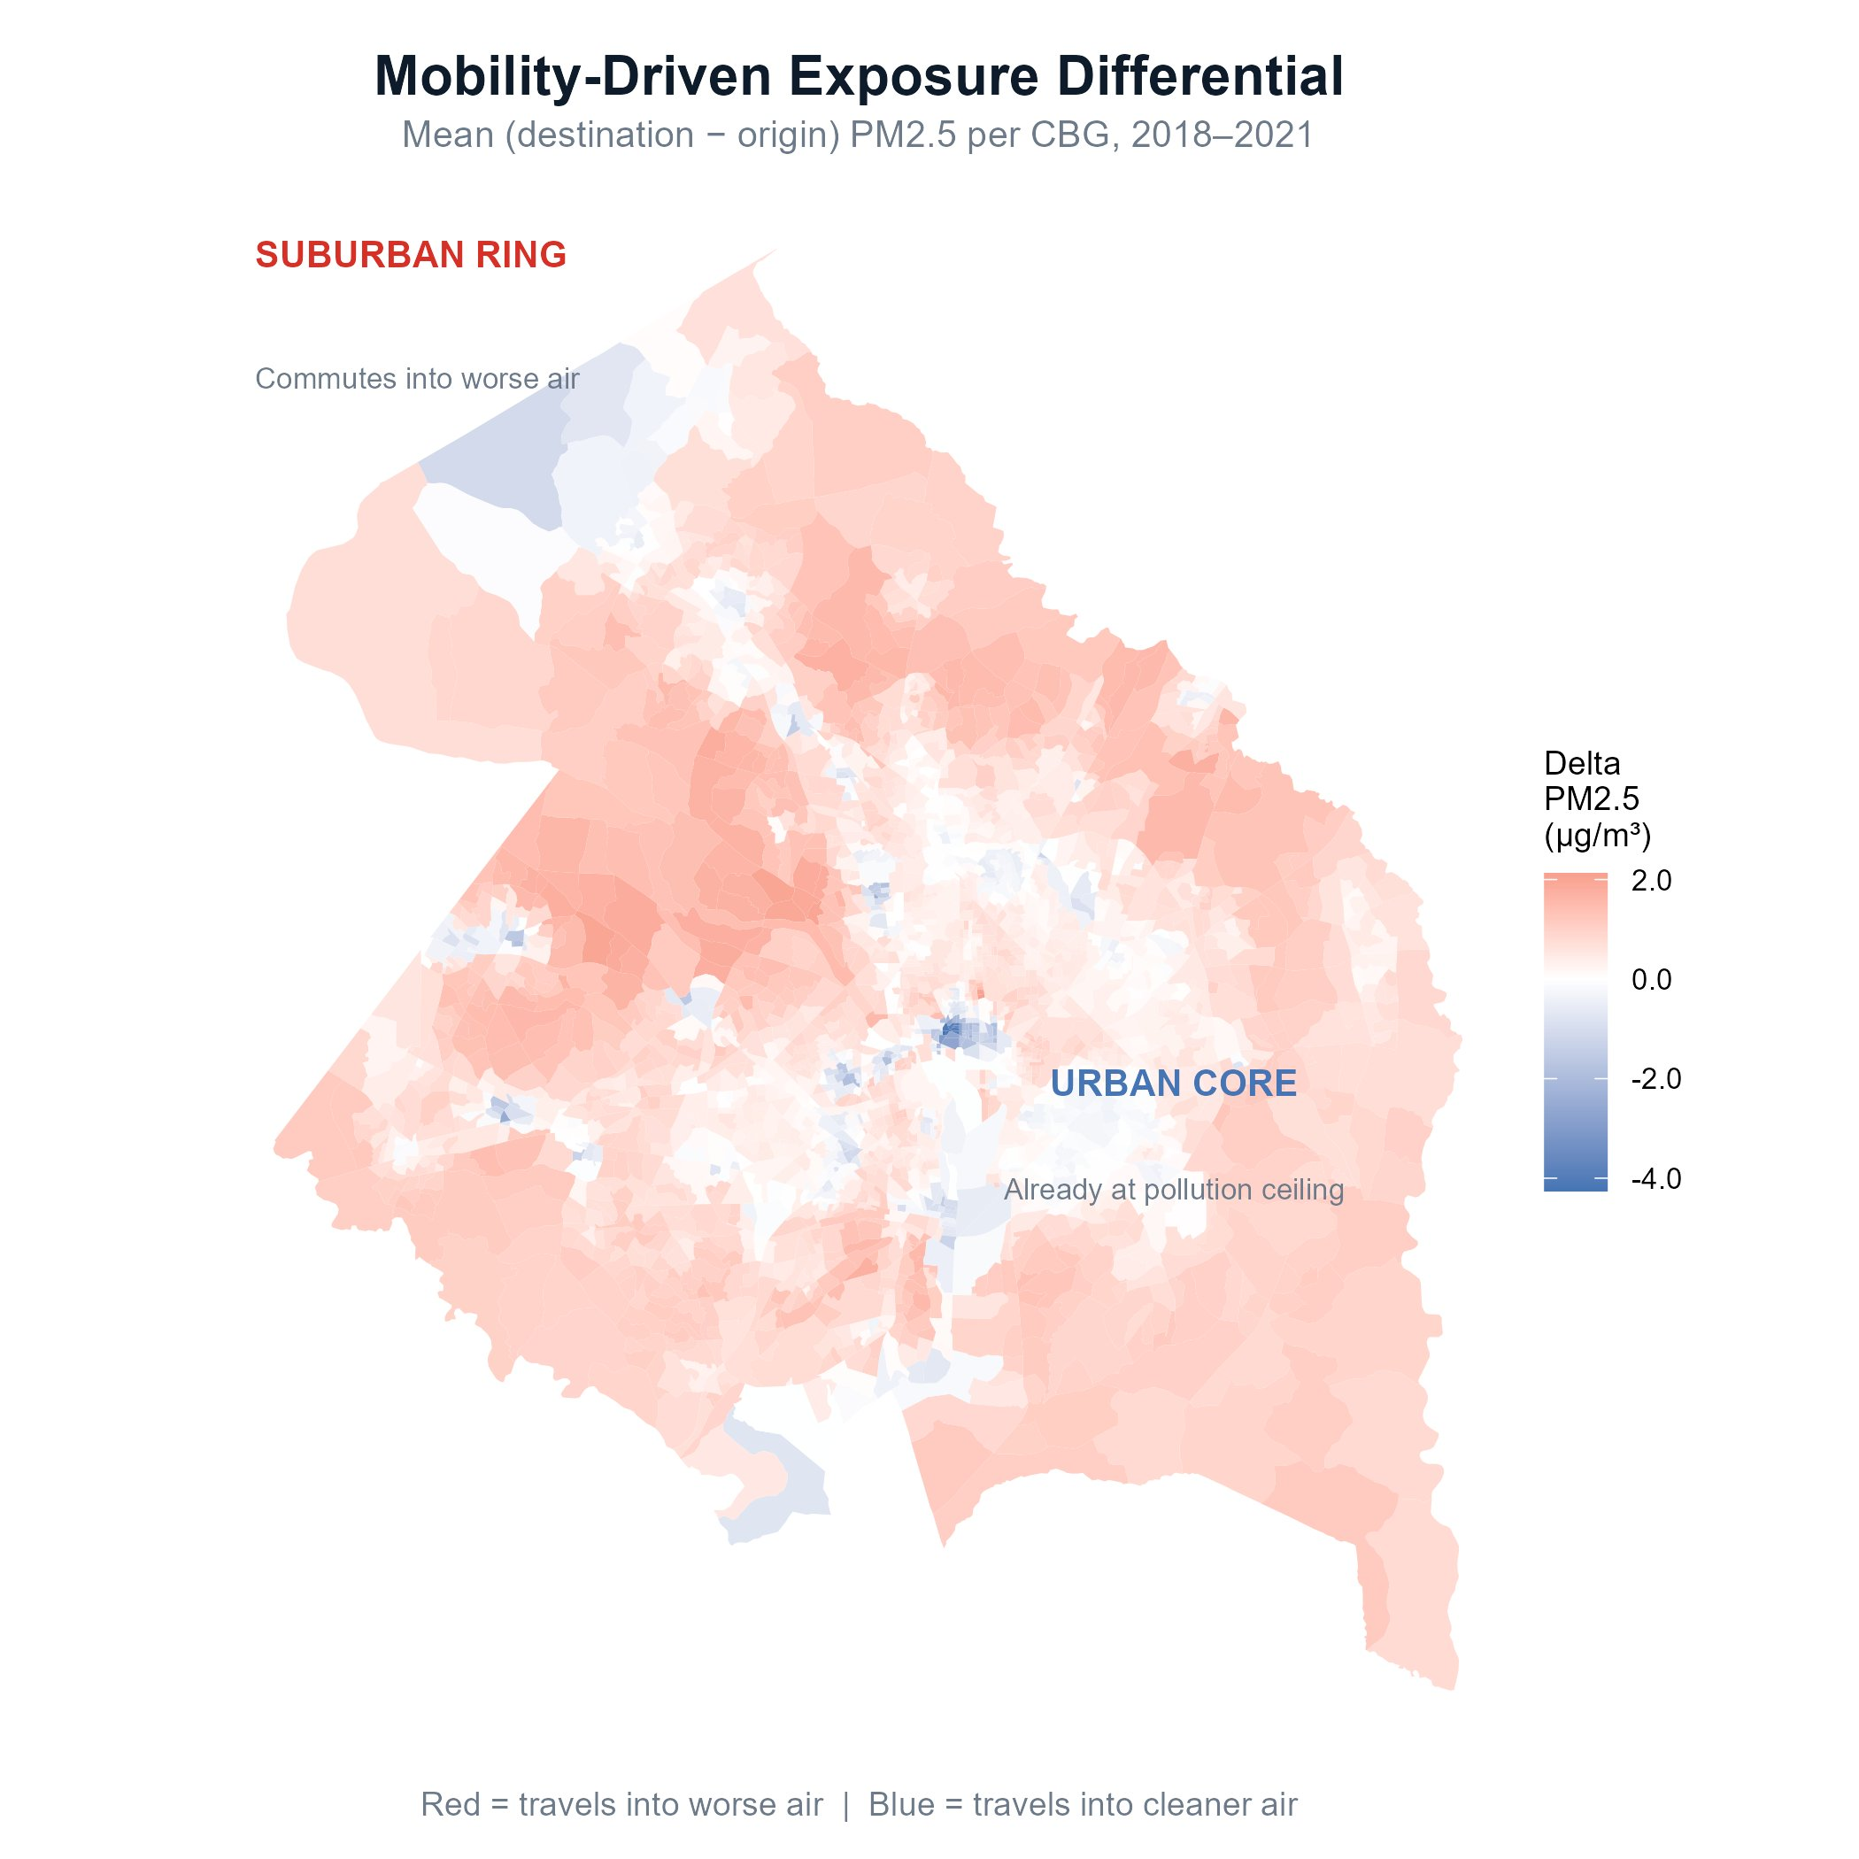
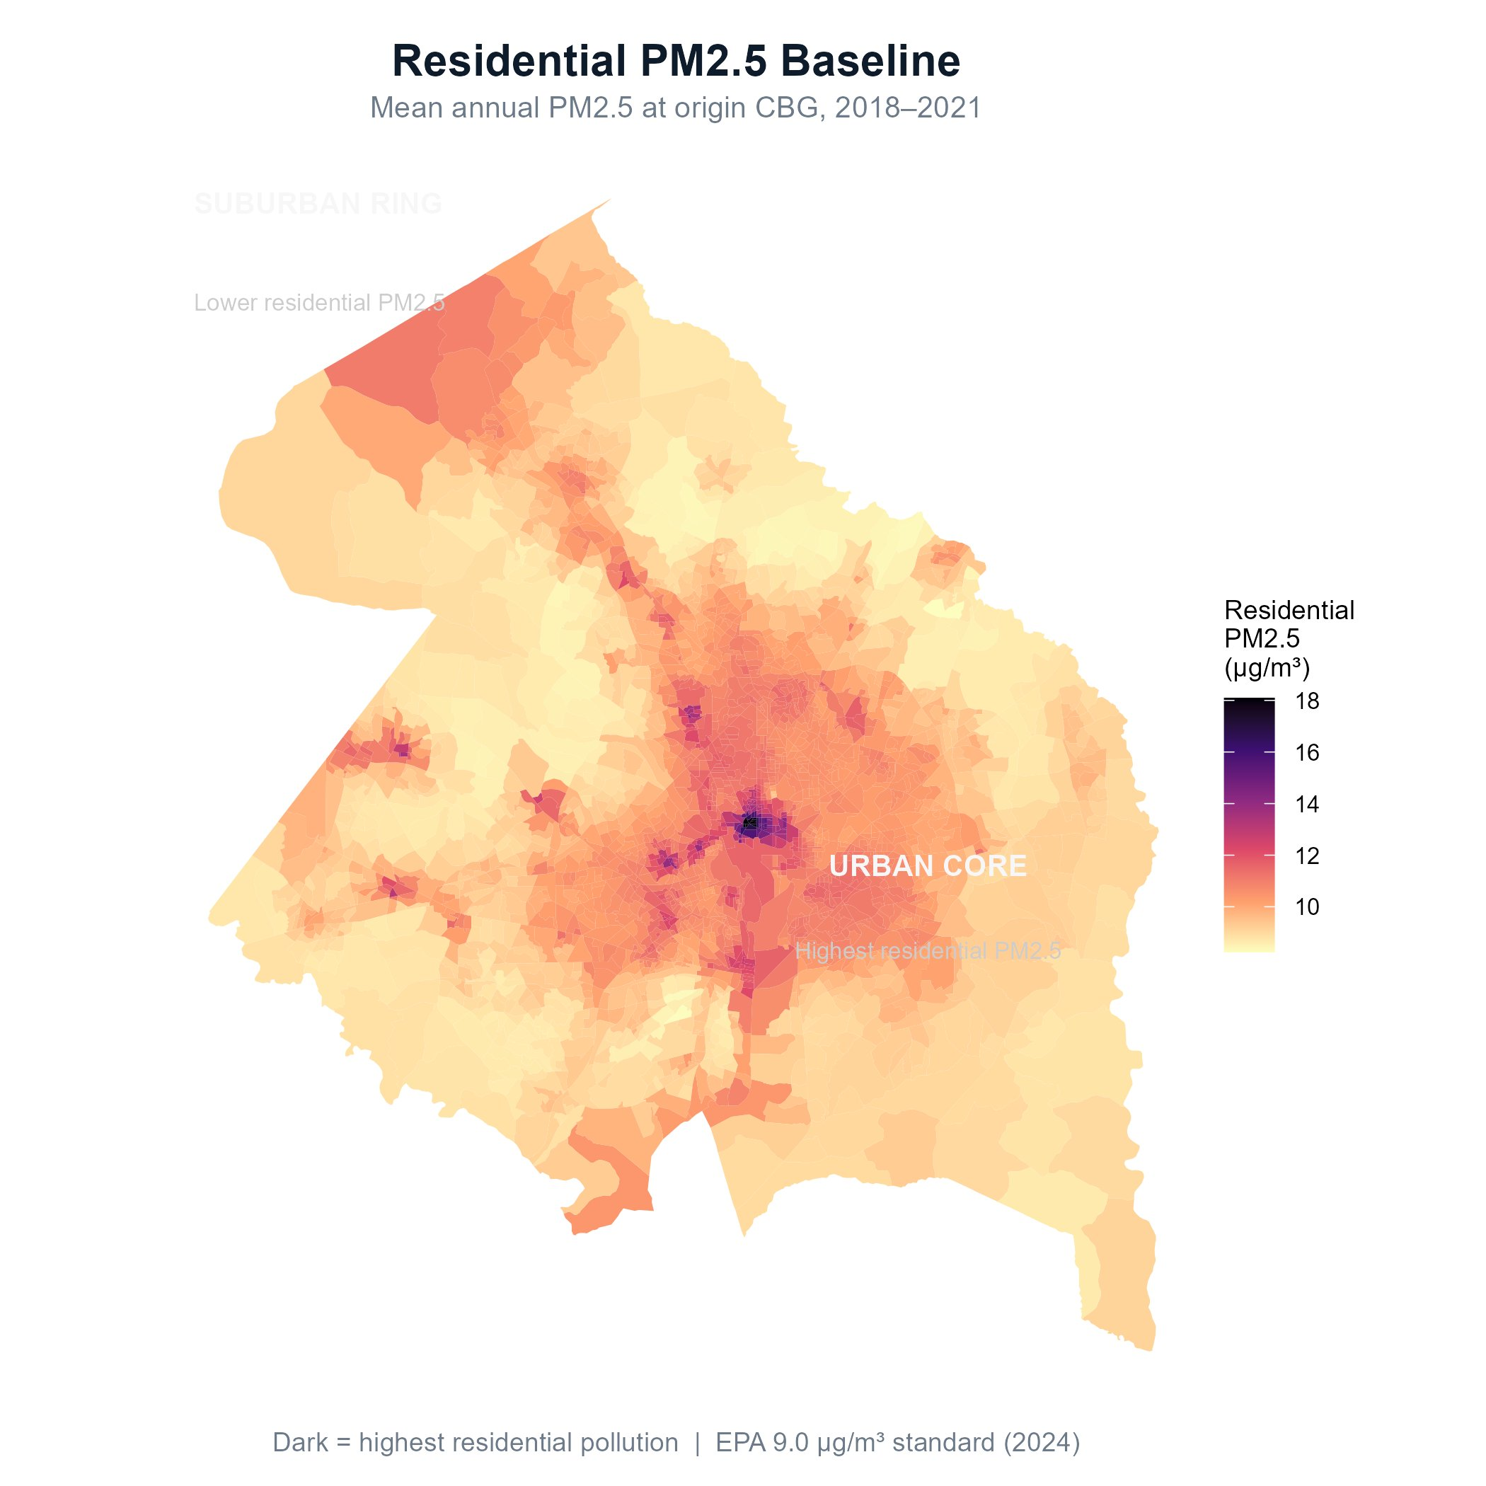
SPATIAL PATTERN
Where You Live Determines Where You Can Go
VS
Mobility-Driven Exposure Differential
Residential PM2.5 Baseline
Suburban ring (red) commutes into worse air than home.
Urban core (white/blue) already at pollution ceiling.
Urban core already high at home.
Suburban ring starts clean — but daily commutes change that.

Slide 7
TEMPORAL
COVID-19 Halved Mobility-Driven Exposure
COVID-19
Mar 2020
0.528 μg/m³
2019 mean Δ (pre-COVID)
0.266 μg/m³
2020 mean Δ (−50%)
0.208 μg/m³
2021 mean Δ (still below 2020)
Paired t-test: mean difference = −0.262 μg/m³, p < 0.001 · When mobility collapsed, the exposure gap closed.

Slide 8
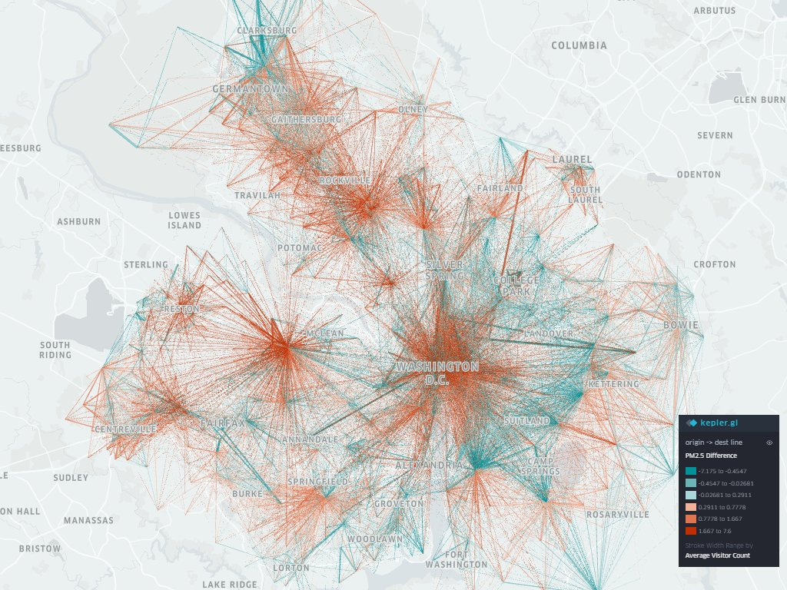
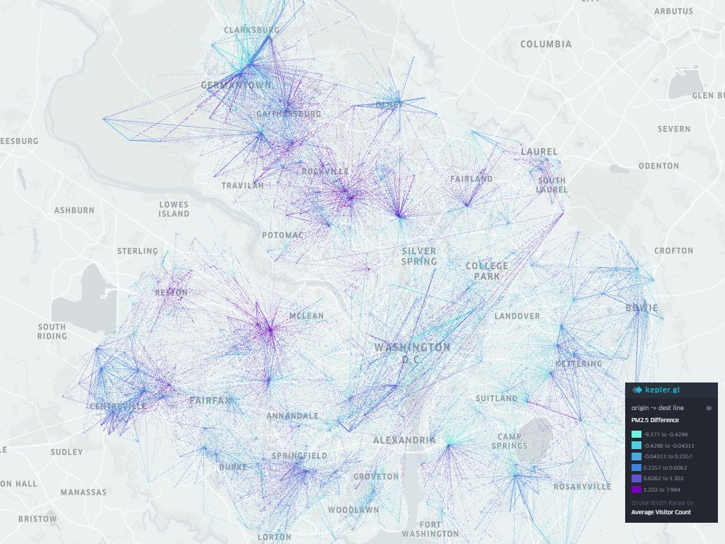
TEMPORAL
COVID Mobility Collapse — Visible in the Flow Maps
Pre-COVID (2018–2019) — Dense red flows, high-volume commuting into worse air
COVID Era (2020–2021) — Sparse blue/purple flows, commuting collapsed
Red = traveling into worse air | Blue/teal = traveling into cleaner air | Line thickness = visitor volume

Slide 9
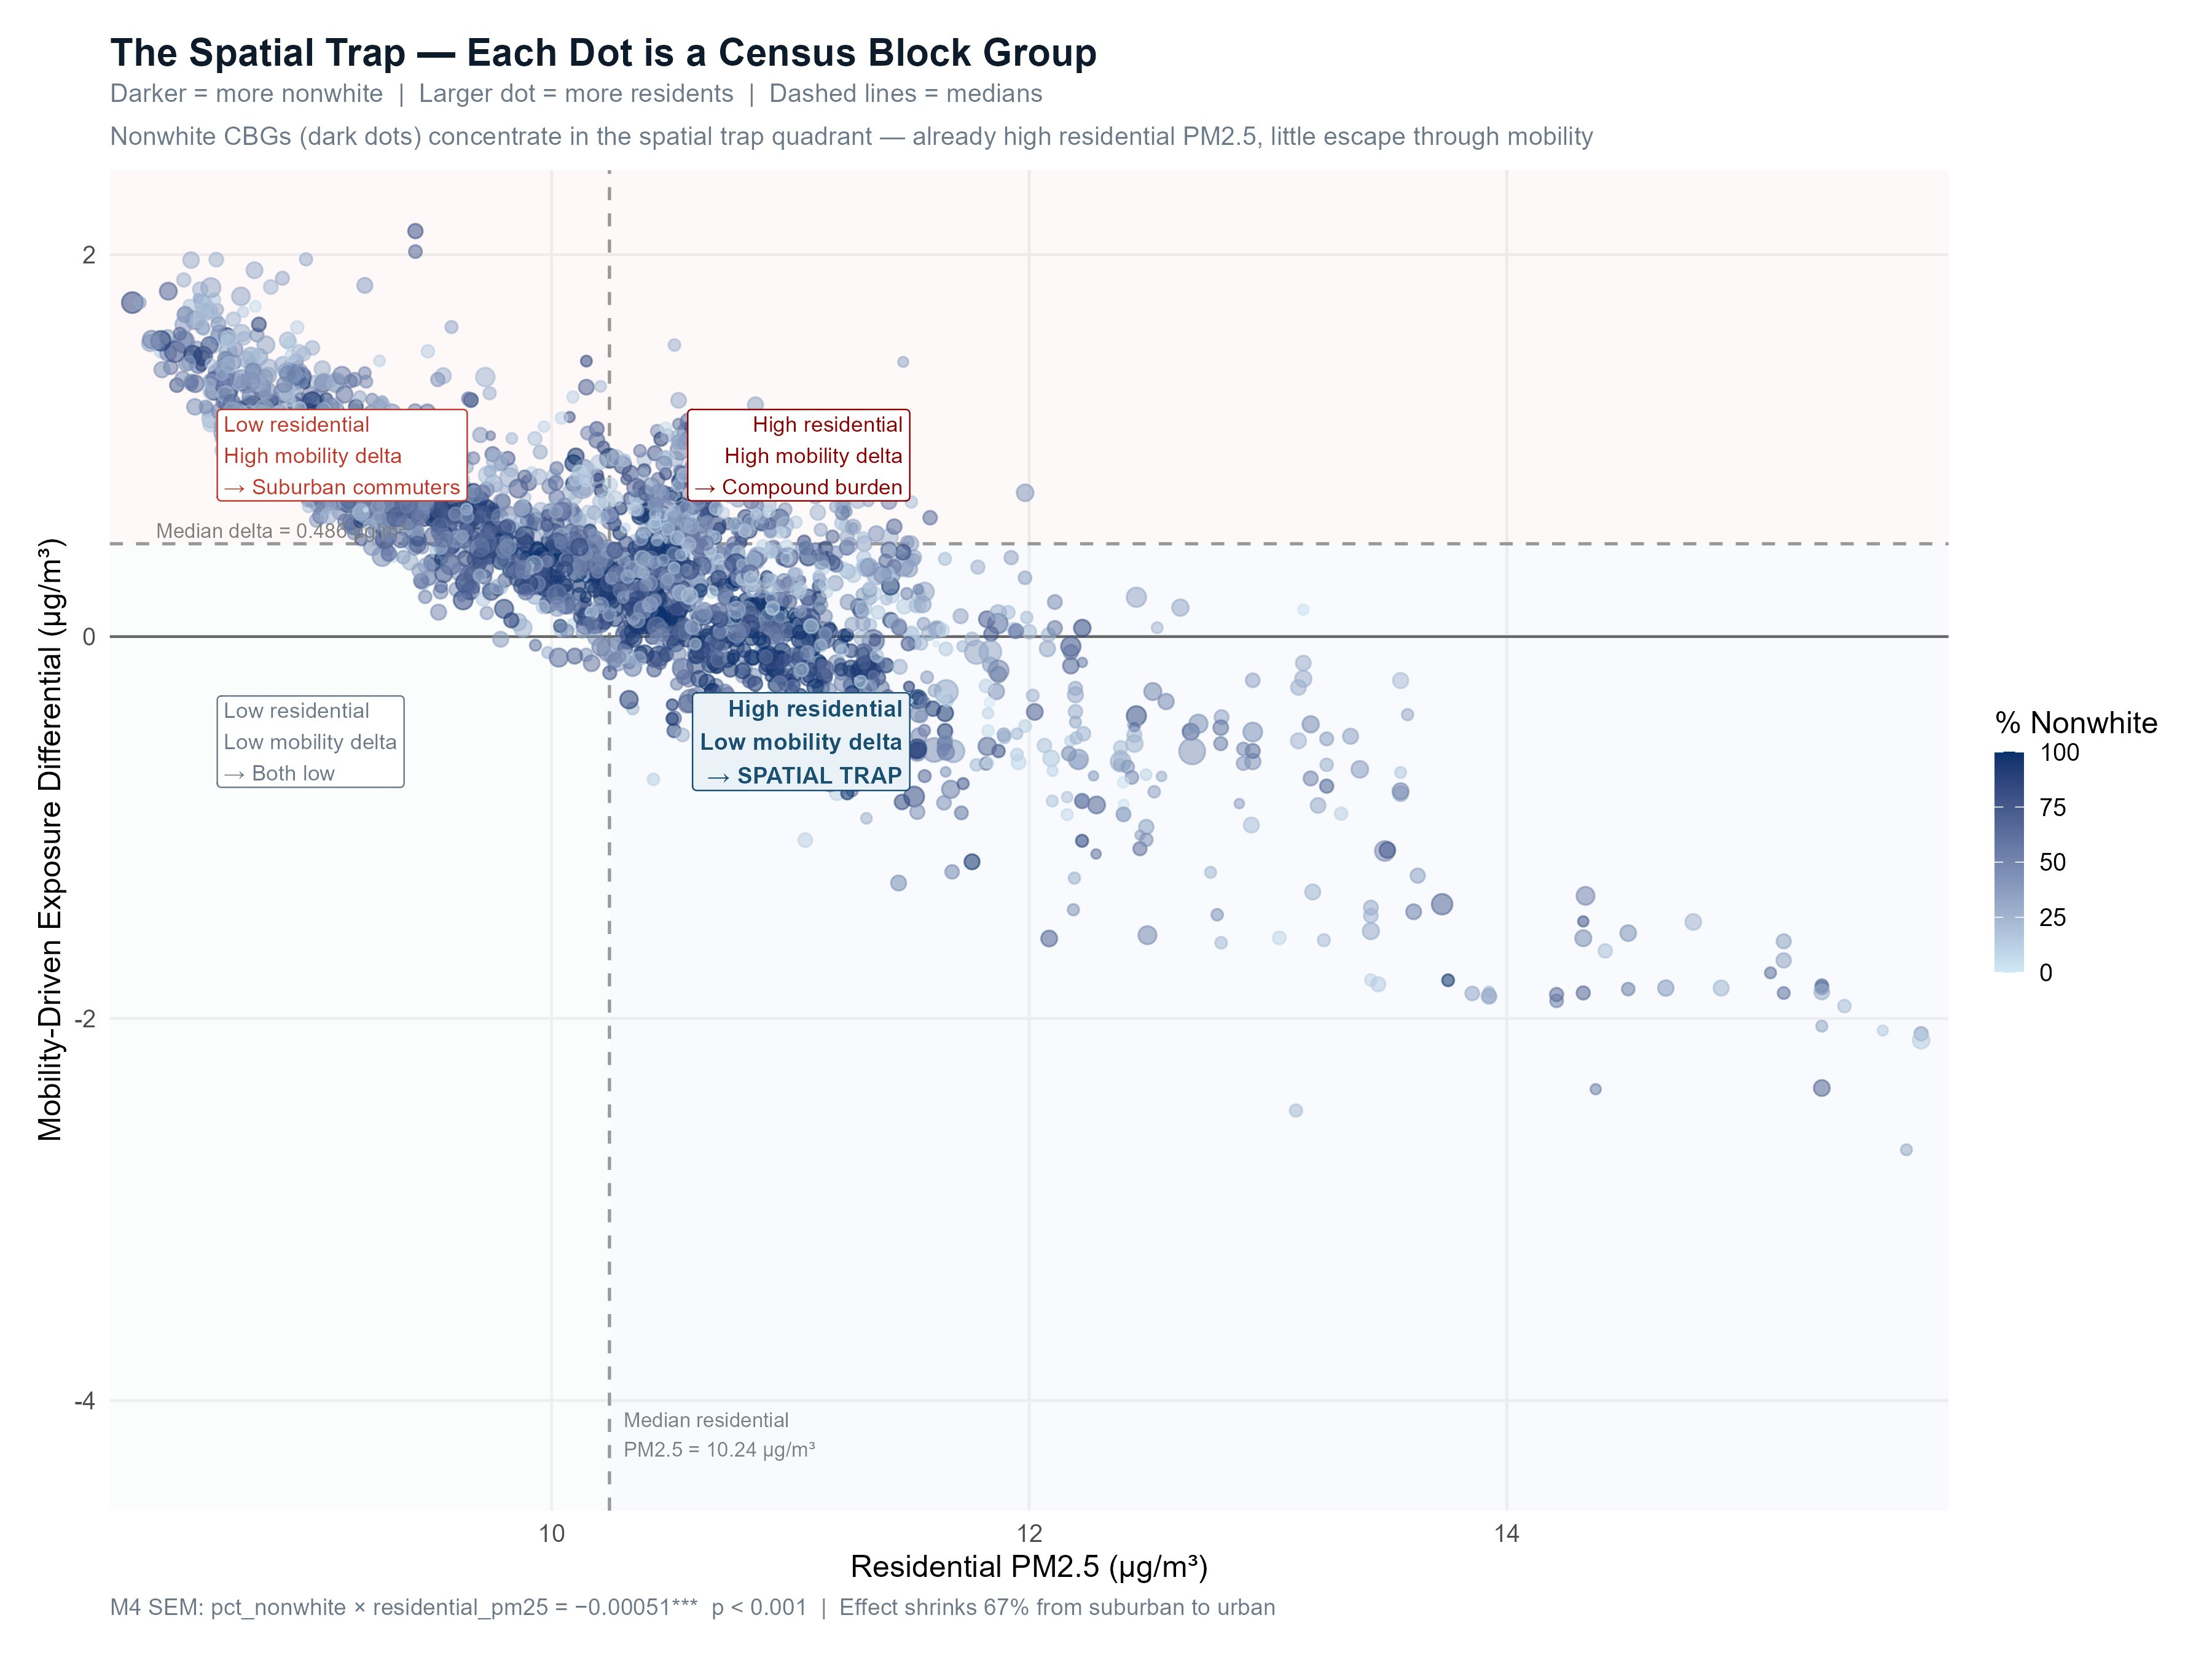
THEME 3 — SPATIAL TRAP
Nonwhite CBGs Cluster Where There Is No Escape
Suburban commuters
Low residential PM2.5
High mobility delta
Travel into worse air daily
Spatial trap
High residential PM2.5
Low mobility delta
Already at pollution ceiling
Compound burden
High residential PM2.5
High mobility delta
1.7M people affected
The negative slope confirms the spatial trap — as residential PM2.5 increases, mobility delta falls. Dark dots (nonwhite CBGs) cluster in the trap quadrant.

Slide 10
REGRESSION
Why Spatial Regression?
Model Selection
Model | AIC | Residual Moran's I | Status
M1 OLS | +539.6 | 0.612 | ✗ Biased
M2 SEM | −3,979 | −0.157 | ✓ Clean
M3 SLM | −64.1 | 0.292 | ✗ Residual autocorrelation
M4 SEM+Interaction PRIMARY | −4,002 | −0.161 | ✓ Primary
1
OLS Moran's I = 0.612 — neighboring CBGs share unobserved factors → standard errors biased
2
LM tests: adjRSerr = 2,004 >> adjRSlag = 152 → SEM preferred over spatial lag model
3
λ = 0.984 — spatial error absorbs urban form and transit infrastructure clustering
4
Income sign flip: OLS +0.107 → SEM −0.013 (NS). Geography was doing the work, not income.

Slide 11
SPATIAL TRAP
The Spatial Trap: Nonwhite CBGs in Polluted Areas Cannot Escape
Low residential PM2.5
(suburban, ~9.3 μg/m³)
Median residential PM2.5
(~10.2 μg/m³)
High residential PM2.5
(urban, ~10.8 μg/m³)
Effect of race on Δ PM2.5:
Effect of race on Δ PM2.5:
Effect of race on Δ PM2.5:
+0.00117
+0.00070
+0.00039
per 1% nonwhite
per 1% nonwhite
per 1% nonwhite
Nonwhite CBGs travel
into worse air
Effect shrinks
as baseline rises
Nonwhite CBGs trapped —
no escape via mobility

Slide 12
LIMITATIONS
Limitations & Future Work
SafeGraph sampling bias
POI-based mobility
Underrepresents Hispanic and low-income populations — EJ signal is likely conservative. True burden may be larger.
Captures visits to registered points of interest only. Informal destinations, parks, and residential visits are missed.
DMV-specific findings
Static demographics
Race signal is weak due to DMV's unusual demographic geography. Industrial metros may show stronger race effect.
ACS 2019 5-year estimates applied across 2018–2021. Demographic shifts during COVID period are not captured.
Red = affects direction of findings · Blue = affects generalizability · Gray = scope constraints

Slide 13
Summary
01
3.4M DMV residents (80.7%) travel into worse air — mean mobility exposure differential = +0.451 μg/m³
02
Transit dependence (not race alone) is the primary demographic driver
03
COVID — mobility collapse halved the exposure differential, confirming daily travel as the causal mechanism
04
Spatial trap — nonwhite CBGs in already-polluted areas cannot escape through mobility
05
Standard residential-based EJ tools understate true exposure burden — mobility must be incorporated into policy screening

