Slide 1
Contextualized Lay Explanations using AI Radiology reports
An Artificial Intelligence (AI) -powered personalized patient-centred communication system for interpretation of radiology findings
Hui Sin Yu (UID:3036102866)
Supervisors: Dr. EYP Lee (HKU), Dr. KWH Chiu (QEH)

Slide 2
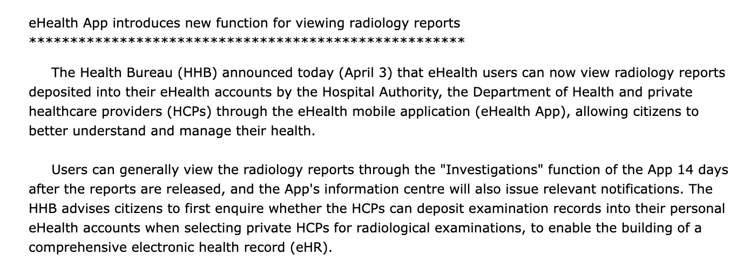
The Problem – Why this matters
Radiology reports are critical for diagnosis and patient management
Reports now directly accessible to patients (recent policy shift)
Major problem: Medical jargon → patient confusion, anxiety, misinterpretation
https://www.info.gov.hk/gia/general/202504/03/P2025040300250.htm
Notes:
Radiology reports provide timely, accurate, and actionable information to the patient care team, facilitating diagnosis and guiding patient management, which are pivotal in clinical decision-making, serving as the primary communication tool between radiologists and referring physicians for diagnosis and management guidance.(1[WC1] ). The advent of artificial intelligence (AI) and in particular large language models (LLMs) are poised to change radiological practice. A collaborative model of AI can be used to handle repetitive tasks in the future thereby radiologists are able to focus on more complex cases, patient communication and final decision-making. However, the successful integration of AI hinges on overcoming significant challenges related to data quality, model interpretability and clinical workflow integration

Slide 3
Current Limitations of AI Solutions
Existing AI uses "one-size-fits-all" approach
Critical gaps:
Fails to account for varying health literacy levels
Ignores cultural and linguistic diversity (crucial in Hong Kong)
Lacks personalization based on patient history
Trust barrier:
Concerns about AI hallucinations and patient safety

Slide 4
Research Gap & Innovation
Gap:
No validated system for personalized, multilingual, literacy-appropriate radiology reports
Our innovation
AI that adapts to:
Patient's education level
Disease knowledge
Preferred language (critical for Hong Kong context)
Self-management skills

Slide 5
Research Hypothesis & Objectives
Hypothesis:
Artificial Intelligence is able to provide a more personalised patient-centred communication for interpretation of radiology findings.
Primary Objectives
To build a validated AI algorithm that generates personalised radiology reports:
Convey accurate medical information
Use patient's preferred language
Match patient's education level and disease knowledge

Slide 6
Study Design Overview
Retrospective study
Using public, open-source datasets for preliminary training
Real radiology reports collected from Queen Elizabeth Hospital
Cohort
500 patients from QEH
100 for each imaging modality for X-ray, USG, CT, MRI and Mammography
English radiology reports and accompanied EHR data (structured and unstructured)
Notes:
Power Calculation: The power calculation of this study is based on a previous study by Elsie van Drisel who evaluate the effectiveness of GPT-4 in enabling patient comprehension of radiology reports, and showed that patient classification of report outcomes increased from 63.9% to 83.3%. Assuming GAI has a ~20% improvement in patient comprehension, a significance level (alpha) of 5%, power of 90% (1-beta), a sample size of 104 patients is necessary. With 5 different imaging modalities, this equates to ~500 patients in total[KC1] [SH2] .

Slide 7
Data Collection & Curation
Inclusion Criteria:
Patients with English radiology reports from QEH
Reports linked to electronic patient records (ePR)
Complete diagnostic information
Collection of Public Datasets:
Publicly available datasets which include English Radiology reports are downloaded
E.g. NIH Chest X rays, Padchest

Slide 8
Data Collection & Curation
Data Processing:
Anonymization of all patient data
Secure server storage
Standardization of quantitative measurements
Ground truth labeling: education level, disease knowledge, language preference, self-management skills

Slide 9
AI Model Development Pipeline
Model selection:
Compare state-of-art LLMs, supervised and unsupervised models (e.g. NLLB, Mistral 7B)
Dataset split:
70% training / 20% validation / 10% testing
Baseline performance assessment before fine-tuning
Fine-tuning objectives:
Improve medical accuracy
Enhance linguistic accuracy
Identify patient characteristics for personalization
Notes:
And then we will finetune it Reinforcement Learning from Human Feedback (RLHF)

Slide 10
Evaluation Framework (Multi-Dimensional Assessment)
Readability Metrics:
Flesch-Kincaid Grade Level
Chinese Readability Index Explorer 3.0
Clinical Accuracy:
Research team assessment of medical correctness
Appropriateness of information for patient level

Slide 11
Evaluation Framework (Multi-Dimensional Assessment)
Hallucination Mitigation:
Fact-checking against source reports
Radiologist review of AI outputs
Confidence scoring for uncertain content
Statistical Analysis:
Paired T-tests and ANOVA for continuous variables
McNemar's test for model comparison
Significance level: p < 0.05

Slide 12
Milestones
Month | Milestone | Deliverable
Nov 2025 | IRB submission & public data collection | Collected data for preliminary training
Nov-Dec 2025 | Data curation & labeling (Public Dataset) IRB approval & data collection at QEH | Labeled dataset with ground truth
Jan 2026 | Model selection & baseline testing | Performance benchmarks
Jan 2026 | Model fine-tuning (RLHF) | Improved model versions
Early Feb 2026 | Evaluation & validation | Test set results, statistical analysis
Mar 2026 | Thesis first draft submission | Thesis that includes quantitative results

Slide 13
Contingency Plans
Poor baseline model performance
Mitigation: Test multiple models and not to only limit with LLMs; consider ensemble approaches
Ethical approval delays
Mitigation: Parallel preparation of data infrastructure; use public datasets for pipeline testing
AI hallucinations persist
Mitigation: Implement rule-based fact-checking layer; require radiologist review for clinical deployment

Slide 14
Thank you!
Questions?

Slide 15
References
1. Mityul MI, Gilcrease-Garcia B, Mangano MD, Demertzis JL, Gunn AJ. Radiology Reporting: Current Practices and an Introduction to Patient-Centered Opportunities for Improvement. AJR Am J Roentgenol. 2018;210(2):376-85.
2. Reschke P, Booz C, Gruenewald LD, Koch V, Hohne E, Gokduman A, et al. Rethinking radiology reports: A survey of referring physicians' perspectives. Eur J Radiol. 2025;187:112068.
3. Rogers C, Willis S, Gillard S, Chudleigh J. Patient experience of imaging reports: A systematic literature review. Ultrasound. 2023;31(3):164-75.
4. Davis Giardina, T., et al. “Patient access to medical records and healthcare outcomes: A systematic review.” Journal of the American Medical Informatics Association, vol. 21, no. 4, 1 July 2014, pp. 737–741, https://doi.org/10.1136/amiajnl-2013-002239.
5. Wieland J, Quinn K, Stenger K, Cheng S, Acoba J. Patient Understanding of Oncologic Radiology Reports: Is Access to Electronic Medical Records Helpful? J Cancer Educ. 2023;38(3):895-9.
6. Alarifi M, Patrick T, Jabour A, Wu M, Luo J. Understanding patient needs and gaps in radiology reports through online discussion forum analysis. Insights Imaging. 2021;12(1):50.
7. Cook TS, Oh SC, Kahn CE, Jr. Patients' Use and Evaluation of an Online System to Annotate Radiology Reports with Lay Language Definitions. Acad Radiol. 2017;24(9):1169-74.
8. Kemp J, Short R, Bryant S, Sample L, Befera N. Patient-Friendly Radiology Reporting-Implementation and Outcomes. J Am Coll Radiol. 2022;19(2 Pt B):377-83.
9. Huisman M, Hannink G. The AI Generalization Gap: One Size Does Not Fit All. Radiol Artif Intell. 2023;5(5):e230246.
10. Balas, Michael, et al. “Translating ophthalmic medical jargon with artificial intelligence: A comparative comprehension study.” Canadian Journal of Ophthalmology, vol. 60, no. 4, Aug. 2025, https://doi.org/10.1016/j.jcjo.2024.11.003.
11. Amin KS, Davis MA, Naderi A, Forman HP. Release of complex imaging reports to patients, do radiologists trust AI to help? Curr Probl Diagn Radiol. 2025;54(2):147-50.
12. Busch F, Hoffmann L, Xu L, Zhang LJ, Hu B, Garcia-Juarez I, et al. Multinational Attitudes Toward AI in Health Care and Diagnostics Among Hospital Patients. JAMA Netw Open. 2025;8(6):e2514452.
13. Herwald SE, Shah P, Johnston A, Olsen C, Delbrouck JB, Langlotz CP. RadGPT: A System Based on a Large Language Model That Generates Sets of Patient-Centered Materials to Explain Radiology Report Information. J Am Coll Radiol. 2025;22(9):1050-9.
14. Dijkman EM, Ter Brake WWM, Drossaert CHC, Doggen CJM. Assessment Tools for Measuring Health Literacy and Digital Health Literacy in a Hospital Setting: A Scoping Review. Healthcare (Basel). 2023;12(1).

