Slide 1
Python Closure Demo
Quan Nguyen

Slide 2
Closure.py
class coffee(object): def outerF(self): menu = { 'espresso': '$2.10', '*espresso': lambda x: menu.update({'espresso': x}), 'mocha': '$4.15', '*mocha': lambda x: menu.update({'mocha': x}), 'latte': '$3.65', '*latte': lambda x: menu.update({'latte': x}), 'cappuccino': '$3.75', '*cappuccino': lambda x: menu.update({'cappuccino': x}), 'macchiato': '$2.65', '*macchiato': lambda x: menu.update({'macchiato': x}) } def innerF(self, item): if item in menu: return menu[item] else: return None return innerF run = outerF('whatever')

Slide 3
Closure.py
class starbucks(coffee): def outerF(self): menu = { 'macchiato': '$4.45', '*macchiato': lambda x: menu.update({'macchiato': x}) } def innerF(self, item): if item in menu: return menu[item] else: return super(starbucks, self).run(item) return innerF run = outerF('whatever')

Slide 4
Closure Demo Using ‘exec’ function in lis.py
import Closure c1 = Closure.coffee() s1 = Closure.starbucks() c1.run("*espresso")("$2.60") s1.run("*espresso")("$4.15") print c1.run("espresso") print s1.run("espresso") c1.run("*macchiato")("$2.20") s1.run("*macchiato")("$4.95") print c1.run("macchiato") print s1.run("macchiato")

Slide 5
Java Stream Ops Demo
James Thorpe

Slide 6
lis.py
import streamOp import makeObject import listComp env = Env() env.update(vars(math)) # sin, cos, sqrt, pi, ... env.update({ 'streamOp': lambda x: streamOp.ops(x[:]), 'where': lambda x: streamOp.where(x), 'orderby': lambda x: streamOp.orderBy(x), 'jArray': lambda x: makeObject.jarray(x),

Slide 7
makeObject.java
import java.util.*; public class makeObject { public static Object jarray(List<Object> arg) { List<Object> output = new ArrayList<Object>(); for (Object item: arg) { //System.out.println(item.getClass()); output.add(item); } return (output); } }

Slide 8
streamOp.java
public class streamOp { public static List<Object> where(List<ArrayList<Object>> arg) { List<Object> output = new ArrayList<Object>(); arg.stream() .filter(e -> (Integer) e.get(0) < 40) .forEach (e -> {output.add(e);}); return (output); }

Slide 9
streamOp.java
public class streamOp { //code for "order by" opertation public static List<Object> orderBy(List<ArrayList<Object>> arg) { List<Object> output = new ArrayList<Object>(); arg.stream() .sorted((e,a) -> ((Integer)e.get(0)).compareTo((Integer)a.get(0))) .forEach (e -> {output.add(e);}); return (output); }

Slide 10
Python Lambda & List Comprehension Demo
Quan Nguyen

Slide 11
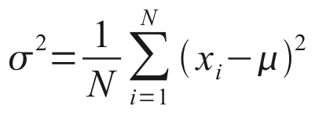
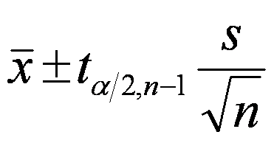
listComp.py
def intersection(x, y): return {i for i in x for j in y if i == j} def statistics(x): mean = round(float(sum(x))/float(len(x)),4) median = round((float(x[len(x)/2 - 1]) + float(x[len(x)/2]))/2,4) if len(x) % 2 == 0 else x[len(x)//2] listRange = x[len(x)-1] - x[0] variance = (lambda l: round(sum(l)/len(x),4))(map(float,[(i - mean)**2 for i in x])) tscore = (12.706,4.303,3.182,2.776,2.571,2.447,2.365,2.306,2.262,2.228, 2.201,2.179,2.160,2.145,2.131,2.120,2.110,2.101,2.093,2.086, 2.080,2.074,2.069,2.064,2.060,2.056,2.052,2.048,2.045,2.042, 2.040,2.037,2.035,2.032,2.030,2.028,2.026,2.024,2.023,2.021) CI = (lambda a, b: [round(a - b,4), round(a + b,4)])(mean, tscore[len(x)-2]*(variance/len(x))**0.5) stats = ['mean', 'median', 'range', 'variance', 'standard deviation', '95% CI for mean'] values = [mean, median, listRange, variance, round(variance**0.5,4), CI] return [(stats[i], values [i]) for i in range(len(stats))]

Slide 12
Add ‘intersection’ and ‘statistics’ functions to lis.py
def standard_env(): ... import listComp
env = Env()
...
env.update({
...
'intersection': lambda x,y: listComp.intersection(x,y), 'statistics': lambda x: listComp.statistics(sorted(x)), })
return env

Slide 13
Lambda & List Comprehension Demo
(intersection (list 1 5 3 9 7 8) (list 8 2 6 3 5 0 9))
(intersection (list 1 1 5 5 5 5 3 3 3 9 8 8 7) (list 2 2 6 3 3 5 5 5 0 0 8 8 8 9))
(statistics (list 5 36 4 27 1 11 34 95 83 3 2) )
(statistics '(5 36 4 27 1 11 34 95 83 3 2))

Slide 14
Java Stream Ops Demo
James Thorpe

Slide 15
Bugs Fixed
1) fixed some of ? operations 'iseq': op.is_, 'isequal': op.eq, 'islist': lambda x: isinstance(x,list), 'isnumber': lambda x: isinstance(x, Number), 2) added negative operator 'neg': lambda x: -1 * x,

Slide 16
Willow Programming Language
Ryan Wechter

Slide 17
What goes into building a programming language?
Identify a problem to solve
General purpose or specific to problem domain
Consider language semantics
Reserved words, built-in functions, data types, logical and mathematical operators, data storage, flow control
Define syntax/grammar rules
Parse input to create AST. Evaluate AST to execute program

Slide 18
Scope of Implementation
Print Statements
Comments
Variable Instantiation, Assignment and Access
If Else Statements
Logical and Mathematical Operators
Function Definition and Calls (without parameters)
Casting (float to int)

Slide 19
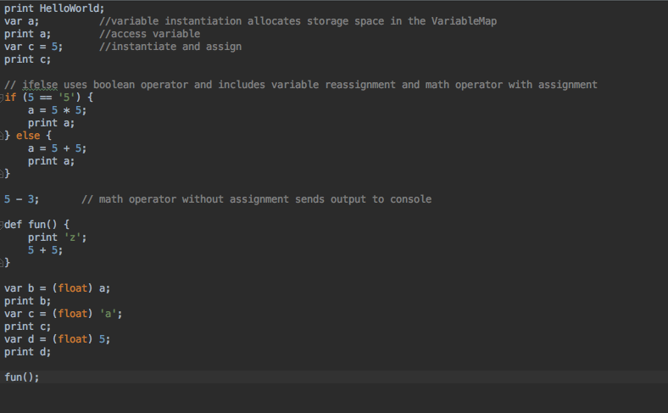
Tester Code

Slide 20
Abstract Syntax Tree
['Print', 'HelloWorld', 'VariableInst', 'a', 'Comment', 'Print’, 'a', 'Comment',
'VariableDeclaration', 'c', 5, 'Comment', 'Print', 'c', 'Comment',
'IfElseStatement', False,
['MathAssExp', 5, 5, '*', 'a', 'Print', 'a'],
['MathAssExp', 5, 5, '+', 'a', 'Print', 'a'],
'MathExp', 5, 3, '-', 'Comment',
'DefineFunction', 'fun', ['Print', "'z'", 'MathExp', 5, 5, '+'],
'FloatCast', 'b', 'a', 'Print', 'b', 'FloatCast', 'c', "'a'", 'Print', 'c',
'FloatCast', 'd', 5, 'Print', 'd', 'CallFunction', 'fun']

Slide 21
Interpreter Output
HelloWorld
0
5
10
2
10.0
cannot cast str to float
'a'
5.0
'z'
10

