Slide 1
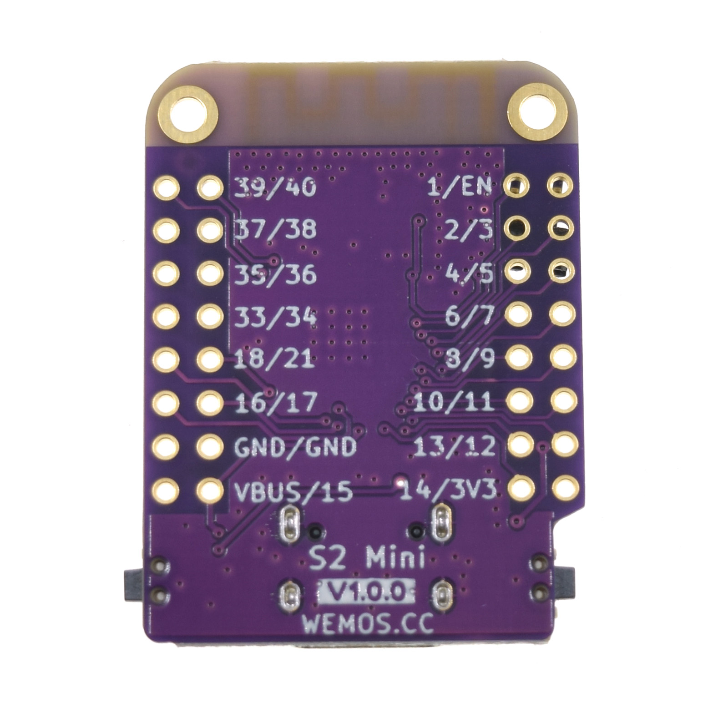
CN105
GND
5V
Tx
Rx
1
5
12V
DO NOT USE

