Slide 1

Introduction to Leaflet
Reina Chano Murray
JHU Data Services

Slide 3
Agenda
An Overview of Leaflet
What is Leaflet?
What does it do? What does it not do?
What do you need to know to get started?
Demonstration
Questions

Slide 4
An Overview of Leaflet

Slide 5
What is Leaflet?
Created 11 years ago by Volodymyr Agafonkin, a Ukrainian citizen and currently a developer at MapBox
The leading open-source JavaScript library for creating mobile-friendly, interactive maps
What is JavaScript (JS)?
One of the core programming language for web development
Can be used for both front-end (visual aspects of a website) and back-end development (website structure, system, data, etc)

Slide 6
What is Leaflet?
Lightweight, simple and flexible
Extendible base features can be extended via plugins (such as Leaflet for R, Esri Leaflet)
Interoperable (mobile and desktop friendly)

Slide 7
What does Leaflet do?
Put simply, Leaflet is a framework to create web maps (maps accessible via a web browser) with data and to interact with said data.

Slide 8
What does Leaflet do?
Interactive:
Able to zoom and pan around (Slippy)
With layers that can be turned on or off, moused over/clicked on for information

Slide 9
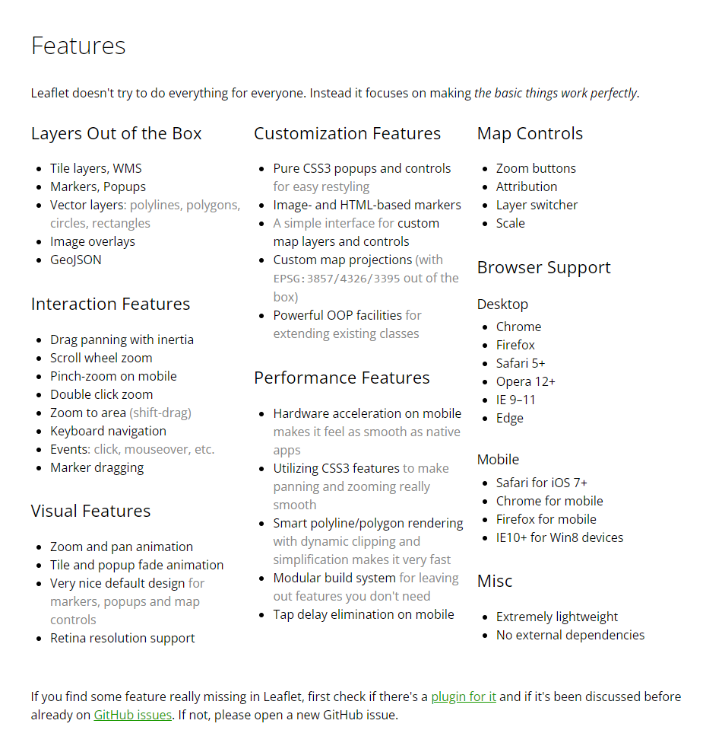
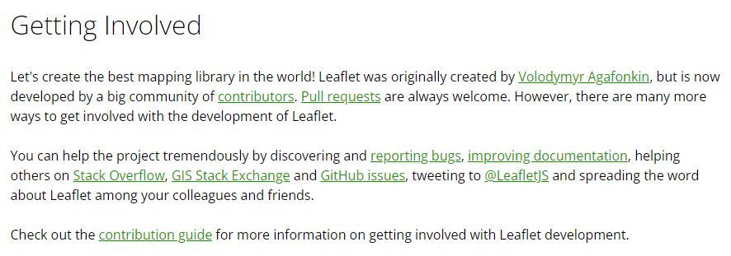
What does Leaflet do?
Read over documentation at https://leafletjs.com/
Open Source Contributions

Slide 10
What does Leaflet NOT do?
Does NOT provide data – you provide the data!
Is NOT a GIS replacement – not a system to manage, clean and analyze spatial data
Can be used together with GIS (Mapbox, Carto, Esri)

Slide 11
What do You Need to Know?
Basic knowledge of HTML & CSS
Basic knowledge of Javascript
…or the willingness to learn and tinker around

Slide 12
How do I start? Demo time!

Slide 13
Demonstration
What We’ll Cover
Creating a base HTML file
Referencing Leaflet CSS and Leaflet JavaScript into HTML file
Creating a Map div (division) element
Initializing Map
Adding Layers and Data to Map

Slide 14
Resources to Keep Learning
https://leafletjs.com/examples.html
https://handsondataviz.org/
https://tomik23.github.io/leaflet-examples/#01.simple-map
https://rstudio.github.io/leaflet/

Slide 15

Fall 2022 Data Bytes Schedule
GIS and Maps
Programming
All sessions are on Mondays from 12 to 1 pm.
Finding Maps and Map Data
Speeding up your Python Code
More info at: bit.ly/data-bytes
Sept 12th
Oct 10th
Choosing a Python IDE
Introduction to Leaflet
Sept 19th
Oct 17th
Thank you
for attending!
Please complete our survey at:
bit.ly/data-bytes-survey
Creating Infographics in
Business Analyst
Advanced StoryMaps
Tips and Tricks
Sept 26th
Oct 24th
Debugging your Python Code
Introduction to APIs in R
Oct 3rd
Oct 31st

Slide 16
Questions?

