Slide 1

Peter Lawson, Ph.D.
Data and Visualization Librarian
Digital Scholarship and Data Services plawson@jhu.edu
Combining Python {CODE}
and Documentation
An Introduction to Jupyter Notebooks and JupyterLab

Slide 2






Helping you
Contact JHU Data Services
GO TO
dataservices.library.jhu.edu
EMAIL
dataservices@jhu.edu
SHARE DATA AT
archive.data.jhu.edu
DATA
SURVEY
bit.ly/dsds-survey

Slide 3
Imagine you want to know how your colleague has cleaned their data.

Slide 4
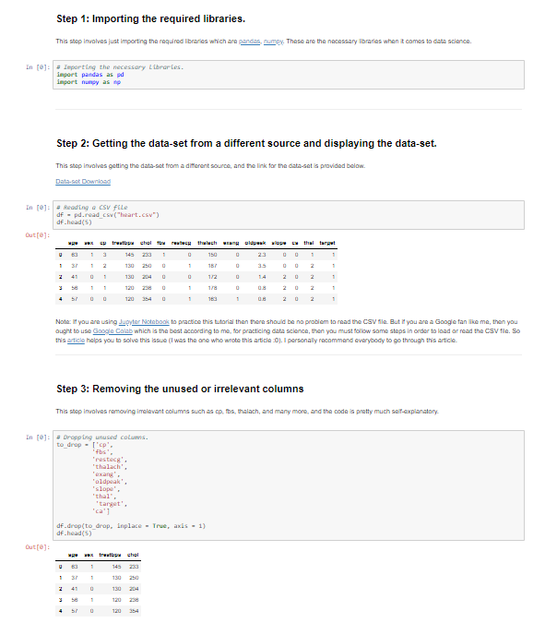
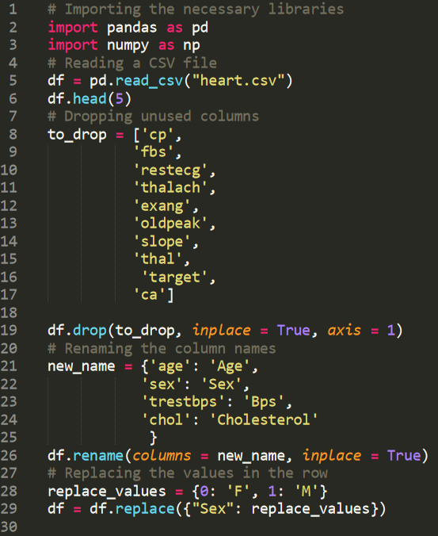
Which would be easier to understand?
Notebook
Script

Slide 5
What is an ”Interactive Notebook”?

Slide 6
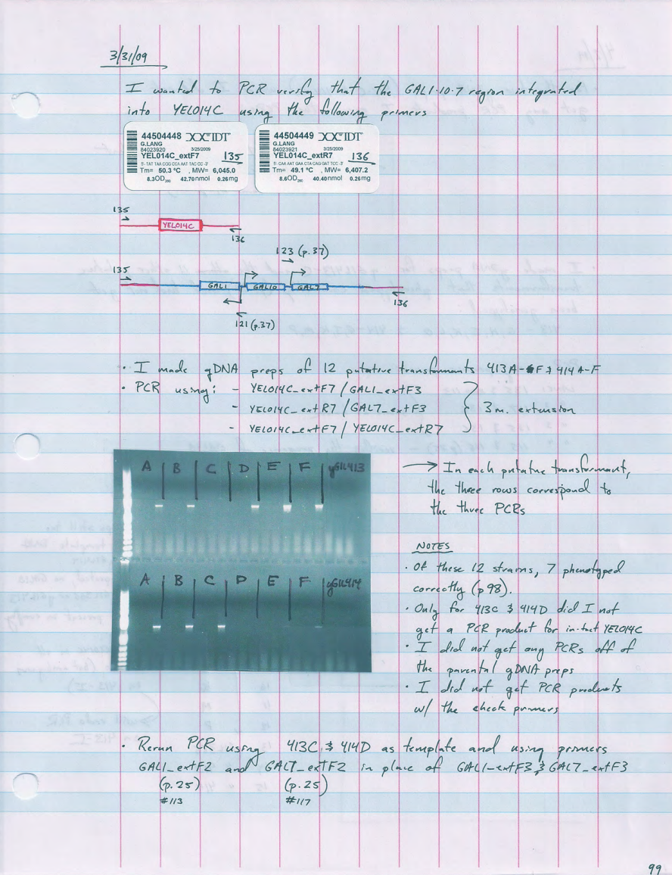
Interactive Notebooks
Weave together documentation and executable code
Typically made of cells that can be run individually to explore step-by-step results
Can be general purpose or specific to a programming language or discipline.

Slide 7
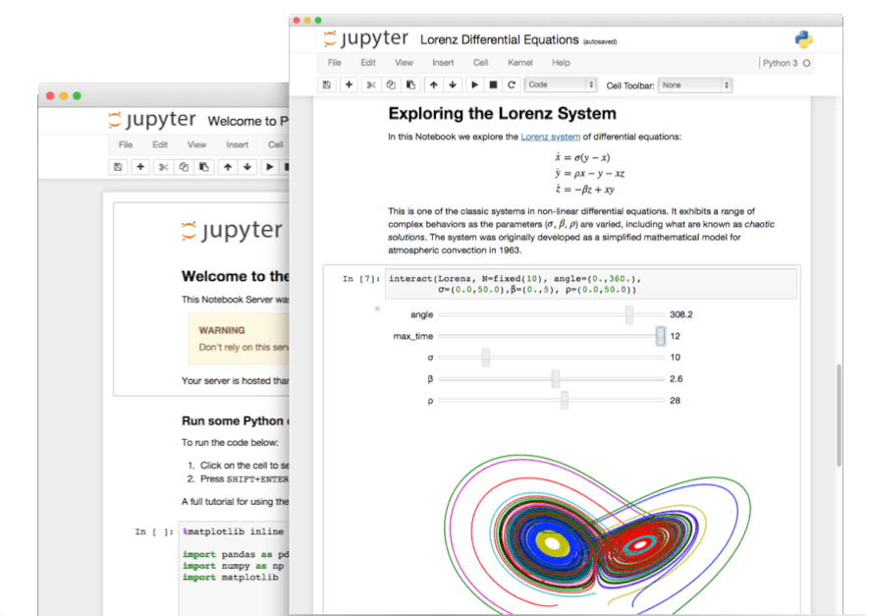
Jupyter Notebooks
Interactive notebooks for data analysis and visualization
Can execute code, or display formatted text, using markdown
Supports multiple programming languages (Python, R, Julia, Fortran and more) through kernels, software that executes code.
Can be shared directly, or in other formats
Notebook Website | Slides PDF Document

Slide 8
Key Concepts
Jupyter Notebook

Slide 9
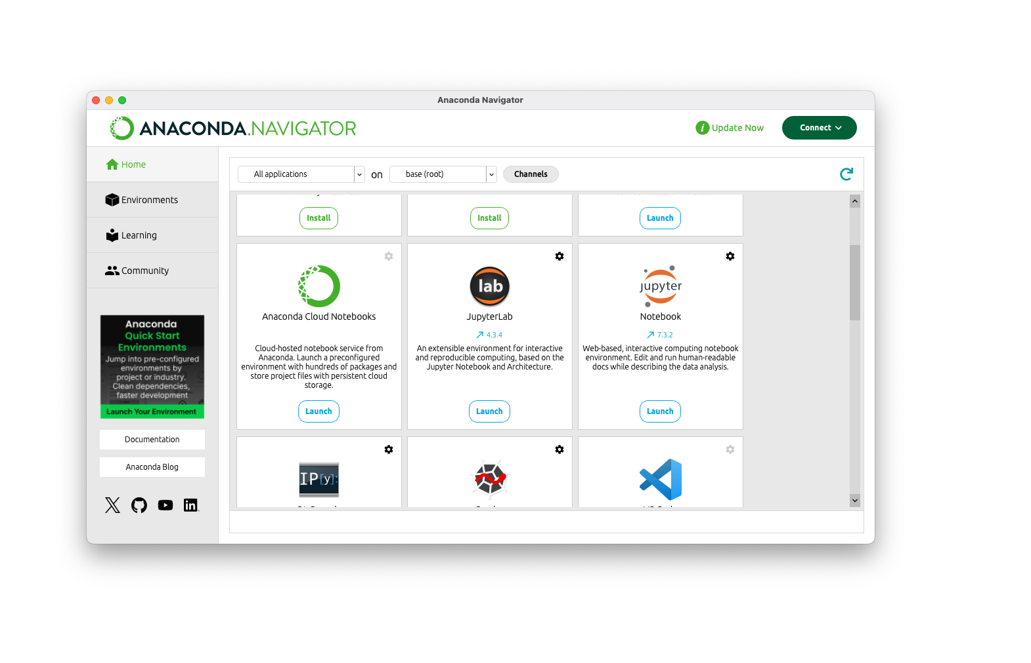

Slide 10
Jupyter Lab
Interactive notebooks for data analysis and visualization
Can execute code, or display formatted text, using markdown
Supports multiple programming languages (Python, R, Julia, Fortran and more) through kernels, software that executes code.
Can be shared directly, or in other formats
Notebook Website | Slides PDF Document

Slide 12
What is reproducible code?
Can someone else, or you six months from now, run your work from start to finish and get the same results?
Notes:
About 3 minutes. Reproducible: another person (or you, later) can run your work from start to finish and get the same results. Distinguish briefly: reproducible means the same data and code give the same results; replicable means new data gives consistent conclusions. A notebook is reproducible only if it runs top to bottom on a fresh kernel, and someone else can find the data and install the packages.

Slide 13
Is this notebook reproducible? Why or why not?
Open bad_example.ipynb and skim it for 3 minutes. Share your answer in the chat.
Notes:
7 minutes. Give learners 3 minutes to skim, then ask in chat. Sort answers into themes on screen as they arrive and do not correct them yet. Flaws the notebook should contain: execution numbers out of order; a variable used before it is defined (hidden state); an absolute file path like C:\Users\...; imports scattered through the notebook; no markdown or explanation; unlabeled plots; no README or package list. If few learners respond, ask for a one-word yes or no first, then reasons, or call on a named person.

Slide 14
Reproducibility tips: code
Restart & Run All
Run it top to bottom on a fresh kernel. If it fails, it isn't reproducible.
Keep cells in order
Your analysis should flow from top to bottom.
Use relative paths
Keep data in a folder next to the notebook, such as data/.
Imports and seeds first
Put imports and random seeds in the first code cell.
Notes:
Tips 1 to 4 of 8. Map each to a flaw learners just named. Restart & Run All is the one-click reproducibility test. Also mention clearing stale output or re-running before sharing, so saved output matches the code.

Slide 15
Reproducibility tips: sharing
Explain in markdown
Add a title, a purpose, and a heading before each step.
Record your environment
List package versions in environment.yml or requirements.txt.
Separate the stages
Separate the major steps of your analysis, such as cleaning, analysis, and visualization
Add a README
Say what the project is, how to run it, and what each file does.
Notes:
Tips 5 to 8 of 8. Tips 7 and 8 set up Exercise 2. About 8 minutes for both tip slides together.

