Slide 1
Unserious Data: JHU in film
Asking research questions and finding answers with data

Slide 2
Today’s Agenda
Asking questions of data
Scoping a question
JHU in film
  Did the appearance of JHU in the movies effect application rates?
    Finding the data we need
    Preparing the data
    Analyzing the data
Ask questions or make notes in https://pad.carpentries.org/unserious
Notes:
Not all data has to be in service of some very important research project. Sometimes, we just have a weird question we’d like to explore. Today we’re going to go through the process of moving from question, to data, to breaking the question down into actions the computer understands, to data analysis.

Slide 3
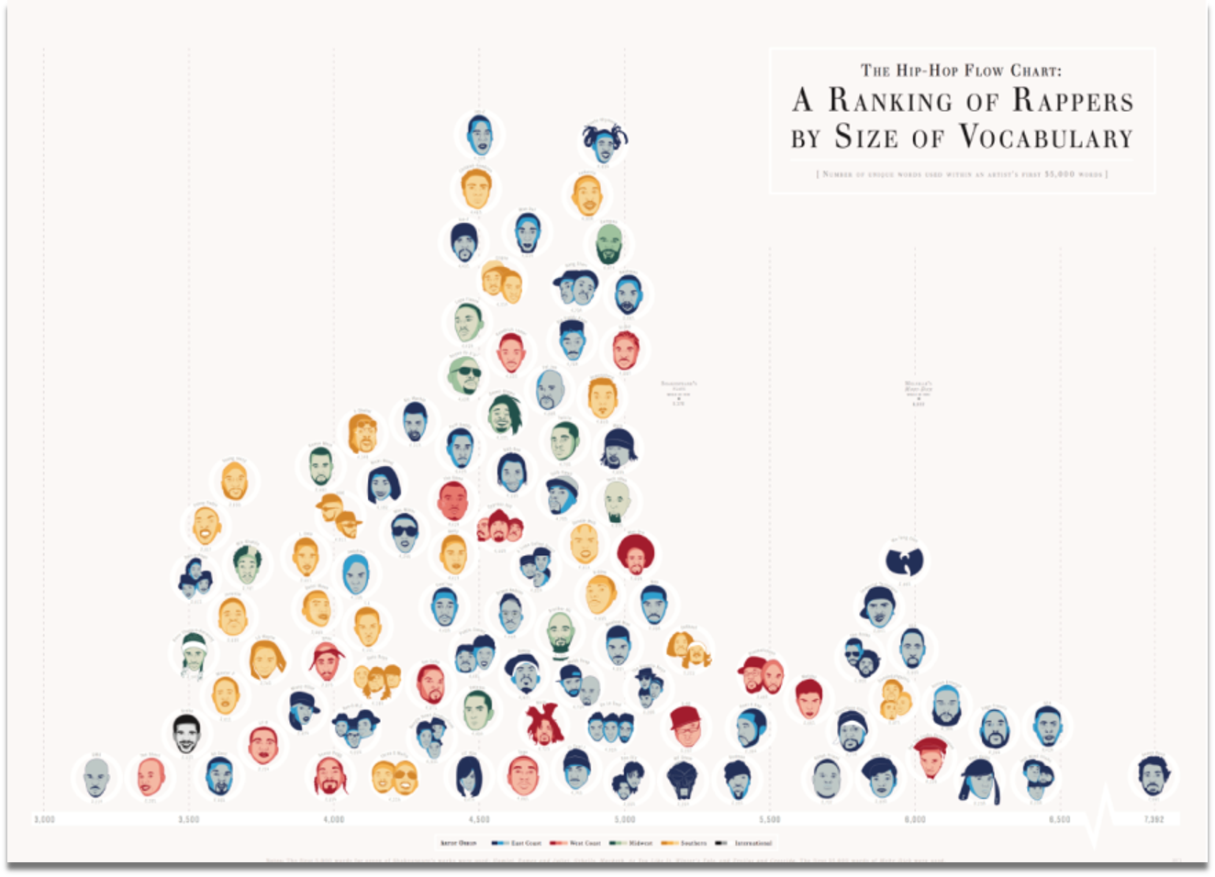
https://pudding.cool/projects/vocabulary/index.html
Notes:
To get a feel for what we mean, here’s one of my favorite examples of unserious data. It’s a chart that ranks rappers by the size of their vocabulary, color coded by geographic area (south, east coast, west coast, midwest really Chicago). The two dotted lines are Shakespeare and Melville who are famous for their large vocabularies as writers. It’s from 2014 so it doesn’t have newer artists, but DMX is on the left with the smallest vocabulary and Aesop Rock on the left with the largest.
I love it, but how did they make it? We’ll reverse engineer their process and dissect their methodology.
This website has a lot of other examples of unserious data analysis, like the size of women’s pockets and the gender of animals in kids’ books.

Slide 4
Scoping a question
Rappers ranked by size of vocabulary
Not about:
Style/Genre
Popularity
Album Sales
Flow
Data
Notes:
First, let’s look at the title. It’s very specific and only rates the size of their vocabulary, not their style, popularity, album sales, or flow. The data chosen therefore only needs to reflect vocabulary and doesn’t need to account for these other factors.

Slide 5
Translating questions to computation
How do you measure “vocabulary” computationally?
How do rappers rank by the “size of vocabulary?”
  Here size = number of unique words (strings that only appear once in an individual rapper’s lyrics) by %
Who uses the most complex words?
  Complex = longest
  Find length of strings and rapper who uses the longest strings by %
Who uses the most neologisms (new words)?
  Compare corpus to dictionary corpus
  Find what words in your corpus are NOT in the dictionary
  Rank rappers by % of neologisms
Notes:
So what does vocabulary mean to a computer? These are a few options of how this data might be interpreted.
In this instance, it’s the first option. They took the first 35,000 words in an artist’s body of lyrics and noted the percent of words, measured computationally by the number of strings (characters), that were only used once, and plotted the results on this bar chart

Slide 6
JHU in Film
Does the appearance of JHU in the movies effect application rates?

Slide 7
Asking Questions of Data
What do you want to know?
  What questions do you have?
  How would you test these questions computationally with the data you have?
What’s in your data?
  What do you have?
  What’s missing?
Collaborative doc for any questions you have of our data, or more broadly how to do the analysis in Python https://pad.carpentries.org/unserious
Notes:
Let’s look at the data we have.

Slide 8
Finding the data
Does the appearance of JHU in the movies effect application rates?
What do we need for data?
  List of JHU appearances in film
  application rates
What about time?
  Appearance in film likely released before we see a change in applications
    films by year
    application rate by year
      Find the application rate of the year after the film
Notes:
Let’s breakdown our specific question:
What do we need for data?
List of JHU appearances in film
applications rates
What about time?
Appearance in film likely released before we see a change in applications
films by year
application rate by year
Find the application rate of the year after the film

Slide 9
Translating data to computation
Does the appearance of JHU in the movies effect application rates?
Get the film list to match up with application rates
  Join
Get only the application rate for the years of the films
  Filter
  Create new dataframe
Visualize the results
  ggplot2 (what is this in Python?)
  Line graph of movies with a different color for each one over a bar graph of application rates
Notes:
Computers are dumb and do exactly what we tell them to do. So now that we have the data how do we analyze it?

Slide 10
Translating data to computation
Does the appearance of JHU in the movies affect application rates?
Data sources we have:
  List of films and shows that feature JHU from JHU blog post
  Application and acceptance data from IPEDs
  Information about films from IMDB
How do we get this data to “talk to each other”? What preparation do we need to do to be ready to answer our research question?

Slide 11
Data Preparation
Does the appearance of JHU in the movies affect application rates?
List of films and shows that feature JHU from JHU blog post
  Scrape title and year from website
Application and acceptance data from IPEDs
  Download the data for the years that our movies and shows span
  Combine the data from all years
  Calculate acceptance rate in each year
Information about films from IMDB
  Pull IMDB data for the titles from the blog post
  Decide what variables we want to analyze

Slide 12
Data Preparation
Does the appearance of JHU in the movies affect application rates?
JHU in Film list | IMDB Data | IPEDS Data
Title | Title
Year | Year | Year
 |  | Acceptance Rate
 | Genre
 | Rating

Slide 13
What do we see?
Does the appearance of JHU in the movies effect application rates?
How do we answer this question given the graph we just made?
  No is an answer
  I can’t tell from this graph is an answer
Where would you go from here?
What else would you ask from this data?
Notes:
Does this graph tell us anything?
What would you want to know next? (consult the collaborative doc)
Application rates on a longer time span
Were the movies actually good?
Rotten Tomatoes score
Film gross income (if we have this data)
Does a certain genre affect the numbers more than others?
[Can we do this kind of thing on the fly? Should there be “canned” other avenues of exploration?]

Slide 14
Thank You!
Pete Lawson
Emily McGinn
Lubov McKone
dataservices.library.jhu.edu

