Slide 1
Spire: Intrusion-Tolerant SCADA for the Power Grid
Yair Amir, Amy Babay, Sam Beckley
Johns Hopkins University, Computer Science
John Schultz
Spread Concepts LLC

Slide 2
SCADA Migrating to IP Networks
Traditional SCADA systems ran on proprietary networks
Created air gap from outside world and attackers
Cost benefits and ubiquity of IP networks are driving SCADA to use IP networks
Exposes SCADA to hostile environments, removing the air gap
Raises additional concerns because SCADA systems are:
In service for decades
Running legacy code with well-known exploits
Increasingly becoming a target for attackers
Stuxnet (2010)
First sophisticated SCADA attack in the wild targeting ICS

Slide 3
SCADA is Vulnerable on Several Fronts
The move to IP makes SCADA vulnerable on several fronts:
SCADA system compromises
SCADA Master – system-wide damage
RTUs, PLCs – limited local effects
HMIs
Network level attacks
Routing attacks that disrupt or delay communication
Isolating critical components from the rest of the network
HMI
Primary
SCADA Master
Backup
SCADA Master
PLC
RTU
Physical
Equipment
Physical
Equipment

Slide 4
Spire
Spire is an intrusion-tolerant SCADA system for the power grid: it continues to work even if some critical components have been compromised
Intrusion tolerance as the core design principle:
Intrusion-tolerant network
Intrusion-tolerant consistent state
Intrusion-tolerant SCADA Master
Open Source - http://dsn.jhu.edu/spire

Slide 5
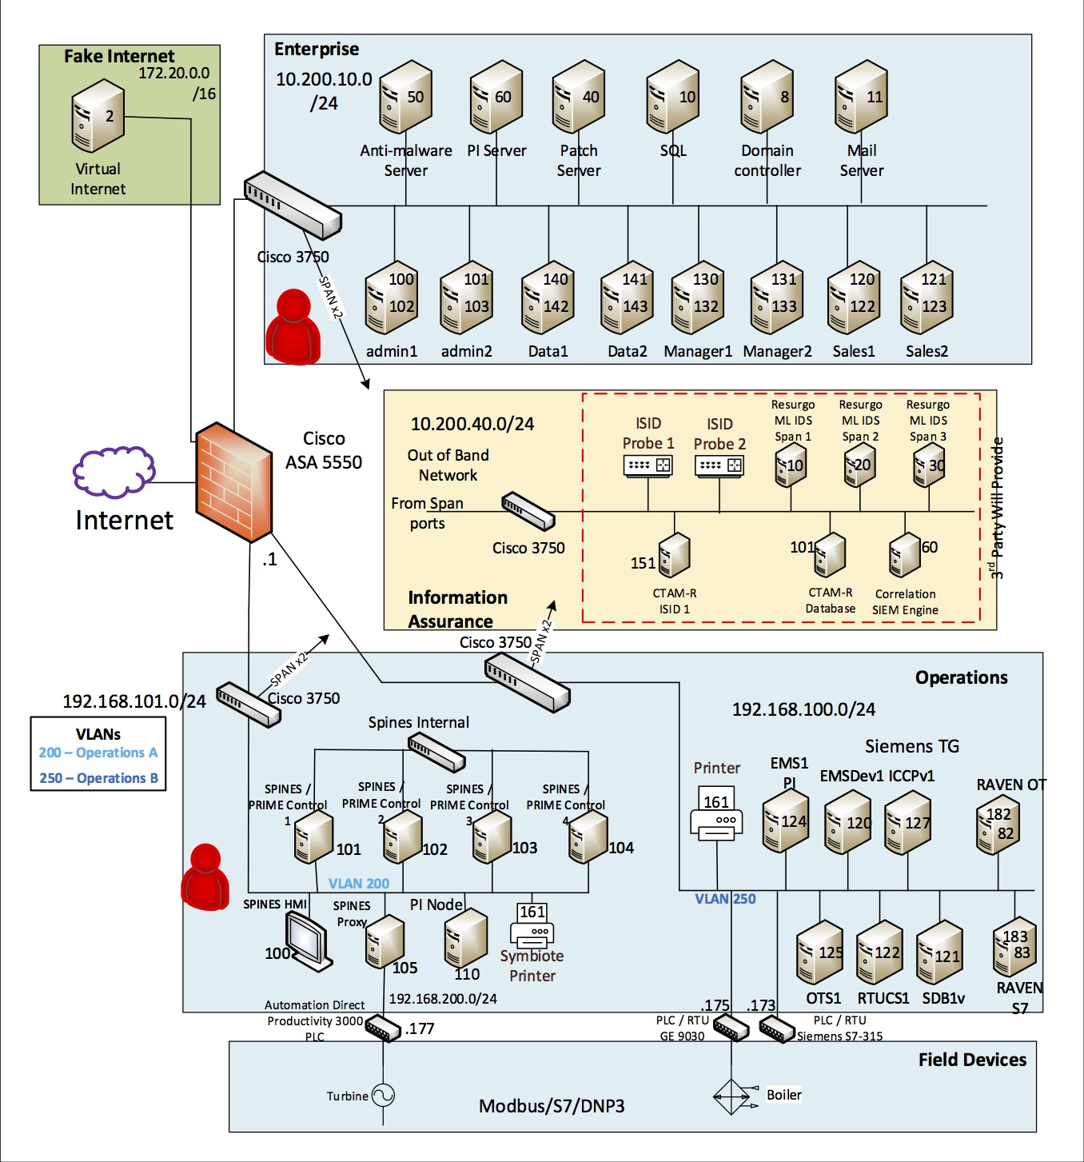
DoD ESTCP Results
NIST-compliant system completely taken over
MITM attack from corporate network
Direct access to PLC from operational network
Spire completely unaffected
Attacks in corporate and operational network
Given complete access to a replica and code
Red team gave up after several days

Slide 6
Defense Across Space and Time
Byzantine Fault Tolerant Replication (BFT)
Correctly maintains state in the presence of compromises
3f+1 replicas needed to tolerate up to f intrusions
2f+1 connected correct replicas required to make progress

Slide 7
Defense Across Space and Time
Byzantine Fault Tolerant Replication (BFT)
Correctly maintains state in the presence of compromises
3f+1 replicas needed to tolerate up to f intrusions
2f+1 connected correct replicas required to make progress
What prevents an attacker from reusing the same exploit to compromise more than f replicas?

Slide 8
Defense Across Space and Time
Byzantine Fault Tolerant Replication (BFT)
Correctly maintains state in the presence of compromises
3f+1 replicas needed to tolerate up to f intrusions
2f+1 connected correct replicas required to make progress
Diversity
Present a different attack surface so that an adversary cannot exploit a single vulnerability to compromise all replicas
Multicompiler from UC Irvine

Slide 9
Defense Across Space and Time
Byzantine Fault Tolerant Replication (BFT)
Correctly maintains state in the presence of compromises
3f+1 replicas needed to tolerate up to f intrusions
2f+1 connected correct replicas required to make progress
Diversity
Present a different attack surface so that an adversary cannot exploit a single vulnerability to compromise all replicas
Multicompiler from UC Irvine
What prevents an attacker from compromising more than f replicas over time?

Slide 10
Defense Across Space and Time
Byzantine Fault Tolerant Replication (BFT)
Correctly maintains state in the presence of compromises
3f+1 replicas needed to tolerate up to f intrusions
2f+1 connected correct replicas required to make progress
Diversity
Present a different attack surface so that an adversary cannot exploit a single vulnerability to compromise all replicas
Multicompiler from UC Irvine
Proactive Recovery
Periodically rejuvenate replicas to a known good state to cleanse any potentially undetected intrusions
3f+2k+1 replicas needed to simultaneously tolerate up to f intrusions and k recovering replicas
2f+k+1 connected correct replicas required to make progress

Slide 11
Spire Architecture: Single Control Center

Slide 12
Beyond a Single Site
To protect against sophisticated network attacks, Spire supports multiple control sites
Since it is expensive to construct control sites, Spire is able to operate with two control sites plus additional sites that can be served by commodity data centers (that lack the ability to communicate with RTUs and PLCs in the field)

Slide 13
Novel Resilient Configuration
3+3+3+3
(progress: 7)
Data Center 1
Data Center 2
SM
SM
SM
SM
SM
SM
Control Center 1
Spines
Control Center 2
HMI
SM
SM
SM
SM
SM
SM
HMI
Spines
RTU
RTU
…
Physical
Equipment
Physical
Equipment
Substation
Substation

Slide 14
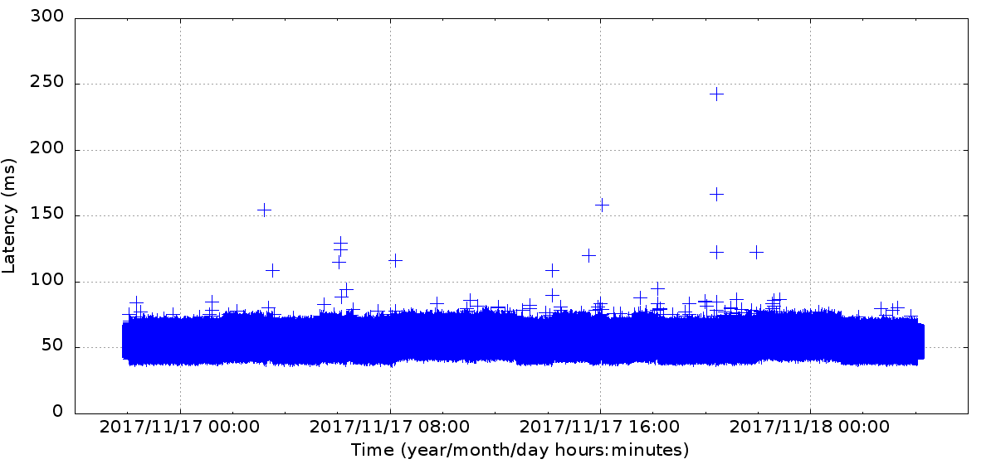
Wide Area Update Latency Plot
30-hour wide-area deployment of configuration 3+3+3+3
Control centers at JHU and SVG, data centers at WAS and NYC
10 emulated substations sending periodic updates
1.08 million updates (108K from each substation)
Nearly 99.999% of updates delivered within 100ms (56.5ms average)

Slide 15
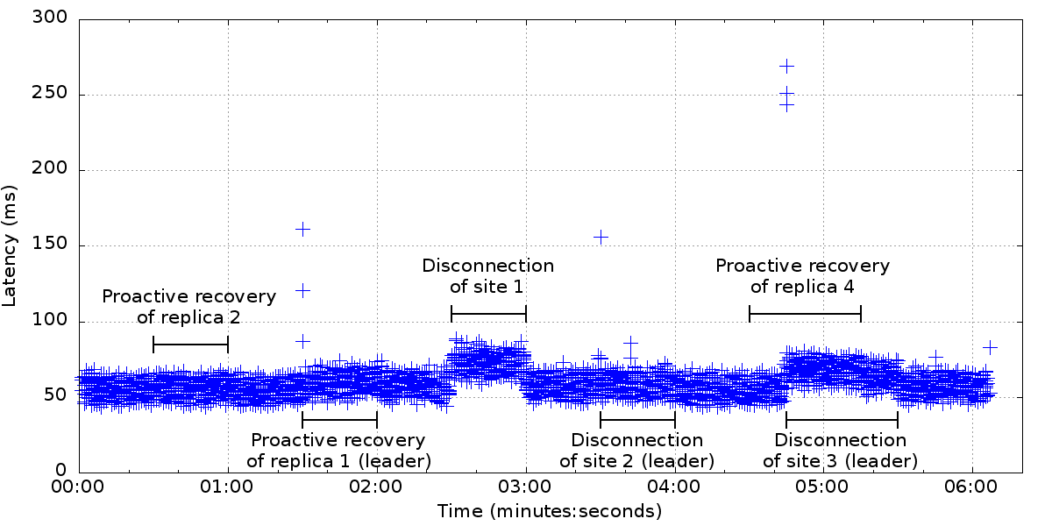
Wide Area: Latency Under Attack
Targeted attacks designed to disrupt the system
All combinations of site disconnection (due to network attack) + proactive recovery

Slide 16
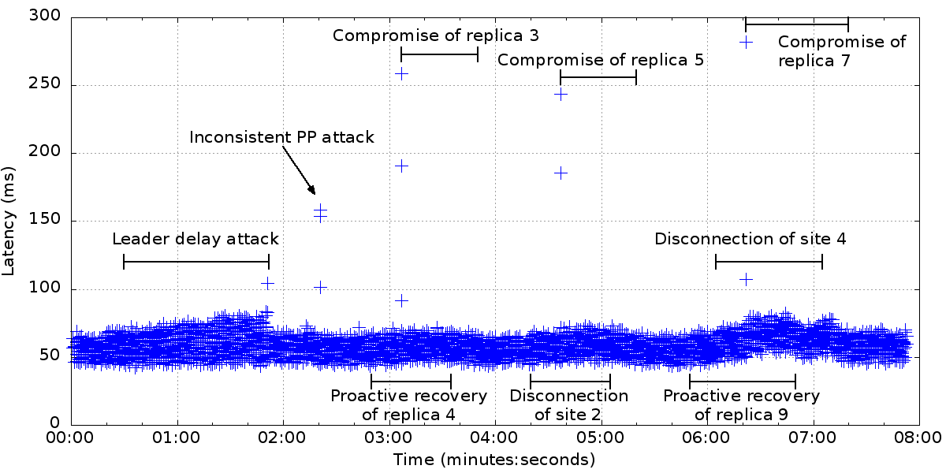
Wide Area: Latency Under Attack
Targeted attacks designed to disrupt the system
All combinations of intrusion + site disconnection (due to network attack) + proactive recovery

Slide 17


The Spire Forum
Forum focused on open source intrusion-tolerant control systems for the power grid
Please join the Spire forum if interested
http://dsn.jhu.edu/spire
Distributed Systems and Networks Lab

