Slide 1
Dynamic Load Balancing and Instantiation
Brian Duddie

Slide 2


Need for a Solution
mod_backhand: good approach to load balancing, but does not support Apache 2, no support planned
mod_proxy_balancer: Apache 2 built-in, but only simple balancing algorithms available (round robin)

Slide 3
Need for a Solution
No solution to “Slashdot effect” except increase hardware capacity
  Hosting service point of view: best to suspend until traffic subsides to keep other clients happy
    Usually requires manual intervention
    May have already experienced service interruption
  Website owner point of view: want to keep site online
    Can make low-bandwidth, static version of page
    Requires manual intervention, site owners don't know when it will happen, most likely first notification is when the site goes offline

Slide 4
Need for a Solution
Hosting provider has more resources available than individuals
  Most of the resources are unused most of the time
  Best interest of company & client to be able to allocate unused resources when needed
    No economical way to do this currently

Slide 5
Project Goals
Design and implement a load balacing solution for Apache 2 which decides based on load (a “smart” algorithm)
Create a system which will allow websites to expand and contract capacity on-demand, giving the benefit of the scalability of a large cluster to every website hosted in the cluster, without the overhead of keeping them on all servers at all times

Slide 6
Load Balancer Overview
Use existing mod_proxy_balancer infrastructure
Add messaging layer to distribute knowledge (daemon)
Create Cost-Benefit algorithm to give load scores to servers in cluster
Add load balancer method in mod_proxy_balancer to utilize this information (bycost)

Slide 7
Load Balancer Implementation
Spread used as multicast toolkit
Program written to gather information from /proc/stat and /proc/meminfo pseudofiles
Raw data converted into percent usage values

Slide 8
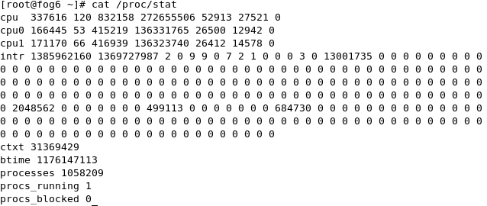
Load Balancer Implementation
/proc/stat: Information given about CPU time spent doing a certain task, unit is 1/100th of a second
  Order: user, user-nice, system, idle
  Delta calculated, percent usage = (total – idle) / total

Slide 9
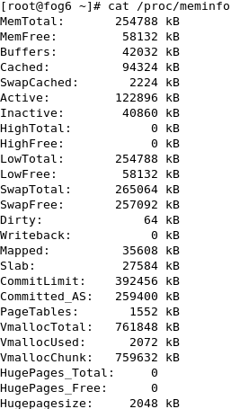
Load Balancer Implementation
/proc/meminfo: Not as straightforward
MemFree != Memory available for use, usually this is much less than the actual amount available
Inactive memory is available for quick reallocation
Used = (Total - (Free + Inactive)) / Total
Slight overestimate

Slide 10
Load Balancer Implementation
Percent values for CPU and memory are converted into scores via exponential function:
n = number of servers
c = CPU usage (%)
m = memory usage (%)
score = n^c + n^m
Score gets higher faster when resource is getting scarce, effect amplified when more servers available (helps differentiation)
A Cost-Benefit Approach to Resource Allocation in Scalable Metacomputers (R.Sean Borgstrom)

Slide 11
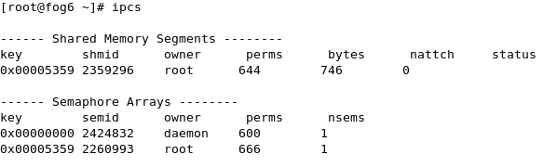
Load Balancer Implementation
Problem: how to get data to Apache module?
Solution: Shared Memory, protected by semaphores
  Fast and thread safe approach
  Allows Apache read-only access to data

Slide 12
Results
It works!
Project developed to proof-of-concept form, shown to work as expected
Stress tested with Apache's benchmarking tool ab
Once working, moved on to next part of project
  No performance benchmarks completed, debug output from Apache and mod_proxy_balancer left enabled

Slide 13
Dynamic Instantiation Overview
Example of intended functionality:
CompanyX hosts 2,000 websites on 8 servers
Websites exist on at least 2 servers and at most 8
Medium-traffic site1.com exists on servers 2, 4, and 7
One day, site1.com posts interesting content
  Makes front page of digg.com and reddit.com simultaneously
  Site administrator is unaware – his website has boomed from 500 unique visitors per day to 5,000 per hour

Slide 14

Dynamic Instantiation Overview
If site1.com were in a normal shared hosting environment, it would either bring the server and hundreds of other websites hosted on the machine to a crawl, or even crash the server and/or get suspended (usually after the load causes problems)

Slide 15

Dynamic Instantiation Overview
But, site1.com is hosted on my system:
  Algorithm recognizes the spike in demand and instantiates site1.com on all the servers automatically
  No servers go down, no other websites on the servers are noticeably affected by the increased visitors

Slide 16
Dynamic Instantiation Overview
After the initial spike has subsided, the algorithm decides that site1.com now only needs 4 servers
  Contracts from 4 servers with the heaviest load, in order, until “balance” obtained
Expansion & contraction effectively creates automatic migration of websites
  Gives optimal distribution of websites across servers in the cluster

Slide 17
Dynamic Instantiation Implementation
Hardest part: The algorithm (predict the future)
  Involves gathering of statistics from many sources: CPU, Memory, Network, Apache Scoreboard
  Discussed but not yet implemented
  Definitely will work in a controlled testing environment, but how will it perform in real-world situations?

Slide 18
Dynamic Instantiation Implementation
Mechanism for expansion and contraction
  Implemented and tested
  Request based – you make the final decision about what you will do
    Decentralized decision making
    More secure
  Uses rsync to copy files over LAN
  PHP scripts to modify Apache virtual host configuration file
  Entire group knows who is able to serve what

Slide 19
Dynamic Instantiation Implementation
Problems that need to be overcome to go from proof-of-concept to production environment-ready:
  DNS: Each server hosting site.com can already serve and load balance the requests, DNS round-robin can be applied to distribute the initial entry point
    Problem: What happens if i.e. server3 no longer hosts site1.com? site1.com is still hosted by server1 and server2, but the DNS record may linger showing that site1.com is hosted by server3.
    Potential Solution: Every server knows where each website exists, so the entire cluster can be made a valid entry point – simply redirect if you don't host the site locally

Slide 20
Dynamic Instantiation Demonstration
See sky machine:
8 servers (fog6, fog8, fog9, fog10, fog12, fog13, fog14, fog15) in the cluster
test.cnds.jhu.edu initially exists only on fog6
Enter commands to daemon:
  e test fog8 = expand “test” website from local machine to fog8
  c test fog14 = send contraction request for “test” to fog14

