Slide 1
Toward Open Source Intrusion Tolerant SCADA
Trevor Aron
JR Charles
Akshay Srivatsan
Mentor: Marco Platania

Slide 2
Outline
What is SCADA?
SCADA Vulnerabilities
What is Intrusion Tolerance?
Prime
PvBrowser
Our Architecture
Demo
Future Directions

Slide 3
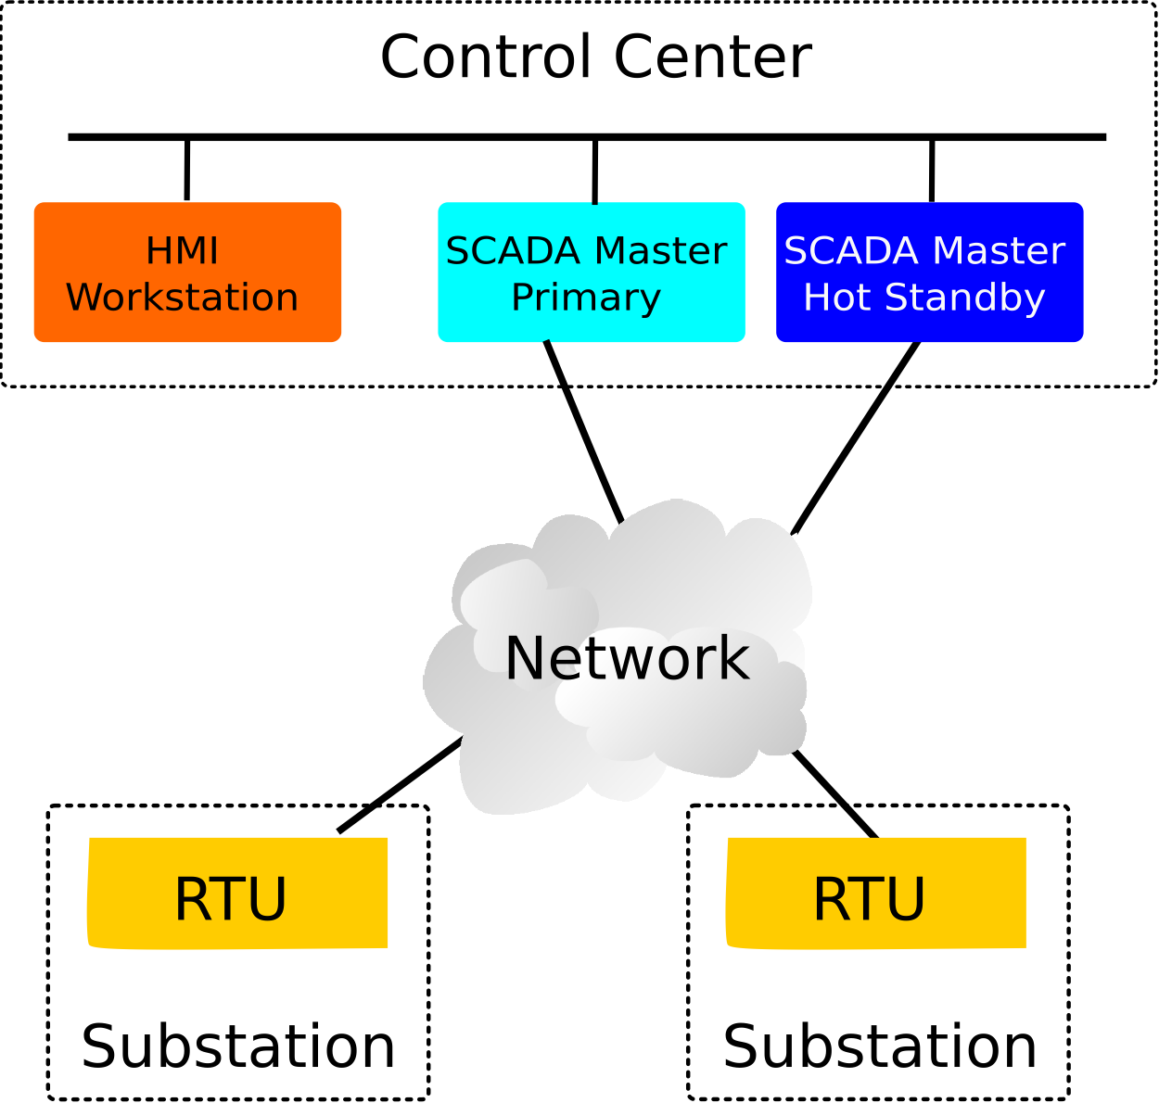
What is SCADA?
Supervisory Control and Data Acquisition
Used to supervise and control national infrastructure
Main components:
Master
HMI
PLCs/RTUs
Designed to work with propriety hardware and protocols
Components are connected on private, isolated network

Slide 4

SCADA in Power Grids (1)
Power grids include generation plants and transmission/distribution substations which are spread across wide areas
Electrical Generation Plant: generates electrical power to be transmitted across the grid
Transmission Substation: transforms power for long distance transmission and provides switching between sources/destinations to meet the needs of the grid
Distribution Substation: receives power from a transmission substation(s) to be distributed on site

Slide 5
SCADA in Power Grids (2)
SCADA system is used to monitor power substations
RTUs read data from field devices
Transformers
Generators
Switches
…
Data is processed by the SCADA master and presented to the user through the HMI
If the values read from RTUs exceed predefined safety threshold, alarms are raised by the master

Slide 6
SCADA Systems moving to the Internet
Traditional Security Model
Perimeter based
Security through obscurity
Primary/Standby Architecture
SCADA systems originally designed to run on private networks and are not optimized for security
In the past decade, SCADA systems witnessed many changes
Use of off-the-shelf hardware
Standardized protocols
Open networks (e.g. Internet)

Slide 7
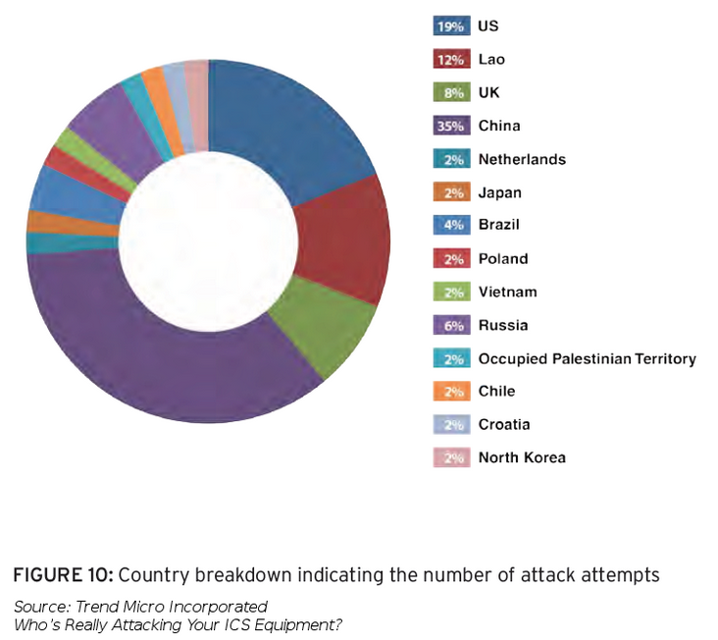
SCADA vulnerabilities
Attacks exploiting software vulnerabilities
Stuxnet
Project SHINE
Attacks involving foreign governments
Current solutions are ineffective against malicious intrusions

Slide 8
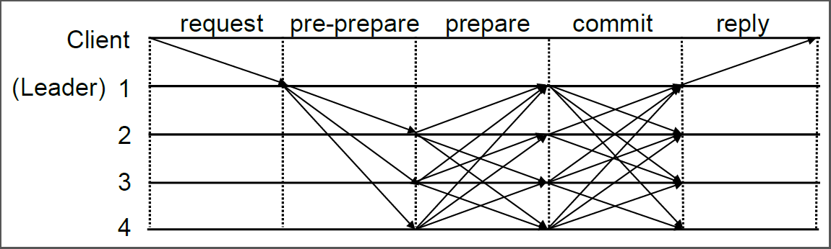
What is Intrusion Tolerance?
Intrusion Tolerance: Executing correct operations even if a part of the system is controlled by an adversary
Safety: all correct replicas maintain consistent state
Liveness: eventual progress
There are many algorithms in literature that provide byzantine fault tolerant replication, until less than one third of the system is compromised
BFT
Zyzzyva
Prime
Aardvark
…

Slide 9
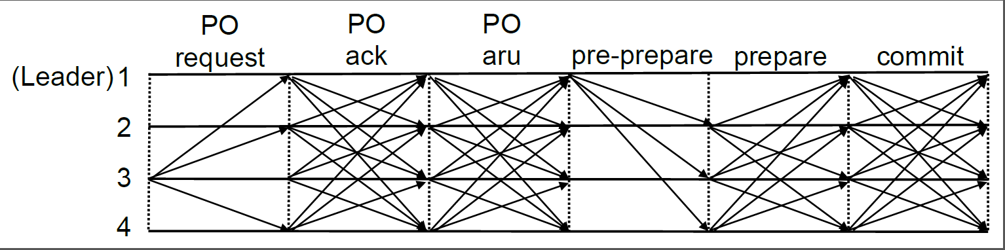
Prime: Byzantine Replication with Performance Guarantees Under Attack
First BFT protocols to provide performance guarantees while under attack
Limits the power of a malicious leader to achieve bounded delay performance guarantee

Slide 10
Defense across space and time
Prime and BFT protocols in general are fragile over long system life time
Solution
Defense Across Space: diversify the execution environment to generate different versions of the same application
Defense Across Time: periodic and proactive replica rejuvenation to clean undetected intrusions
Diversity + Proactive recovery allow for long lived intrusion tolerant systems

Slide 11
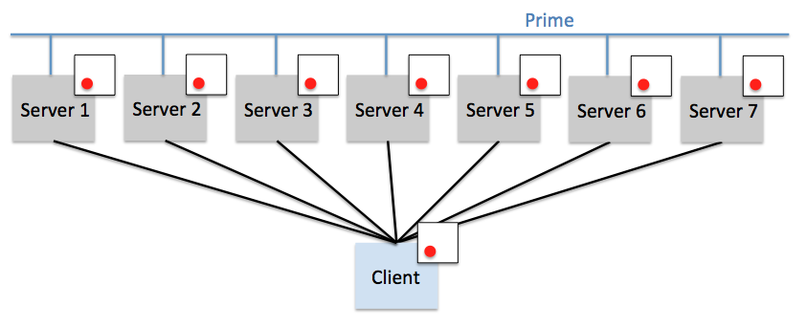

Slide 12
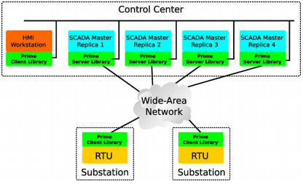
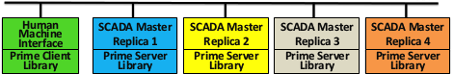
Intrusion tolerant SCADA
Use Prime to replicate SCADA masters
SCADA master works correctly if no more then f replicas out of 3f+1 replicas have been intruded
Diversity and proactive recovery allow for the system to function for a long time
An earlier version of Prime was integrated by Siemens into their SCADA product for the power grid, but it does not include diversity and proactive recovery (no protection across space and time)

Slide 13
Our Goals
To develop a proof-of-concept of an open source intrusion tolerant SCADA
Components:
PvBrowser: Open source SCADA software
Prime: Intrusion tolerant replication with performance guarantees under attack
RTU emulator: simulates data generation from field devices

Slide 14
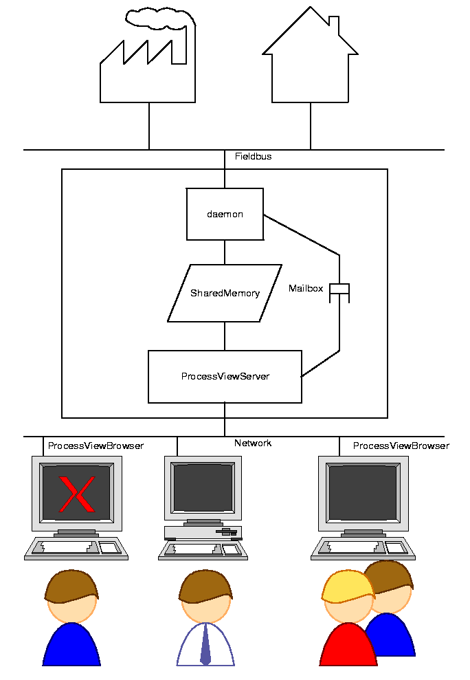
PvBrowser
Open source SCADA Master and HMI server
Architecture
Master
Data acquisition daemon (DAD): communicates with RTUs/PLCs
Shared memory: medium for communication between DAD and Pvserver
ProcessViewServer: visualizes data from DAD and communicates with HMI
HMI
ProcessViewBrowser: presents information from the visualizer to user

Slide 15
PvBrowser (Modifications)

Slide 16
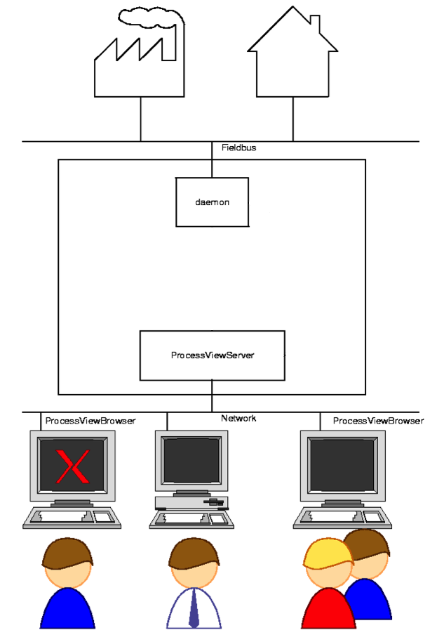
PvBrowser (Modifications)
Break Shared Memory

Slide 17

PvBrowser (Modifications)
Break Shared Memory
Implement message passing between DAD and PVServer
Allows us to:
Eliminate nondeterministic behavior

Slide 18
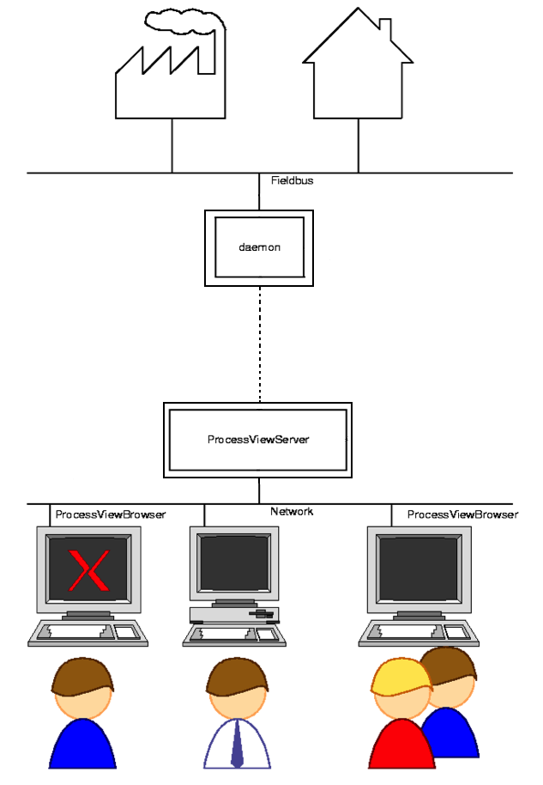
PvBrowser (Modifications)
Break Shared Memory
Implement message passing between DAD and PVServer
Allows us to:
Eliminate nondeterministic behavior
Run processes on different machines

Slide 19
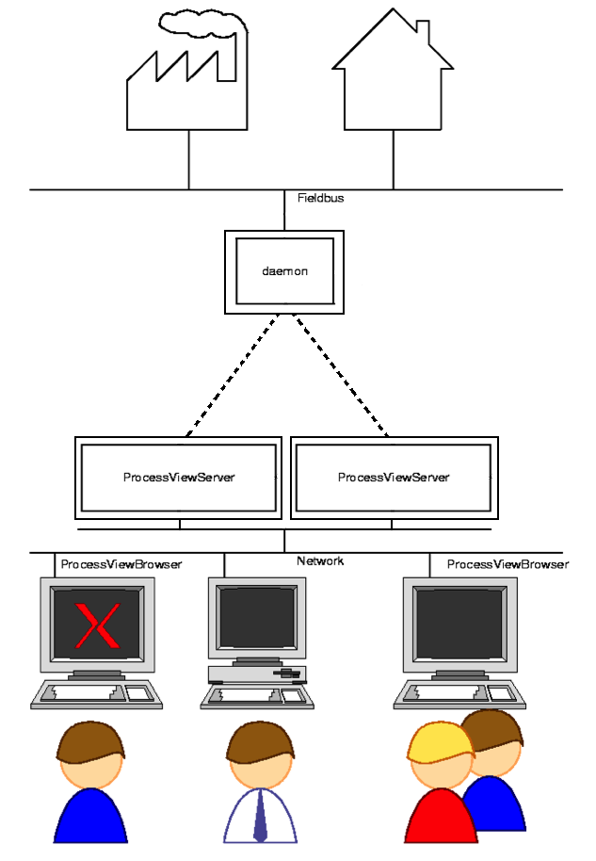
PvBrowser (Modifications)
Break Shared Memory
Implement message passing between DAD and PVServer
Allows us to:
Eliminate nondeterministic behavior
Run processes on different machines
Implement replication

Slide 20
Modbus
Standardized communication protocol used by many SCADA systems around the globe
Used to communicate with Remote Terminal Units (RTUs)
Values stored in memory registers, organized as:
Input Registers: analog inputs of different types (e.g. voltage, amperage)
Input Status: digital input used to represent dichotomous values (e.g. electrical breakers, switches)
Coil Status: digital output used to switch voltage in a relay (e.g. switch power ON/OFF to field device)
Holding Registers: store additional data the can be used by other devices; less commonly used

Slide 21
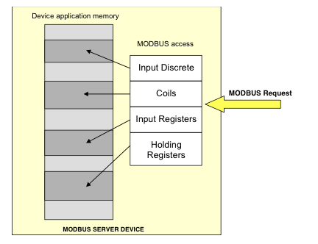
Modbus Example

Slide 22
Our Architecture
DAD and 3f+1 PVServers all run on different physical machines
DAD polls RTUs and communicates data to servers via message passing
Data polled from field units is replicated consistently across all servers using Prime
HMI can connect to any server and observe consistent data at each correct replica
RTU
RTU
RTU
MODBUS
Data Acquisition
PRIME
MASTER
MASTER
MASTER
MASTER
BROWSER

Slide 23
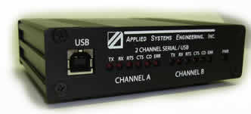
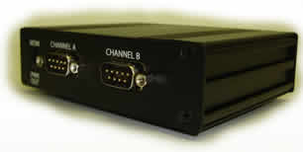
RTU Emulator
ASE2000 Version 2 RTU Test Set
Allows the user to define RTUs
For each RTU, it is possible to specify communication protocol (e.g. Modbus) and the number of registers
Used to test how the SCADA master responds to events (e.g. change of values/states)
Allows testing of newly implemented protocols (e.g. DNP3)

Slide 24
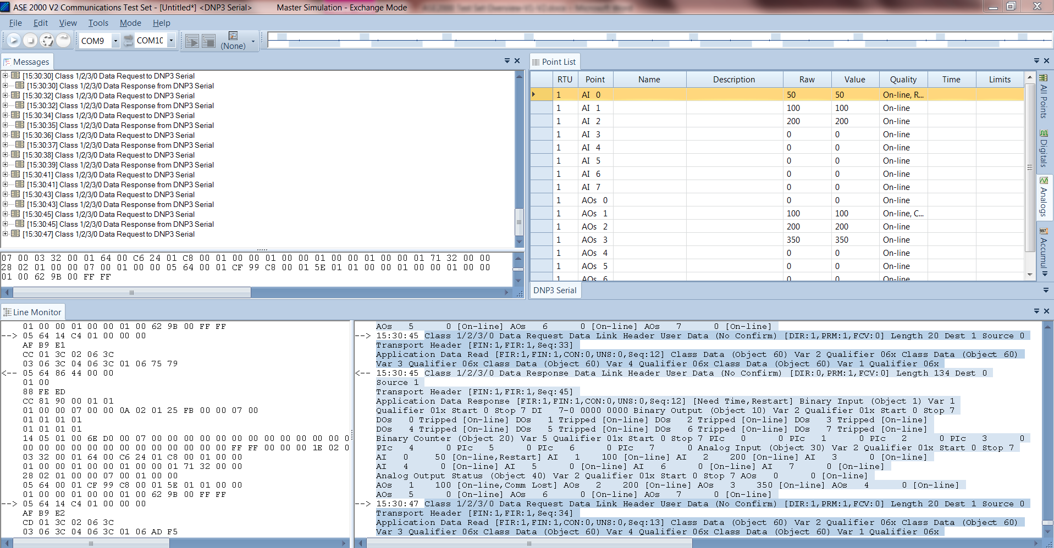
RTU Emulator Example

Slide 25
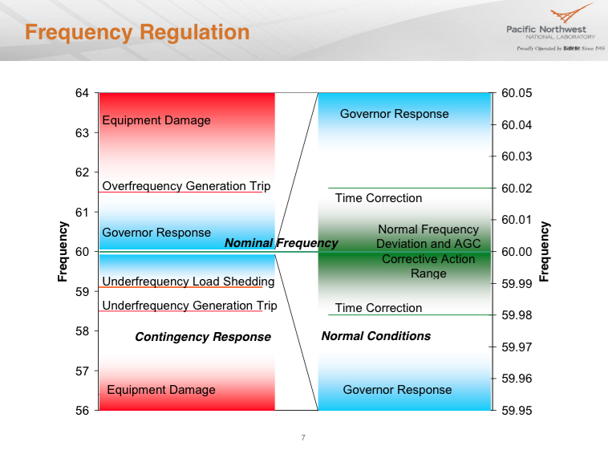
https://cdn.fbsbx.com/hphotos-xap1/v/t59.2708-21/11170697_10206615424567947_1652314067_n.pdf/PowerGridOverview-Dagle.pdf?oh=a311fd53c7bdbe0459294bafa930067f&oe=5547523F&dl=1

Slide 26
Future Directions
Our Architecture provides intrusion tolerant replication of the data used by the SCADA Master
RTU
RTU
RTU
MODBUS
Data Acquisition
PRIME
MASTER
MASTER
MASTER
MASTER
BROWSER

Slide 27
Future Directions
RTU
RTU
RTU
MODBUS
Our Architecture provides intrusion tolerant replication of the data used by the SCADA Master
Additional components:
Replication of all events involving the SCADA master, allowing a client to compare the state of each server and determine the correct state (with f+1 consistency)
Data Acquisition
PRIME
MASTER
MASTER
MASTER
MASTER
CLIENT LIBRARY
BROWSER

Slide 28
Future Directions
RTU
RTU
RTU
MODBUS
Our Architecture provides intrusion tolerant replication of the data used by the SCADA Master
Additional components:
Replication of all events involving the SCADA master, allowing a client to compare the state of each server and determine the correct state (with f+1 consistency)
Implementing intrusion tolerance for data acquisition
Replicating DAD
Using Prime to synchronize and order data polled from RTUs/PLCs
Data Acquisition
Data Acquisition
Data Acquisition
Data Acquisition
PRIME
MASTER
MASTER
MASTER
MASTER
CLIENT LIBRARY
BROWSER

Slide 29
Special Thanks
Johns Hopkins DSN Lab
Dr. Yair Amir
Dr. Marco Platania

Slide 30
Intrusion tolerance: the time is now!
Critical Infrastructures (power grids, water plants, transportation systems, …) are at the heart of human society
Power grids are particularly important because other Critical Infrastructures, systems, and human activities rely on them
This is one of the factors that make power grids an increasingly important target for cyber attacks
In 2013 DHS reported that in 2012 the 40% of cyber attacks targeted the energy sector
“Now our enemies are also seeking the ability to sabotage our power grid, our financial institutions, and our air traffic control systems. We cannot look back years from now and wonder why we did nothing in the face of real threats to our security and our economy”
Barack Obama, State of the Union 2013

Slide 31
Breaking the barriers
Power service industry is highly regulated
Power companies strictly follows the regulation requirements
SCADA system manufacturers have no (or little) incentive to develop capabilities that are not demanded by power companies
Because intrusion tolerance is not on the regulations, power companies and SCADA system manufacturers are not interested in working on intrusion tolerant solutions
The first prototype of intrusion tolerant SCADA produced by Siemens was never translated to a product in the field, lacking customer demand and regulatory requirements

Slide 32
Our goal
Building the first survivable intrusion tolerant open source SCADA system
Impact on the energy ecosystem:
Showing to regulators, power companies, and SCADA manufacturers the importance of intrusion tolerance and that the problem is solvable
Making intrusion tolerant a regulatory requirement
Showing and teaching SCADA manufacturers how to integrate intrusion tolerance in their own systems via open source
Involving other researchers so to enlarge the SCADA community and increase the impact that it can have

